Slide 1
Automatic earthquake detection for Botswana M6.5 and its aftershocks using deep learning algorithms
Joseph Maritinkole, Onkgopotse Ntibinyane
Botswana Geoscience Institute
Advanced techniques are essential to handle the increasing volume of seismic data. Machine learning-based phase picking and earthquake detection automate monitoring and improve accuracy. The study focuses on enhancing Phasenet and EQTransformer models for efficient event detection and phase picking, enabling timely dissemination of earthquake parameters.
The seismic waveform analysis workflow involves data collection from the Botswana Seismological Network, preprocessing with Obspy, manual analysis for labeled dataset creation, model retraining in Seisbench, and automatic phase picking and event association, facilitating accurate seismic analysis and monitoring.
The study employed EQTransformer, GPD, and Phasenet models for phase picking and earthquake detection. The results demonstrated their effectiveness in accurately identifying seismic phases and detecting earthquakes, including the overlapping event associated with the 2017 Botswana M6.5 earthquake. This highlights the potential of these models to enhance seismic analysis and monitoring capabilities, particularly in complex scenarios.
DNN algorithms show superiority in earthquake detection and phase picking, outperforming traditional methods in handling noisy data and overlapping events. Further tasks include phase association, creating a labeled dataset for Southern Africa, and evaluating model performance using precision, recall, and F1 scores.
Please do not use this space, a QR code will be automatically overlayed
P3.5-780

Slide 2
Introduction
The increasing density of broadband seismic stations has generated a significant volume of seismic data, necessitating advanced techniques for efficient processing and analysis.
Automatic phase picking and earthquake detection using machine learning algorithms present a promising approach to accurately identify seismic phases and reduce the workload for seismologists.
Manual data processing in earthquake monitoring organizations can result in delays and limited accuracy, highlighting the need for automated methods to improve efficiency and reliability.
Financial constraints often limit access to licensed modules, requiring verification from human analysts and making reliance on free modules for automatic processing challenging.
The study aims to fine-tune the models of Phasenet and EQTransformer without altering their architectures. The refined models will be retrained to enhance their performance.
The refined Phasenet and EQTransformer models will be employed for automatic event detection and phase picking, enabling more accurate and timely dissemination of earthquake parameters
Please do not use this space, a QR code will be automatically overlayed
P3.5-780

Slide 3
Objectives
The study aims to improve automatic earthquake detection and perform phase picking using deep neural network algorithms by addressing the following objectives:
Retrain PhaseNet and EQTranformer deep learning models using their original dataset and selected earthquakes recorded in Botswana and their corresponding waveforms as recorded by the Botswana Seismological Network.
Perform automatic earthquake detection and phase picking.
Please do not use this space, a QR code will be automatically overlayed
P3.5-780

Slide 4
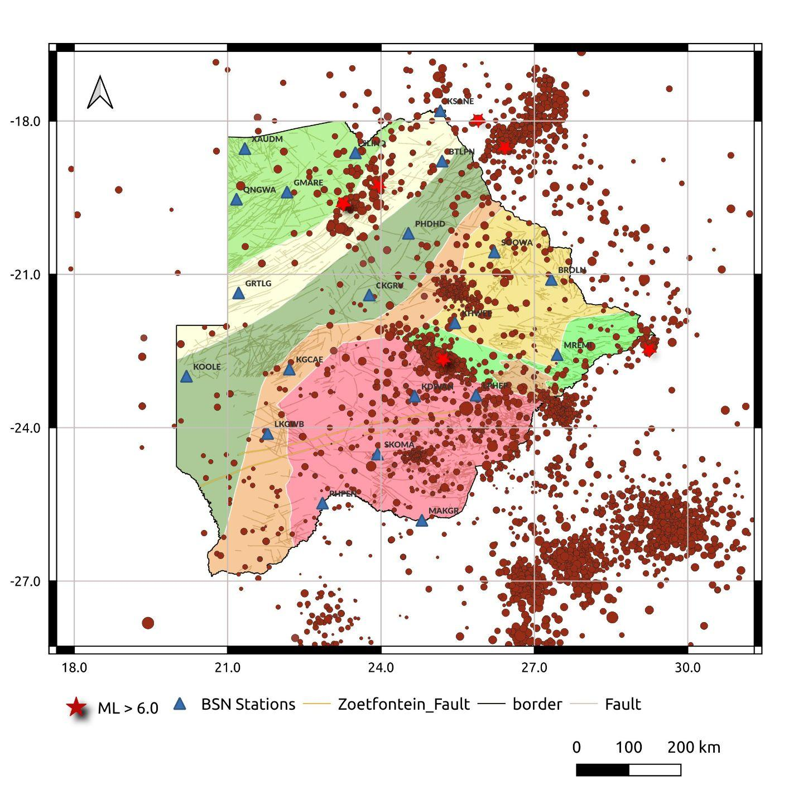
Methods/data
 | EQT | GPD | PhaseNet
Type | CNN RNN Attention layers | CNN | U-Net
Training Dataset | STEAD + BSN | S. California +BSN | N. California + BSN
 | (Mousavi et al., 2020) | (Ross et al., 2018b) | (Zhu & Beroza, 2018)
Figure:
The figure provides a visual representation of the seismic activity in Botswana and highlights the distribution of earthquakes in the region.
197 earthquakes of magnitude greater than Ml 3.0 are used for creating a labeled dataset, which is essential for training and evaluating models in seismic analysis and earthquake monitoring.
Table:
The table summarizes the deep learning models utilized for seismic analysis and earthquake monitoring. Details such as model names and architecture types are included in the table.
Data Collection: Collect seismic waveform data from the Botswana Seismological Network (BSN) with varying sampling rates (40 Hz and 20 Hz).
Data Preprocessing: Use Obspy seismological software to downsample the datasets to a consistent 20 Hz sampling rate, apply a bandpass filter (1 Hz - 5 Hz) to remove noise, and perform amplitude normalization for consistent scaling.
Labeled Dataset Preparation: Generate a labeled dataset for Botswana by analyzing known earthquakes from BSN data manually, utilizing Seisbench.
Model Retraining: Retrain models in Seisbench (Woollam et al., 2021) using the labeled dataset to enhance accuracy for automatic phase picking.
Automatic Phase Picking and Association: Employ the retrained models in Seisbench to automatically pick phases, associate them, and generate a seismic event catalogue.
Please do not use this space, a QR code will be automatically overlayed
P3.5-780

Slide 5
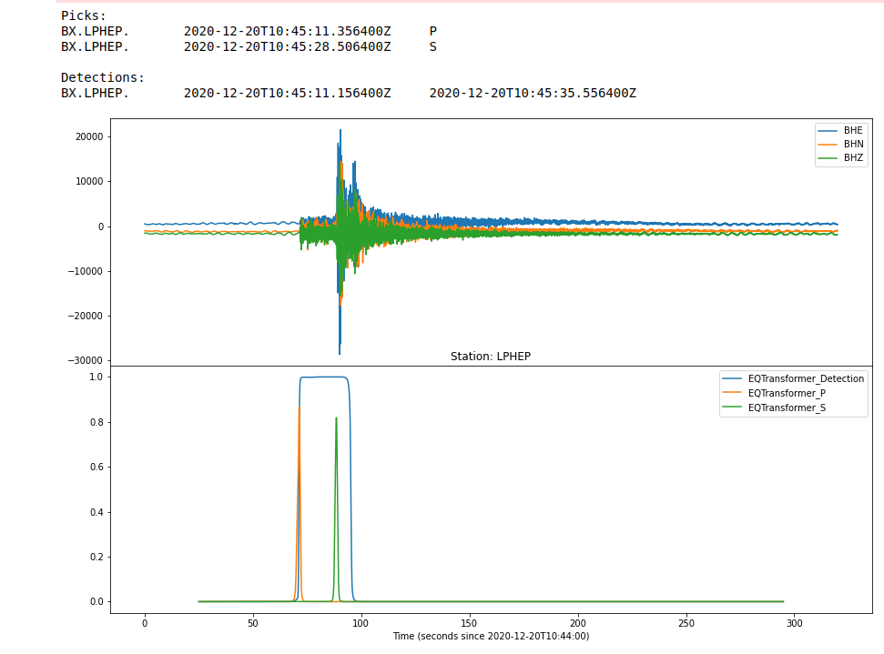
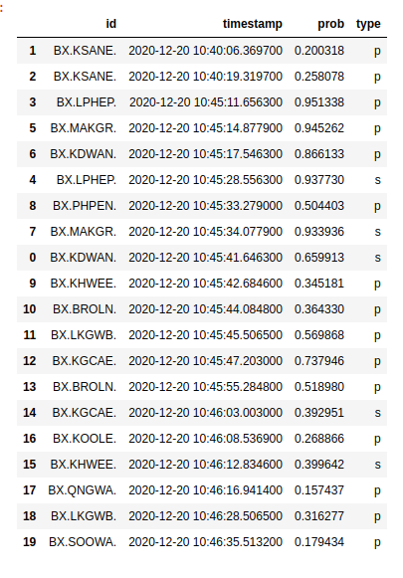
Results 1
Figure: Seisbench, utilizing Obspy modules, downloads seismic data and applies EqTransformer for automatic phase picking and event detection. The figure displays the provided P and S arrival times, while the envelope depicts the detection of seismic events.
Please do not use this space, a QR code will be automatically overlayed
P3.5-780

Slide 6
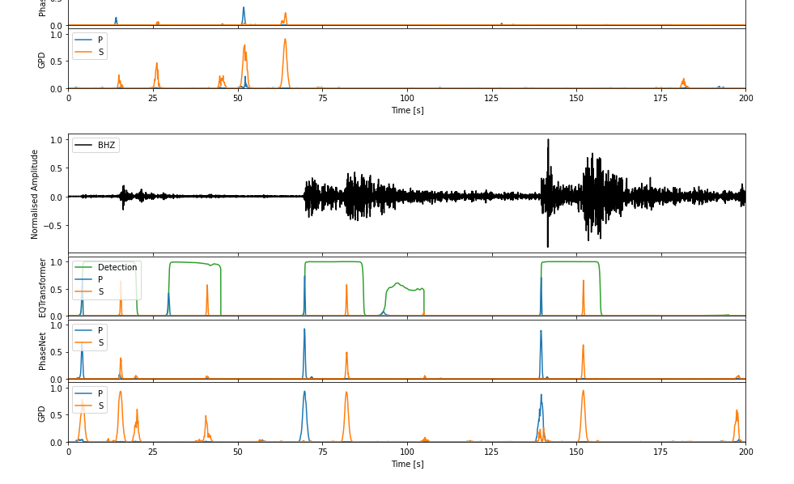
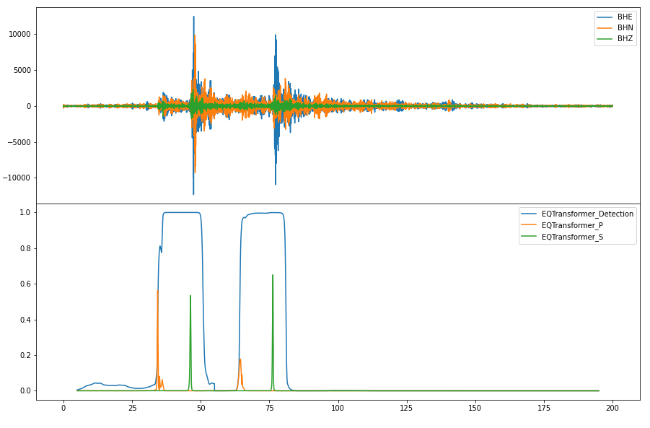
Results 2
The figure shows three models were utilized for earthquake detection and phase picking, demonstrating exceptional performance. These models exhibit a high level of sensitivity, successfully identifying even small earthquakes that were previously undetected by other methods. Their enhanced capabilities contribute to improved seismic monitoring and analysis. In the figure, the blue color represents the P phase, the orange color represents the S phase, and the green envelope indicates the detection of seismic activity.
The figure highlights the success of the EqTransformer model in detecting two closely occurring overlapping events. Despite the challenging nature of the overlapping events, EqTransformer exhibits accurate detection capabilities, distinguishing and representing both events distinctly. This showcases the model's effectiveness in handling complex seismic scenarios and contributes to improved event identification and analysis.
Please do not use this space, a QR code will be automatically overlayed
P3.5-780

Slide 7
Conclusion
The work in progress showcases the superiority of Deep Neural Network (DNN) algorithms over conventional methods in earthquake detection and phase picking.
Preliminary results highlight the DNN models' ability to outperform traditional approaches in handling noisy data and overlapping events.
DNN models excel in identifying ambiguous events, evident from clear outlier detections in the presented examples.
Moving forward, further assistance is sought to accomplish the following tasks:
Associating the picked phases to create comprehensive event bulletins and catalogues.
Preparing a labeled earthquake dataset specifically for Southern Africa.
Calculating precision, recall, and F1 scores to accurately evaluate the performance of the models.
Please do not use this space, a QR code will be automatically overlayed
P3.5-780

Slide 8
References
Mousavi, S.M., Ellsworth, W.L., Zhu, W., Chuang, L.Y. and Beroza, G.C. (2020). Earthquake transformer—an attentive deep-learning model for simultaneous earthquake detection and phase picking. Nature Communications 11, 3952. https://doi.org/10.1038/s41467-020-17591-w.
Ross, Z.E., Meier, M.A., Hauksson, E. and Heaton, T.H. (2018b). Generalized seismic phase detection with deep learning. Bulletin of the Seismological Society of America 108, 2894–2901.
Woollam, J., Münchmeyer, J., Tilmann, F., Rietbrock, A., Lange, D., Bornstein, T., and Soto, H. (2021). Seisbench-A toolbox for machine learning in seismology. Seismological Research Letters, 81(3), https://arxiv.org/abs/2111.00786
Zhu, W., and Beroza, G.Z. (2018). PhaseNet: A deep-neural-network-based seismic arrival-time picking method. Geophysical Journal International 216 (1), 261–273.
Please do not use this space, a QR code will be automatically overlayed
P3.5-780

