Slide 1

PGNN for Emplacement Classification and Yield and Depth of Burial Estimation Using TDSF – Algorithm
Chandan K. Saikia¹, Mitchell Solomon¹, Seong H. Hong²
¹AFTAC, Patrick SFB, FL 32925, USA; ² FlT, Melbourne, FL 32901, USA
We use Time-domain Source Functions (TDSF) to explore the feasibility of Temporal Neural Network (TNN), XGboost and PGNN AI/ML algorithms for classification of the emplacement condition for an explosion and estimating its yield and depth. Regional waveforms generated using velocity models that consist of laminated structure with random perturbation in velocity parameters are also used.
Generated TDSFs for six emplacement conditions for a suite of yield and depths for the classification study. Using these TDSFs, an automated algorithm constructed a table of different features for testing the AI/ML algorithm. PGNN and also PINN are based on a new formulation which uses Fully Connected neural Network (FCNN) and analytic partials of TDFS amplitudes w.r.t the yield and depth.
TDSFs were successfully classified for six chosen emplacement conditions with our new yield and Depth of Burial (YDOB) AI/ML tool. Yield and depth with uncertainty could also be reliably estimated. XGboost exhibits potential for estimating yield and depth. More the features, better is the result. Analysis of the PINN method is on-going; expect it to provide a successful implementation.
Our e-posters explain the underlying mathematical background of the PDE (Partial Differential Equation) for the PINN algorithm. Details on the application of the algorithm can be found in the poster P3.5-098 by Solomon et al.
Please do not use this space, a QR code will be automatically overlayed
P3.5-097

Slide 2
Introduction
In recent years AI/ML gained attention in seismology for the detection and location of regional and teleseismic seismic events using PhaseNet (Zhu and Beroza, 2018) and EQTransformer (uses hierarchical attenuation mechanism, Mousavi et al. 2020), and engineering applications. In this study, we explore the feasibility of Temporal Neural Network (TNN) based AI/ML algorithms using synthetic waveforms for automatic classification of the emplacement conditions for an explosion, and estimating its yield and depth of burial using the regression analysis.
The dimension reduction technique UMAP (Uniform Manifold Approximation and Projection) is used for the classification visualization and XGboost to estimate the source parameters of low-yield synthetic events using a tabular data set consisting of features derived from the time-domain source functions (TDSFs)
We generated about 48,000 physics-guided TDSFs for six material classes: granite, wet Granite, Shale, Sand, Tuff/Rhyolite, and wet Tuff for suite of yield and depth combinations.
We convolved TDSFs with regional frequency-wavenumber seismograms up to 1200 Km for velocity models consisting of laminated structure in 60 thin layers (each with thickness of 100m) in the upper 6 Km. We allowed a random perturbation up to 5%. Thus, these waveforms ingest wave-propagation physics in the classification study.
We are now exploring of a PINN (Physics-Informed Neural Network) to investigate TDSFs of various emplacement conditions, including the yield and depths of event, are predicted by the method.
Please do not use this space, a QR code will be automatically overlayed
P3.5-097

Slide 3
OBJECTIVES
Given a large set of TDSFs with and without wave-propagation effect, and extracted features from therein, train the AI/ML tools to classify emplacement conditions and reliably estimate the yield and depth of burial of an explosion.
Use the trained AI/ML algorithm, test and validate the performance on the accuracy of the classification, including the yield and depth.
Train PINN and evaluate its performance in accomplishing the goal using the same TDSFs.
Features:
Corner-frequency (fc),
Half-Width (HW)
Peak Amplitude (PA) for filtered waveforms
PA of WWSSN short-period waves
area under source functions.
These features are observable in recorded waveforms and are unique to emplacement conditions.
PINN:
We use simulated TDFSs as a function of yield (w) and depth of burial (h) in a fully connected neural network (FCNN) to be trained, tested and validated using the gradient constructs
We use analytical formula representing the partials of TDFS w.r.t w and h.
Please do not use this space, a QR code will be automatically overlayed
P3.5-097

Slide 4
DATA CONSTRUCTS
Generate High-Frequency Regional Explosion Green Functions (GF, distance up to 1000 Km) for shallow depth sources
Interpolate regional GF (RGF) to the sampling rate of TDSF (∆t=0.001s)
convolve interpolated RGF with the TDSF
low pass filter to the Nyquist frequency of the RGF
Interpolate the resulting time history to the RGF’s sampling interval
Construct Double-Couple Seismograms (DC)
For each station and event depth, construct earthquake seismograms using eight fundamental fault green functions for many focal mechanisms to sample the entire focal sphere.
Used 3 dip, 13 slip and 10 strike values to coarsely represent the focal sphere and 10 azimuths for each station
Construct the CLVD seismograms
Compute seismograms at all depths for a vertically symmetric dip-slip fault dipping at a 45º
Ensure that azimuth of the observing station is 45º
Please do not use this space, a QR code will be automatically overlayed
P3.5-097

Slide 5
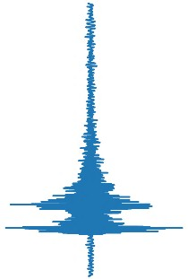
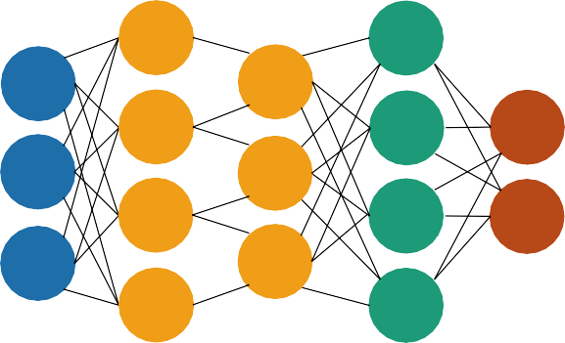
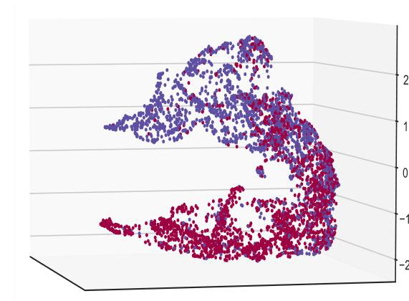
METHOD / DATA CONSTRUCTS
(a) Temporal Convolution Network for Emplacement Classification: Train, Test and Validate
Dimension Reduction for Visualization
1.1
*
*
UMAP
Repeat
*
0.7
*
*
color
*
0.6
*
Layer
Activation
Network to Train Input Signals
Projection Space
Please do not use this space, a QR code will be automatically overlayed
(b) Regression Analysis – Estimate Yield and Depth including the errors in the estimates.
P3.5-097

Slide 6


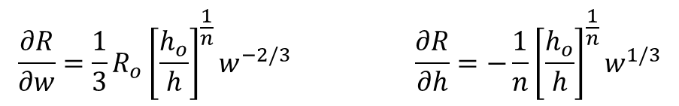
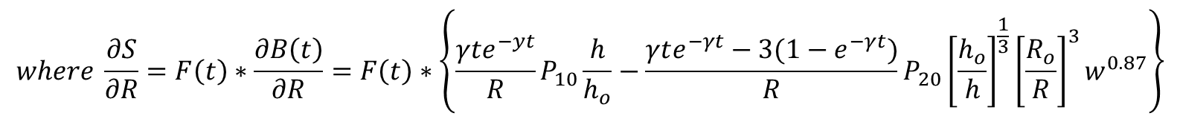
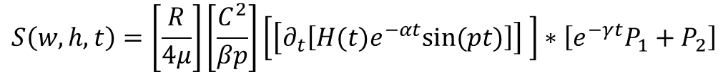
PINN – Mathematical Formulation
PINN is a deep learning framework for solving forward and inverse problems involving non-linear PDE (partial differential equation, Raissi et al., 2018). In this study, each TDSF of an explosion as a function of yield (w) and depth (h) is a solution to the PDE of the wave equation, which we write following Saikia (2017) as below
$$S\left(w,h,t\right)=\left[\frac{R}{4μ}\right]\left[\frac{C^{2}}{βp}\right]\left[\left[∂_{t}\left[H(t)e^{−αt}sin⁡(pt)\right]\right] \right]∗\left[e^{−γt}P_{1}+P_{2}\right]$$
(1)
F(t)
B(t)
Definition of each variable in equations here is in Saikia (2017). Analytic expressions for the partials of wavefield S w.r.t. the dependent variables w and h as needed by the PINN method are derived as follows
$$\frac{∂S}{∂w}=\frac{∂S}{∂R}\frac{∂R}{∂w}$$
$$\frac{∂S}{∂h}=\frac{∂S}{∂R}\frac{∂R}{∂h}$$
(2)
$$where \frac{∂S}{∂R}=F\left(t\right)∗\frac{∂B\left(t\right)}{∂R}=F\left(t\right)∗\left\{\frac{γte^{−yt}}{R}P_{10}\frac{h}{h_{o}}−\frac{γte^{−γt}−3(1−e^{−γt})}{R}P_{20}{\left[\frac{h_{o}}{h}\right]}^{\frac{1}{3}}{\left[\frac{R_{o}}{R}\right]}^{3}w^{0.87}\right\}$$
(3)
Please do not use this space, a QR code will be automatically overlayed
$$\frac{∂R}{∂w}=\frac{1}{3}R_{o}{\left[\frac{h_{o}}{h}\right]}^{\frac{1}{n}}w^{−2/3} \frac{∂R}{∂h}=−\frac{1}{n}{\left[\frac{h_{o}}{h}\right]}^{\frac{1}{n}}w^{1/3}$$
(4)
P3.5-097

Slide 7
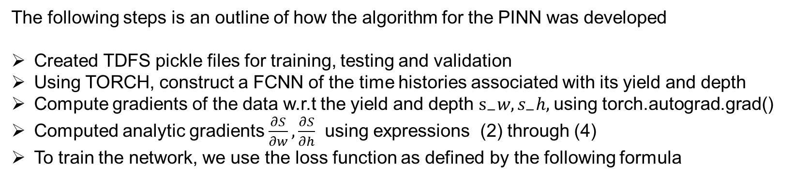

PINN – Mathematical Formulation (Contd)
The following steps is an outline of how the algorithm for the PINN was developed
Created TDFS pickle files for training, testing and validation
Using TORCH, construct a FCNN of the time histories associated with its yield and depth
Compute gradients of the data w.r.t the yield and depth $s_{−}w,s_{−}h,$using torch.autograd.grad()
Computed analytic gradients $\frac{∂S}{∂w},\frac{∂S}{∂h}$ using expressions (2) through (4)
To train the network, we use the loss function as defined by the following formula
$$loss={mse}_{d}+λ .\left({mse}_{sw}+{mse}_{sh}\right)$$
$where {mse}_{d}=criterion(input,target)$ ${mse}_{sw}=criterion\left(s_w,\frac{∂S}{∂w}\right) { mse}_{sh}=criterion(s_{−}h,\frac{∂S}{∂h})$
$$criterion=nn.MSELoss()$$
Please do not use this space, a QR code will be automatically overlayed
We select the loss criterion nn.MSELoos() and optim.Adam with learning rate of 0.1, betas=(0.9,0.999), eps=1.e-8
weight decay to optimize and we compute the RMSE (Root Mean Square Error) and minimize it during iterations.
For details – please visit the e-poster by Solomon et al. (P3.5-098 this meeting).
P3.5-097

Slide 8
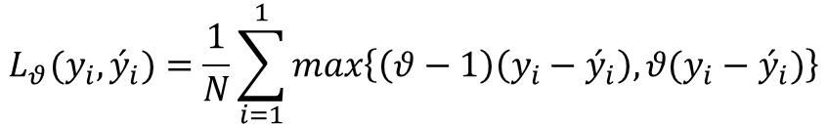
RESULTS from TNN and REGRESSION
Quantile Loss: Penalizes predictions of the target variable around a quantile 𝜗
Examples of Far-Field TDSFs at the elastic radii for each yield and DOB using Saikia (2017,GJI, 209,1048-1063).
$$L_{θ}(y_{i},{\acute{y}}_{i})=\frac{1}{N}\sum_{i=1}^{1}{max\left\{\left(θ−1\right)\left(y_{i}−{\acute{y}}_{i}\right),θ(y_{i}−{\acute{y}}_{i})\right\}}$$
Symmetric quantiles drive predictions towards the median
One-sided quantile biases predictions towards the quantile
Ability to tune predictor to under-/over-estimate target
amplitude
Please do not use this space, a QR code will be automatically overlayed
P3.5-097
Time

Slide 9
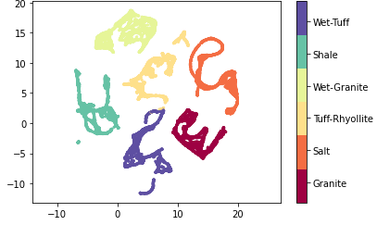
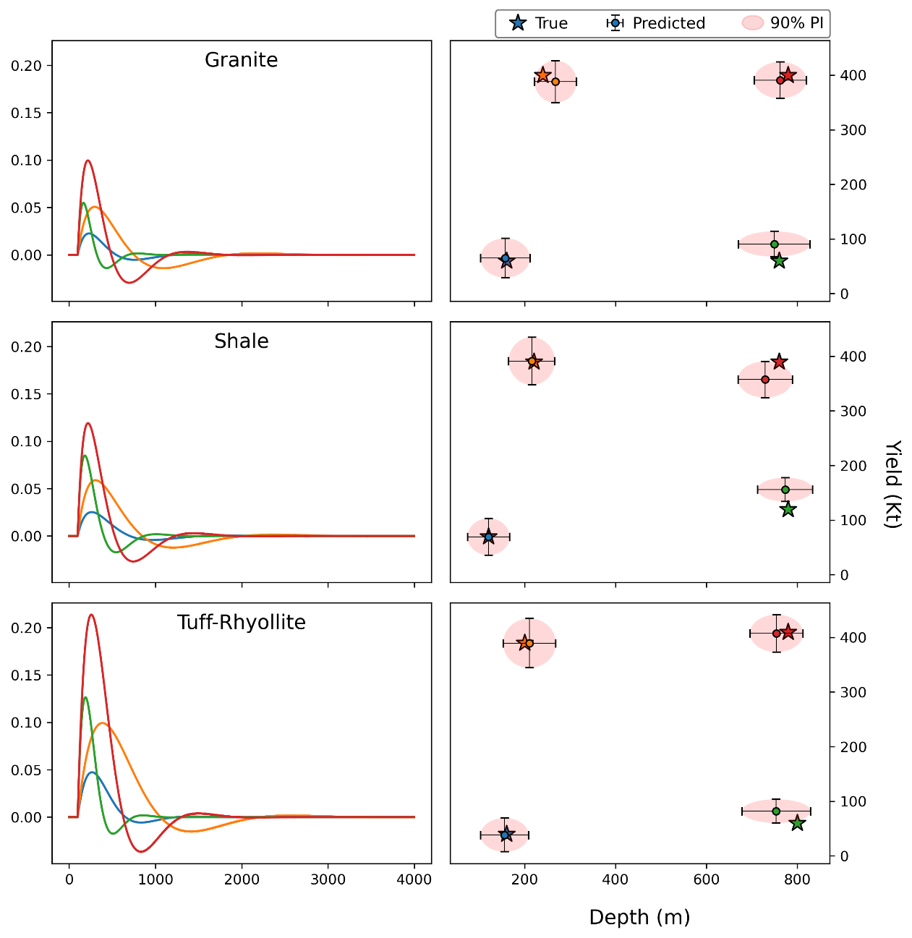
TNN and Regression Analysis – Classification & Parameter Estimation
Estimations of Parameter with Errors
Classification
Please do not use this space, a QR code will be automatically overlayed
Time
P3.5-097

Slide 10
XGboost – Results Using the Meta Data
fc, HW, ampFILT, ampWWSP, aPOS, aNEG
 | YIELD | DEPTH | W_preds | H_preds | material | cl_preds
8258 | 0.5 | 300.0 | 0.479587 | 303.802521 | Granite | Granite
24658 | 0.5 | 300.0 | 0.514945 | 304.355438 | Salt | Salt
16458 | 0.5 | 300.0 | 0.518385 | 332.562134 | Shale | Shale
58 | 0.5 | 300.0 | 0.504299 | 293.013428 | Tuff-Rhyolite | Tuff-Rhyolite
32858 | 0.5 | 300.0 | 0.521207 | 292.310638 | Wet-Granite | Wet-Granite
41058 | 0.5 | 300.0 | 0.543079 | 316.306793 | Wet-Tuff | Wet-Tuff
9379 | 1.5 | 300.0 | 1.492430 | 303.806885 | Granite | Granite
25779 | 1.5 | 300.0 | 1.523218 | 303.525421 | Salt | Salt
17579 | 1.5 | 300.0 | 1.472211 | 309.119141 | Shale | Shale
1179 | 1.5 | 300.0 | 1.488157 | 295.490906 | Tuff-Rhyolite | Tuff-Rhyolite
33979 | 1.5 | 300.0 | 1.496750 | 311.308777 | Wet-Granite | Wet-Granite
42179 | 1.5 | 300.0 | 1.494206 | 292.525635 | Wet-Tuff | Wet-Tuff
10837 | 0.5 | 700.0 | 0.477996 | 682.095947 | Granite | Granite
27237 | 0.5 | 700.0 | 0.597250 | 701.402771 | Salt | Salt
19037 | 0.5 | 700.0 | 0.521698 | 714.170044 | Shale | Shale
2637 | 0.5 | 700.0 | 0.475775 | 711.099304 | Tuff-Rhyolite | Tuff-Rhyolite
35437 | 0.5 | 700.0 | 0.455299 | 709.856079 | Wet-Granite | Wet-Granite
43637 | 0.5 | 700.0 | 0.532853 | 698.140137 | Wet-Tuff | Wet-Tuff
12034 | 1.5 | 700.0 | 1.532544 | 695.454163 | Granite | Granite
28434 | 1.5 | 700.0 | 1.472545 | 702.038208 | Salt | Salt
20234 | 1.5 | 700.0 | 1.520384 | 700.532776 | Shale | Shale
3834 | 1.5 | 700.0 | 1.478584 | 668.530518 | Tuff-Rhyolite | Tuff-Rhyolite
36634 | 1.5 | 700.0 | 1.426909 | 720.225403 | Wet-Granite | Wet-Granite
44834 | 1.5 | 700.0 | 1.480092 | 676.993958 | Wet-Tuff | Wet-Tuff
Features:
Fc= source corner
HW=Halfwidth
ampFILT = peak amplitude of filtered displacement
ampWWSP=peak amplitude – Wood Anderson short period
aPOS = area under the positive side of the first pulse
aNEG = area under the negative side of the first pulse
Targets:
Yield
Depth (DOB)
Please do not use this space, a QR code will be automatically overlayed
Details available in the e-poster of Solomon et al.
(P3.5-098 this meeting)
P3.5-097

Slide 11
CONCLUSIONS
Successfully used TDSFs for explosions generated for six different emplacement conditions in the context of a new AI/ML tool (YDOB) to identify the material, and the yield and depth with uncertainty.
UMAP is a powerful projection tool for the classification study.
XGboost exhibits enormous potential for the estimation of yield and depth of burial for explosion sources. Multiple features are absolutely helpful for a successful implementation of the algorithm.
Investigation of the PINN method is on-going and we expect it to provide a successful implementation.
References:
Mousavi, S.M., Ellsworth, W.L., Zhu, W., Chuang, L, Y., and Beroza, G, C. (2020). Earthquake transformer—an attentive deep-learning model for simultaneous earthquake detection and phase picking. Nat Commun 11, 3952. https://doi.org/10.1038/s41467-020-17591-w
Raissi, M., P. Perdikaris and G.E. Karniadakis (2018) Physics-Informed Neural Networks: A deep learning framework for solving forward and inverse problems involving nonlinear partial differential equations, reprint from Jourbnal of computational physics, 45pages.
Saikia, C. K. (2017), Time-domain source function (TDSF) for nuclear and chemical explosions – analysis around Nevada National Security Site (NNSS), Geophys. Journal Internationa, 209, 1048-1063.
Zhu, W. and G. C. Beroza (2018). PhaseNet: a deep-neural-network-based seismic arrival-time picking method, Geophys. J. International, 216, 261-273.
Reference s
[Optional slide Font: Arial Regular Size 20]
Please do not use this space, a QR code will be automatically overlayed
P3.5-097

