Slide 1
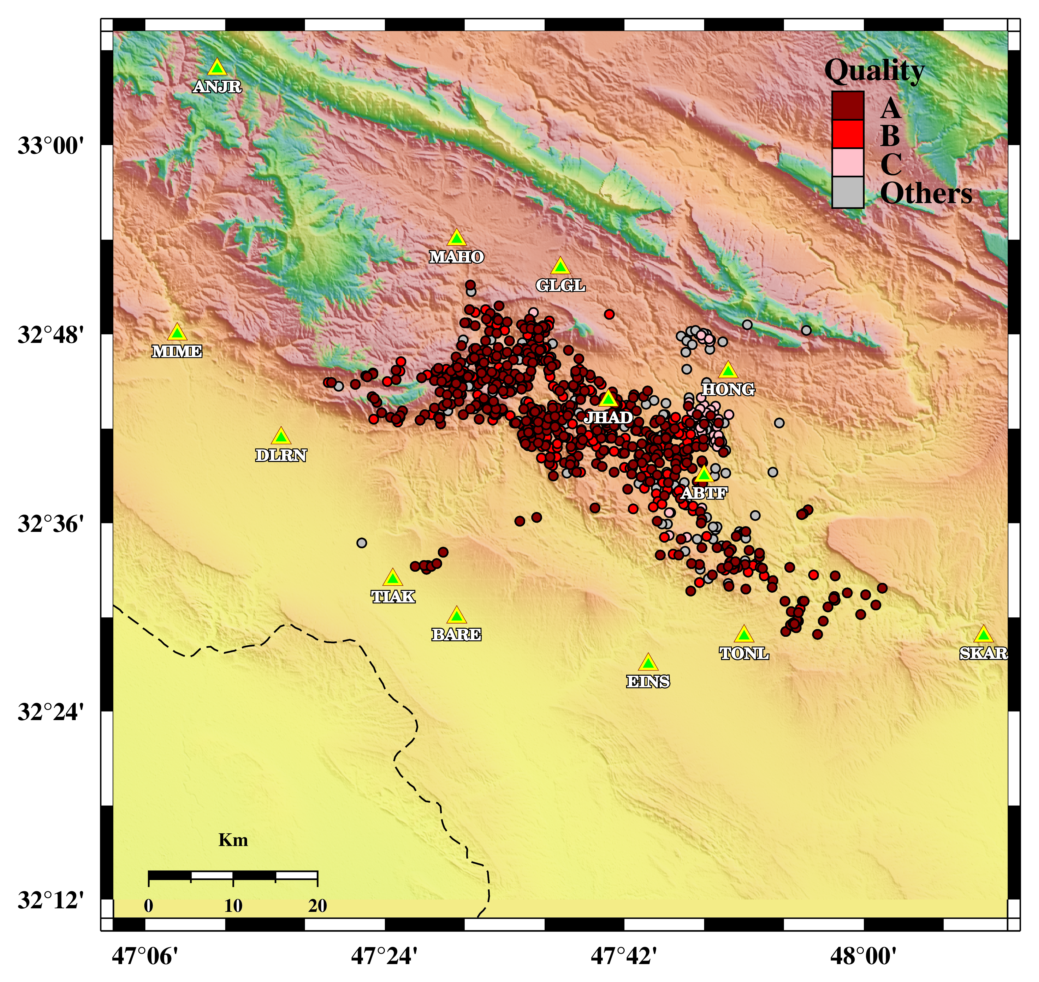
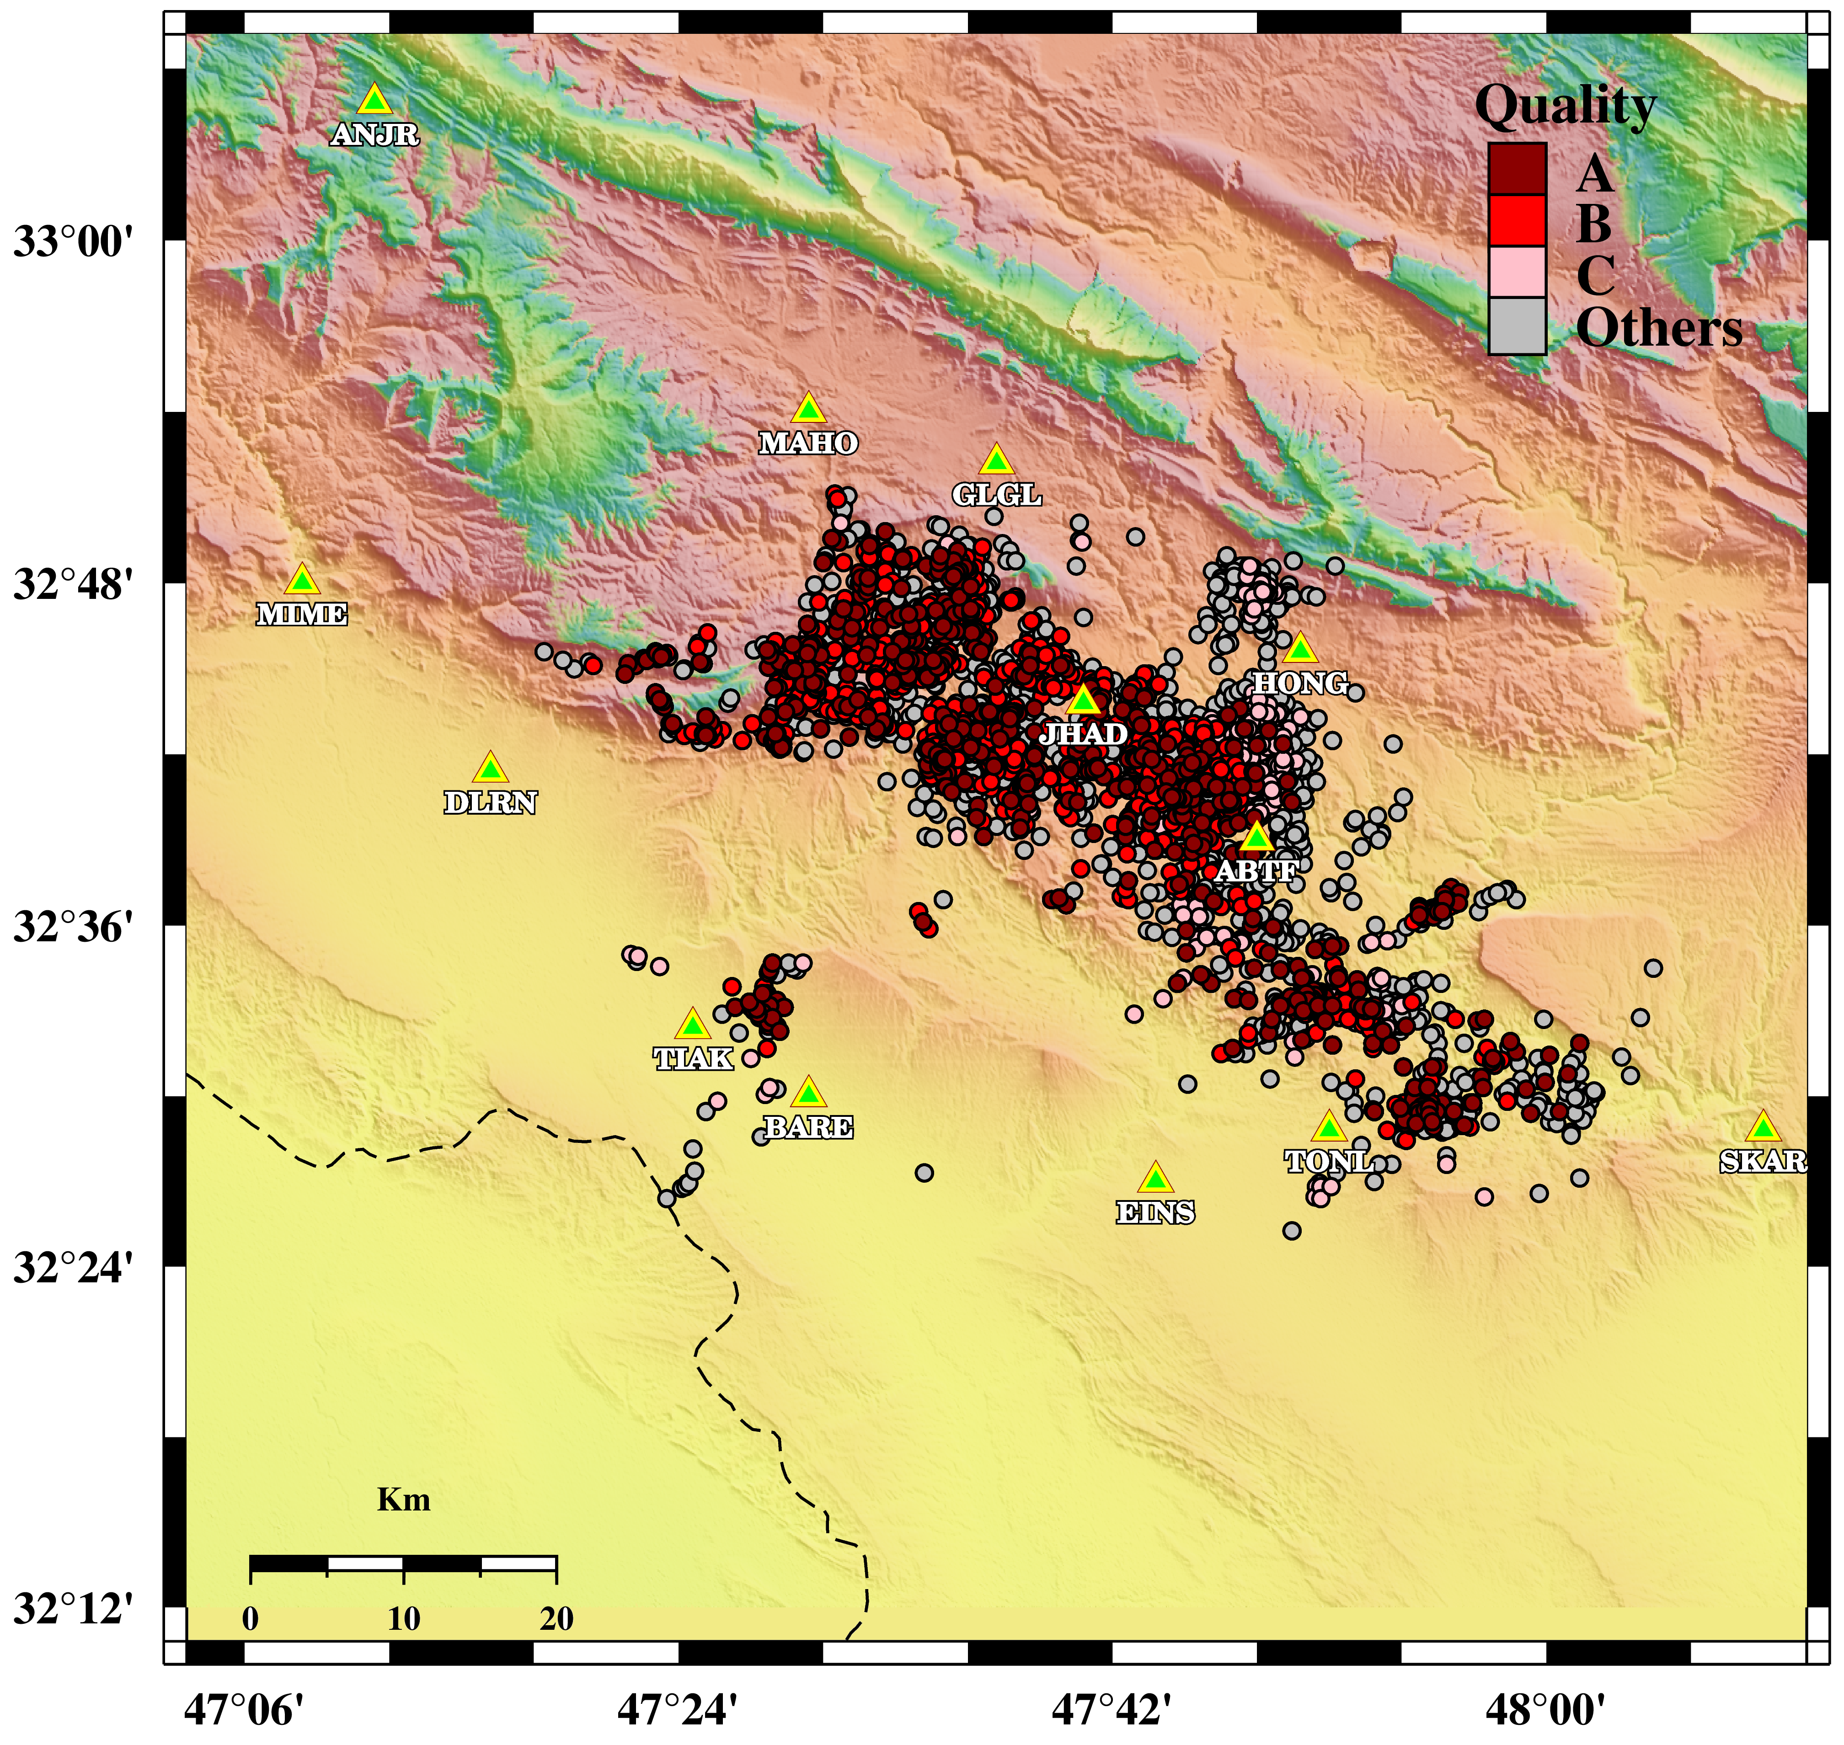
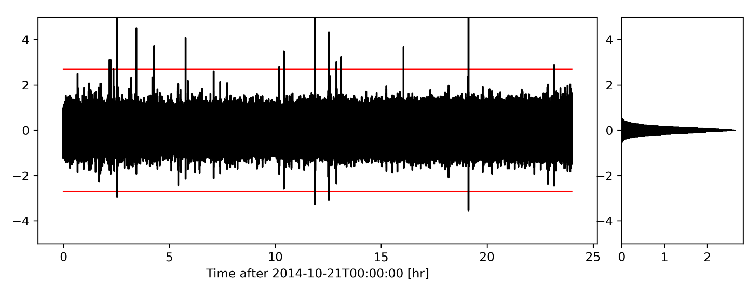
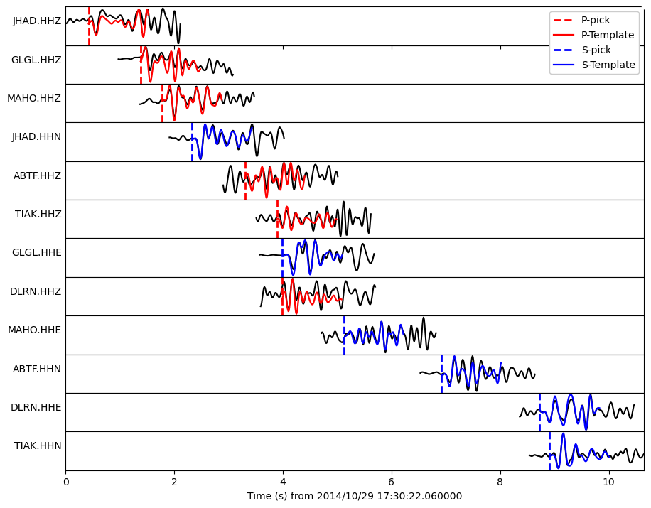
Matched-Filter for detecting aftershocks of the 2014 Mormori-Ilam earthquake
Iman Kahbasi, Ehsan Karkooti, Saeed SoltaniMoghadam
International Institute of Earthquake Engineering and Seismology
P3.5-626
The detection of earthquakes with magnitudes less than the Mc is a challenging task, because of seismic waves attenuation and unavoidable noise levels at seismic stations. The Matched-Filter (MF) technique is a signal processing approach, which makes it possible to identify seismic phases even with very low SNR in case of repeating events.
We utilized the MF method on 95 days of continuous data with 13 temporary seismic stations installed for the August 2014 ML 6 earthquake in Mormori, Ilam province.
We detected 3575 aftershocks (4.27 times the number of events in the prior catalog)
Using Matched-Filter
Manual approach
Matched-Filter approach

