Slide 1
Keeping an Eye on Reviewed Event Bulletin Quality -
Recent Performance Compared to the Year 2012
Karl Koch
Formerly German NDC / Former CTBTO/IDC staff
Routine checks were made on the REB quality from the year 2000 onwards by the IDC through the year 2007. Additional work was com-pleted for 2008-2012 and presented during S&T2015.
It encompassed comparisons of the REB with the global bulletin of the ISC focusing on location differences within certain distances ranges.
This study relies on the bul-letin comparison interface developed at the ISC within the CTBT-ISC link.
Both the IDC REB and the ISC bulletin are readily accessible - with 34195 REB events and 41561 ISC solution providing 27757 common events.
Location difference bounds at the 0.5° and 1° level are reached for 88% and 96% common events, following the trend seen for 2008-12.
The number of rejected REB events by the ISC, seen as increasing until 2012, was again lower in 2020, at pre-2010 levels.
- Location accuracy of REB events show fairly stable levels since 2000, with a slight trend of decrease.
- Error ellipses of 1,000 km² are found for only ~30% of events (5,000 km² for 80%).
- Improvements in advanced location procedures seem not reflected by the recent REB performance.
Please do not use this space, a QR code will be automatically overlayed
P3.5-656

Slide 2
Introduction
For the years from 2000, when official bulletin production at the International Data Centre (IDC) of the Provisional Technical Secretariat (PTS) started, until 2012 comparisons of the Reviewed Event Bulletin (REB) with the Published Bulletin of the International Seismological Center (ISC) had been carried out (Koch, 2013; Koch, 2015) and results were summarized on yearly bases.
In these efforts the ISC served as reference bulletin under the assumption that the location accuracy is in general higher, as more station arrival readings are commonly available for any given event. As additional data from local seismic networks are often also available, the inadequacy of a global seismic travel time model, as used in REB production, may affect the event location less severely when using travel time data from close-in stations, in contrast to the data from regional stations of the IMS network , which can be fairly remote from a specific event location.
Please do not use this space, a QR code will be automatically overlayed
P3.5-656

Slide 3
Objectives
A number of developmental efforts have taken place at the IDC since 2012 reflected by the previous study, such as enhancing the automatic as well as the interactive bulletin production system. Thus a fresh look at the performance of the REB with respect to the ISC bulletin for a recent year seems to be in order to assess if any significant improvements have been achieved.
For example, the inclusion of the regional seismic travel time model (RSTT) to account for differences in regional seismic wave propagation with respect to the generic 1-D travel time model could have improved the location accuracy for REB events in recent years
A comparison has therefore been carried out for the most recent year of ISC bulletin availability, which currently is the year 2020. Such comparisons could be a proper means to monitor the effectiveness of new developments in the IDC location procedures.
Please do not use this space, a QR code will be automatically overlayed
P3.5-656

Slide 4
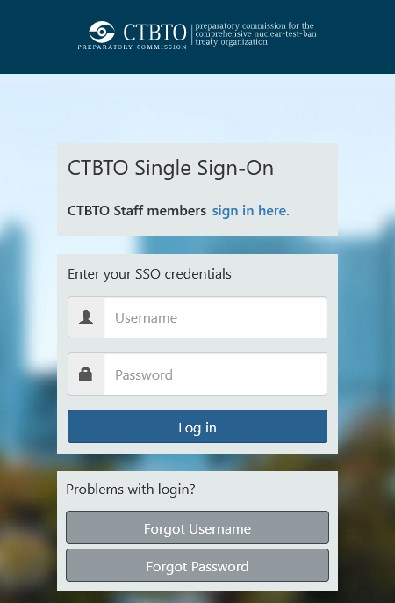
Methods/data - I
http://www.isc.ac.uk/projects/ctbtolink/
For the comparison of the REB bulletin with the ISC Published Bulletin the CTBTO-ISC web link was used (see e.g. Storchak et al., 2021; Storchak & Gallacher, 2023) which provides web tools for searching the ISC database and performing various tasks including the computation of network comparison statistics. In this study it was used for the assessment of the accuracy and completeness of the Reviewed Event Bulletin.
Output of the network comparison tool includes the statistics of location differences (in distance ranges less than 1 km, 10 km, 20km, 30 km, 50 km, 100 km, 200 km and greater) and the same depth differences. It also generates grouped rows of common/matched event hypocenters and values concerning hypocentral location differences.
Please do not use this space, a QR code will be automatically overlayed
P3.5-656

Slide 5
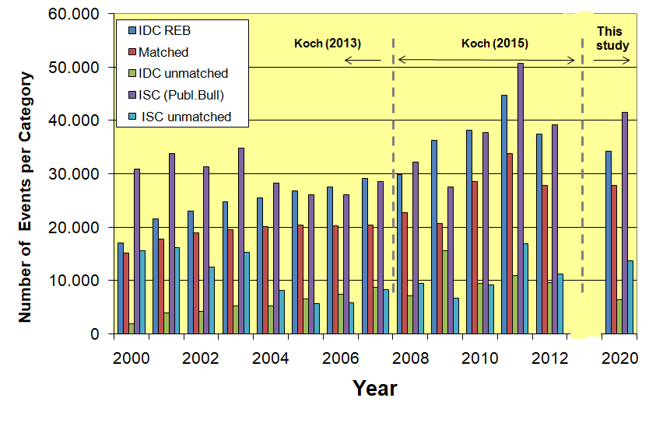
Methods/data - II
The comparison between REB and ISC bulletin for 2020 is based on 34195 REB events and 41561 solutions that were produced at the ISC from event locations and additional phase arrival data provided by global and local seismic networks. From these event locations 27757 events were common, i.e. matched by the ISC; they are then further used to assess the location accuracy between IDC and ISC by considering the differences between event locations from both institutions.
The unmatched IDC events, on the order of about 20% REB events, are mostly only found by the IDC, while, at least for 2020, there is a significant number of events found by a local seismic network, such as the Altai-Sayan Seismological Centre. These events are mostly of man-made nature – and the ISC eventually used one or the other origin as the prime event location.
Please do not use this space, a QR code will be automatically overlayed
P3.5-656

Slide 6
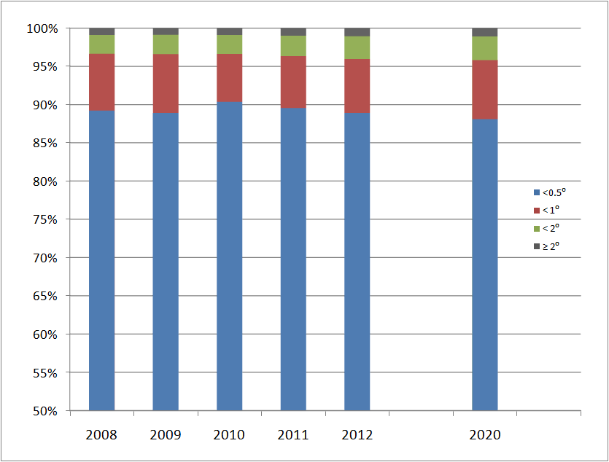
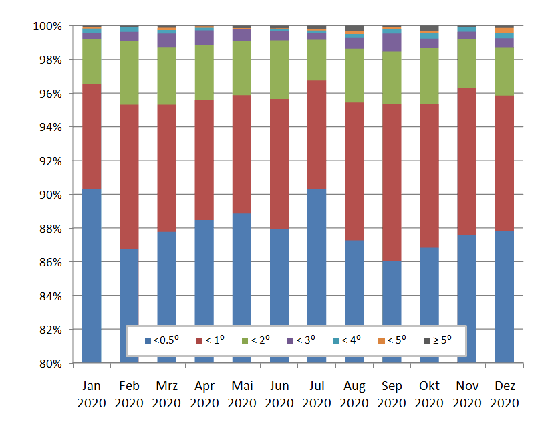
Results - I (Location differences)
In a more detailed view, the graph below shows the location difference statistics binned on a monthly basis, and grouped for additional range classes. Of the 1% of events with locations differences larger than 2°, about half are within 3°. Differences larger than 5° can occur for up to 0.4%, or more than half a dozen per month, i.e. 1-2 events per week.
The location differences between matched IDC and ISC solutions were grouped in four range classes. For 2020, a total of ~88% of these events were within 0.5°, and ~96% within 1°. For only ~1% the differences exceeded 2°. However, a slight trend to a decrease in these numbers from 2008 onward seems to persist.
Please do not use this space, a QR code will be automatically overlayed
P3.5-656

Slide 7
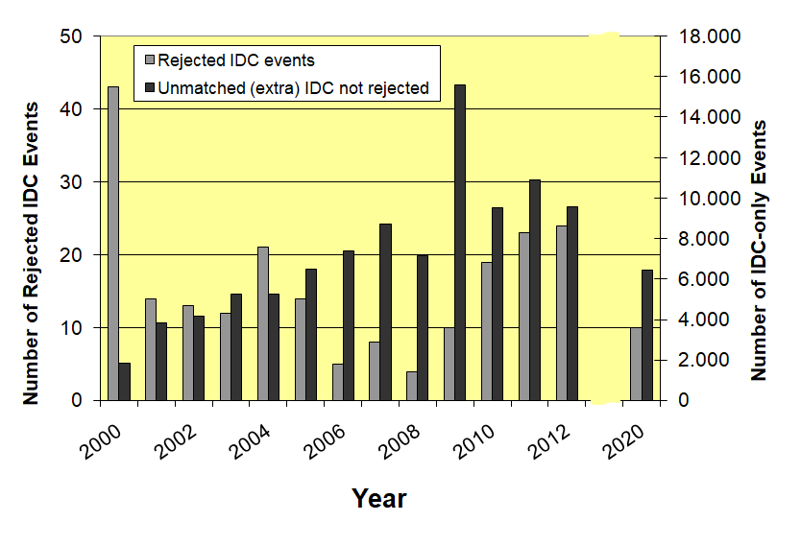
Results - II (Rejected / extra events)
Considering the number of REB events banished from inclusion in the ISC published bulletin (rejected IDC events in the figure) there was a fairly stable number of these events in the initial years of REB projection, except for a large number in the year 2000. In the following years this number decreased to about half of the previous level between 2006 and 2009, but then increased steadily until 2012. In the year 2020, the number of rejected REB events returned again to previous levels.
For the number of unmatched /extra IDC events, for which the ISC could not produce a revised hypocenter solution, usually due to the lack of supplementary phase data from non-IMS stations, there is a steady increase from 2000 to 2012, with an extraordinary number for 2009. This may have been due to the progressive completion of the IMS network. However, the decrease of this number in 2020 by about 30% or more compared to the latest year considered by Koch (2015) would suggest a lower detection threshold of the IMS, since the number of common events remained constant (see Methods/data – II).
Please do not use this space, a QR code will be automatically overlayed
P3.5-656

Slide 8
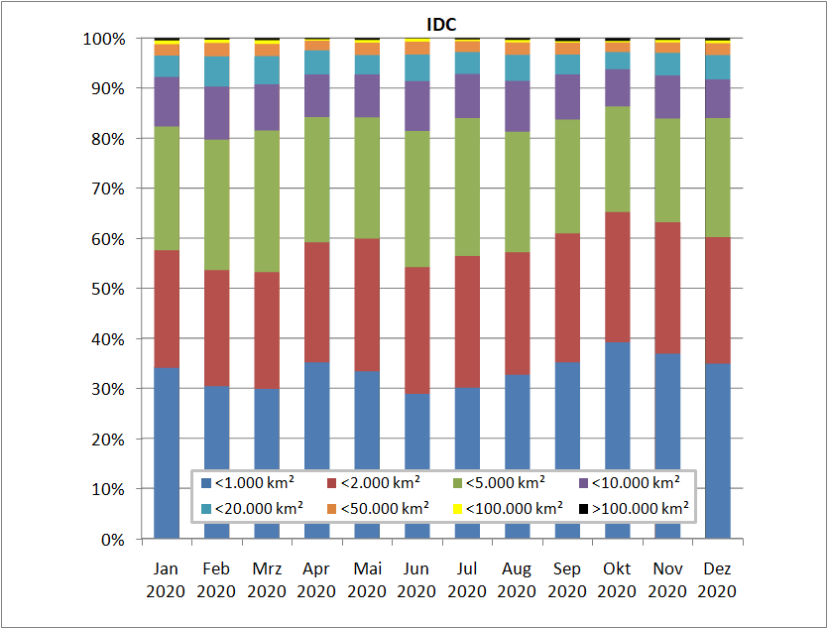
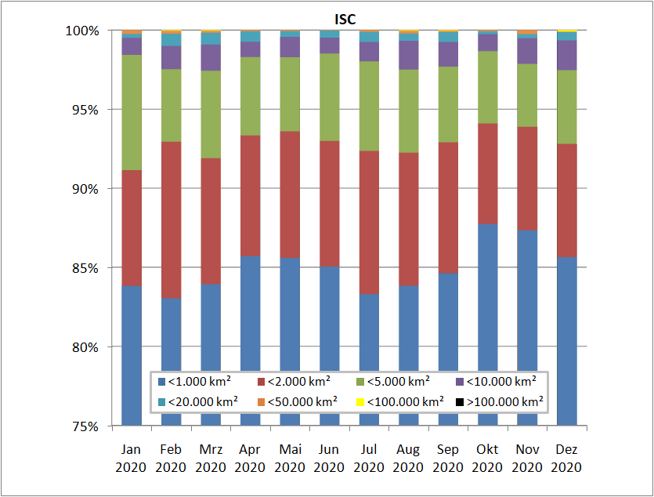
Results - III (Error ellipse sizes)
The error ellipse sizes estimated at the ISC for common events seem significantly smaller, thus giving levels of 85% of events with error ellipses smaller than 1,000 km². For the next three classes this level reaches ~92%, nearly 98% and 99%, respectively. The question however is, to what degree error ellipse estimates at IDC and ISC are equivalent.
The error ellipse size is a useful estimate in the framework of potential on-site inspections, restricted to an area of 1,000 km² by Treaty provisions. For 2020, a size not exceeding this level is found by the IDC for about 30% of the common events, varying by 5-10% from month to month. It applies to 60% , 80% and 90% of events for thresholds of 2,000, 5,000 and 10,000 km².
Please do not use this space, a QR code will be automatically overlayed
P3.5-656

Slide 9
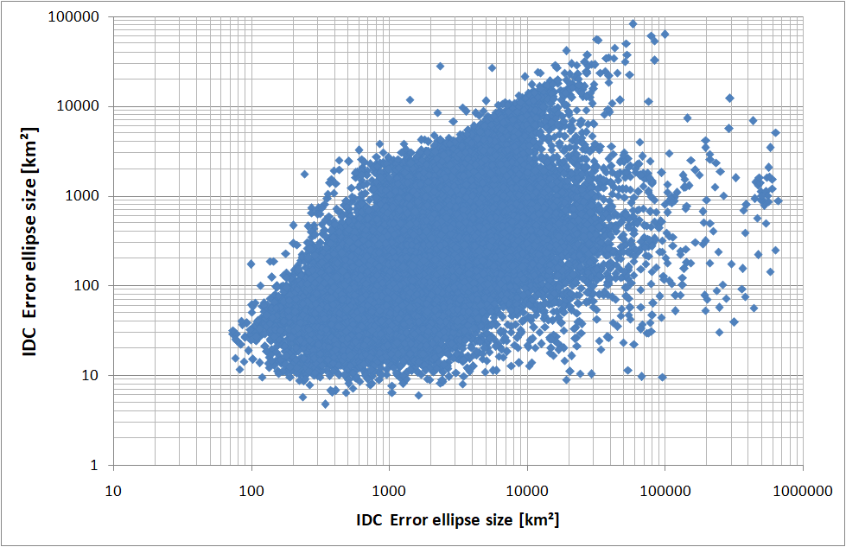
Results - IV (Error ellipse comparison)
A direct comparison of the error ellipse sizes estimated at the IDC and the ISC for the more than 27,000 common events does not suggest in general any significant correlation for events. In terms of the ISC error ellipses, their size did not exceed 100,000 km², while for the IDC an order of magnitude larger maximun error ellipse is found.
The differences in the error ellipse sizes may certainly be related to different calculations procedures applied at both institutions. If these procedures are, however, equivalent and results mainly depend on the amount of station data used, then the higher portion of ISC events within smaller size limits compared to the IDC may indeed argue for the use of the ISC bulletin as a suitable reference for location accuracy assessments.
Please do not use this space, a QR code will be automatically overlayed
P3.5-656

Slide 10
Conclusions
From the comparison of the Reviewed Event Bulletin (REB) with the ISC Published Bulletin for the year 2020 the following conclusions can be drawn:
Epicentral locations differences of common events are found to be similar over the years for the distance classes considered. However, one might expect that improvements are found in that larger location differences diminish, while there is a slight opposite trend.
For 2020 the number of rejected event solutions return to levels seen prior to 2010. So there is a reversal of a trend of more rejected events that occurred between 2010 and 2012.
The relative number of REB events not relocated by the ISC became significantly smaller in 2020 compared to 2012, with nearly the same number of common events, i.e. the IDC locates less events in remote areas, where local and regional seismic networks lack.
The portion of common events with specific error ellipse size is much smaller for REB locations than for ISC locations. This may be related to the generally smaller sizes of error ellipses for ISC locations than for IDC locations. This difference should be further investigated.
All in all, the last 8 years seem not to have resulted in more consistent event locations between IDC and ISC.
Please do not use this space, a QR code will be automatically overlayed
P3.5-656

Slide 11
References
- Koch, K. (2013): Eight years of continuous quality assessment of the International Data Centre (IDC) Reviewed Event Bulletin, Bull. Seism. Soc. Am., 103, 296-305, doi: 10.1785/0120110350.
- Koch, K. (2015): Quality assessment of the Reviewed Event Bulletin – the next five years, CTBTO Science and Technology Conference, T4.1-P20, 22-26 June 2015, Vienna, Austria.
- Storchak, D.A., R. Gallacher & James Harris (2021): CTBTO link to the ISC database as a tool for capacity building and education, CTBTO Science and Technology Conference, O5.3-639, 28 June – 2 July 2021, Vienna, Austria.
- Storchak, D. & R. Gallacher (2023). CTBTO link to the International Seismological Centre database providing access to current and historical seismic data, CTBTO Science and Technology Conference, P2.5-450, 19-23 June 2023, Vienna, Austria.
Acknowledgements: Thanks go to the ISC and its staff for the availability of the ISC bulletin and the development of the CTBTO-ISC link utilized for this work, in particular D. Storchak and R. Gallacher, who assisted in many ways.
Please do not use this space, a QR code will be automatically overlayed
P3.5-656

