Slide 1

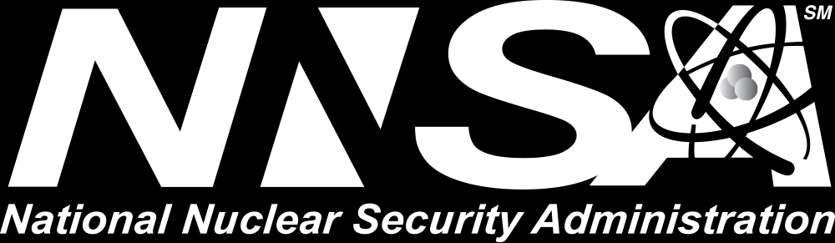
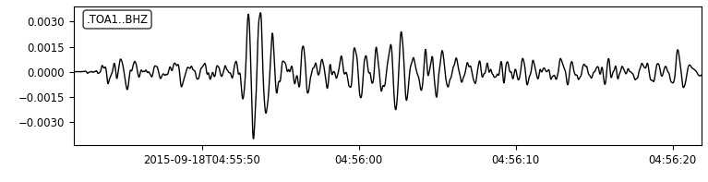
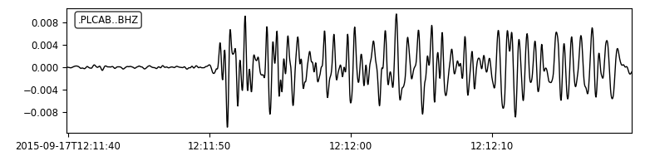
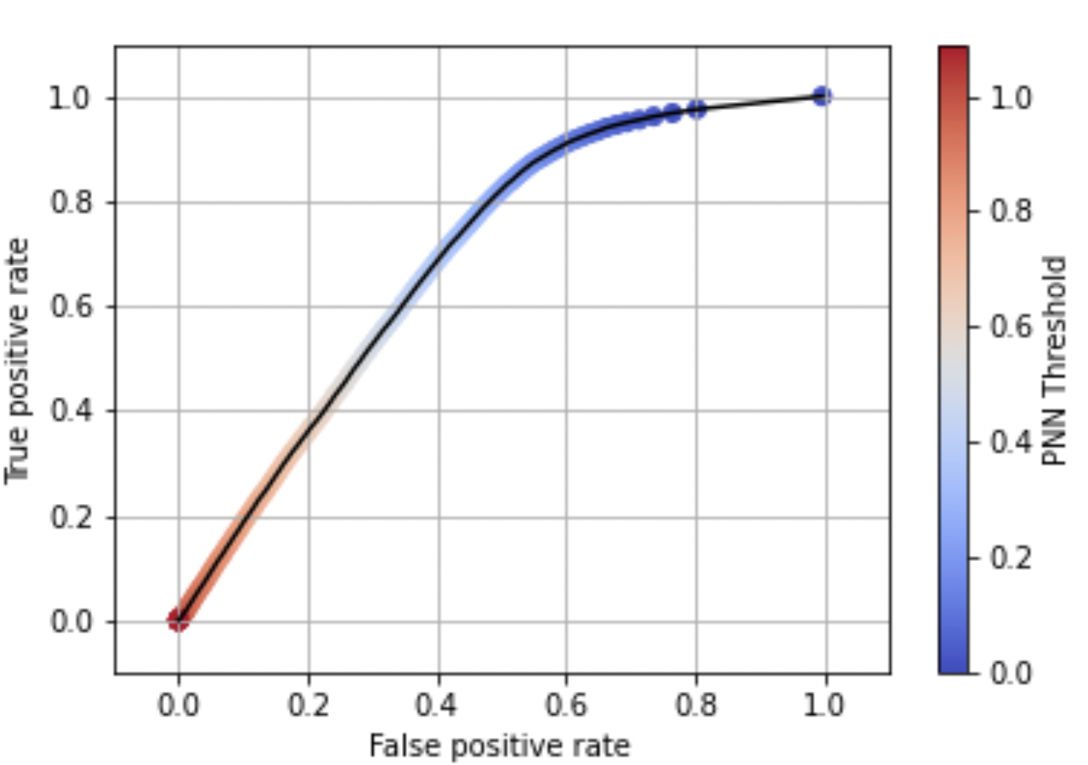
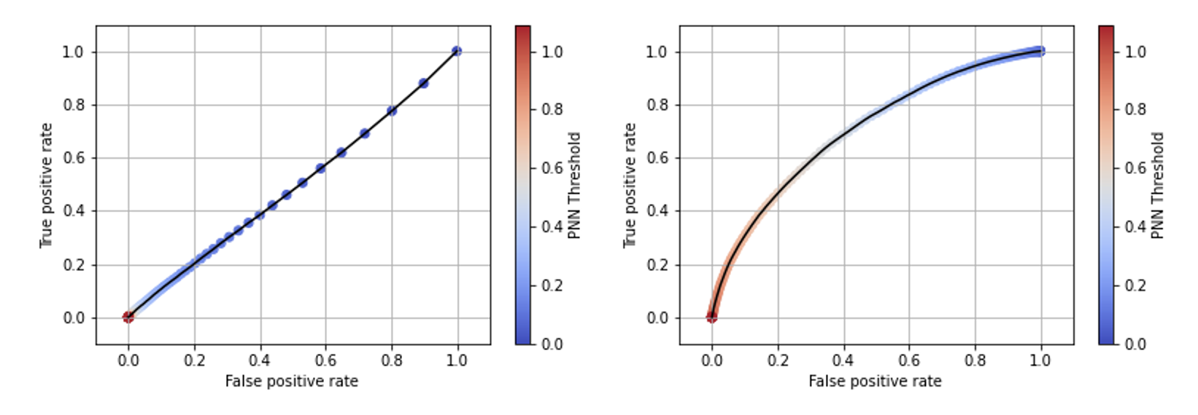
Testing a Paired Neural Network to Characterize Aftershock Sequences
Erica Emry, Brendan Donohoe, Andrea Conley,
Rigobert Tibi, and Christopher Young
Sandia National Laboratories, Albuquerque, NM
P3.5-348
We tested 6 different Paired Neural Network (PNN) models trained to recognize similar waveforms against 2 analyst-validated aftershock sequences.
Goal: See if PNN model outperforms correlation.
  PNN models trained using a constructed global earthquake dataset of similar waveforms (to simulate aftershock similarity).
  Each waveform consisted of a high SNR waveform with added noise.
We tested models according to 2 different ‘Match’ and ‘Non-Match’ criteria.
Overall, the existing PNN models (trained with constructed data) struggled to generalize to the aftershock datasets.
However, fine-tuning PNN models with some aftershock data indicates improvement.
Come to the poster to discuss with us!
*Performance of the PNN models
decreased when applied to real
aftershock sequences
Convolution
Max Pooling
Convolution
Max Pooling
Convolution
Dropout
Max Pooling
Convolution
Max Pooling
Flatten
Dense
L1 distance (PNN score)
Non-Match
Match
Result before fine-tuning
Result after fine-tuning
*Fine-Tuning the
PNN Models may help
This Ground-based Nuclear Detonation Detection (GNDD) research was funded by the National Nuclear Security Administration, Defense Nuclear Nonproliferation Research and Development (NNSA DNN R&D). SNL is managed and operated by NTESS under DOE NNSA contract DE-NA0003525

