Slide 1
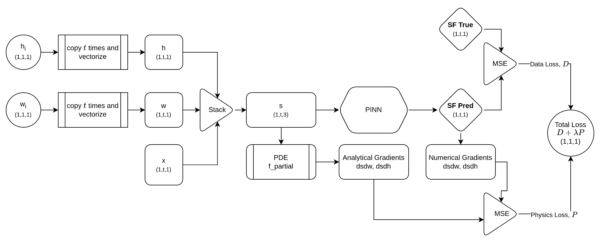
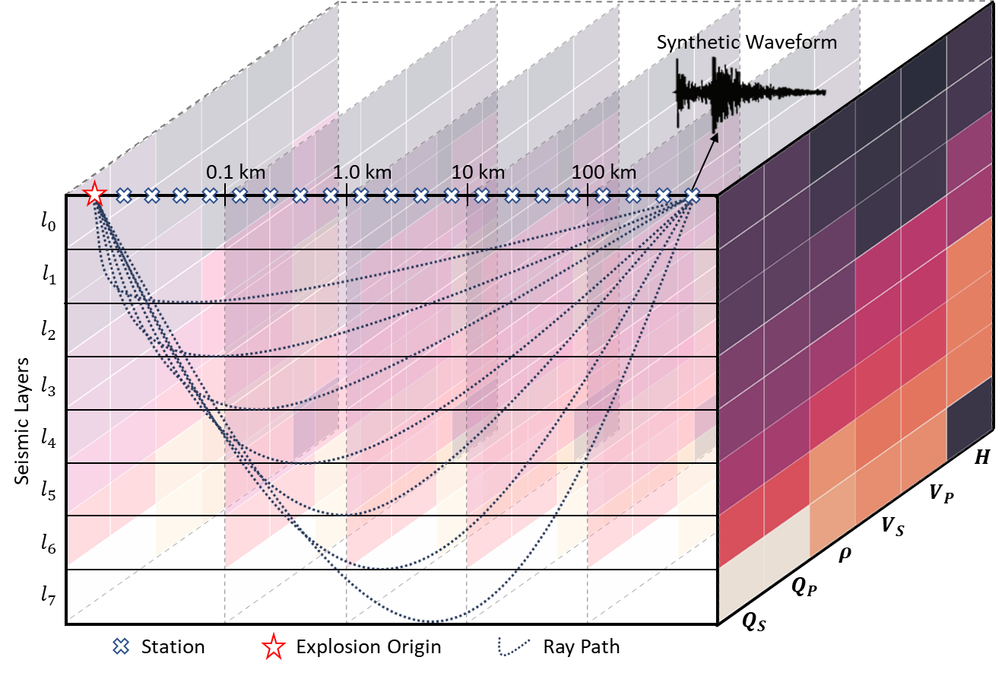
Towards PINN for Emplacement Classification and Yield and Depth of Burial Estimation using TDSF - Applications
¹Mitchell Solomon, ¹Chandan Saikia, ²Seong H. Hong, ¹Alan Poffenberger
¹AFTAC, Patrick SFB, FL 32925, USA; ² FlT, Melbourne, FL 32901, USA
P3.5-098
Synthetic Seismogram Dataset
Physics-Informed Deep Learning Framework
Fast forward modeling
Improved out-of-distribution generalization
Explainable ML for source characterization
SnT 2023
Future work
Forward modeling of TDSF and OOD experimental results showcased in corresponding eposter.

