Slide 1
PINN for Emplacement Classification and Yield and Depth of Burial Estimation using TDSF - Applications
¹Mitchell Solomon, ¹Chandan Saikia, ²Seong H. Hong, ¹Alan Poffenberger
¹AFTAC, Patrick SFB, FL 32925, USA; ² FlT, Melbourne, FL 32901, USA
A novel Physics-Informed Neural Network (PINN) algorithm is assessed for generating synthetic time-domain source functions (TDSF) outside of the training regime, based on explosion source yield (W) and depth of burial (DoB).
~58,000TDSFs were established at the elastic radii of multiple explosions for various emplacement material properties. W and DoB range from 0.01 to 2 Kts and 100 to 900m.. PINN models were evaluated by varying the physics loss penalty term, 𝝺, where the train-test split is defined by quadrants of the W and DoB plane.
As the weight of the physics loss term is increased, the root mean-squared error between true and generated TDSF’s decreases, indicating improved out-of-distribution generalization. Additionally, training on low-W, low-DoB seems to generalize better to high-W, high-DoB than the inverse training scenario.
Preliminary results show promise for the PINN framework based on favorable out-of-distribution generalization trends. The PINN framework will be extended to generate full seismograms, and finally inverted to predict W and DoB from synthetics and real data.
Please do not use this space, a QR code will be automatically overlayed
Please do not use this space, a QR code will be automatically overlayed
P3.5-098
Notes:
This study uses 48 000 synthetically generated time-domain source functions (TDSF) to illustrate the performance of newly developed physics-guided neural network algorithms for classification of the emplacement conditions in materials where the explosions are detonated. TDSFs were constructed at the elastic radii of many explosions for material properties representing the granite, shale, tuff-rhyolite, wet granite and wet tuff emplacement conditions at the source. For each material type, we allowed yield (W) to vary between 10 tonnes to 2 Kts and depth of burial (DOB) to vary between 100 m and 900 m, respectively. The effect of the one dimensional wave-propagation path models including the attenuation by convolving TDSFs with synthetic path seismograms for stations located at 100 km to 1200 km was further investigated. Different levels of real-time broadband noise and source complexity comprising of both isotropic and non-isotropic sources were added, and compared the performance of the algorithm in the material classification and estimation of W and DOB to the neural network algorithm without governing laws and regularization of the physics-guided method. Results will be presented showing the performance for the event classification applying the algorithm individually to the Pg, Pn, Sn, Lg amplitudes, including the Pg/Lg and Pn/Sn amplitude ratios.

Slide 2
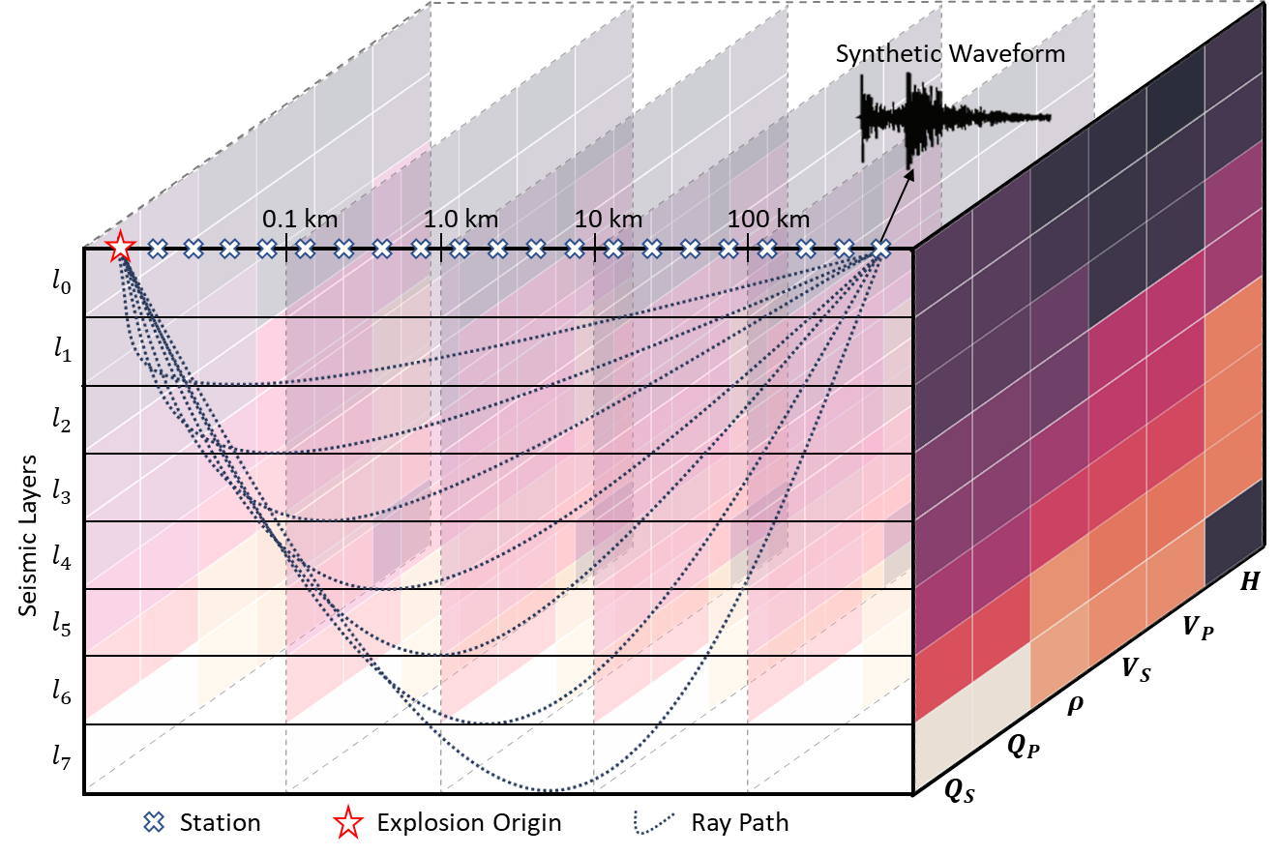
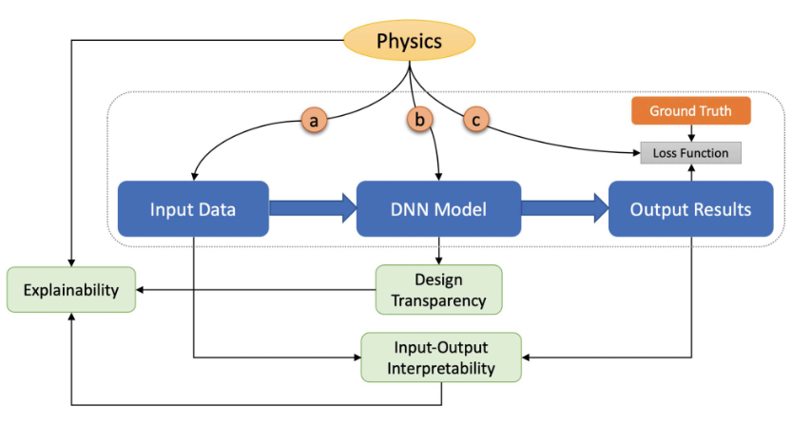
Introduction
Solving inverse problems from observed seismic data presents challenges for supervised machine learning techniques that impact generalization (Mousavi 2023).
Because data-driven techniques, especially popular deep learning methods, are poor at extrapolating, large datasets are often necessary to capture adequate variation in the data domain.
PINN’s have been proposed to help solve this problem by imposing a physics loss term during training, thus constraining the model to behave with respect towards fundamentals and improving generalization for various problems.
Synthetic Seismograms
Physics Informed Deep Learning
Fast, explainable, and generalizable source characterization
Please do not use this space, a QR code will be automatically overlayed
Mousavi 2022
P3.5-098

Slide 3
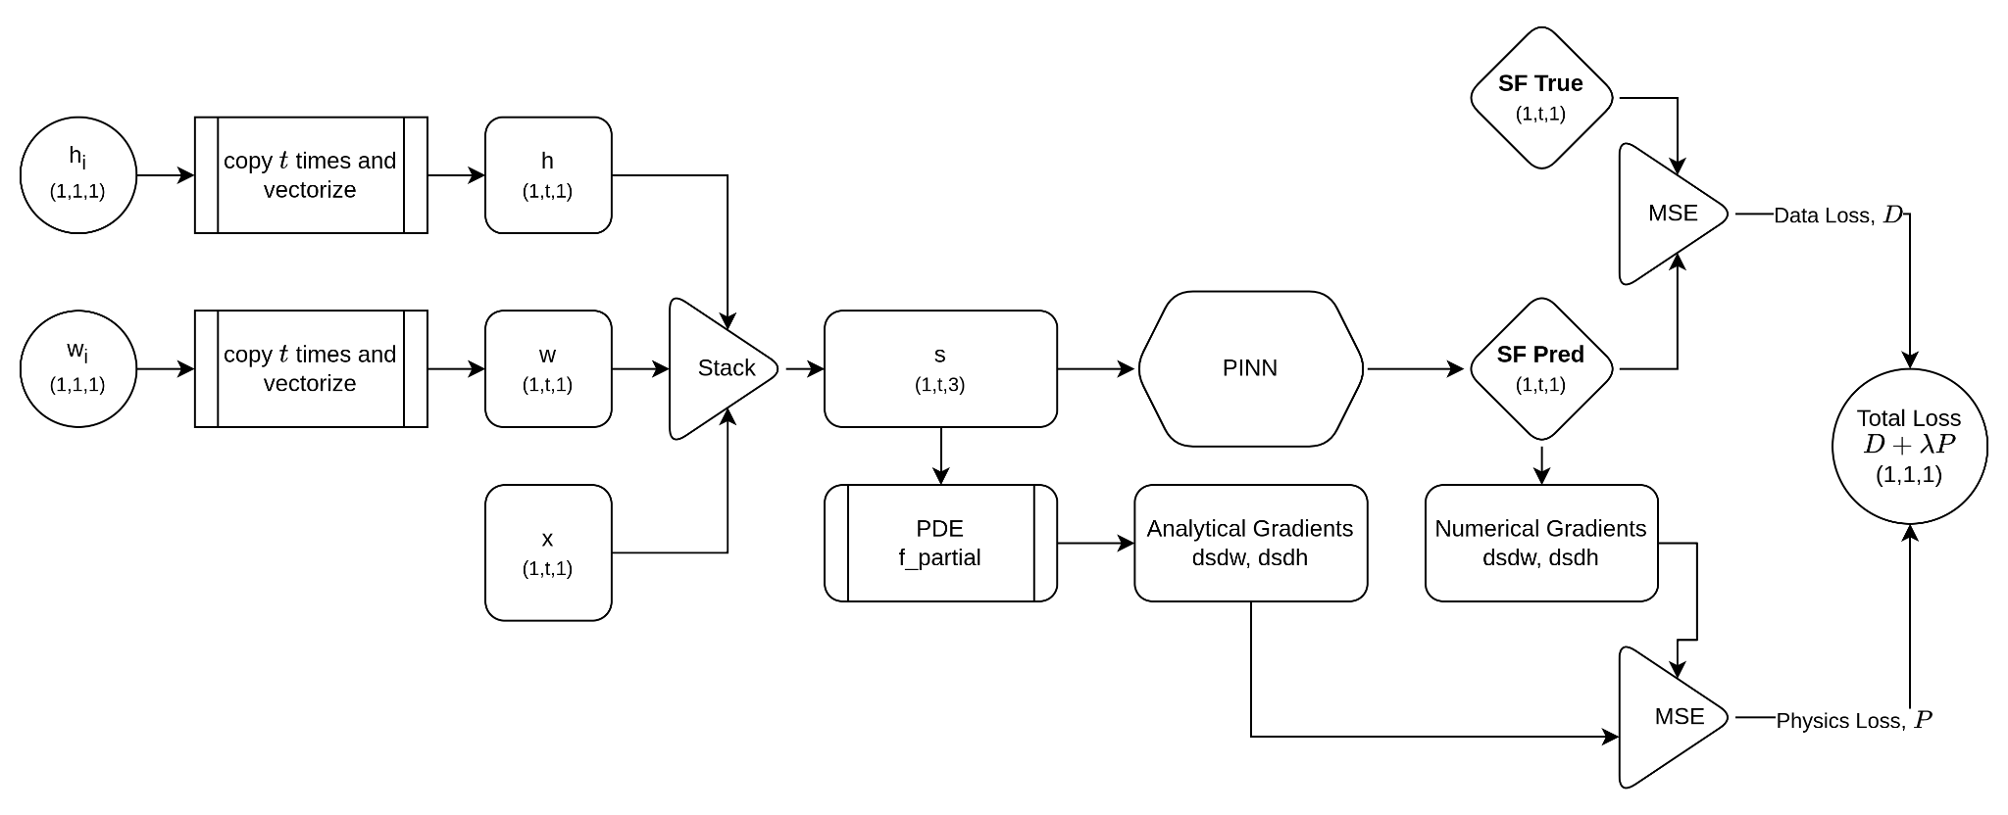
Objectives
Overall: characterize out-of-distribution generalization utility of PINN framework for forward and inverse modeling
Develop PINN model for forward modeling seismogram from W and DoB
Develop PINN model for inverse modeling of W and DoB from synthetic seismogram
Generate vast dataset of synthetic seismograms for model validation
Apply framework and testing concepts to observed events
Showcased here: 1) proof-of-concept for forward modeling of synthetic TDSF, 2) out-of-distribution testing experiment based on W and DoB quadrants
PINN Framework – TDSF Forward Modeling
Please do not use this space, a QR code will be automatically overlayed
P3.5-098

Slide 4
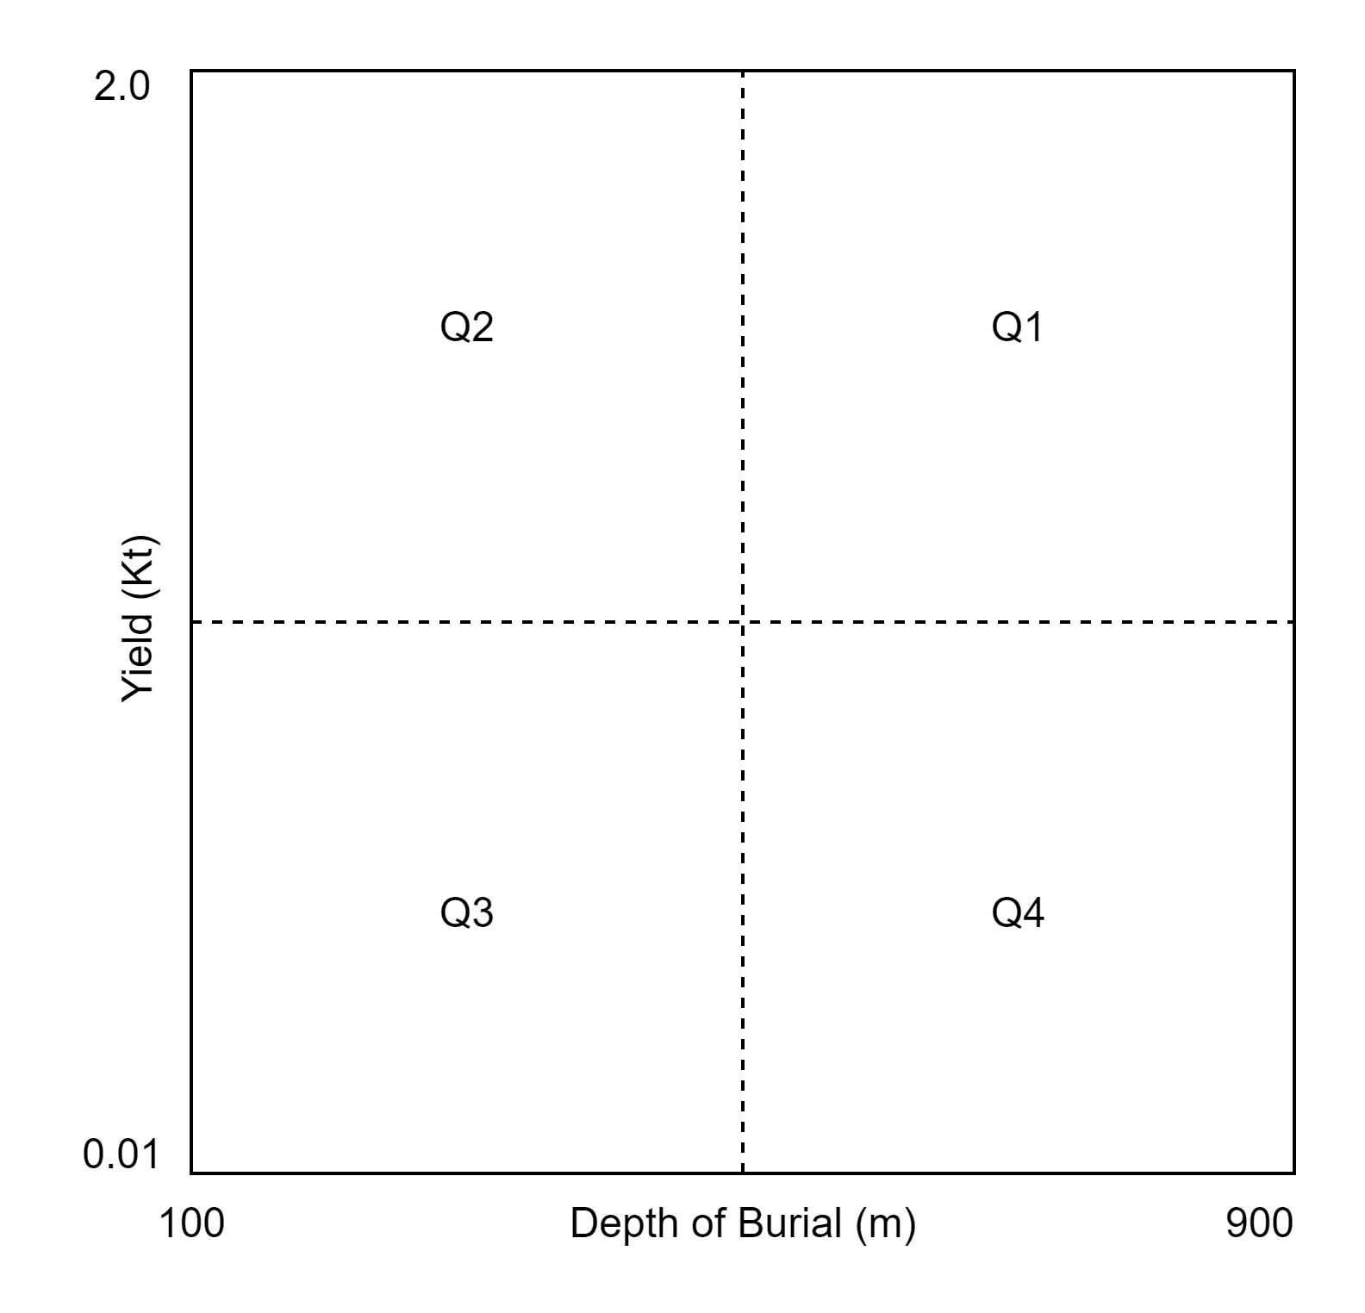
Methods & Data
A dataset of ~58,000 TDSFs were generated at the elastic radii of multiple explosions sources for various emplacement material properties and a suite of yield and depth of the explosions (Saikia 2017).
W and DoB range from 0.01 to 2 Kts and 100 to 900m, respectively.
PINN model is a simple, 3-layered, and fully-connected neural network (FCNN) that takes W and DoB to predict a TDSF. MSE loss of between the input and this prediction from the FCNN was calculated.
During training, a physics loss term is added to the MSE loss (see P3.5-097)
PINN models were evaluated by varying the physics loss penalty term, 𝝺, where the train-test split is defined by quadrants of the W and DoB plane. The loss terms consisted of the sum of two MSE values, one for the partials of TDSF w.r.t. yield and the other w.r.t depth.
Consolidate observations about OOD generalization from all train-test quadrants and 𝝺 value combinations as shown to the figure in the right
far-field (dynamic) equation 12c of Saikia (2017)
OOD Experimental Setup
$$S\left(t\right)=\left[\frac{∂_{t}F\left(t\right)}{R_{el}C}\right]∗\left[B\left(t\right)\right]$$
Test
Train
$$P=MSE(\frac{dS}{dW}$$
Test
Test
Please do not use this space, a QR code will be automatically overlayed
P3.5-098

Slide 5
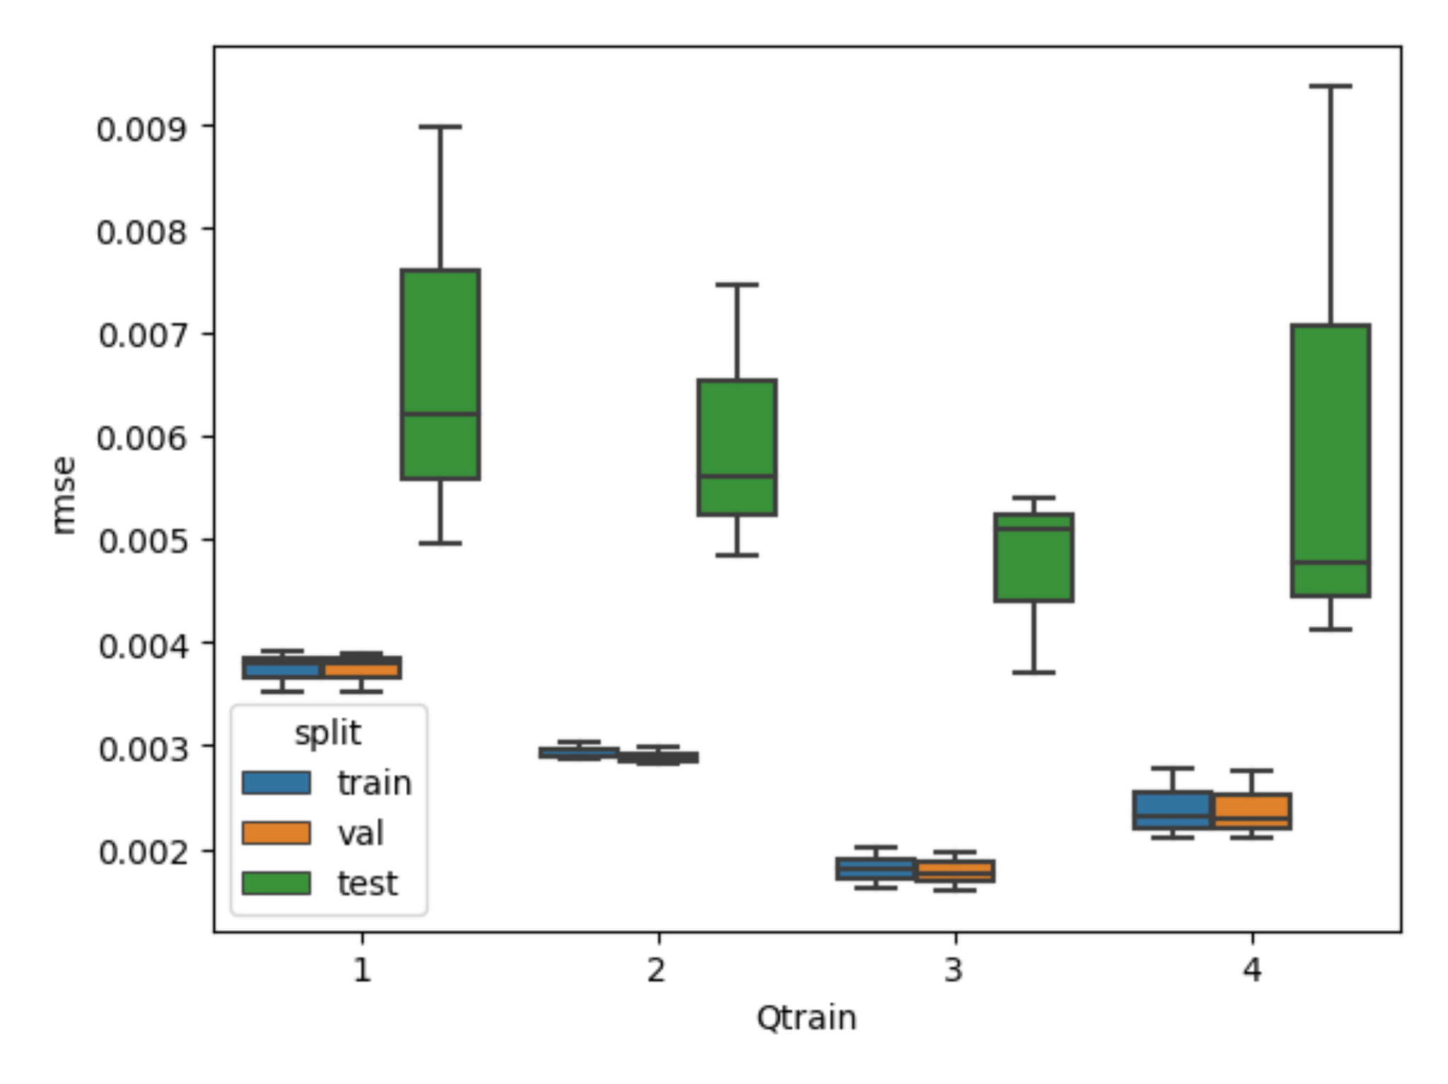
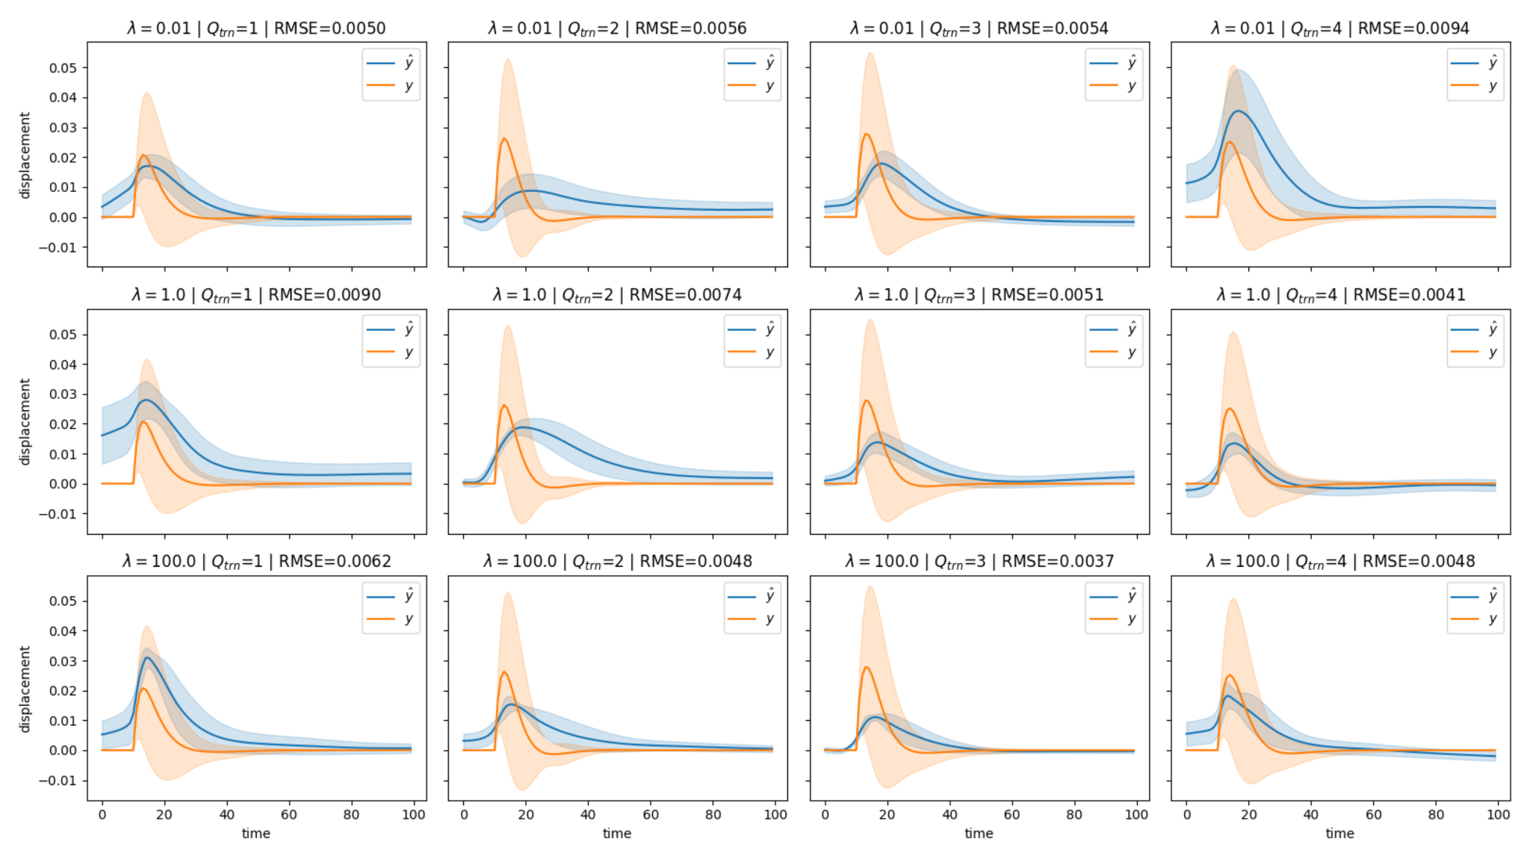
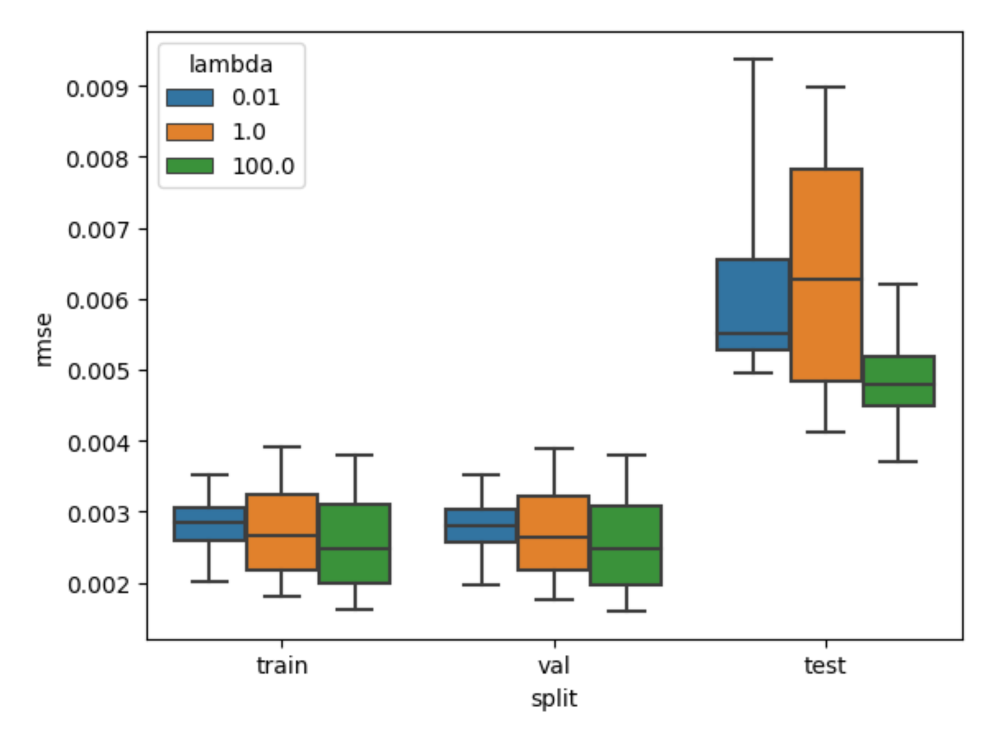
Results
RMSE drops as deviation from fundamental physics increased
Features learned from low-yield and shallow DoB TDSF’s show improved generalization to remaining quadrants
Further validation necessary to prove out concept
Please do not use this space, a QR code will be automatically overlayed
P3.5-098

Slide 6
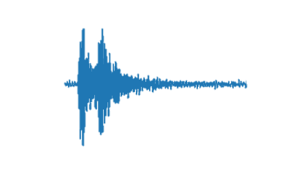
Conclusion
Preliminary results suggest positive relationship between the weight of the physics loss term and generalization performance. More testing necessary.
Features learned from low-yield and shallow DoB TDSF’s show improved generalization of OOD to remaining quadrants.
Future work:
Complete synthetics dataset to include full forward-modeled synthetic seismograms
Curate real dataset of seismograms that spans event types
Construct inverse modeling framework
Please do not use this space, a QR code will be automatically overlayed
P3.5-098

Slide 7
References
Mousavi, S. Mostafa, and Gregory C. Beroza. 2023. “Machine Learning in Earthquake Seismology.” Annual Review of Earth and Planetary Sciences 51 (1): 105–129.
Saikia, Chandan K. 2017. “Time-Domain Source Function (TDSF) for Nuclear and Chemical Explosions—analysis around Nevada National Security Site (NNSS).” Geophysical Journal International 209 (2): 1048–1063.
Karniadakis, George Em, Ioannis G. Kevrekidis, Lu Lu, Paris Perdikaris, Sifan Wang, and Liu Yang. 2021. “Physics-Informed Machine Learning.” Nature Reviews Physics 3 (6): 422–440. Moseley, Ben, Andrew Markham, and Tarje Nissen-Meyer. 2020. “Solving the Wave Equation with Physics-Informed Deep Learning.” arXiv [physics.comp-Ph]. arXiv. http://arxiv.org/abs/2006.11894. Song, C., T. Alkhalifah, and U. B. Waheed. 2021. “Solving the Frequency-Domain Acoustic VTI Wave Equation Using Physics-Informed Neural Networks.” Geophysical Journal. https://academic.oup.com/gji/article-abstract/225/2/846/6081098.
Please do not use this space, a QR code will be automatically overlayed
P3.5-098

