Slide 1
Applying Compression Metrics to Seismic Data to Assist Analysts
Christina Ting, Richard Field, Angela Zhou, Laura Matzen
Sandia National Laboratories
This work introduces a novel compression-based signal processing method that can assist analysts with triaging and analyzing seismic data.
The Sliding Information Distance (SLID) is a metric that can identify signal arrivals in seismic data.
An advantage of SLID is that it provides a measure of uncertainty quantification (UQ), which can be leveraged in multiple ways.
On 444 waveforms, SLID had a mean difference of 0.54s to the expert’s pick.
When visualizing SLID, participants are able to utilize SLID beneficially, particularly when shown together with UQ information.
SLID successfully predicts event arrival times with high accuracy.
Together with UQ measures, SLID can assist with data triage and event level analysis.
Place your QR Code here after removing this text box!
This Low Yield Nuclear Monitoring (LYNM) research was funded by the National Nuclear Security Administration, Defense Nuclear Nonproliferation Research and Development (NNSA DNN R&D). The authors acknowledge important interdisciplinary collaboration with scientists and engineers from LANL, LLNL, NNSS, PNNL, and SNL
Sandia National Laboratories is a multimission laboratory managed and operated by National Technology & Engineering Solutions of Sandia, LLC, a wholly owned subsidiary of Honeywell International Inc., for the U.S. Department of Energy’s National Nuclear Security Administration under contract DE-NA0003525. SAND2023-04709C.
P3.5-318

Slide 2
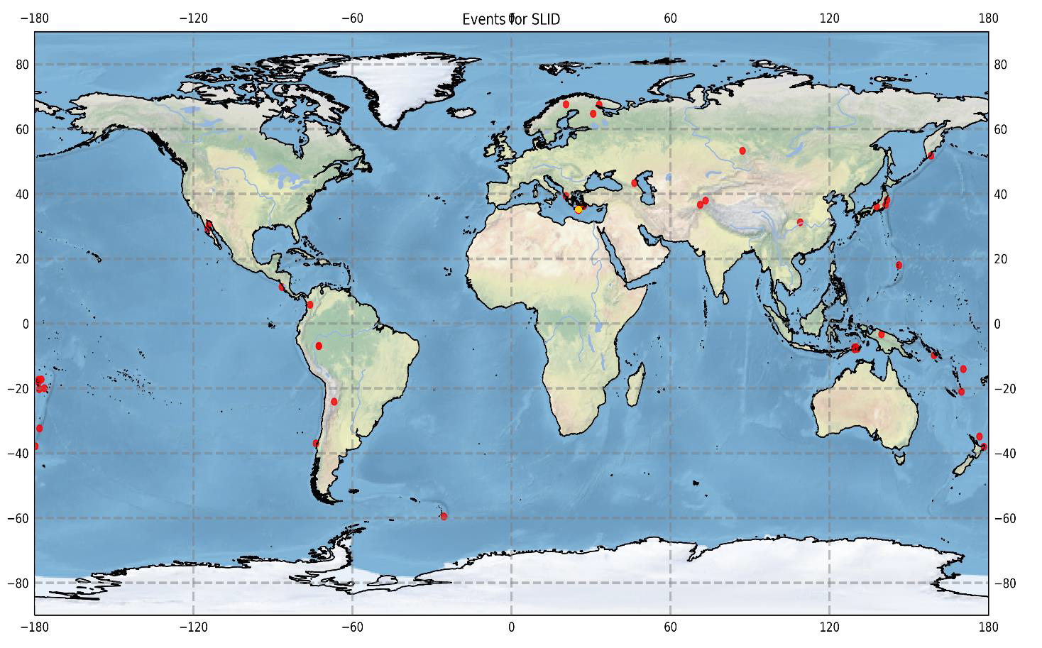
Introduction: Current Approach
Seismic analysis is a critical national security mission that relies heavily on human expertise to identify and mark seismic waves embedded in background noise.
How is it solved today:
Automatic event picks contain ~40% false positives miss ~20% of true positives
Seismic analysts spend a great deal of time and effort correcting and adjusting the picks
Each pick is adjusted multiple times by different analysts
Seismic station locations
Place your QR Code here after removing this text box!
Event bulletin of seismic waveforms from different seismic stations.
P3.5-318

Slide 3
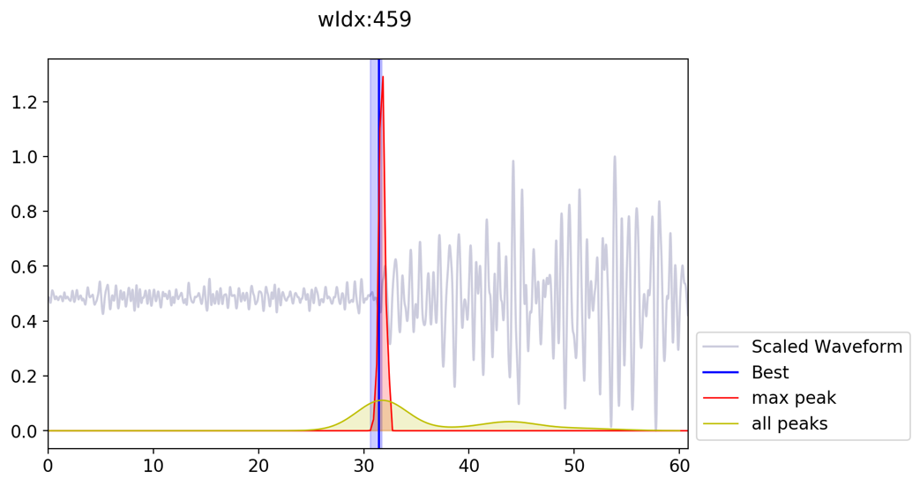
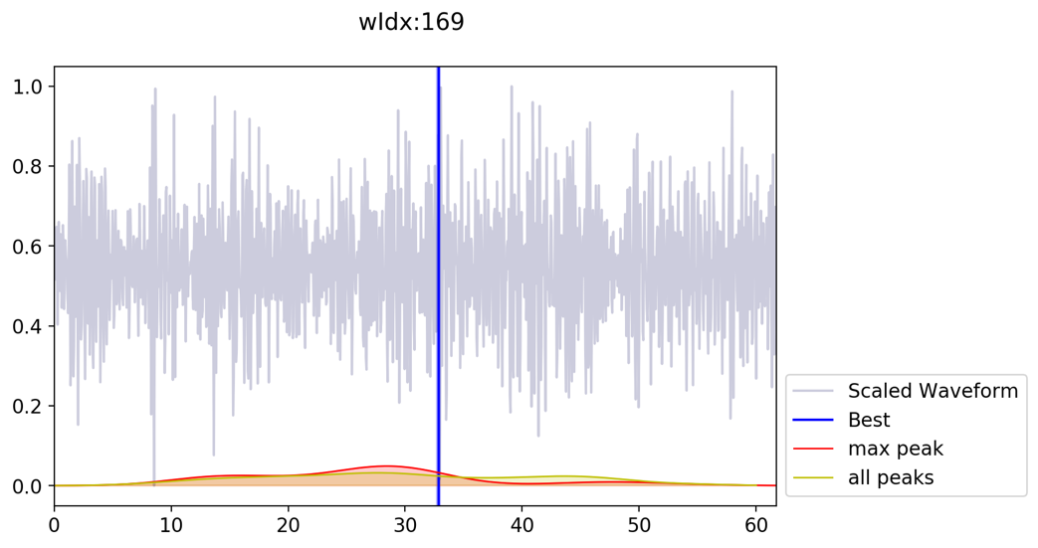
Objectives: Apply Data Science Methods
Objective: Apply data science methods to assist seismic analysts with data triage, allowing them to devote their cognitive resources to waveforms where their expertise is required.
Ground truth
Ground truth
Algorithm prediction and confidence
Algorithm prediction and confidence
Algorithm has high confidence: does not require analyst review
Algorithm has low confidence: requires analyst review
Place your QR Code here after removing this text box!
P3.5-318

Slide 4
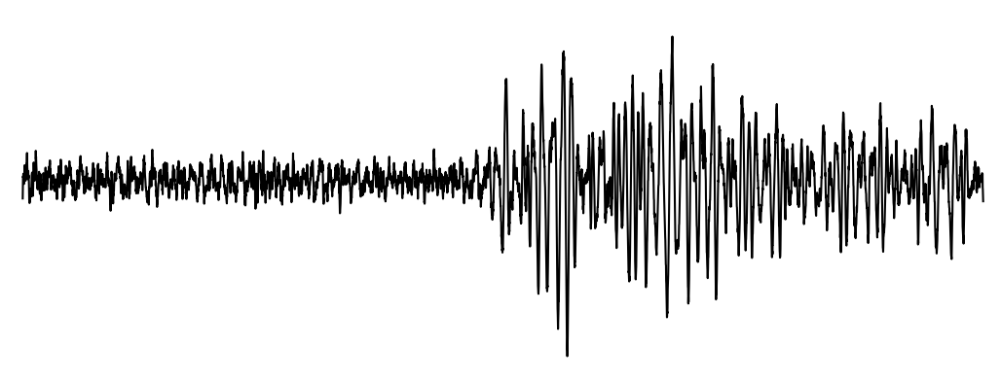
Methods: Compression Metrics
Based on using compression algorithms to approximate the normalized information distance (i.e., similarity) between any two data items:
The Sliding Information Distance (SLID)^{1,2} is a general approach for boundary detection within signals. It considers the distance between two adjacent sliding windows in a signal. Peaks in SLID indicate a change, or a seismic event (i.e., large distances before and after an event).
If A and B similar:
If A and B not similar:
item A compressed
item B compressed
item A and B compressed
item A and B compressed
Place your QR Code here after removing this text box!
Adjacent windows similar, SLID score is low
Leading window starts to change,
SLID score increases
Adjacent windows are maximally different, SLID score peaks
¹Ting, Christina, et al. "Generalized boundary detection using compression-based analytics." IEEE ICASSP (2019).
²Field, Richard, Tu-Thach Quach, and Christina Ting. "Efficient generalized boundary detection using a sliding information distance." IEEE Transactions on Signal Processing (2020)
P3.5-318

Slide 5
Results: Accuracy of SLID
Accuracy of SLID at predicting arrival times on a data set of 444 waveforms from 95 events, with expert pick as ground truth.
When compared to expert pick:
Mean difference of 0.54s between SLID pick and expert pick.
When compared to the Akaike Information Criterion (AIC):
Less than 0.1s difference between SLID and AIC for 88% of the waveforms.
SLID picks were closer to expert picks than AIC picks were.
Place your QR Code here after removing this text box!
P3.5-318

Slide 6
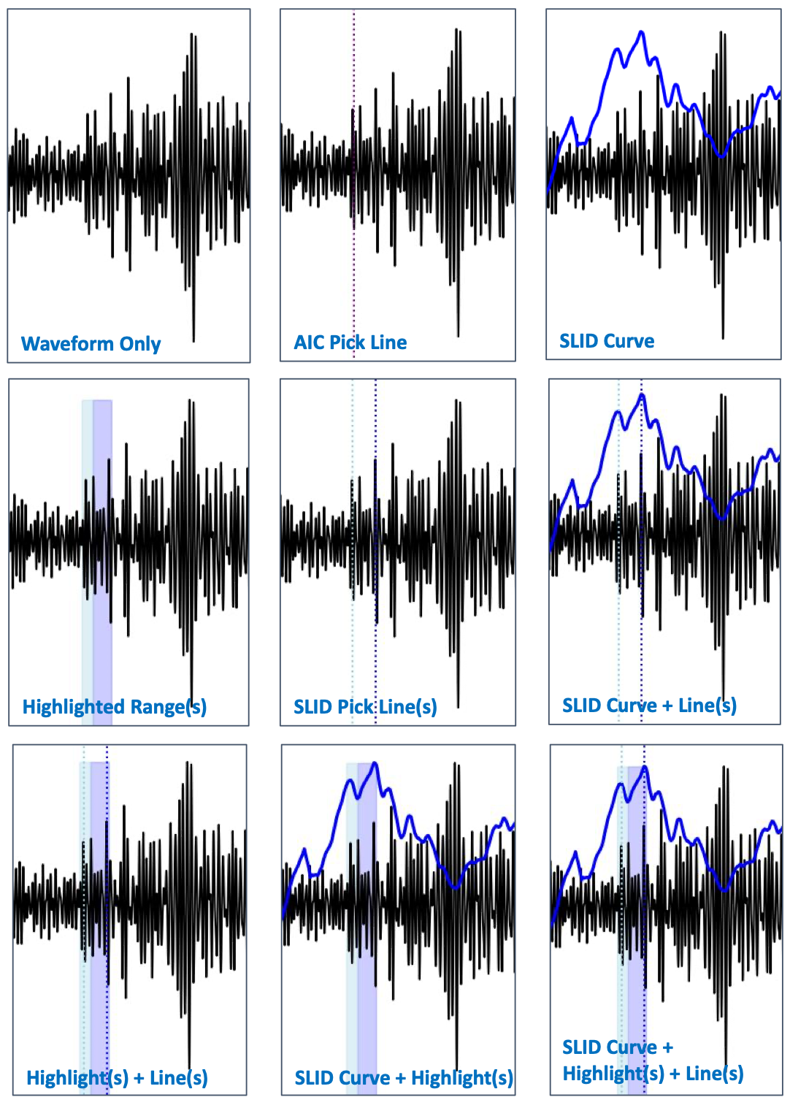
Results: Impact on Human Decision Making
Study 1: 11 participants shown 1 of 9 visualization conditions.
When only the AIC line is shown, participants show an anchoring effect.
When the SLID curve is shown, participants are able to decide when to utilize SLID and when to make their own decision.
Users preferred seeing SLID plots
Study 2: 10 participants shown uncertainty quantification (UQ) information.
Strong preference for seeing UQ information.
Users made more accurate picks (closer to the ground truth expert pick) when the UQ plot was shown.
Place your QR Code here after removing this text box!
P3.5-318

Slide 7
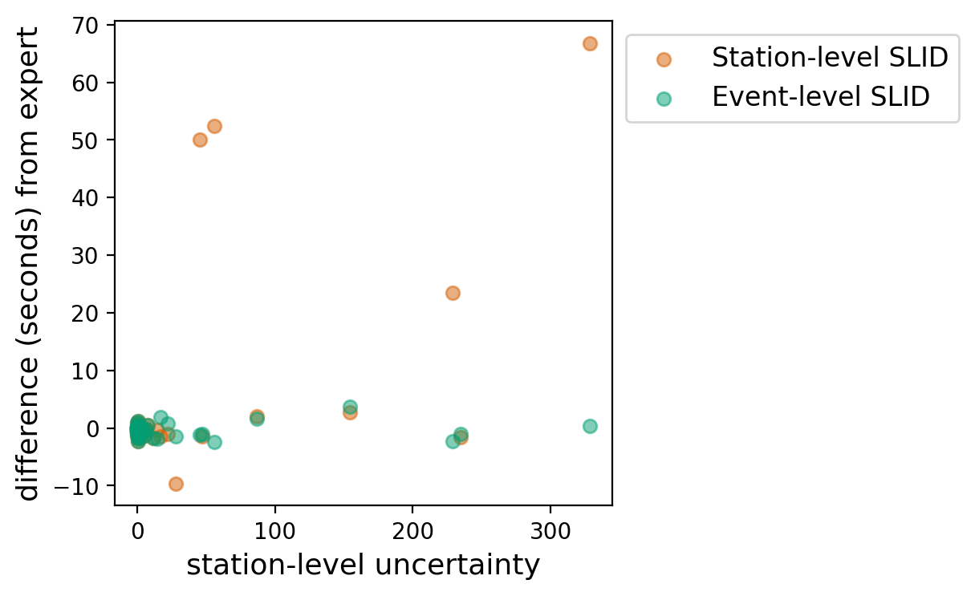
Conclusion: Summary and Ongoing Research
Compression metrics can be applied to seismic waveforms to identify signal arrival times
SLID can help seismic analysts focus their efforts:
Data Triage: Indicating which waveforms do or do not require expert judgement based on algorithm uncertainty.
Data Analysis: Directing analysts to most likely arrival times within a waveform.
Transparency: Communicating uncertainty of the algorithm.
SLID can also be applied at the event-level, using high confidence detections to refine the timing of lower confidence detections at other seismic stations.
Contact: Christina Ting (clting@sandia.gov)
Place your QR Code here after removing this text box!
Above this station-level uncertainty, use event-level prediction: overall predictions better match the expert prediction
P3.5-318

