Slide 1
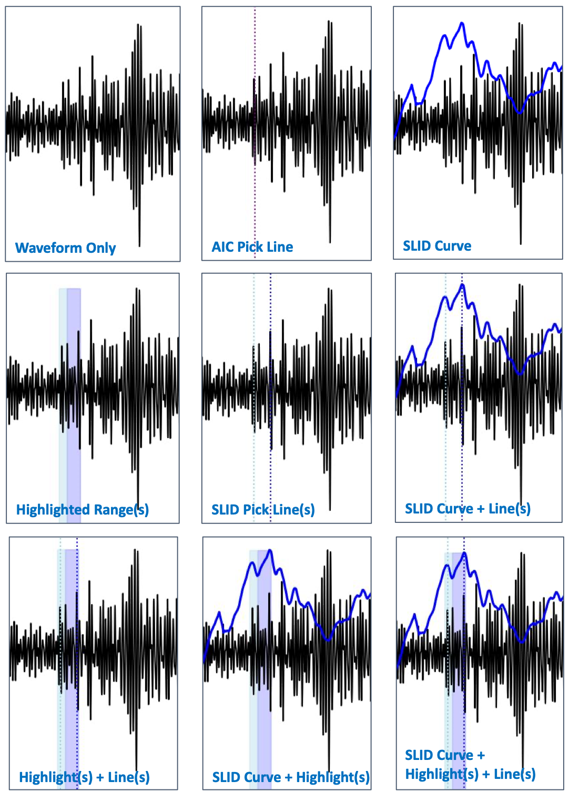
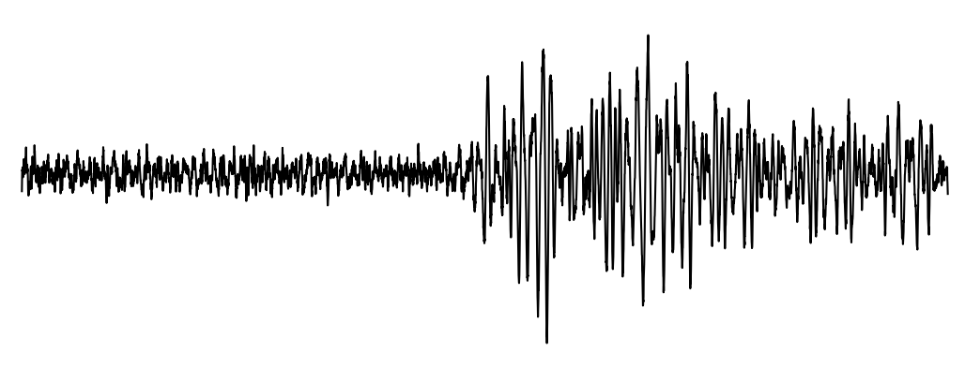
Applying Compression Metrics to Seismic Data to Assist Analysts
Christina Ting, Richard Field, Angela Zhou, Laura Matzen
Sandia National Laboratories
P3.5-318
Objective: Apply data science methods to assist seismic analysts with data triage, allowing them to devote their cognitive resources to waveforms where their expertise is required.
Normalize Compression Distance (NCD)
If A and B similar:
If A and B not similar:
item A compressed
item B compressed
item A and B compressed
item A and B compressed
Sliding Information Distance (SLID)
Adjacent windows similar, SLID score is low
Leading window starts to change, SLID score increases
Adjacent windows are maximally different, SLID score peaks
This Low Yield Nuclear Monitoring (LYNM) research was funded by the National Nuclear Security Administration, Defense Nuclear Nonproliferation Research and Development (NNSA DNN R&D). The authors acknowledge important interdisciplinary collaboration with scientists and engineers from LANL, LLNL, NNSS, PNNL, and SNL.
Sandia National Laboratories is a multimission laboratory managed and operated by National Technology & Engineering Solutions of Sandia, LLC, a wholly owned subsidiary of Honeywell International Inc., for the U.S. Department of Energy’s National Nuclear Security Administration under contract DE-NA0003525. SAND2023-04709C.

