Slide 1
Seismic Events Classification Based on Feature Extraction and XGBoost Algorithm
Tingting Wang; Yinju Bian
Institute of Geophysics, China Earthquake Administration
Establishing accurate earthquake catalogs, explosion catalogs, and mining-induced earthquake catalogs is crucial for studying seismic activity and the physical mechanisms of explosions, and for assessing the seismic risk associated with human mining activities.
Classify earthquakes, explosions, and mining-induced earthquakes through feature extraction methods and different AI methods
The data includes 5181 earthquakes, 5199 explosions, and 1079 mining-induced earthquakes in the central and eastern regions of China from 2009 to 2020.
Based on the network-averaged dataset,the earthquake/mining-induced earthquake classifiers constructed by different AI methods had the best performance, followed by the earthquake/explosion classifier and the explosion/mining-induced earthquake classifier.
The accuracies obtained with the network-averaged dataset are greater than those obtained with the single-station dataset.
The feature extraction methods used in this article can effectively highlight the differences in the seismic records of different types of events.
Please do not use this space, a QR code will be automatically overlayed
P3.5-123

Slide 2
INTRODUCTION
Seismic analysis is regarded as an effective technical approach to monitor long-distance underground nuclear explosions and discriminate them from earthquakes. Scholars have proposed a variety of identification features, such as the m_{b}:Ms magnitude ratio, the initial motion of P-wave, P-wave complexity, and the P/S amplitude ratio(e.g., Pomeroy et al.,1982; Fisk et al., 2009; Douglas, 2013; Zhao et al.,2017).
Stump et al. (1994) point out that with the quantification of nuclear tests, the identification of low-yield nuclear explosions, natural earthquakes and explosions will be a scientific challenge. With the establishment of global and national intensive networks, there will be more small magnitude earthquakes, explosions, mining-induced earthquakes, landslides and other events in regional and local records, and the classification of multi-type earthquakes will also face more challenges.
In recent years, artificial intelligence has shown strong applicability in seismic data processing and has been widely used in seismic event classification. Most researches focus on the classification of earthquake/explosion or earthquake/unnatural earthquake. Further research is needed on the multi classification of seismic events, the analysis of the characteristics of mining-induced earthquakes, and the construction of large-scale classification models.
Please do not use this space, a QR code will be automatically overlayed
P3.5-123

Slide 3
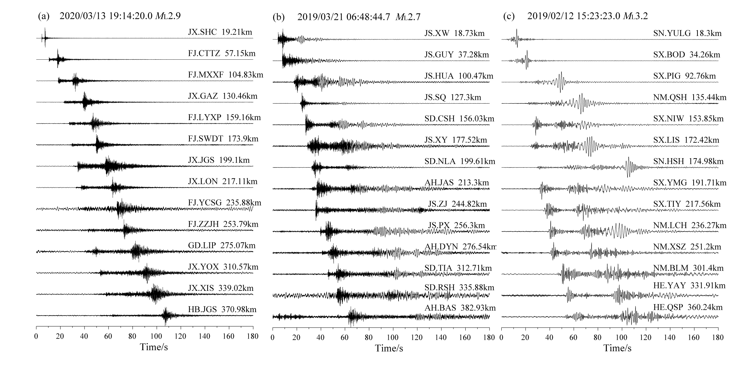
OBJECTIVES
This study mainly focuses on the classification of tectonic earthquakes, explosions, and mining-induced earthquakes in central and eastern China. First, we establish two different datasets through feature extraction and spectral amplitude analysis. Second, extreme gradient boosting (XGBoost) and other four AI methods are used to build two-class and three-class models between three types of events. Finally, we compare the five AI models through model performance measures, analyze the change in the classification performance with different epicentral distances and evaluate the generalizability of different classifiers.
Please do not use this space, a QR code will be automatically overlayed
Fig.1 Waveforms of different types of events: (a) earthquake, (b) explosion, and (c) mining-induced earthquake. The distances of the seismic records of different seismic events are similar, with a minimum distance of 18.3 km and a maximum distance of 382.93 km.
P3.5-123

Slide 4
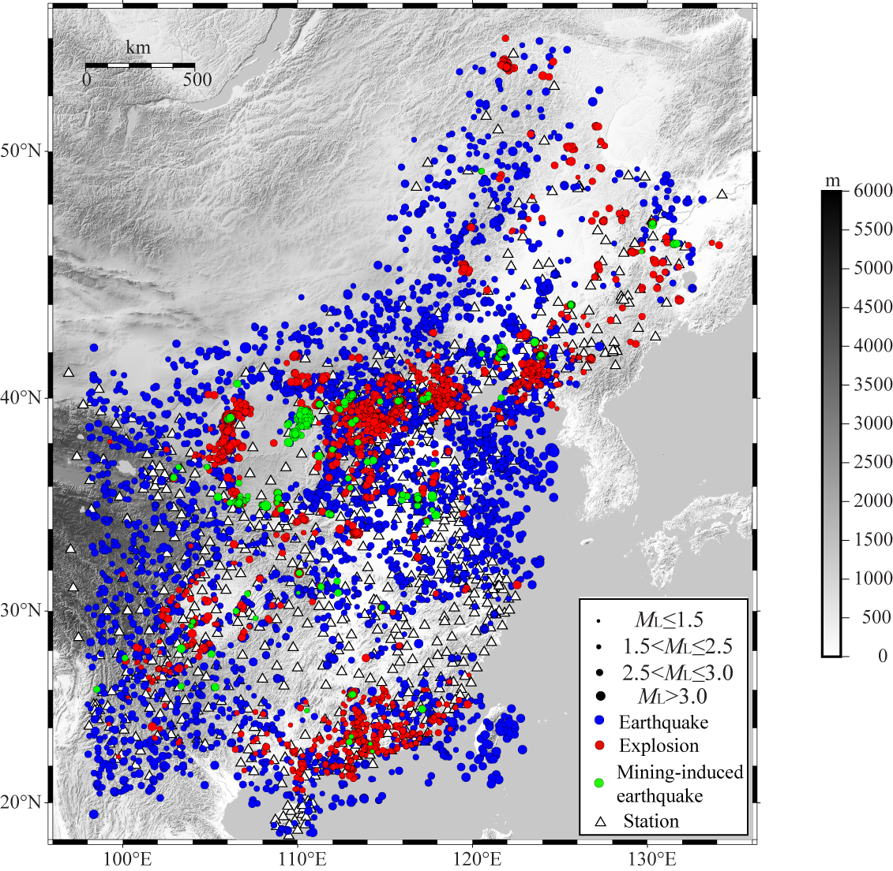
DATA
The data include 2009-2020 natural earthquake and unnatural seismic event, which include explosions of various industrial activities and mining-induced earthquakes. Earthquake refers to a tectonic earthquake, explosion refers to a blast generated by industrial activities or a sudden explosion disaster, and mining-induced earthquake refers to an earthquake induced by mining. Compared with tectonic earthquakes, mining-induced earthquakes are usually shallower in depth and more complex in focal mechanism, which may be implosion (mine collapse), double-couple, or a combination of both (Koper et al., 2016).
After event verification and data screening, 5181 earthquakes, 5199 explosions, and 1079 mining-induced earthquakes were used for this study.
Please do not use this space, a QR code will be automatically overlayed
Fig.2 Locations of earthquakes (blue circles), explosions (red circles), mining-induced earthquakes (green circles), and stations (white triangles); the focal depth of the earthquakes is less than 50 km, with a magnitude between ML1.5 and ML3.5.
P3.5-123

Slide 5
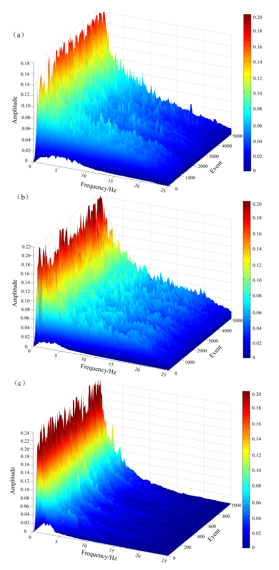
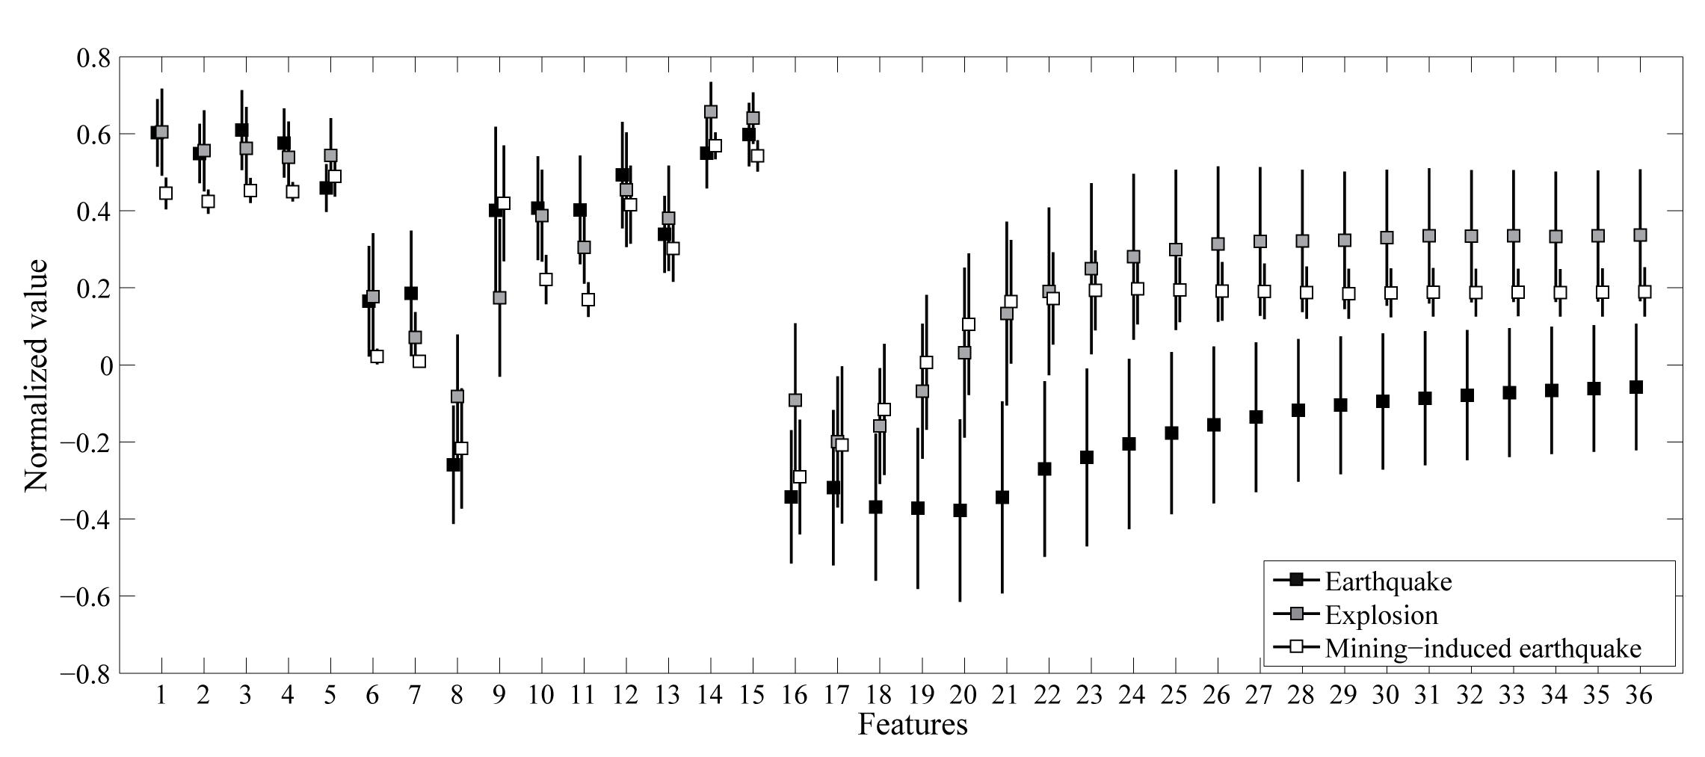
DATA
Feature extraction dataset
we established a 36-dimensional single-station and network-average feature extraction dataset, including amplitude ratio, high- and low-frequency energy ratio, corner frequency, waveform duration, waveform complexity, zero-crossing rate, cepstral complexity, and instantaneous frequency complexity (Zhang et al.,2021).
(2) Spectral amplitude dataset
The Thomson multitaper spectrum estimation method (Thomson, 1982;) was used to calculate the spectral amplitude for each seismic record, and the spectral amplitude datasets were established.
Please do not use this space, a QR code will be automatically overlayed
Fig.3 The average value with one standard deviation of 36 features of earthquakes (black squares), explosions (gray squares), and mining-induced earthquakes (white squares).
Fig.4 Network-averaged spectral amplitude distribution of (a) 5181 earthquakes, (b) 5199 explosions, and (c) 1079 mining-induced earthquakes.
P3.5-123

Slide 6
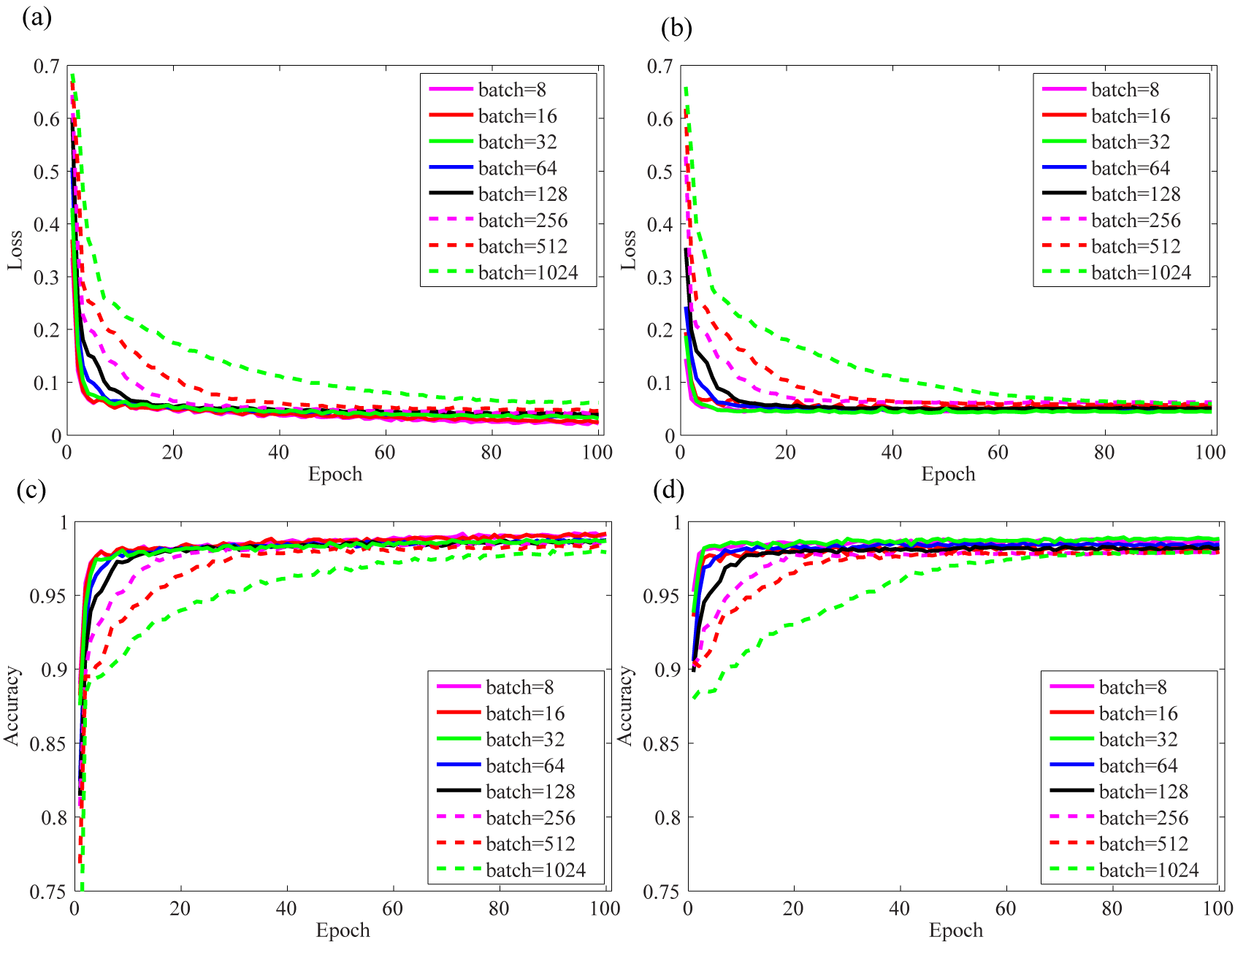
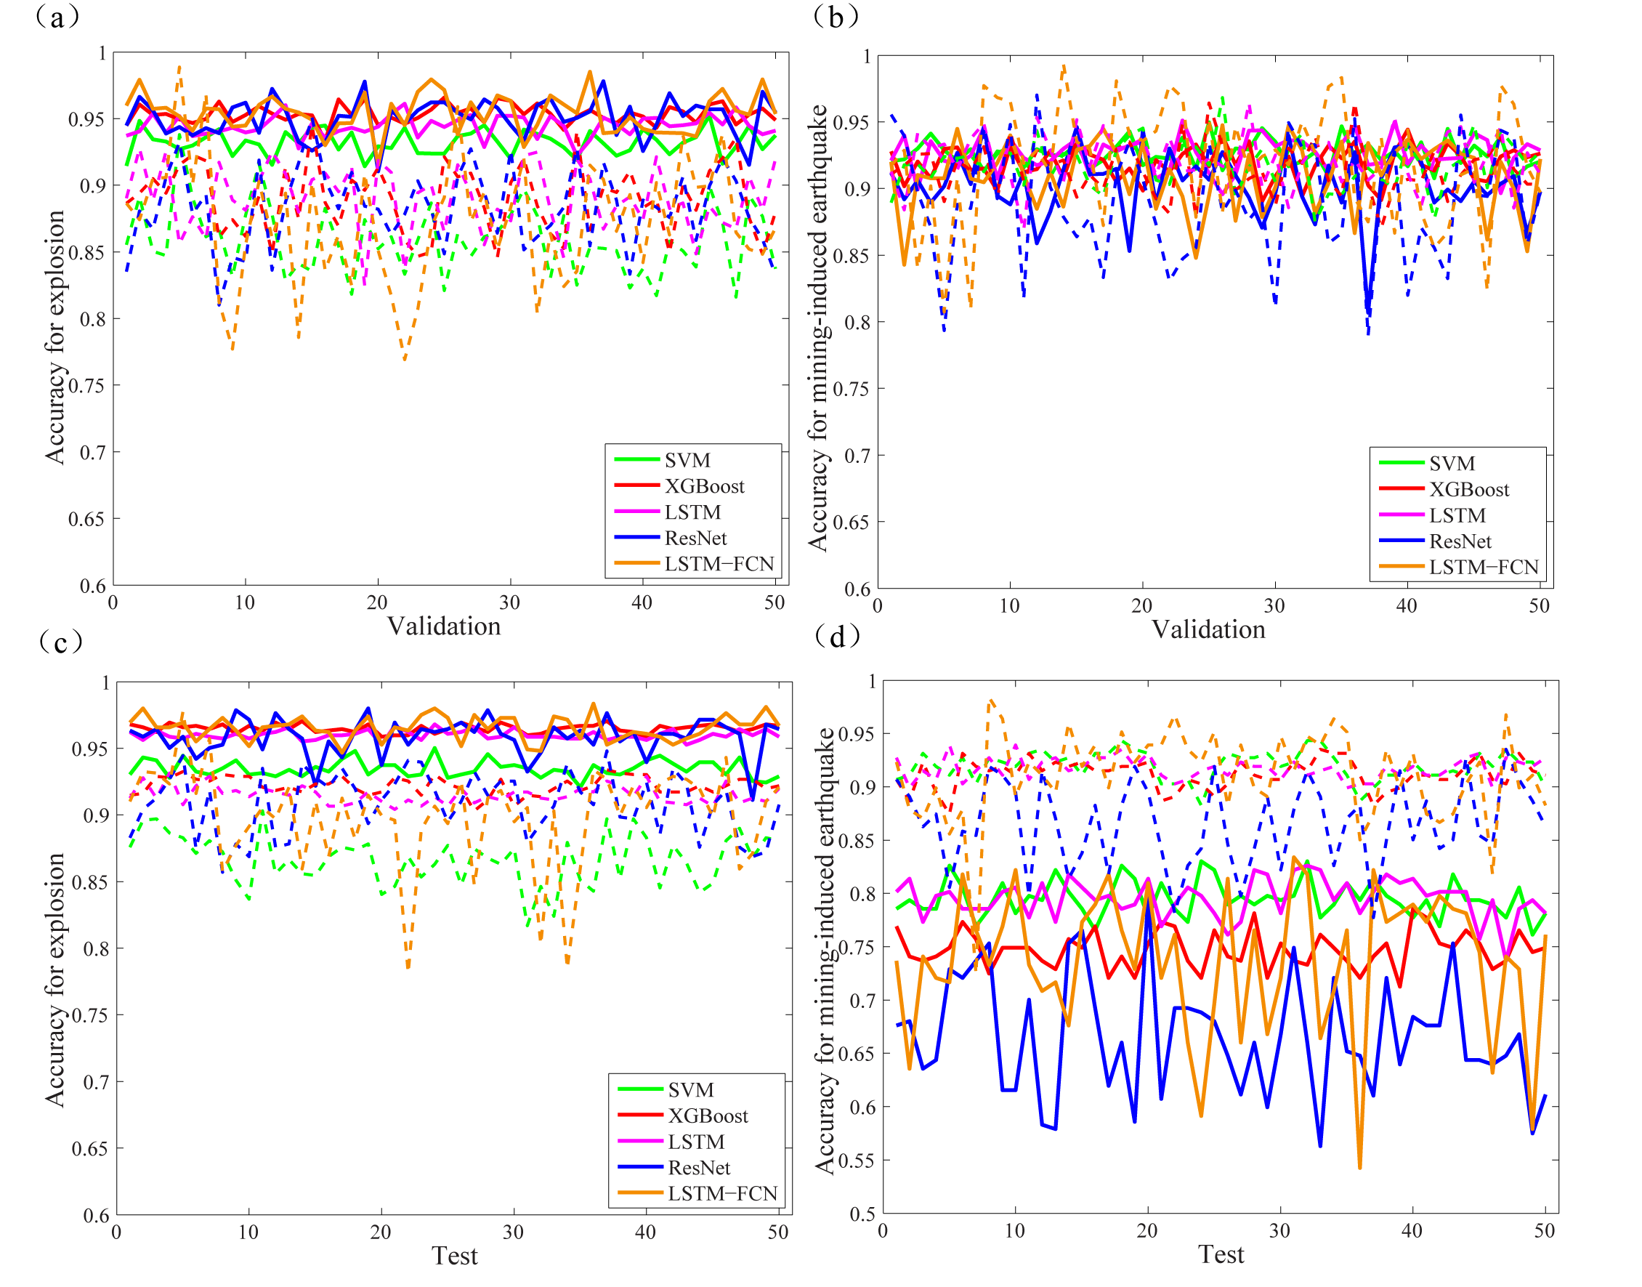
METHODS
We used 5 AI methods, XGBoost is a flexible and portable recently developed boosting decision tree algorithm proposed by Chen et al. (2016), and the other 4 AI methods are Support vector machine(SVM), long short-Term memory (LSTM) networks, residual neural network (ResNet), and long short-term memory fully convolutional network (LSTM-FCN). The GridSearchCV function in scikit-learn of Python 3.8 software were used to optimize the main parameters of SVM and XGBoost. LSTM, ResNet, and LSTM-FCN, relying on the Keras interface to TensorFlow, were used for building and training the classifiers.
Please do not use this space, a QR code will be automatically overlayed
Fig.6 The validation and test accuracy of data augmentation(solid line) and undersampling (dotted line). (a) and (c) represent the validation and test accuracy for explosions, and (b) and (d) represent the validation and test accuracy for mining-induced earthquakes respectively.
Fig.5 The loss of LSTM model on training (a) and testing (b) datasets with different batch sizes; The accuracy of LSTM model on training (c) and testing (d) datasets with different batch sizes.
P3.5-123

Slide 7
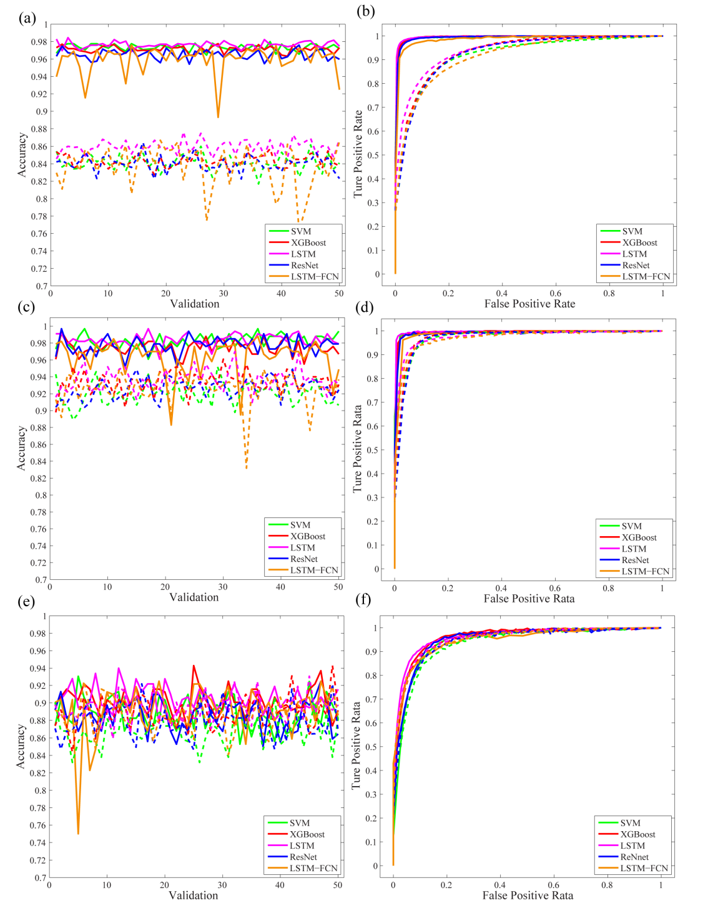
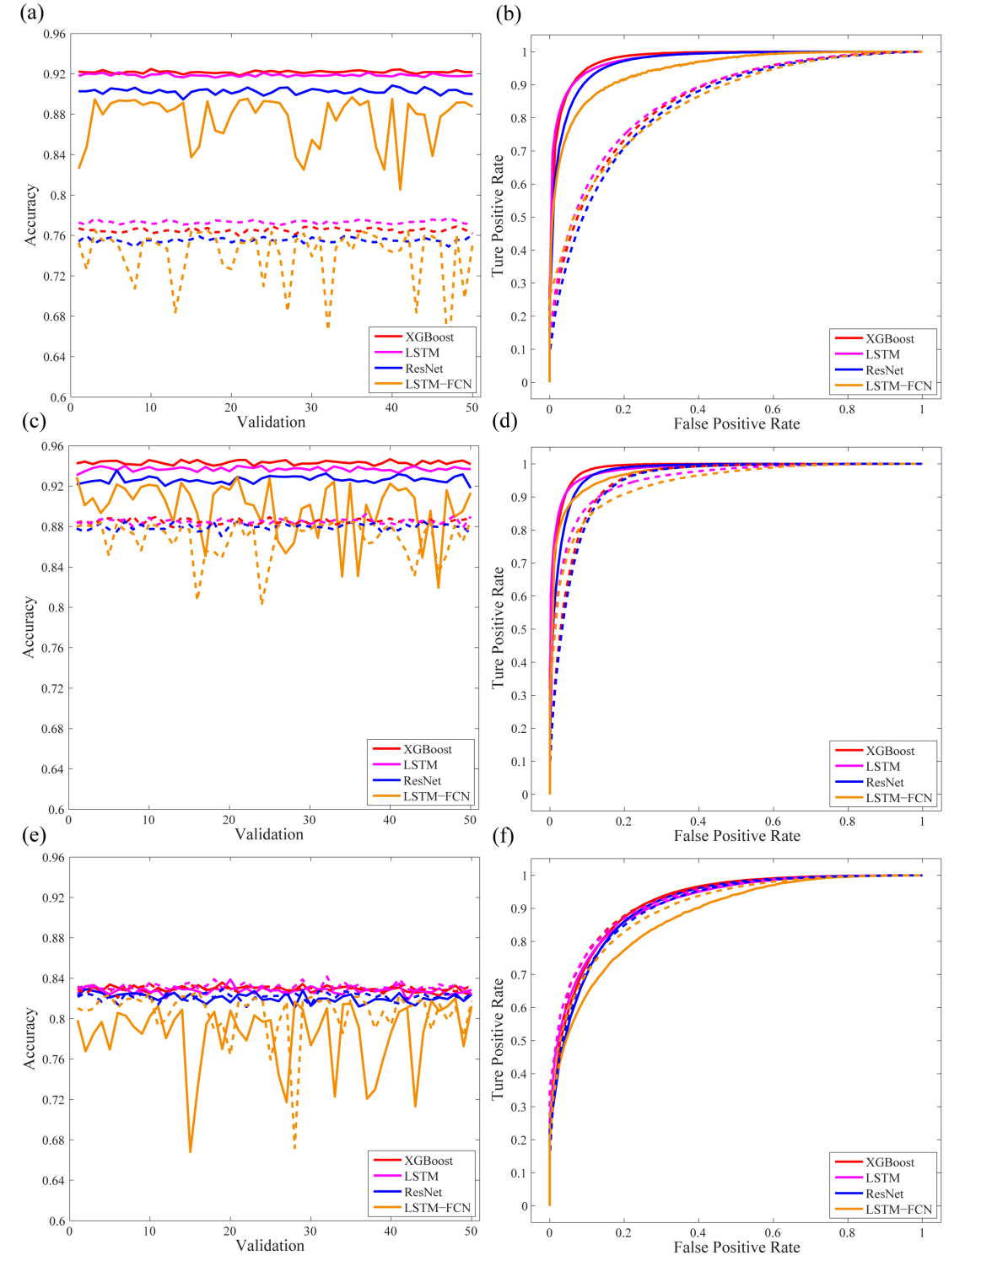
RESULTS
(1) The accuracies of the five AI models on the 36-dimensional feature extraction dataset are greater than those on the 60-dimensional spectral amplitude.
(2) The 0/2 classifiers constructed by different AI methods had the best performance, followed by the 0/1 classifier and the 1/2 classifier, with average accuracies of 97.4–98.4%, 96.5–97.6% and 88.8%–90.6% respectively.
(3) The accuracies obtained with the single-station dataset were approximately 5%- 8% less than those obtained with the network-averaged dataset.
Please do not use this space, a QR code will be automatically overlayed
Fig.7 The accuracies and ROC curves obtained on 50 validations by different AI methods on the network-averaged dataset in 0/1 (a, b), 0/2 (c, d) and 1/2 (e, f) classification. Earthquakes, explosions, and mining-induced earthquakes are labeled 0, 1, and 2, respectively.
Fig.8 The accuracies and ROC curves obtained on 50 validations by different AI methods on the single-station dataset in 0/1 (a, b), 0/2 (c, d) and 1/2 (e, f) classification. Earthquakes, explosions, and mining-induced earthquakes are labeled 0, 1, and 2, respectively.
P3.5-123

Slide 8
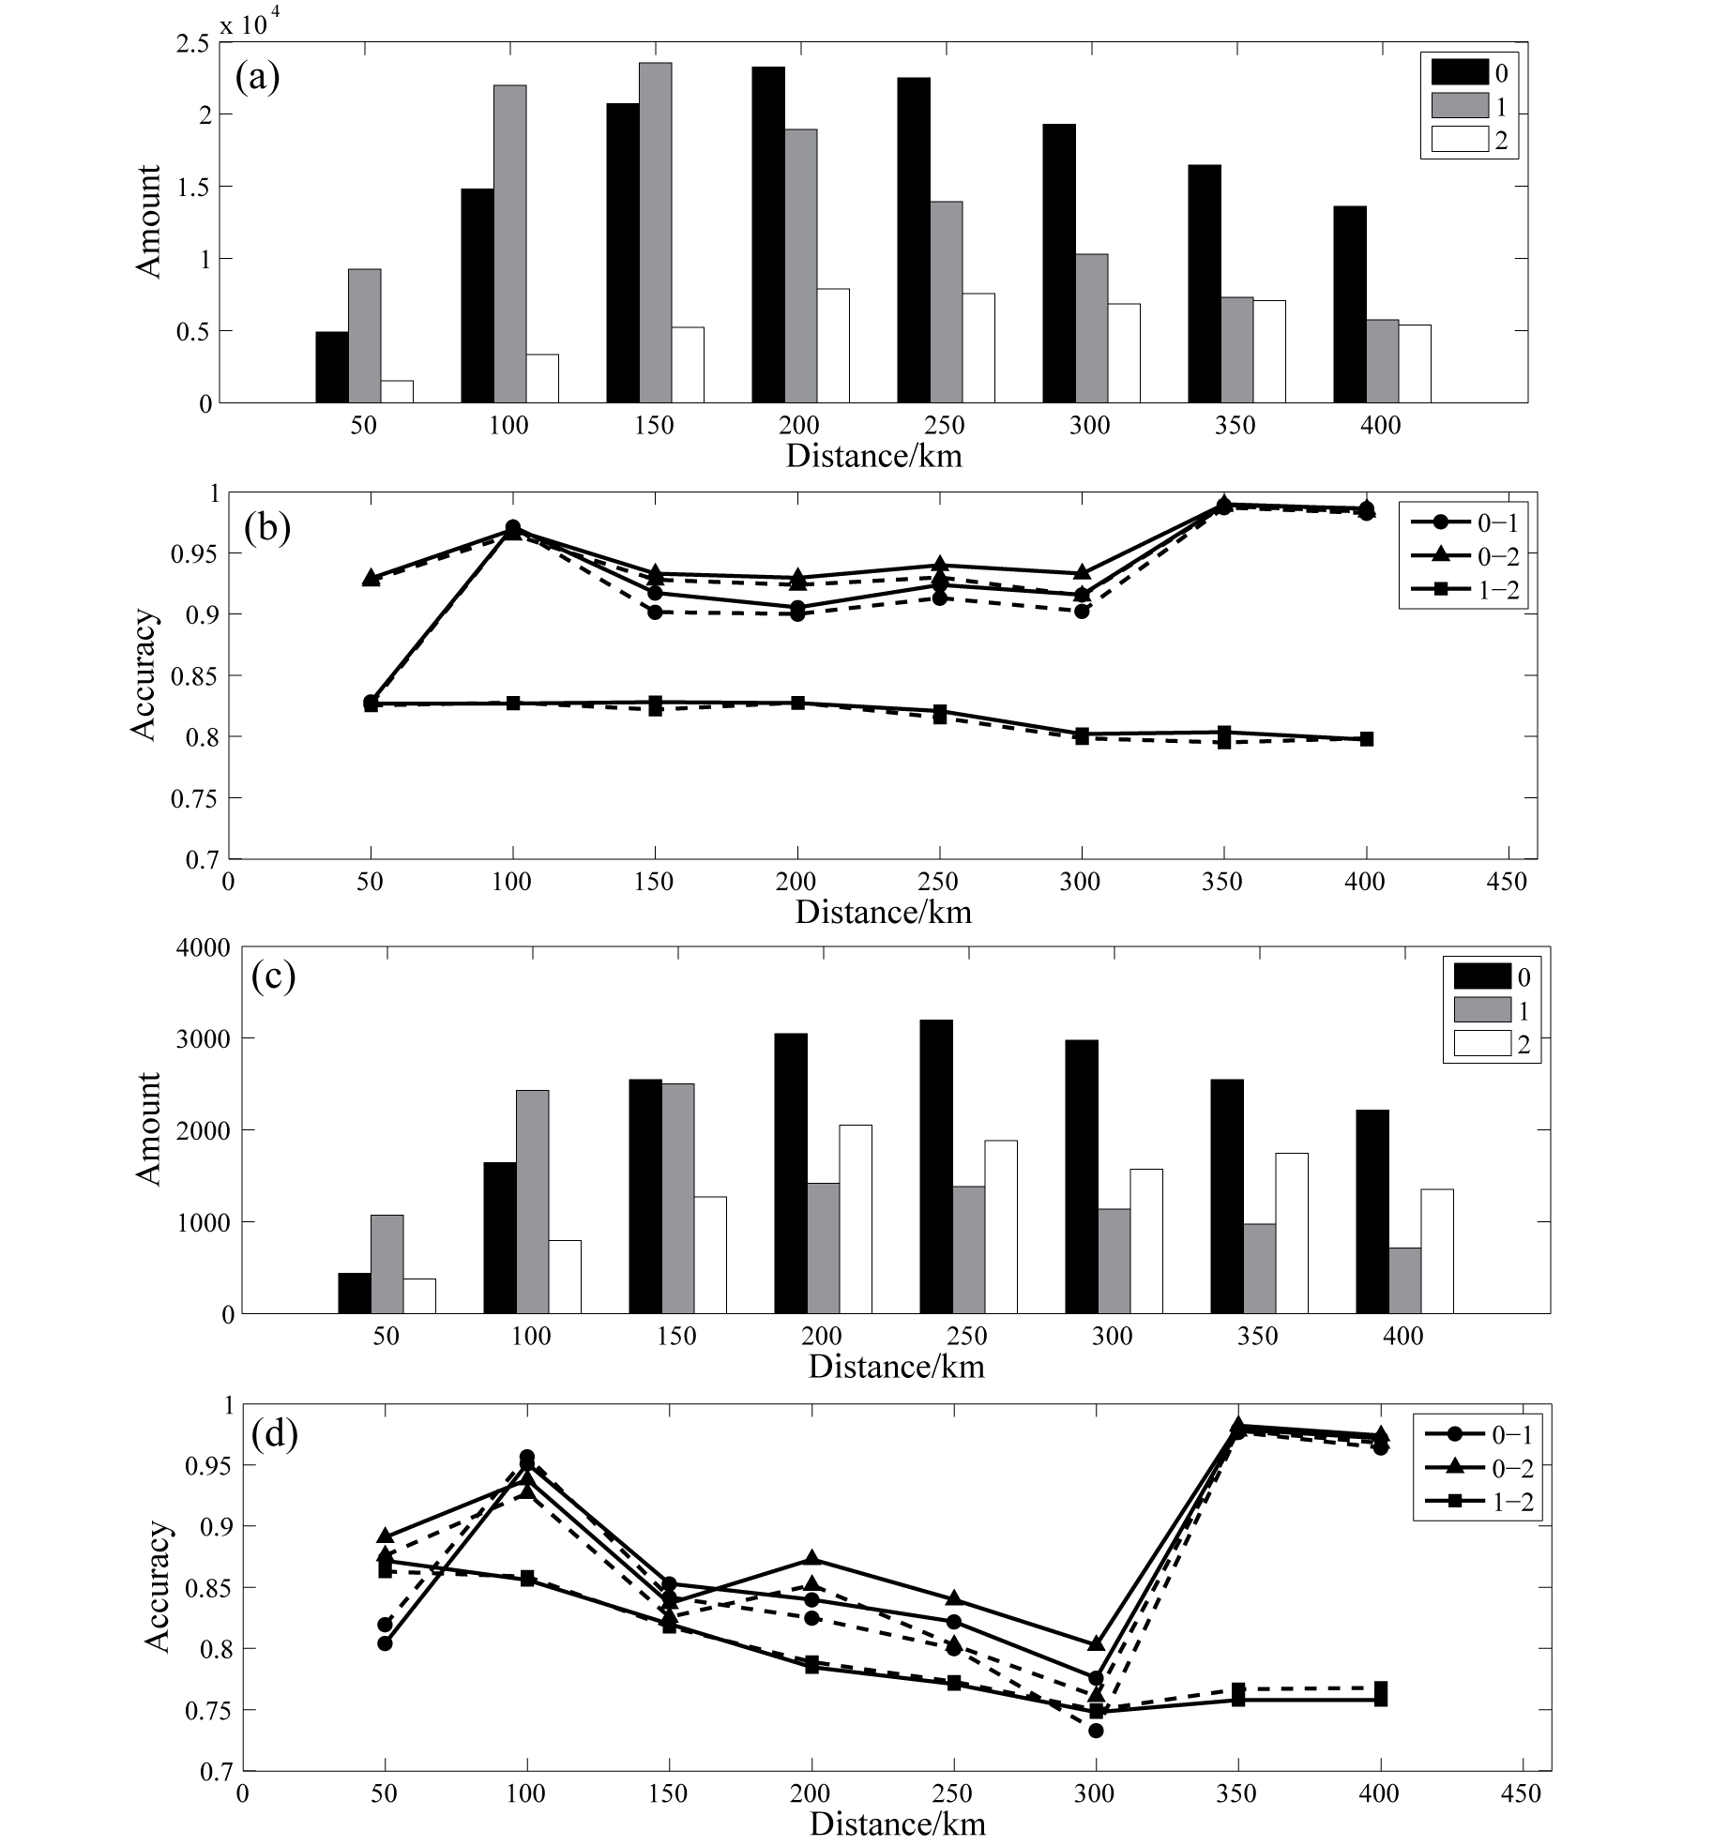
RESULTS
Pyle and Walter (2019) concluded that the P/S discriminant in earthquakes/explosions classification performed more poorly for distances less than 100 km and failed at distances less than 50 km, which is possibly because of the mixing of Rg in the Lg measurement or the generation of shear waves near the source.
The single-station dataset was segmented at an interval of 50 km to study the change of accuracy with epicenter distance. For 0/1 classification, the test accuracy was less than 82% within 50 km. For 0/1 and 0/2 classification, the test accuracies were enhanced at 50–100 km, reaching 93%. These values were reduced within 100-300 km and then increased again at distances greater than 300 km. This may be related to the rapid attenuation of high-frequency signals of unnatural seismic events and the low SNR of high-frequency at distances greater than 300 km (Wang et al.,2022).
Please do not use this space, a QR code will be automatically overlayed
Fig.9 Numbers and accuracies on the 36-dimensional training dataset (a,b) and test dataset (c,d) with different epicentral distances. The solid line and the dashed line indicate XGBoost and LSTM methods, respectively.
P3.5-123

Slide 9
CONCLUSION
(1) The accuracies obtained with the network-averaged dataset are greater than those obtained with the single-station dataset. Based on the network-averaged dataset, the earthquake/mining-induced earthquake classifiers constructed by different AI methods had the best performance, followed by the earthquake/explosion classifier and the explosion/mining-induced earthquake classifier, with average accuracies of 97.4–98.4%, 96.5–97.6% and 88.8%–90.6% respectively
(2) With both the network-averaged and single-station datasets, the accuracies obtained on the 36-dimensional feature extraction dataset were greater than that of 60-dimensional spectral amplitude dataset, indicating that the feature extraction methods used in this paper effectively highlight the differences in the seismic records of different types of events.
(3) XGBoost and LSTM had better performance and higher accuracy, indicating that these models have good application prospects for seismic event classification.
In future work, we will continue to expand the types of seismic events, including rockslides, landslides, and induced earthquakes, and carry out additional extraction methods. We will further collect unnatural seismic events in more regions of China to popularize and verify the trained AI models and continue to improve the accuracy of AI methods through data preprocessing, feature selection, and algorithm integration.
Please do not use this space, a QR code will be automatically overlayed
P3.5-123

Slide 10
REFERENCES
Chen, T. Q. and C. Guestrin (2016). XGBoost: a scalable tree boosting system, In: Proceedings of the 22Nd ACM SIGKDD international conference on knowledge discovery and data mining, San Francisco, 785–794, doi: https://doi.org/10.1145/2939672.2939785.
Douglas, A. (2013). Forensic seismology and nuclear test bans, Cambridge University Press, 342-344, doi: 10.1017/CBO9781139524001.
Fisk, M. D., S. R. Taylor, W. R. Walter and G. E. Randall (2009). Seismic event discrimination using two-dimensional grids of regional P/S spectral ratios applications to Novaya Zemlya and The Korea Peninsula, Proceedings of the 2009 Monitoring Research Review, Tucson, Arizona, 21–23 September 2009, 465-474.
Pomeroy, P. W., W. J. Best and T. V. McEvilly (1982). Test ban treaty verification with regional data: a review, Bull. Seism. Soc. Am. 72 S89-S129, doi: https://doi.org/10.1785/BSSA07206B0089.
Pyle, M. L. and W. R. Walter (2019). Investigating the Effectiveness of P/S Amplitude Ratios for Local Distance Event Discrimination, Bull. Seism. Soc. Am. 109 1071-1081, doi: 10.1785/0120180256.
Thomson, D. J. (1982). Spectrum estimation and harmonic analysis, Proc. IEEE. 70 1055-1096, doi: 10.1109/PROC.1982.12433.
Wang, T., Y. Bian, Q. Yang and M. Ren (2021). Correction of P/S Amplitude Ratios for Low-Magnitude Seismic Events Based on Bayesian Kriging Method, Bull. Seism. Soc. Am. 111 2799-2813, doi: 10.1785/0120200293.
Wang, T., Y. Bian, Y. Zhang and X. Hou (2023). Using artificial intelligence methods to classify different seismic events. Seismol. Res. Lett, 94, 1–16, doi: 10.1785/0220220055.
Zhang, Y., T. Wang, Y. Bian, and Q. Yang (2021). Features of different types of seismic events in China’s Capital Region, Earthq. Sci. 34 489–506, doi: 10.29382/eqs-2021-0035.
Zhao, L., X. Xie, W. Wang, N. Fan, X. Zhao and Z. Yao (2017). The 9 september 2016 north Korean underground nuclear test, Bull. Seism. Soc. Am. 107 3044-3051, doi: https://doi.org/10.1785/0120160355.
Please do not use this space, a QR code will be automatically overlayed
P3.5-123

