Slide 1
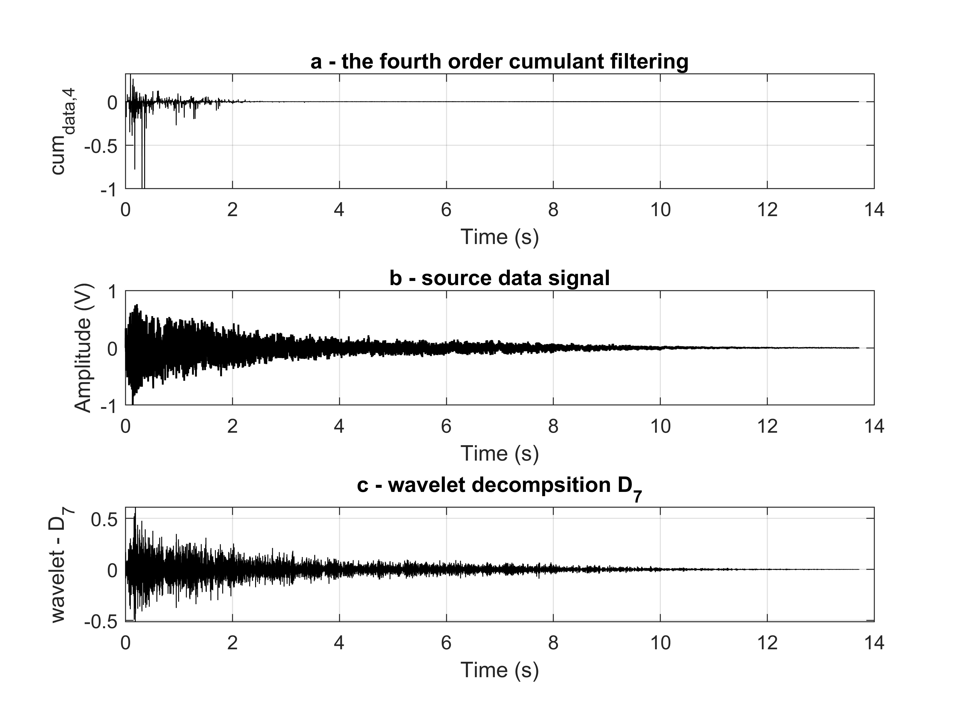
On-site estimation of the arrival time of an acoustic, seismic or hydroacoustic strongly distorted signals
Miodrag Vračar, Military Technical Institute, Belgrade, vracarmiodrag@mts.rs
Stevo Vračar, Information Technology School, Belgrade, stevo5817@its.edu.rs
P3.5-055
Our work presents a new way of filtering signal data based on the application of the fourth – order cumulant.
The fourth – order cumulant filter is developed.
This filtering method is very useful in all cases where the signal is highly distorted and noisy.
On such filtered signal is possible to apply the algorithm for estimation time of arrival (ToA) of the event on-site.
Proposed method can be applied in acoustics, hydroacoustics, seismic, sonar and radar, and other areas.
Figure: Example of hydroaciustic signal – torpedo launch [4] (b), (a) – signal after filtration by cumulant filter (measuring noise and reverberation is removed), and (c) – wavelet decomposition of the original signal (b).

