Slide 1
Seismic Signal Classification using Deep Neural Networks
El Hassan Ait Laasri, Driss Agliz and Abderrahman Atmani
Faculty of Applied Sciences, Ibn Zohr University
Automatic seismic signal classification is of great importance in many applications. One of the main goal of this processing task is the identification of nuclear explosion signals.
The capability of a deep neural network CNN to classify seismic signals is investigated in this study. To evaluate the performance of this approach, experiments were conducted on real seismic volcano data of distinct characteristics composed of four classes
Many experiments were conducted to find an optimal CNN classifier with the best performance. The obtained optimal classier shows generally good classification results with an overall accuracy of Ac=99.8 %.
The results show the ability of the CNN to achieve high recognition rate without requiring any subjective signal features. Therefore, as future work would be the application to nuclear explosion recognition if a sufficient dataset could be constructed.
Please do not use this space, a QR code will be automatically overlayed
P3.5-342

Slide 2
Introduction
Seismic activity monitoring plays a central role in various applications, including discovering the earth interior, quantifying the activity state of volcanoes and detection of underground explosions.
Nowadays, large digital seismic monitoring networks have been installed worldwide and the amount of recorded data has been getting huge. Hence, an automatic seismic signal classification task becomes indispensable as it may reduce significantly the processing time and the workload of analysts.
One of the main goal of seismic signal classification is the identification of nuclear explosion signals. Indeed, detection and recognition of these signals is of considerable interest in the context of nuclear test ban treaty verification as they provide interesting information such as location of a nuclear test and charge used.
Many different approaches have been investigated to address the seismic signal classification problem. recently, artificial intelligence techniques have attracted increasing attentions due to their capabilities to learn easily and directly the input/output relationship from the training data and to their ability to model extremely complex non-linear mappings [1-3].
So far, the most widely known and used neural network for automatic seismic signal classification is the so-called multilayer perceptron MLP [4]. As was shown by many authors, this traditional neural network offers a good classification performance. However, its performance depends considerably on the selected features. To develop a more objective classifier, we have opted, in this study, for a convolutional neural network (CNN).
Please do not use this space, a QR code will be automatically overlayed
P3.5-342

Slide 3
Objective
The aim of the present study is to investigate and explore the capability of the CNN to classify seismic signals.
The main idea behind developing an artificial intelligence based approach for seismic signal recognition is to try to imitate the intelligence of human analysts who are mostly able to recognize seismic signals based on their accumulated knowledge during years of processing. The idea is to try to learn this intelligence from the data using a CNN.
Please do not use this space, a QR code will be automatically overlayed
P3.5-342

Slide 4
Method/data
The proposed classifier consists of the following steps:
- Compute the spectrogram
- Convert the spectrogram to an RGB image
- Apply the image to the proposed CNN
The proposed CNN architecture is composed of three layers of convolution, followed by Max-pooling. These layers aim to extract the pertinent features. The latter are then applied to a fully-connected neural network.
Seismic signal
Spectrogram
Fully-connected NN
Convolution 1
Max-Pooling
Convolution 2
Max-Pooling
Convolution 3
Flattening
LP
TC
TR
Please do not use this space, a QR code will be automatically overlayed
RGB image
n₁ channels
n₂ channels
n₃ channels
VT
P3.5-342

Slide 5
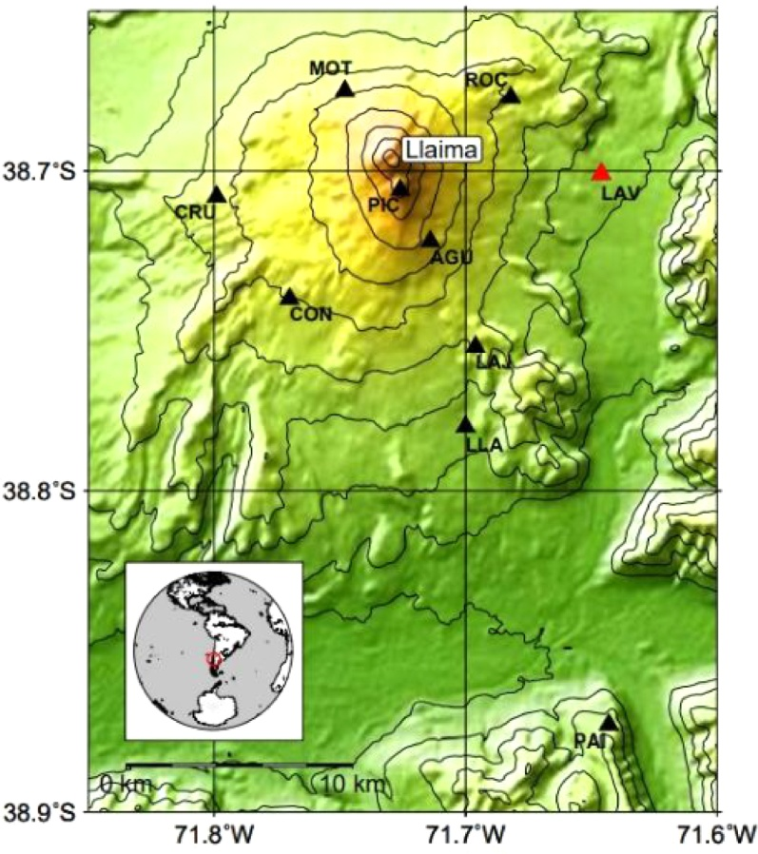
Method/data
To evaluate the proposed classifier, experiments were conducted on volcano seismic data of distinct characteristics, composed of four classes. This volcano, namely Llaima volcano, is located in Chile (figure on the right) [5].
The employed dataset is composed of 3592 signals, distributed non-uniformly among four classes (see figure below). The data are randomly divided, using the hold out method, into three separated sub-datasets: the training set 70%, the validation set 15% and the test set 15%. Data augmentation has been performed to increase the diversity of the training data. As a result, a final dataset of 38960 signals is constructed.
Location of Llaima volcano
and its monitoring stations
Examples of typical signals belonging to the four classes:
LP: Long Period
TC: Tectonic
TR: Tremor
VT: Volcano-Tectonic
Please do not use this space, a QR code will be automatically overlayed
P3.5-342

Slide 6
Results
To construct an optimal CNN classifier with the best performance, different architectures of different parameters were tested. These experiments were conducted to arrive at the best optimal model with the parameters given in table on the right.
The dimension of each layer is given in table below.
Hyperparameter | Value
Convolution layers | 3
Max_pooling layers | 3
Activation Function | Relu
Learning rate | 0.001
Optimization algorithm | Adam
Batch size | 32
Convolution_kernel size | 3×3
padding | same
Pooling_kernel size | 2×2
Pooling_strides | 2×2
Layer (Type) | Output size
Spectrogram RGB image | 128 x 128 x 3
Conv2D | 128 x 128 x 16
Max_pooling | 64 x 64 x 16
Conv2D | 64 x 64 x 32
Max_pooling | 32 x 32 x 32
Conv2D | 32 x 32 x 64
Max_pooling | 16 x 16 x 64
Flatten | 16384
Dense | 256
Dense | 4
The models are implemented using the NVIDIA GeForce RTX 3080 Graphics Processing Unit. The GPU is built on Ampere architecture. It boasts 8704 CUDA cores, 272 tensor cores, 96 ROPs, and 272 texture units.
Please do not use this space, a QR code will be automatically overlayed
P3.5-342

Slide 7
Results
The proposed CNN model was trained on the training dataset described above. To avoid overtraining and reduce training time, we have employed the early stopping mechanism using the validation dataset. The performance of the model was then evaluated using the test dataset. The obtained result are shown by the confusion matrix on the right.
From the confusion matrix, it can be seen that the classier shows generally good classification results on the volcanic data with an overall accuracy of Ac=99.8 %.
The performance of classifier is further evaluated by computing its sensitivity, specificity, precision, accuracy and error. Table on the right presents the obtained results.
Class | Sensitivity (%) | Specificity (%) | Precision (%) | Accuracy (%) | Error (%)
LP | 99,88 | 100,00 | 100,00 | 99,95 | 0,05
TC | 99,94 | 99,90 | 99,77 | 70,38 | 29,62
TR | 100,00 | 100,00 | 100,00 | 100,00 | 0,00
VT | 99,48 | 99,94 | 99,48 | 99,90 | 0,10
Please do not use this space, a QR code will be automatically overlayed
P3.5-342

Slide 8
Conclusion
In this study, a CNN based classifier is applied to classify volcano seismic signals. The results show the ability of the classifier to achieve high recognition rate. This deep learning approach is more objective and efficient as signal features are not specified by the user. In fact, more research studies should be devoted to this field in order to develop more reliable classifiers. The obtained results, in this work, concern a volcano dataset of four classes, namely, LP, TR, VT and TC. However, we sincerely believe that a CNN based classifier can achieve high accuracy on any types of classes. Therefore, as future work would be the application to nuclear explosion recognition if a sufficient dataset could be constructed.
Please do not use this space, a QR code will be automatically overlayed
P3.5-342

Slide 9
References
[1] E. H. Ait Laasri, E. Akhouayri, D. Agliz, D. Zonta, A. Atmani, “A fuzzy expert system for automatic seismic signal classification”, Expert Systems with Applications”, Vol. 42, Issue 3, pp. 1013-1027, 2015.
[2] P. Castro-Cabrera, G. Castellanos-Dominguez, C. Mera, L. Franco-Marín, M. Orozco-Alzate, “Adaptive classification using incremental learning for seismic-volcanic signals with concept drift”, Journal of Volcanology and Geothermal Research, vol. 413, pp. 1-14, 2021.
[3] Titos, M., Bueno, A., Garcia, L., & C. Benitez. A Deep Neural Networks Approach to Automatic Recognition Systems for Volcano-Seismic Events.IEEE Journal of Selected Topics in Applied Earth Observations and Remote Sensing, 11(5), 1533-1544, 2018.
[4] Langer, H., Falsaperla, S., Powell, T., Thompson, G., 2006a. Automatic classification and aposteriori analysis of seismic event identification at Soufrière hills volcano, Montserrat. Journal of Volcanology and Geothermal Research 153 (1–2 SPEC. ISS.), 1–10.
[5]J. P. Canário,; R. F. d. Mello, M. Curilem, F. Huenupan, R. A. Rios, “Llaima volcano dataset: In-depth comparison of deep artificial neural network architectures on seismic events classification, Data in Brief, Vol. 30, pp. 1-6, 2020.
Please do not use this space, a QR code will be automatically overlayed
P3.5-342

