Slide 1
Events Evaluation Using Machine Learning
Enrique Castillo
Research Division Geophysics, TU WIEN, Austria
Machine learning (ML), Events Classification, PTS-REB and synthetic events.
PTS-REB with 65534 events combined with 6000 synthetic events (randomly generated), ML models for classification problems
ML algorithms for data classification; K nearest neighbors (KNN), Support Vector machine (SVM), Decision tree (DT), Naive Bayes (NB), Random forest (RF), and Logistic regression (LR)
Class Imbalance problem, Random forest (RF) accuracy, relevance of the features in event classification
Please do not use this space, a QR code will be automatically overlayed
P3.5-836

Slide 2
Introduction
As a branch of Artificial Intelligence (AI), Machine learning (ML) provides a set of mathematical methods applied to data analysis. The main goal of the ML models is to learn from data, identifying patterns (based on features), which could lead to taking decisions with minimal or without human intervention.
Classification is a well-know ability of ML models. The model learns from already classified data and after the learning process is completed, the ML model is used for classifying (testing) new data. This approach can be applied to the detection of bogus or “Not earthquake” events in bulletins.
In this work, ML methods have been used for evaluating the PTS-REB based on 65534 real events and 6000 synthetic (“Not real”) events. The training phase uses a dataset with events already classified in two categories: “EQ" and “RAND". In the testing phase, the already trained ML models are used for predicting/classifying new unknown events in “EQ“ (real events) or “RAND“ (possible bogus events or “Not earthquakes”).
Please do not use this space, a QR code will be automatically overlayed
P3.5-836

Slide 3
a third objective is the evaluation of the features
a third objective is the evaluation of the features
Objectives
Create and evaluate ML models for assessing the accuracy of events in any bulletin.
Identify the best ML model for detecting bogus events (“Not earthquakes”) in terms of accuracy (performance and testing time are not relevant for the evaluation given small number of events in any bulletin).
Evaluate the relevance of the common features associated to an event in terms of the contribution for performing a prediction (classification of events). The analysed features are: LAT, LON, DEPTH, TIME, and MB.
Please do not use this space, a QR code will be automatically overlayed
P3.5-836

Slide 4
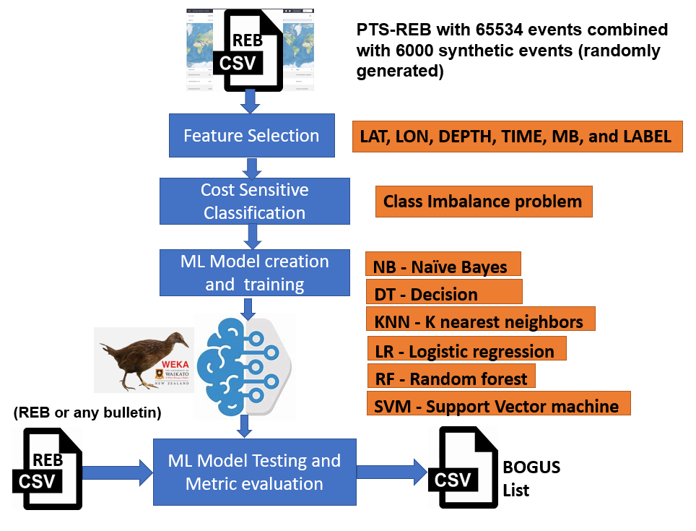
Dataset and Proposed Method
[1]
[3]
Please do not use this space, a QR code will be automatically overlayed
[2]
P3.5-836

Slide 5
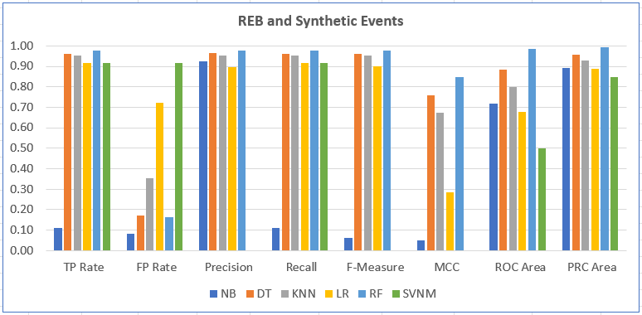
Results
Please do not use this space, a QR code will be automatically overlayed
P3.5-836

Slide 6
Conclusion
The dataset used presents a very common issue in ML classification problems; the number of “RAND" (synthetic) events (6000) is much lower than the number of real (“EQ”) events (65534). This Class Imbalance problem affects the ML-algorithms in the classification of minority classes (with fewer instances). The issue was managed with the Cost Sensitive Classifier approach [1].
The ML algorithm Random forest (RF) yields the best accuracy results (0.977) in the detection of bogus events. It achieves a True Positive rate of 0.978 in classifying real events and a very low False Positive rate (0.164) in identifying bogus events. The ML Model base on Support Vector Machines (SVM) was not able to identify any “RAND” (bogus) event.
The relevance of the features analysed was obtained with the Chi-squared Ranking Filter; the ranking shows: 26613.61 (MB), 17418.564 (LAT), 11699.348 (LON), 6186.524 (TIME) and 2923.36 (DEPTH).
The method followed in this work could be applied to other bulletins for estimating the accuracy of ML models in detecting bogus events.
Please do not use this space, a QR code will be automatically overlayed
P3.5-836

Slide 7
References
[1] Ling, Charles & Sheng, Victor. (2010). Cost-Sensitive Learning and the Class Imbalance
Problem. Encyclopedia of Machine Learning.
[2] Heydarian, Mohammadreza & Doyle, Thomas & Samavi, Reza, MLCM: Multi-Label
Confusion Matrix. IEEE Access. 10. 10.1109/ACCESS.2022.3151048, 2022
[3] Bouckaert R., Eibe F., Hall M., Kirkby R., Reutemann P., Seewald A., Scuse D., WEKA
Manual for Version 3-8-3, https://waikato.github.io/weka-wiki/documentation/
Please do not use this space, a QR code will be automatically overlayed
P3.5-836

