Slide 1
Seismic Discrimination between Nuclear explosions and natural earthquakes using multi-Machine learning Approaches
S.H.Elkhouly(1) and Ghada Ali (1)
National Research Institute of Astronomy and Geophysics
Machine learning plays a critical role in classifying between an earthquake and a nuclear explosion by providing accurate, fast, consistent, and adaptable analysis of data feature. all these techniques had been used in this work first on the base model with the data collecting. On the other hand, SMOTE (Synthetic Minority Oversampling Technique) to balanced data had been utilized in this work.
We examine and assurance their generalizability of data by collecting from five regions (China, Pakistan, India, North Korea and USA). 80 % of data collected are utilized for training and 20 % for testing by using Machine Learning Techniques.
The best model classify between earthquakes and nuclear explosions is Random Forest Classifier at SMOTE model on the other hand, SMOTE model give low accuracy than Base models.
Finally, machine learning models that use extracted features have demonstrated considerable promise in differentiating between earthquake and nuclear explosion occurrences. However, accuracy could be hampered by imbalanced datasets. Consequently, adding SMOTE approach has greatly enhanced the classification, producing findings that are more accurate.
Please do not use this space, a QR code will be automatically overlayed
P3.5-524

Slide 2
Seismic Discrimination between Nuclear explosions and natural earthquakes using multi-Machine learning Approaches
Introduction
Machine learning plays a critical role in classifying between an earthquake and a nuclear explosion by providing accurate, fast, consistent, and adaptable analysis of data feature. Recent successful applications of machine learning to many fields of seismology (Karpatne et al., 2019; Kong et al., 2019) imply that a data-driven strategy may be appropriate for source classification challenges.
Machine learning models with manually selected characteristics have been used in research for discrimination (Mousavi et al., 2016). Combining features gathered through machine learning with those based on physics might enhance the ability to distinguish between earthquakes and explosions (Kong et al., 2022). These investigations are frequently based on characteristics picked by feature and employ a machine learning algorithm to determine the categorization border that best classify between earthquakes and nuclear explosions. There is a wide range of techniques for Machine Learning (ML) classifiers, which include decision trees, logistic regression, support vector machines, k-nearest neighbors, XGB Classifier, Naive Bayes and random forests.
Decision trees use a tree-like model of decisions and their potential consequences to classify instances. Logistic regression utilizes a sigmoid function to map input features to categorical output labels. Support vector machines use a hyperplane to separate classes in high-dimensional space (Kim et al., 2020). K-nearest neighbors classify based on the similarity of an instance to its nearest neighbors. Random forests employ an ensemble of decision trees to improve the accuracy of classification.
Each of these techniques is advantageous in different data sets, and their effectiveness in classification tasks depend on various factors such as the amount and quality of data, the complexity of the problem, and the features used. So, all these techniques had been used in this work first on the base model with the data collecting. On the other hand, SMOTE (Synthetic Minority Oversampling Technique) to balanced data had been utilized in this work.
Please do not use this space, a QR code will be automatically overlayed
P3.5-524

Slide 3
Seismic Discrimination between Nuclear explosions and natural earthquakes using multi-Machine learning Approaches
Objectives
Different kernel functions of SVM are applied in the testing method to determine the difference between earthquakes and explosions. The results of the efficiency range are 70% to 95% (Kim et al., 2020).
Based on our previous results on the methods of discrimination between earthquakes and nuclear explosions, the percentage of discrimination of complexity and spectral ratio parameters are ranging is 70%.
The percentage of discrimination of corner frequency of P and S waves is 78% and the percentage of discrimination of body wave magnitude and surface wave magnitude is 84%.
The above features are used to automatically discriminate using various machine learning techniques in different data sets, and their effectiveness in classification tasks depending on various factors such as the amount and quality of data, and the features used to improve the classification between earthquakes and nuclear explosions.
Please do not use this space, a QR code will be automatically overlayed
P3.5-524

Slide 4
Seismic Discrimination between Nuclear explosions and natural earthquakes using multi-Machine learning Approaches
Methodology/ Data
Data Collection
For earthquakes and nuclear explosions from Five regions (China, Pakistan, India, North KOREA and USA)
Extract 3 main feature from data
Methodology
Feature extract
Calculate:
Body and surface wave magnitudes ($M_{b} \& M_{s}$)
Complexity for time domain and spectral ratio for frequency domain
Corner frequency from frequency domain
Machine Learning for Feature
7 techniques and voting had
been used in this work
1-Logistic Regression
2- SVM support vector Machine
3-KNN algorithm Classifier
4-Decision Tree Classifier
5-Random Forest Classifier
6-XGB Classifier
7- Naive Bayes
8-Voting Classifier
Events of earthquake and nuclear explosion have imbalanced Classification. So, we using SMOTE (Synthetic Minority Oversampling Technique) to balanced data
SMOTE Technique has been used for all the same models. Therefore, this investigation compares between base and SMOTE accuracy.
Validation and test
We examine and assurance their generalizability of data by collecting from five regions. 80 % of data collected are utilized for training and 20 % for testing.
Please do not use this space, a QR code will be automatically overlayed
P3.5-524

Slide 5
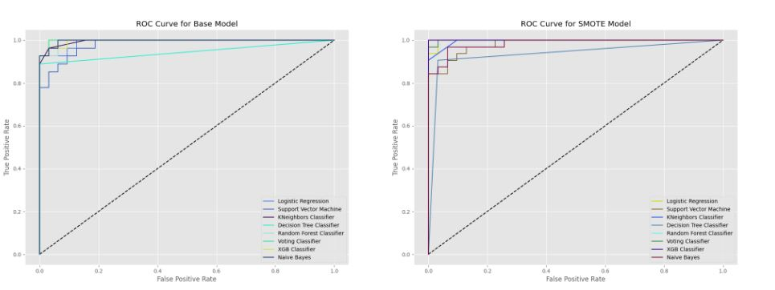
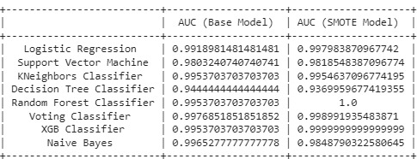
Seismic Discrimination between Nuclear explosions and natural earthquakes using multi-Machine learning Approaches
Results
We judge 16 models performance using Receiver Operating Characteristic (ROC) curves using testing data (the following Figure), which take into account both true positive and false positive rates. In our situation, explosions are good, but earthquakes are bad. The Area Under the Curve (AUC) is used to assess the ROC curve's quality, with 1 being the best.
Please do not use this space, a QR code will be automatically overlayed
P3.5-524

Slide 6
Seismic Discrimination between Nuclear explosions and natural earthquakes using multi-Machine learning Approaches
Conclusion
Finally, machine learning models that use extracted features have demonstrated considerable promise in differentiating between earthquake and nuclear explosion occurrences. However, accuracy could be hampered by unbalanced datasets. Consequently, adding SMOTE approach has greatly enhanced the classification, producing findings that are more accurate specially with Random Forest Technique.
It is clear that predictive models play a key role in identifying abnormal events and that they must be continually enhanced with an emphasis on creating high-quality training data and honed algorithms.
Machine learning will definitely become increasingly important in identifying and classifying a wide range of environmental and social phenomena as technologies develop.
Please do not use this space, a QR code will be automatically overlayed
P3.5-524

Slide 7
Seismic Discrimination between Nuclear explosions and natural earthquakes using multi-Machine learning Approaches
References
Kong, Q., Wang, R., Walter, W.R., Pyle, M., Koper, K. and Schmandt, B., (2022). Combining Deep Learning With Physics Based Features in Explosion‐Earthquake Discrimination. Geophysical Research Letters, 49(13), p.e2022GL098645.
Karpatne, A., Ebert-Uphoff, I., Ravela, S., Babaie, H. A., & Kumar, V. (2019). Machine learning for the geosciences: Challenges and opportunities. IEEE Transactions on Knowledge and Data Engineering, 31(08), 1544– 1554. https://doi.org/10.1109/TKDE.2018.2861006.
Kong, Q., Trugman, D. T., Ross, Z. E., Bianco, M. J., Meade, B. J., & Gerstoft, P. (2019). Machine learning in seismology: Turning data into insights. Seismological Research Letters, 90(1), 3– 14. https://doi.org/10.1785/0220180259.
Mousavi, S. M., Horton, S. P., Langston, C. A., & Samei, B. (2016). Seismic features and automatic discrimination of deep and shallow induced-microearthquakes using neural network and logistic regression. Geophysical Journal International, 207(1), 29– 46. https://doi.org/10.1093/gji/ggw258.
Kim, S., Lee, K., & You, K. (2020). Seismic discrimination between earthquakes and explosions using support vector machine. Sensors, 20(7), 1879. https://doi.org/10.3390/s20071879.
Please do not use this space, a QR code will be automatically overlayed
P3.5-524

