Slide 1
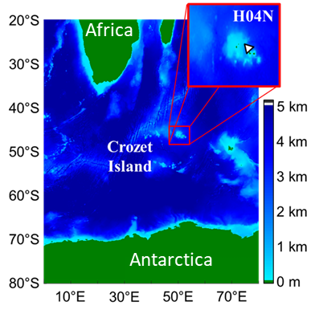
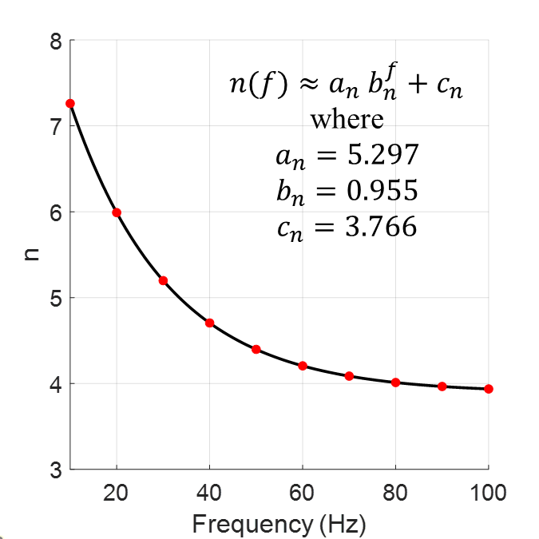
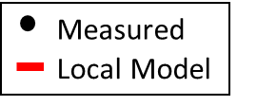
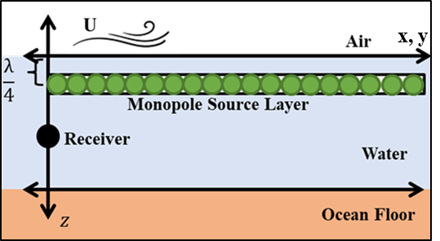
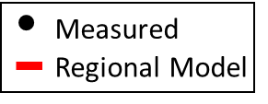
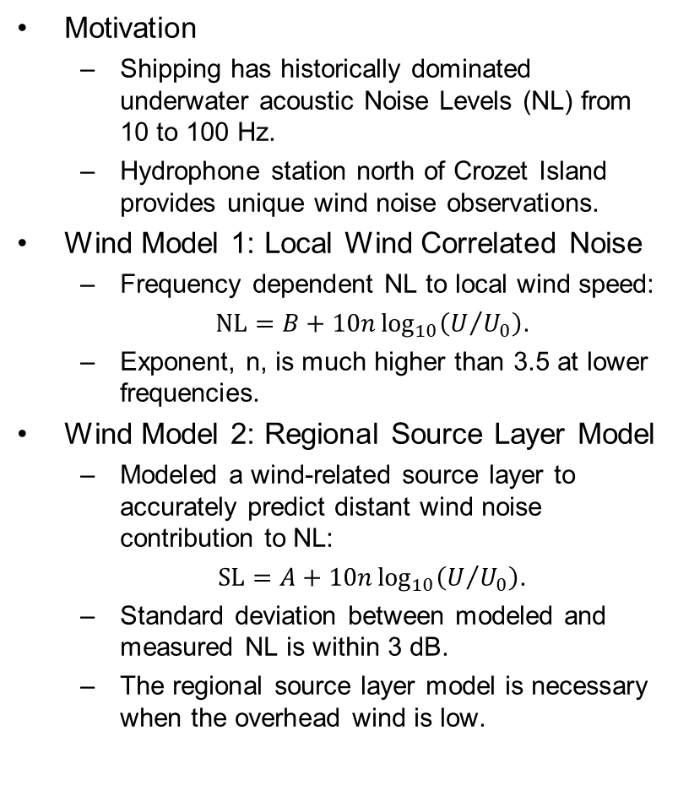
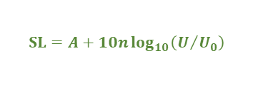
Modeling Low Frequency Wind-Generated Underwater Acoustic Noise
Christopher Stockinger, John Hartman, Preston Wilson
Applied Research Laboratories, The University of Texas at Austin
P3.5-480
Motivation
Shipping has historically dominated underwater acoustic Noise Levels (NL) from 10 to 100 Hz.
Hydrophone station north of Crozet Island provides unique wind noise observations.
Wind Model 1: Local Wind Correlated Noise
Frequency dependent NL to local wind speed:
$NL=B+10n\log_{10}\left(U/{U_{0}}\right)$.
Exponent, n, is much higher than 3.5 at lower frequencies.
Wind Model 2: Regional Source Layer Model
Modeled a wind-related source layer to accurately predict distant wind noise contribution to NL:
$SL=A+10n\log_{10}\left(U/{U_{0}}\right)$.
Standard deviation between modeled and measured NL is within 3 dB.
The regional source layer model is necessary when the overhead wind is low.
Model 1: Local Wind Correlated Noise
$$n$$
NL (dB//μPa²/Hz)
$$NL_{wind}=B+10n\log_{10}\left(\frac{U}{U_{0}}\right)$$
Local Wind Speed (kts)
Model 2: Regional Source Layer Model
$$SL=A+10n\log_{10}\left(U/{U_{0}}\right)$$
NL (dB//μPa²/Hz)
Time (Julian Day)

