Slide 1
Modeling Low Frequency Wind-Generated
Underwater Acoustic Noise
Christopher Stockinger, John Hartman, Preston Wilson
Applied Research Laboratories, The University of Texas at Austin
Shipping is often assumed to dominate ambient underwater acoustic noise
levels from 10 to 100 Hz, however, the data acquired from the north hydrophone triplet of Crozet Island provides unique wind noise observations with minimal shipping interference.
First, acoustic noise was correlated to local wind speed, and second, the regional wind was modeled through a source density and propagation model. The local estimated total intensity and the regional source intensity were both related to wind speed through a power relation with the same exponent.
Frequency and wind speed dependent NL and SL are computed empirically from two years of acoustic and wind data. An important observation is that the exponent n increases as frequency decreases and reaches a value n > 7 at
10 Hz, which is much larger than the n = 3.5 often
measured at 300 Hz
The local wind correlation model is sufficient when overhead wind speed is high, but the regional source layer model is required when the local wind is low. Future works includes performing analysis on more locations and to test the wind speed limitations of the model.
Please do not use this space, a QR code will be automatically overlayed

Slide 2


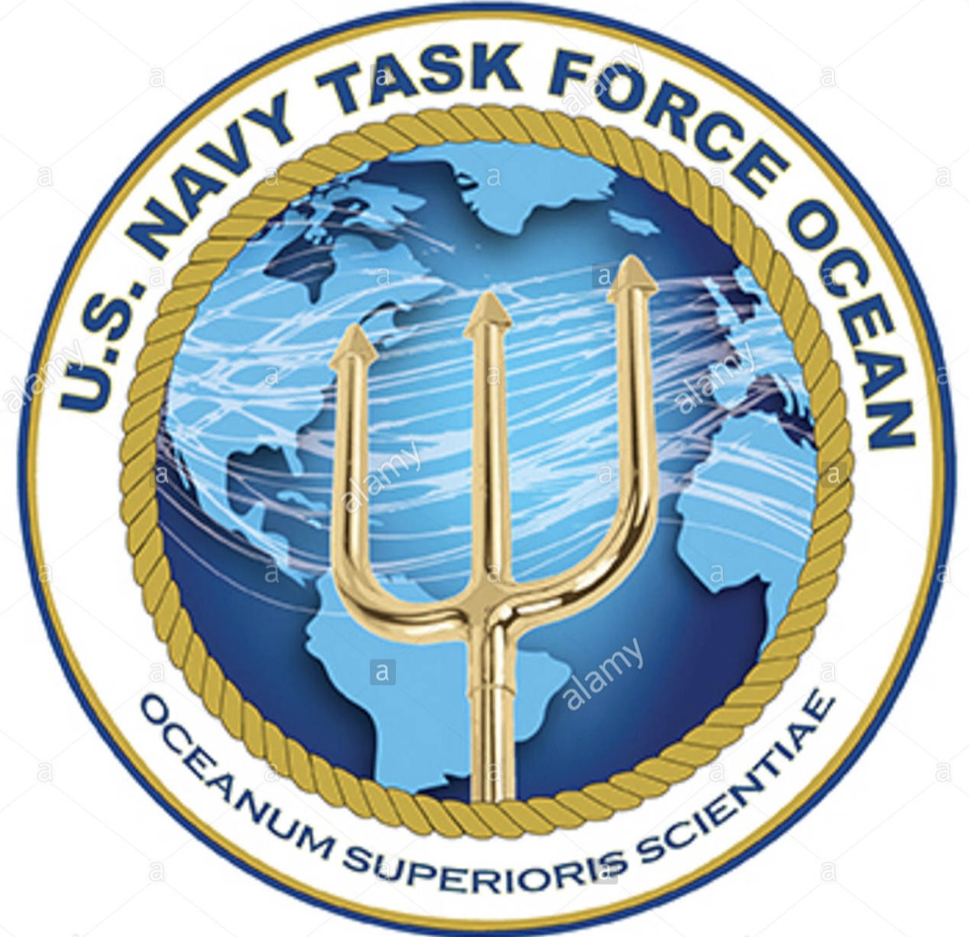
Project Overview
Motivation
  Shipping has historically dominated ambient underwater acoustic Noise Levels (NL) from 10 to 100 Hz, however, the data from the north hydrophone triplet of the Comprehensive Nuclear-Test-Ban Treaty (CTBT) station at Crozet Island provides unique wind noise observations with minimal shipping interference.
Objectives
  The objective is to update modeling accuracy of the wind noise contribution to low frequency NL and develop methods to accurately predict long-range wind-generated NL.
Acknowledgments
  We want to thank Mario Zampolli and the scientist at the Comprehensive Nuclear-Test-Ban Treaty Organization (CTBTO) for their assistance with the acoustic data.
  This research is supported by the Office of Naval Research (ONR) through Task Force Ocean and the Naval Oceanographic Office (NAVO).
Please do not use this space, a QR code will be automatically overlayed

Slide 3
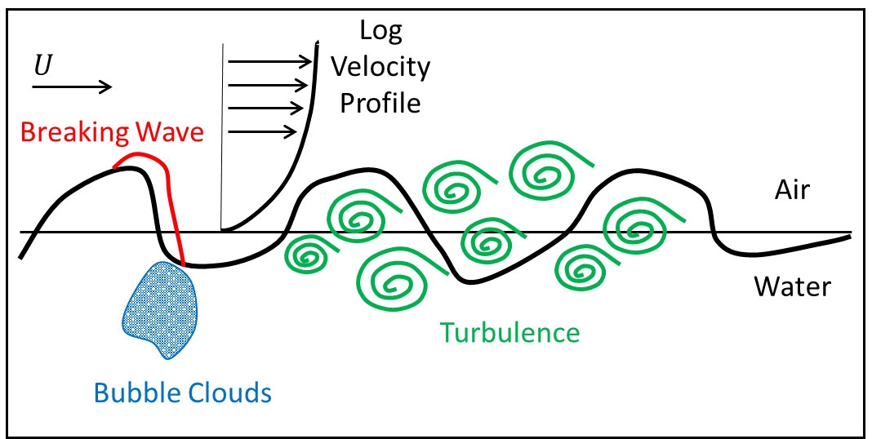
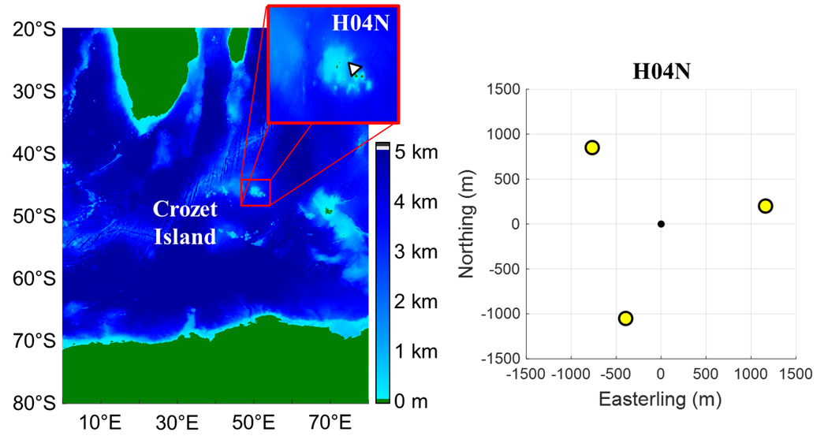
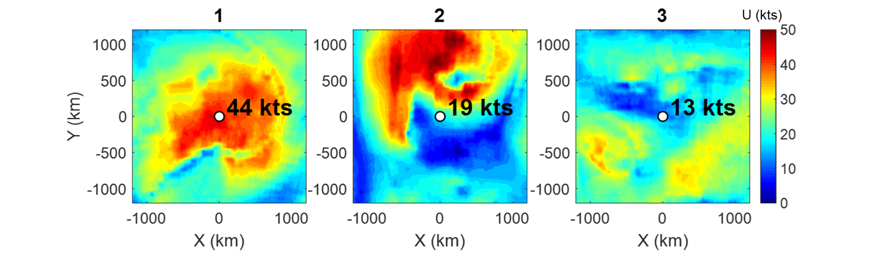
Introduction
Wind-related noise sources
  Breaking waves create ocean spray and droplets.
  Turbulent eddies from the motion of the waves and wind near the ocean surface.
  Bubble cloud oscillation allows for low frequency radiation.
CTBT acoustic triplet north of Crozet Island
  Horizontal triplet have a sampling frequency of 250 Hz.
  Processed year around coverage from 2018 – 2020.
  Bathymetric features to the northwest block shipping noise off the coast of Africa.
ASCAT wind speed data
  Four satellite scatterometers processed by NOAA/NESDIS.
  The satellites measure sea surface roughness and converts to wind speed and calibrates the estimates from weather buoys.
  The data is combined with a numerical weather predictor from the European Center for Medium Weather Forecasts (ECMWF).
  Provides area estimates of wind speed are in increment of 6 hours with 25km spacing.
The air-sea interaction zone (Similar to Carey and Evans, 2011)
Africa
Antarctica
Please do not use this space, a QR code will be automatically overlayed

Slide 4
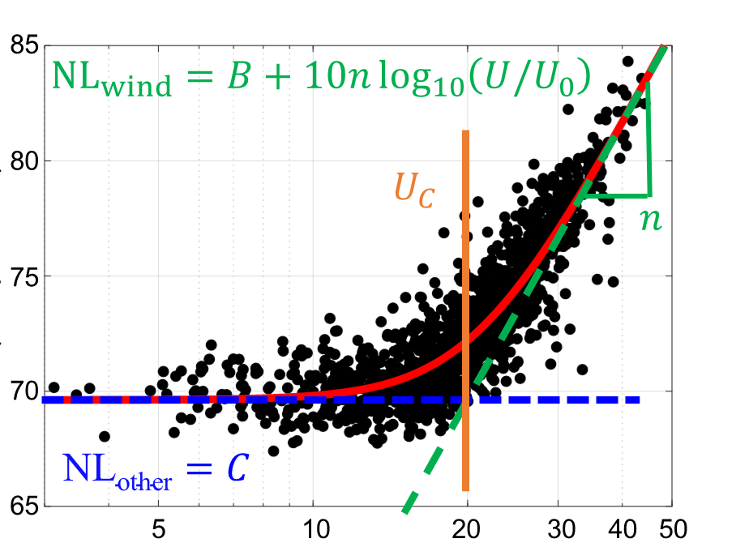
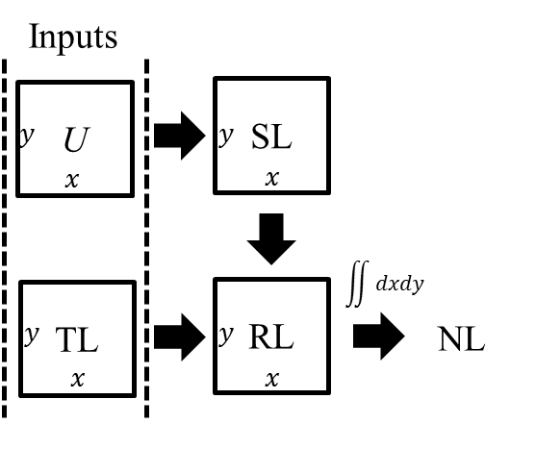
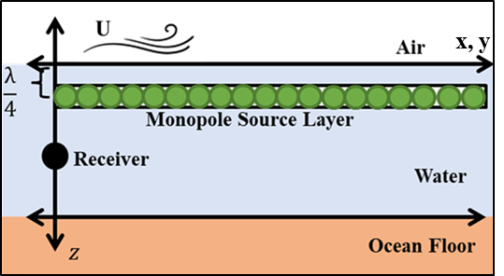
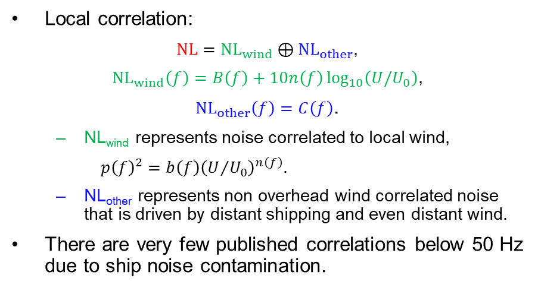
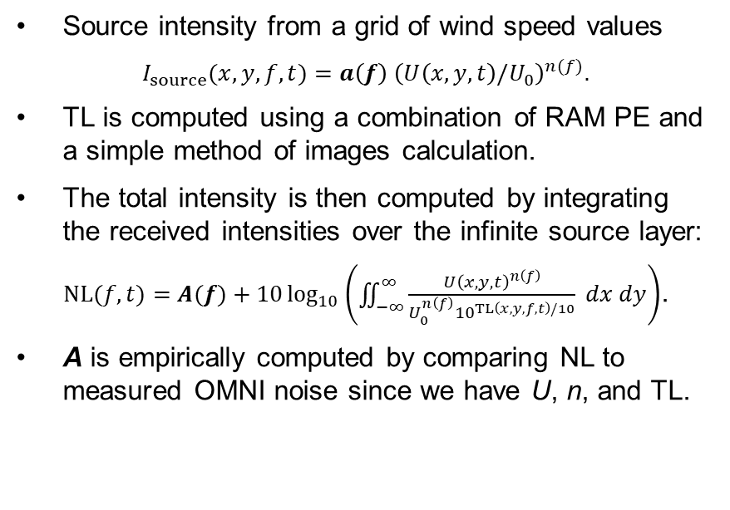
Modeling Methods
Wind Model 1: Locally Correlated Noise
Wind Model 2: Regional Source Layer Model
Local correlation:
$NL={NL}_{wind}⊕{NL}_{other}$,
${NL}_{wind}\left(f\right)=B\left(f\right)+10n\left(f\right)\log_{10}\left(U/U_{0}\right)$,
${NL}_{other}\left(f\right)=C\left(f\right)$.
  NL_{wind} represents noise correlated to local wind,
  $p{\left(f\right)}^{2}=b\left(f\right){\left(U/{U_{0}}\right)}^{n\left(f\right)}$.
  NL_{other} represents non overhead wind correlated noise that is driven by distant shipping and even distant wind.
There are very few published correlations below 50 Hz due to ship noise contamination.
Source intensity from a grid of wind speed values
$I_{source}(x,y,f,t)=a\left(f\right){ \left(U\left(x,y,t\right)/U_{0}\right)}^{n(f)}$.
TL is computed using a combination of RAM PE and a simple method of images calculation.
The total intensity is then computed by integrating the received intensities over the infinite source layer:
$NL(f,t)=A(f)+10\log_{10}\left(\iint_{−∞}^{∞}{\frac{{U\left(x,y,t\right)}^{n\left(f\right)}}{U_{0}^{n\left(f\right)}{10}^{TL\left(x,y,f,t\right)/10}} dx dy}\right)$.
A is empirically computed by comparing NL to measured OMNI noise since we have U, n, and TL.
Note
Acoustic data is the median value within 30 minutes of the corresponding wind data time
One observation (black dot) every 6 hours
NL (dB//μPa²/Hz)
Please do not use this space, a QR code will be automatically overlayed
Local Wind Speed (kts)

Slide 5
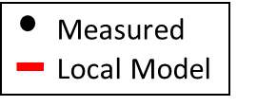
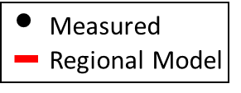
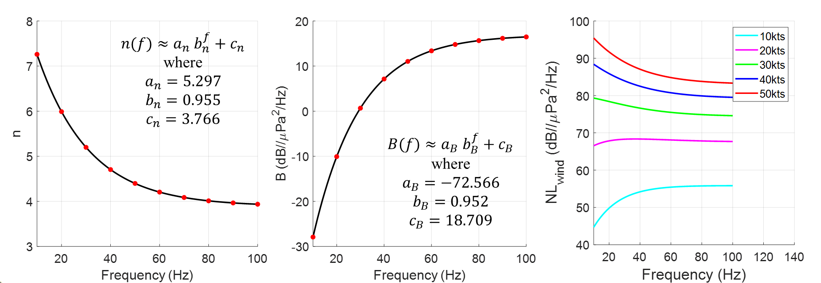
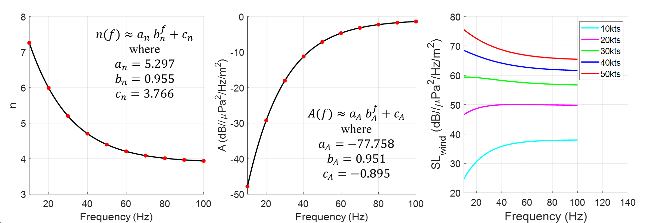
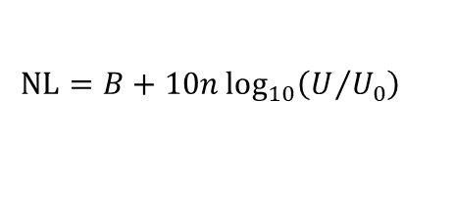
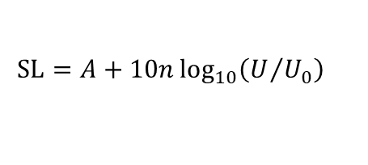
Results
Wind Model 1: Locally Correlated Noise
Wind Model 2: Regional Source Layer Model
Example from July 2019:
Example from July 2019:
NL (dB//μPa²/Hz)
NL (dB//μPa²/Hz)
Wind Speed (kts)
Time (Julian Day)
Model 1 Noise Level Predictions:
Model 2 Source Level Predictions:
$$NL=B+10n\log_{10}\left(U/{U_{0}}\right)$$
$$SL=A+10n\log_{10}\left(U/{U_{0}}\right)$$
$$U_{0}=1 kts$$
$$U_{0}=1 kts$$
Please do not use this space, a QR code will be automatically overlayed

Slide 6
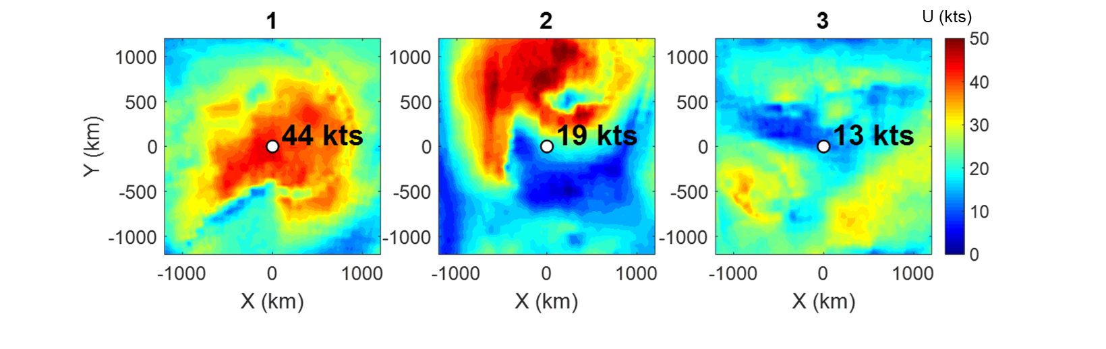
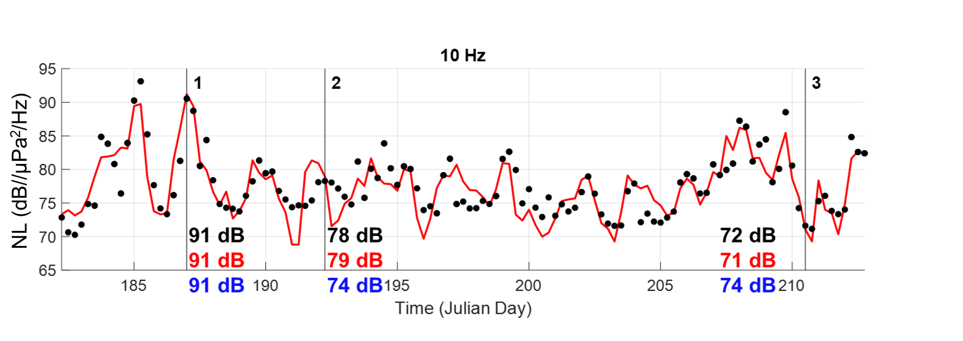
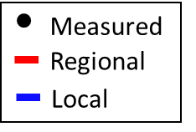
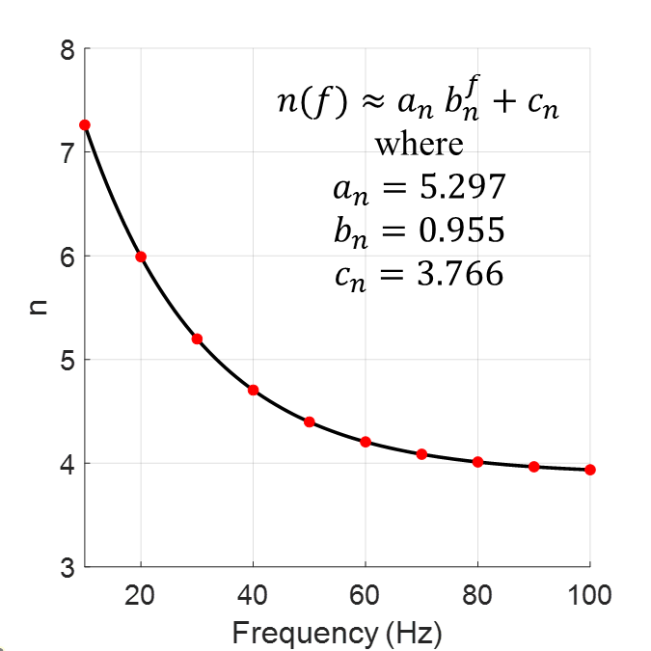
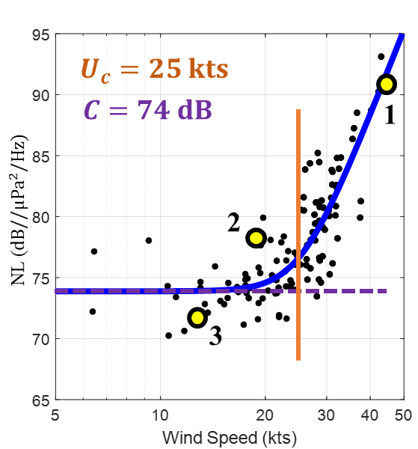
Conclusions
Developed two models
  Frequency dependent NL is empirically related to local wind speed.
    exponent, n, is much higher than 3.5
  A wind-related source layer is modeled to accurately predict distant wind noise contribution to NL.
Compared the two models outputs
  The local wind correlation model is sufficient when overhead wind speed is high as seen in Example 1.
  The regional source layer model is necessary when the overhead wind is low as seen in Examples 2 and 3.
Future Work
  Perform analysis on more locations.
  Continue to test limits of model.
    accuracy during very high wind events such as hurricanes
    interferers such as whales, shipping, geological events, and even distant wind
Please do not use this space, a QR code will be automatically overlayed

Slide 7
References
[1] W. M. Carey and D. Browning. Low frequency ocean ambient noise: Measurements and theory. In B. R. Kerman, editor, Sea Surface Sound, pages 361–376. Kluwer Academic Publishers, Boston, MA, 1988.
[2] W. M. Carey and R. B. Evans. Ocean Ambient Noise Measurement and Theory. Springer, New York, NY, 2011.
[3] G. J. M. Copeland. Low frequency ambient noise - generalized spectra. In B. R. Kerman, editor, Natural Physical Sources of Underwater Sound, pages 17–30. Kluwer Academic Publishers, Boston, MA, 1993.
[4] J. A. Hildebrand, K. E. Frasier, S. Baumann-Pickering, and S. M. Wiggins. An empirical model for wind-generated ocean noise. The Journal of the Acoustical Society of America, 149:4516–4533, 2021.
[5] D. J. Kewley, D. G. Browning, and W. M. Carey. Low-frequency wind-generated ambient noise source levels. The Journal of the Acoustical Society of America, 88:1894–1902, 1990.
[6] B. F. Kuryanov. The theory of low-frequency noise generated by turbulence near the atmosphere-ocean interface. In B. R. Kerman, editor, Natural Physical Sources of Underwater Sound, pages 255–262. Kluwer Academic Publishers, Boston, MA, 1993.
[7] E. C. Monahan. Oceanic whitecaps. The Journal of Physical Oceanography, 1:139–144, 1971.
[8] A. Prosperetti. Bubble dynamics in oceanic ambient noise. In B. R. Kerman, editor, Sea Surface Sound, pages 151–171. Kluwer Academic Publishers, Boston, MA, 1988.
[9] B. Scanlon, B. Ward, C. O’Dowd, and S. G. Jennings. Parameterizing whitecap coverage using sea surface imagery. In P. Vlahos and E. C. Monahan, editors, Recent Advances in the Study of Oceanic Whitecaps, pages 7–24. Springer International Publishing, Cham, Switzerland, 2020.
Please do not use this space, a QR code will be automatically overlayed

