Slide 1
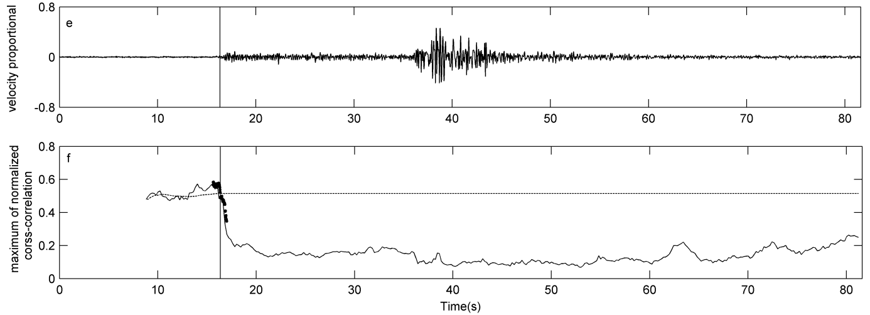
A Review of Frequently used Seismic P Wave Detection and Picking Algorithms
Driss Agliz, Abderrahman Atmani and El Hassan Ait Laasri
National School of Applied Sciences/Ibn Zohr University
P3.5-887
Different seismic detection algorithms are compared in order to evaluate their performance and to choose the most suitable one for a specific application. The comparison helps to have a complete understanding of their characteristics and enables users to choose the most appropriate algorithm for their specific needs, taking into account factors such as accuracy, robustness, efficiency, reliability and adaptability. The most commonly used techniques include :
Amplitude/energy threshold
Cross-correlation
Frequency-based methods
Machine learning
The performance of automatic phase detection algorithms can vary depending on factors such as signal-to-noise ratio, source-receiver geometry, and seismic waveform complexity.

