Slide 1
A Review of Frequently used Seismic P Wave Detection and Picking Algorithms
Driss Agliz, Abderrahman Atmani and El Hassan Ait Laasri
National School of Applied Sciences/Ibn Zohr University
Seismic detection and picking algorithms are extremely important, not only because an earthquake or a nuclear explosion must be detected and localized automatically, but also to optimize the storage memory required.
The need for algorithms for the automatic detection and selection of seismic wave arrivals has led many researchers to study various techniques, ranging from simple to sophisticated procedures. Each procedure has advantages and disadvantages.
Examples of arrival detection methods are presented.
The choice of a method depends on the application requirements such as available data, desired trade-offs between accuracy, efficiency, and other factors.
Please do not use this space, a QR code will be automatically overlayed
P3.5-887

Slide 2
Introduction
The detection of seismic signals and the selection of phase arrivals were initially carried out manually by qualified analysts. Currently, the introduction of large digital seismic monitoring networks has made automatic detection and selection tasks necessary.
These are extremely important, not only because an earthquake or a nuclear explosion must be detected and localized automatically, but also to optimize the storage memory required. Additionally, an automatic picking task can significantly reduce analyst effort and make picking faster and more objective.
The need for algorithms for the automatic detection and selection of seismic signals has led many researchers to study various techniques, ranging from simple to sophisticated procedures. Each procedure has advantages and disadvantages. The choice of an appropriate algorithm depends on the performance required and the type of signal expected (repetitive sources, low/high SNR, emergent, impulsive).
Please do not use this space, a QR code will be automatically overlayed
P3.5-887

Slide 3
Objectives
The objective of this study is to examine the most popular and frequently used automatic detection and picking algorithms.
Arrival detection in seismic signals consists in identifying and extracting the arrival times of specific seismic phases, such as P-waves or S-waves, from the recorded data.
Accurate and reliable time-of-arrival detection is of great importance as it provides critical information about the seismic source and subsurface structure. By analyzing the time differences between arrivals at different seismic stations, it is possible to access the location and amplitude of earthquakes, study the properties of seismic waves and deduce the characteristics of the interior of the Earth.
The different detection algorithms are compared in order to evaluate their performance and to choose the most suitable one for a specific application. The comparison helps to have a complete understanding of their performance characteristics and enables users to choose the most appropriate algorithm for their specific needs, taking into account factors such as accuracy, robustness, efficiency, reliability and adaptability.
Please do not use this space, a QR code will be automatically overlayed
P3.5-887

Slide 4
Methods/data : Detection algorithms
Phase detection algorithms can be listed according to a number of categories. The most commonly used techniques include :
Amplitude/energy threshold : The identification of the beginning of a seismic phase is done according to a predefined threshold on the amplitude/energy of the signal and the arrival of the phase is detected when this threshold is exceeded.
Cross-correlation : Cross-correlation quantify the similarities between a pattern waveform and the recorded seismic signal.
Please do not use this space, a QR code will be automatically overlayed
P3.5-887

Slide 5
Methods/data : Detection algorithms
Frequency-based methods: These methods analyze the frequency content of the seismic signal to identify specific wave arrivals. P-wave arrivals tend to have higher energy in lower frequency bands compared to S-waves. Analysis of frequency characteristics helps to distinguish different phases.
Machine learning : Machine learning techniques, such as artificial neural networks or support vector machines, are trained on labeled seismic data to classify the different wave arrivals. These algorithms learn patterns and characteristics from training data and then apply them to identify phases in new seismic signals.
The performance of automatic phase detection algorithms can vary depending on factors such as signal-to-noise ratio, source-receiver geometry, and seismic waveform complexity.
Please do not use this space, a QR code will be automatically overlayed
P3.5-887

Slide 6
Methods/data : Detection algorithms
Comparing different automatic seismic phase detection methods and choosing the best depends on several factors, including the specific application, data characteristics, and performance metrics needed. The considerations that we retain during the comparison are:
Accuracy: The accuracy of phase detection is a crucial factor. Methods are evaluated on their ability to correctly identify phase arrivals in different types of seismic data. We compare detection performance by analyzing metrics such as detection rate, false positive rate, false negative rate, and overall accuracy.
Robustness: Evaluation of the robustness of methods is done by examining their performance under different data conditions, such as varying signal-to-noise ratios, different magnitudes of seismic events, and different seismic network configurations. A robust method must be able to handle diverse scenarios and provide consistent results.
Please do not use this space, a QR code will be automatically overlayed
P3.5-887

Slide 7
Methods/data : Detection algorithms
Efficiency: Consideration is given to whether phase detection takes place in real time or near real time. The processing time and resource requirements of each method are compared to ensure that it can be practically implemented in the desired application.
Flexibility: The flexibility evaluates the ability of the methods to handle different seismic data sets, waveform types and signal characteristics.
Adaptability: It concerns the capability of methods to adapt and learn from new data. For example, some machine learning-based approaches may require a large training dataset and may struggle with rare or unique events.
Expertise and resources: Consideration is given to the availability of the expertise and resources needed to implement and maintain the different methods. Some techniques may require specialized knowledge or significant computer resources, which could impact their practicality.
Please do not use this space, a QR code will be automatically overlayed
P3.5-887

Slide 8
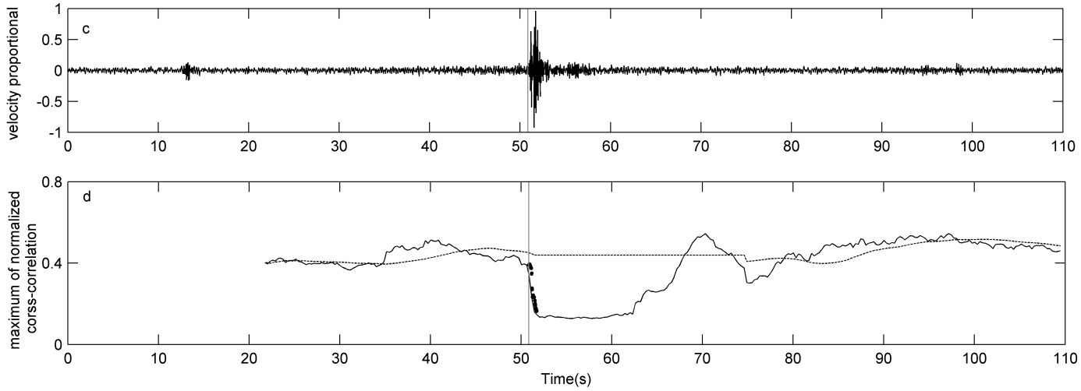
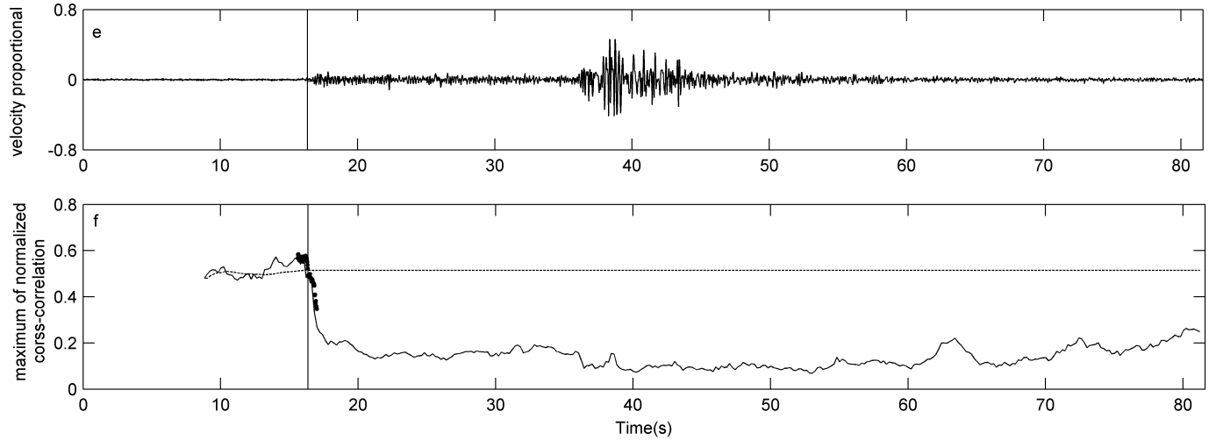
Results
The obtained result using a cross-correlation based method is shown in the figure on the right.
The calculation procedure is simple; the method quantify continually the degree of similarity between tow subsequent signal windows. Thus, when the two windows contain solely the background noise, the cross-correlation coefficient is high. On the contrary, when the second window reaches the seismic wave, the similarity is violated.
The precision is relatively high. The method does not require a model event or a noise model, it only needs a local stationary background noise at the recording site.
Please do not use this space, a QR code will be automatically overlayed
P3.5-887

Slide 9
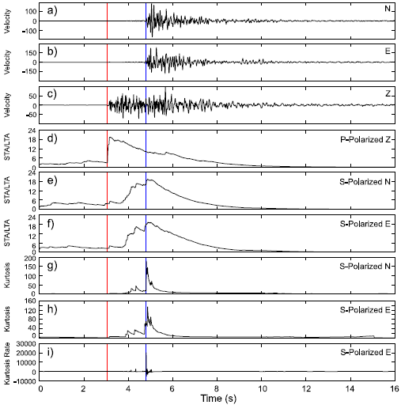
Results
The figure on the right shows a threshold based method.
P and S picking algorithm uses :
Polarization analysis and related filters to remove P-wave energy from the seismograms for S-wave picks.
STA/LTA and kurtosis detectors in tandem to seek for the phase arrival for S-wave.
Please do not use this space, a QR code will be automatically overlayed
P3.5-887

Slide 10
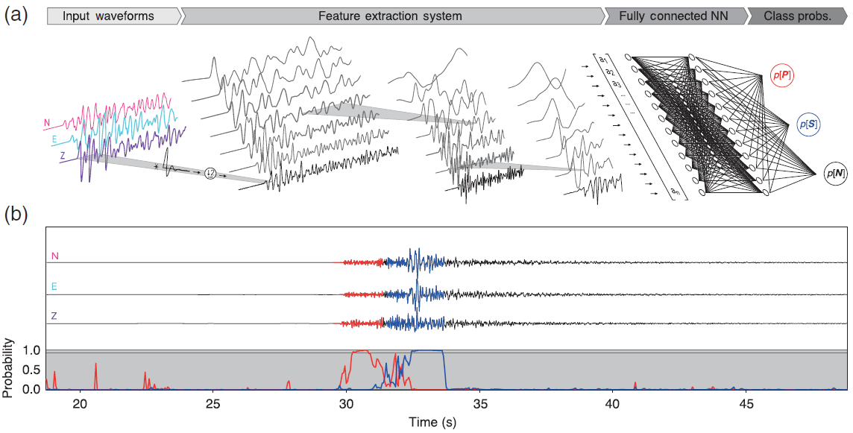
Results
One of the machine learning based seismic body-wave-phase detection method consists in using deep learning, particularly, the convolutional neural network (ConvNet). Training was performed on hand-labeled data archives. The model architecture consists of six layers, including four convolutional layers and two fully connected layers (see figure below).
Please do not use this space, a QR code will be automatically overlayed
P3.5-887

Slide 11
Conclusion
Conclusion :
It is important to note that there is no universal "best" method for automatic detection of seismic phases. The choice of a method depends on the specific application requirements, including available data, desired trade-offs between accuracy, efficiency, and other factors. Comparative studies and benchmark experiences can help understand the strengths and limitations of different methods, allowing us to choose the approach that best suits our specific needs.
Please do not use this space, a QR code will be automatically overlayed
P3.5-887

Slide 12
References
El Hassan Ait Laasri, Es-Saïd Akhouayri, Driss Agliz, Abderrahman Atmani," Automatic detection and picking of P-wave arrival in locally stationary noise using cross-correlation" Digital Signal Processing Volume 26 March, 2014 pp 87–100
Z. E. Ross and Y. Ben-Zion,”Automatic picking of direct P, S seismic phases and fault zone head waves" , Geophys. J. Int. (2014) 199, 368–381
Rodrigo Chi-Duran, Diana Comte, Marcos Dıaz, Jorge F. Silva, “Automatic detection of P- and S-wave arrival times: new strategies based on the modified fractal method and basic matching pursuit”, Journal of Seismology 21(4):1-14, September 2017
Yijun Zhang, Qiang Chen, Xianwen Liu, Jingjing Zhao, Qian Xu, Yinghui Yang and Guoxiang Liu, "Adaptive and automatic P- and S-phase pickers based on frequency spectrum variation of sliding time windows”,Geophys. J. Int. (2018) 215, 2172–2182,
Zachary E. Ross, Men-Andrin Meier, Egill Hauksson, and Thomas H. Heaton,"Generalized Seismic Phase Detection with Deep Learning”, Bulletin of the Seismological Society of America, Vol. 108, No. 5A, pp. 2894–2901, October 2018.
Please do not use this space, a QR code will be automatically overlayed
P3.5-887

