Slide 1
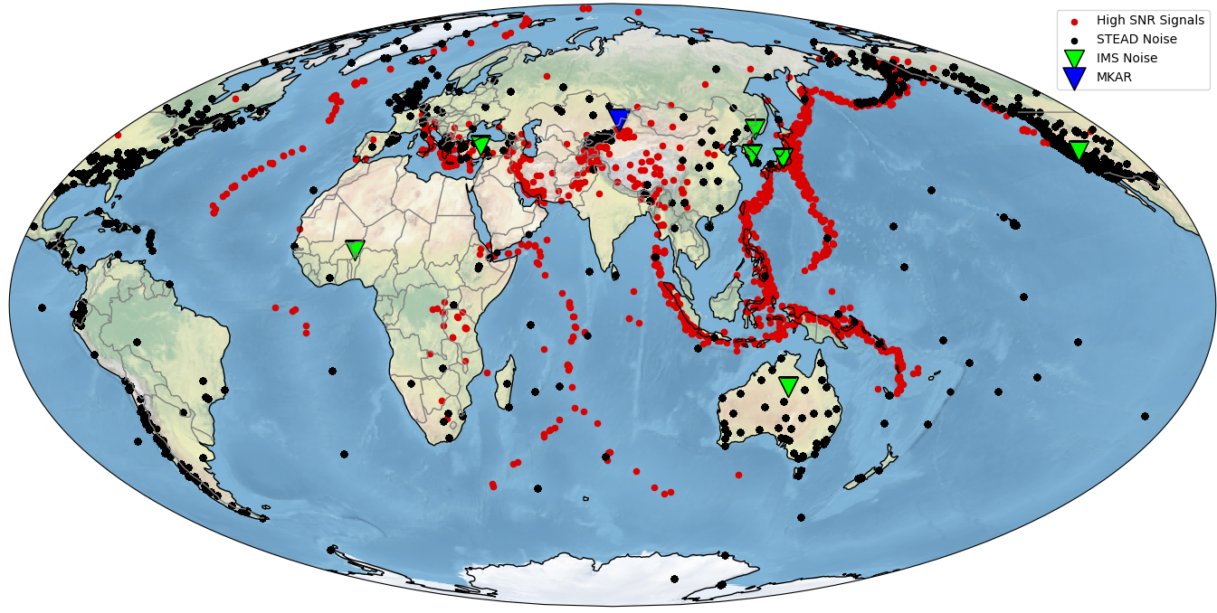
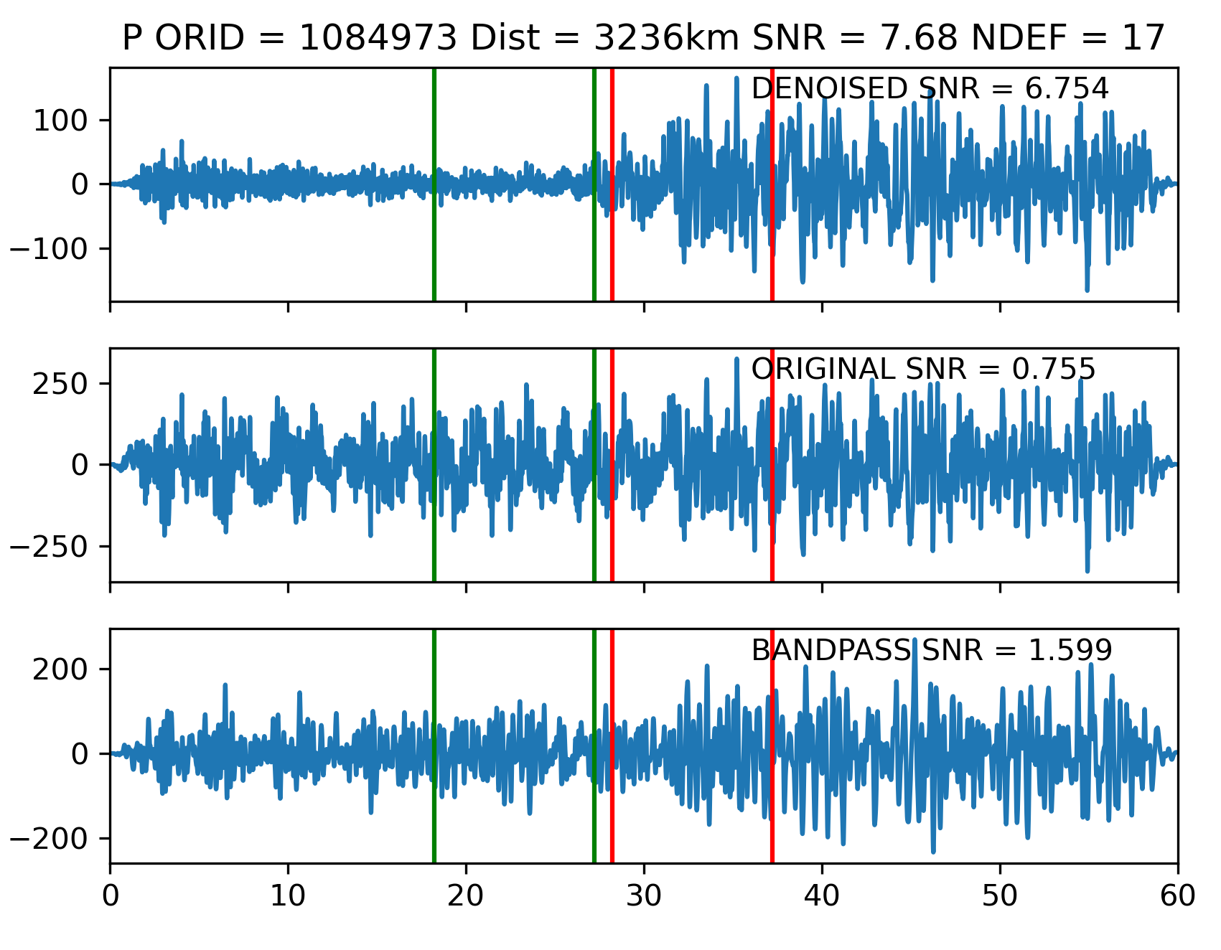
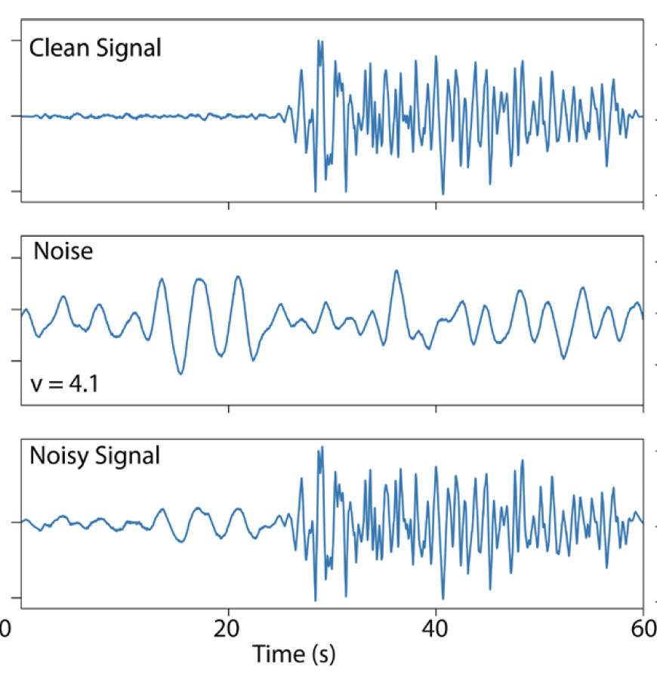
Expansion and Transferability of Convolutional Neural Network Deep Denoisers
Clinton Koch, Rigobert Tibi, Louis Quinones
Sandia National Laboratories
P3.5.176
Introduction
Training
Results
We present results of the 3C denoising model on the Test Dataset and real data from station MKAR.
Test Dataset Ex.
We expanded CNN denoising architectures developed for vertical-component seismograms in Utah to a 3-component seismogram in the IMS network.
Real Signal Ex. - MKAR
We construct a dataset of >850,000 noisy waveforms from ~10,600 high-SNR signals at station MKAR and >650,000 noise from the IMS network and STEAD dataset. We train a STFT CNN on the constructed noisy waveforms.
Noisy Waveform Example
Conclusions
The CNN denoiser outperforms frequency filtering in all metrics. The high CC and SDR values indicate that changes in waveform shape and signal distortion are minimized using the CNN.
Test Dataset Results – Vertical Component
SNR
CC
SDR
The views expressed here do not necessarily reflect the views of the United States Government, the United States Department of Energy, or Sandia National Laboratories.
SAND2023-03411C

