Slide 1
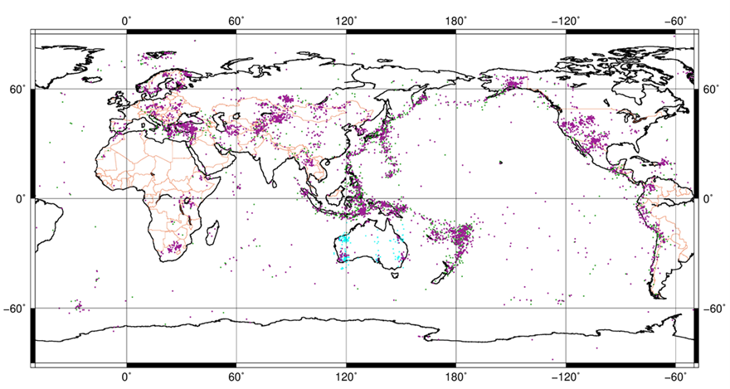
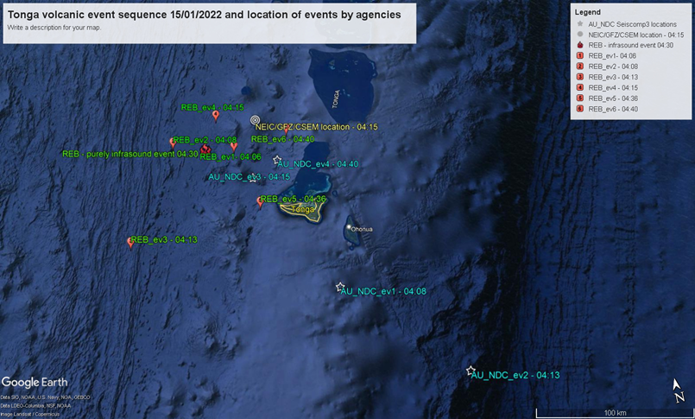
Australian National Data Centre Experience with the use of NDC-in-a-Box Software
Svetlana Nikolova, Matthew Hoyles, Spiro Spiliopoulos
Geoscience Australia
P3.5-388
We present:
Set-up of Seiscomp system that includes IMS and non-IMS stations;
Show and compare result of our NET-VISA automatic location with VSEL3 and Australian reviewed catalogue;
Examples of events detected by our system
We would like to share our experience with other Seiscomp users and offer our assistance in setting Seiscomp IDC.
If you want to learn more about this, come see my e-poster during session 3.5 on 22 of June 2023 10-11 a.m. Zeremoniensaal & Marmorsaal or access it online on the SnT2023 Conference platform!

