Slide 1
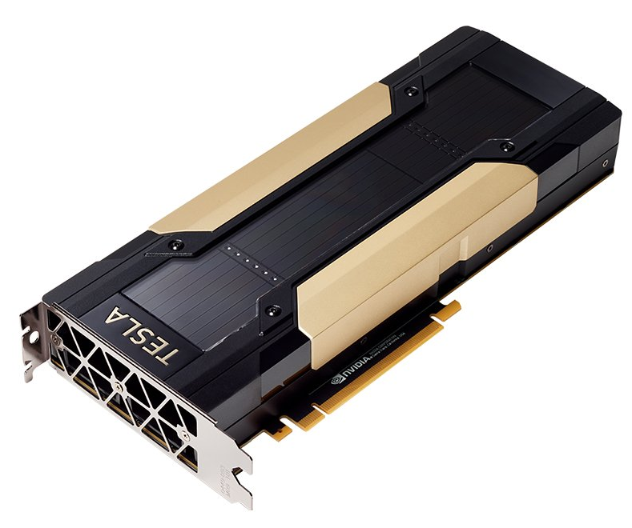
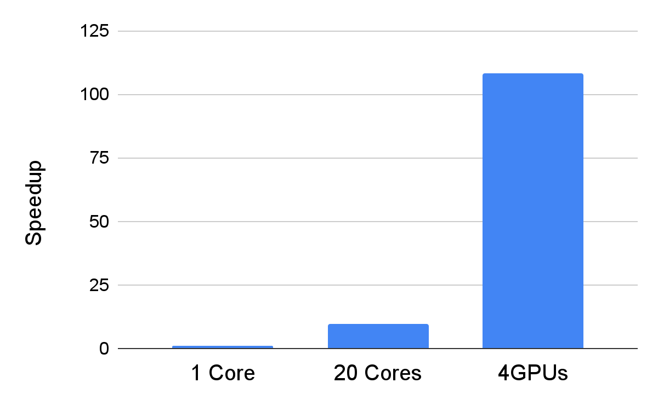
High-Performance Computing Optimization of Broadband Range-Dependent Sound Propagation Simulations
Noriyuki Kushida¹, and Ying-Tsong Lin²
¹CTBTO/IDC/SA, ²Woods Hole Oceanographic Institution
P3.5-396
Rande-dependent Acoustic Model is a well-known hydroacoustic model.
Experts need to perform multi-frequency simulation
In the present study, we employ GP-GPU, which is a massively parallel computing unit
General-Purpose Graphics Processing Unit
As a result, a 110-fold speedup is observed
Thanks to an optimized matrix stroage format, called block tridiagonal matrix
Photos are@Nvidia WEB
x4 Nvidia V100
DGX Station
Conventional (Each freq. has own matrix)
GPU optimized (Each element is a block of frequencies)
x 110 speedup
…
…
Freq. 1
Freq. n
Freq. 1
Freq. n

