Slide 1
High-Performance Computing Optimization of Broadband Range-Dependent Sound Propagation Simulations
Noriyuki Kushida¹, and Ying-Tsong Lin²
¹CTBTO/IDC/SA, ²Woods Hole Oceanographic Institution
Computer modeling for long-range ocean acoustics is a key technology to understand complex hydroacoustic signals. In this study, a multi-frequency 2D Wave equation solver is accelerated using High-Performance computing systems, such as GPU
General Purpose Graphic Processing Unit (GPGPU) is now prevalent because of its high-performance compare with CPUs. In this study, an optimized tri-diagonal matrix equation solver is developed for GPGPU processing.
Under a certain condition, approximately, 110 fold speedup is observed; Approx. 20,000 freqs, 100km range and 5km depth (Δr=250m, Δz=0.5m)
A well established 2D Wave Equation solver using Parabolic Equation method has been accelerated for multifrequency simulation (Broad-Band Simulation)
Please do not use this space, a QR code will be automatically overlayed
P3.5-396

Slide 2
Introduction: Why numerical simulation in the ocean acoustics?
Computer models are increasingly becoming important in ocean acoustics
Particularly, for long-range/large-scale simulations
This includes Deep Neural Networks (more precisely, Physics Informed Neural Network)
The biggest drawback of (simplified) modells is; Uncertainty in extreme/marginal cases. We can use them, when we know they work well
“Ab-initio” HPC ocean acoustics simulation: Namely, solving the wave/Helmholtz equation with supercomputers.
“Ab-initio” is often used in quantum molecular dynamics.
P3.5-396
Please do not use this space, a QR code will be automatically overlayed

Slide 3
Objectives: Range-dependent 2D-PE code, RAM, and a High-Performance Computing (HPC) unit, GPU
Parabolic Equation method (PE) is a Helmholtz equation solver
Waves that propagate from source to the receiver direction are only considered
Range-dependent Acoustic Model (RAM) is a well-known 2D-PE
Broad-band (multi-frequency) simulation of 2D-PE is of strong interest for ocean acoustics experts
In this study, we developed GPU-enabled multi-frequency version of RAM
GPU: General Purpose Graphics Processing Unit (GP-GPU)
Highly parallel processing unit, and it can handle multiple data at one.
Thus, a multi-frequency simulation suits GPU.
P3.5-396
Please do not use this space, a QR code will be automatically overlayed

Slide 4
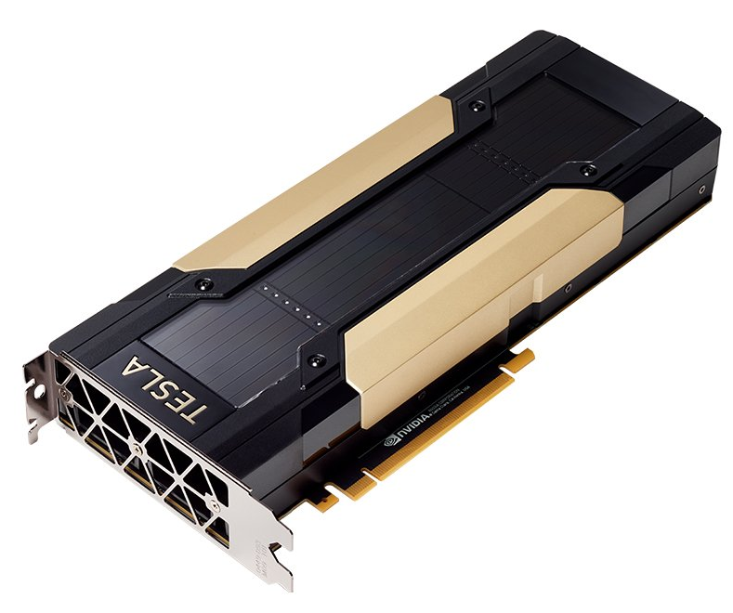
Methods/Data: Tri-diagonal system solution and application of GPU
In RAM, the heaviest routine is the linear equation solver of systems of tri-diagonal matrices.
More than 80% of computing time is used for Gaussian elimination.
Each system can be solved completely independently. So, highly parallel computing units, such as GPU, are well suitable.
We also can apply multi-GPUs without any difficulties
Optimization
However, we still need to optimize the code to obtain the best performance on GPUs
To obtain memory continuity, which is the key to peak performance, we developed a new matrix storage format called block tri-diagonal matrix storage
Conventional (Each freq. has own matrix)
GPU optimized (Each element is a block of frequencies)
P3.5-396
…
x4 Nvidia V100
Please do not use this space, a QR code will be automatically overlayed
…
Freq. 1
Freq. n
Freq. 1
Freq. n
DGX Station
Photos are@Nvidia WEB

Slide 5
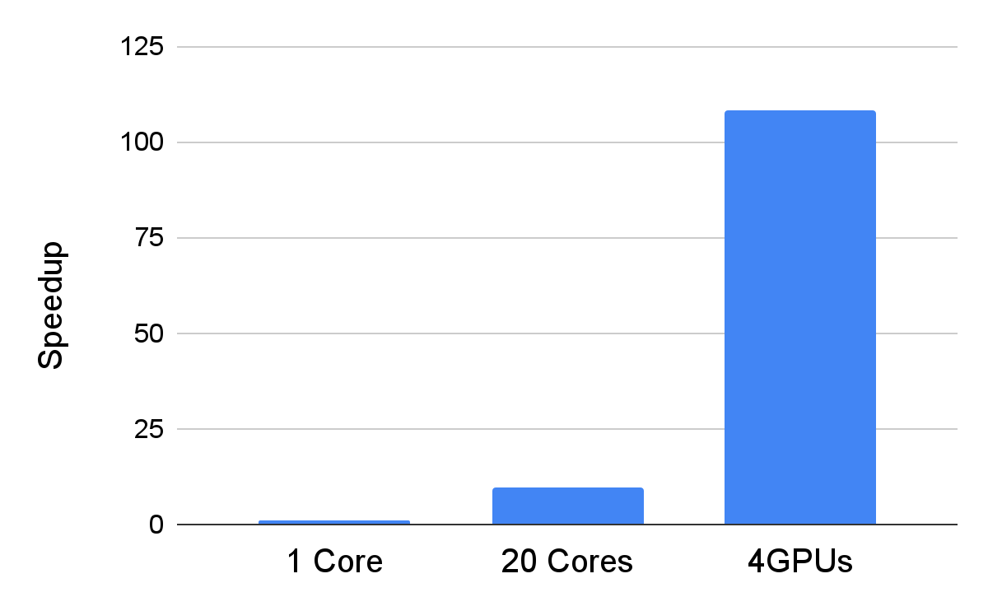
Results: Speedup
To check the speed our implementation, speedup to the original Fortran implementation was measured
Multi-core implementation of original version is also measured on DGX station
As a result;
GPU implementation shows a 110 fold speedup to a single core
Multicore implementation shows a 10 fold speedup with 20 cores
x 110 speedup
P3.5-396
Please do not use this space, a QR code will be automatically overlayed

Slide 6
Conclusion
Our GPU-enabled RAM, 2D-PE solver, performs x110 speedup to 1-core implementation.
This is equivalent to improve a one-year-computation to a 3-day-computation.
Many applications could be achieved with such a drastic speedup; e.g. real time simulation
Since 2D-PE is one of "Ab-initio" ocean acoustics models, the developed program can be applied to a completely unknown case with confidence, unlike simplified models.
P3.5-396
Please do not use this space, a QR code will be automatically overlayed

Slide 7
References
Noriyuki Kushida, Ying-Tsong Lin, Peter Nielsen, Ronan Le Bras, R; Acceleration in Acoustic Wave Propagation Modelling Using OpenACC/OpenMP and Its Hybrid for the Global Monitoring System. In: Wienke, S., Bhalachandra, S. (eds) Accelerator Programming Using Directives. WACCPD 2019. Lecture Notes in Computer Science, vol 12017, 2020. Springer, Cham. https://doi.org/10.1007/978-3-030-49943-3_2
Noriyuki Kushida, Ying-Tsong Lin; High-performance computation toward large-scale underwater acoustics modelling. J Acoust Soc Am 1 March 2023; 153 (3_supplement): A270. https://doi.org/10.1121/10.0018814
Noriyuki Kushida, Tiago Oliveira, Ying-Tsong Lin; High-performance computing for long-range underwater acoustics. J Acoust Soc Am 1 October 2021; 150 (4_Supplement): A169–A170. https://doi.org/10.1121/10.0008014
Brian Dushaw; MPIRAM: The RAM Parabolic Equation Code in Fortran 95, https://staff.washington.edu/dushaw/AcousticsCode/RamFortranCode.html
P3.5-396
Please do not use this space, a QR code will be automatically overlayed

