Slide 1
Azimuth Estimation in Seismic Arrays via Deep Augmented MUSIC
M. Khatib¹, J . Merkofer², Y. Ben-Horin³, Y. Radzyner³, G. Revach⁴, R. Sloun², N. Shlezinger¹, T. Routtenberg^{1,5}
BGU¹, Eindhoven University², Soreq Nuclear Research Center³, ETH Zürich⁴, Princeton University⁵
P3.5-483
The MUSIC algorithm is a well-regarded MB approach, and it exhibits inherent limitations
DD deep learning approaches offer robust DOA estimation yet are computationally intensive
Enable DOA estimation with an unknown number of sources.
DA-MUSIC - a hybrid MB/DD implementation of the MUSIC algorithm for DOA estimation.
Achieve effective handling of broadband signals in the estimation process
Demonstrate the remarkable resolution capability of the hybrid approach in various settings.
Compare the performance of the hybrid MB/DD approach with both MB and DD benchmarks in low and high snapshot domains.

Slide 2
Azimuth Estimation in Seismic Arrays via Deep Augmented MUSIC
M. Khatib¹, J . Merkofer², Y. Ben-Horin³, Y. Radzyner³, G. Revach⁴, R. Sloun², N. Shlezinger¹, T. Routtenberg^{1,5}
BGU¹, Eindhoven University², Soreq Nuclear Research Center³, ETH Zürich⁴, Princeton University⁵
P3.5-483
Covariance Recovery:
Learning a surrogate covariance matrix to overcome limitations.
Number of sources estimation:
Improving the number of sources estimation and categorization of noise eigenvectors.
Peak finding:
Increase resolution and allow differentiation of entire structure.

Slide 3
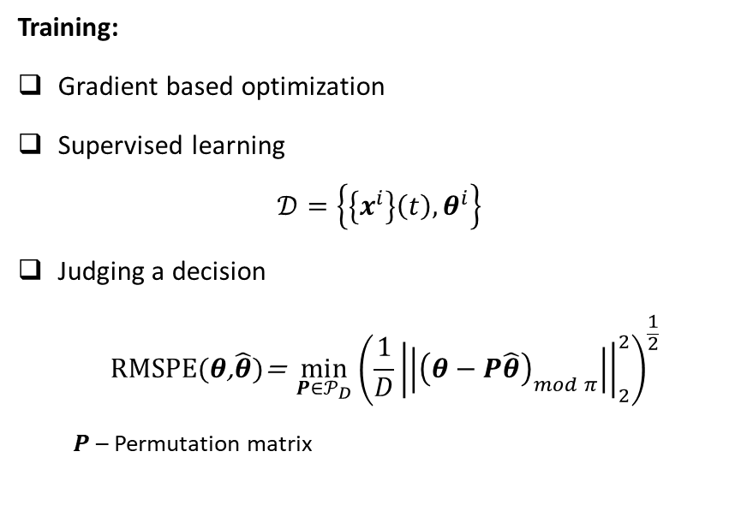
Azimuth Estimation in Seismic Arrays via Deep Augmented MUSIC
M. Khatib¹, J . Merkofer², Y. Ben-Horin³, Y. Radzyner³, G. Revach⁴, R. Sloun², N. Shlezinger¹, T. Routtenberg^{1,5}
BGU¹, Eindhoven University², Soreq Nuclear Research Center³, ETH Zürich⁴, Princeton University⁵
P3.5-483
Training:
Gradient based optimization
Supervised learning
$$𝒟=\left\{\left\{x^{i}\right\}\left(t\right),θ^{i}\right\}$$
Judging a decision
$$\text{R}\text{MSPE}\text{(}θ\text{,}\hat{θ}\text{)}\text{= }\min_{P∈𝒫_{D}}{{\left(\frac{1}{D}{\left|\left|{\left(θ−P\hat{θ}\right)}_{mod π}\right|\right|}_{2}^{2}\right)}^{\frac{1}{2}}}$$
$P$ – Permutation matrix
Advantages
Preserve flow of MUSIC
Enable end-to-end training
Overcome coherent sources
Improved resolutions
Increased robustness
Operate within low snapshots
Overcome broadband

Slide 4
Azimuth Estimation in Seismic Arrays via Deep Augmented MUSIC
M. Khatib¹, J . Merkofer², Y. Ben-Horin³, Y. Radzyner³, G. Revach⁴, R. Sloun², N. Shlezinger¹, T. Routtenberg^{1,5}
BGU¹, Eindhoven University², Soreq Nuclear Research Center³, ETH Zürich⁴, Princeton University⁵
P3.5-483
Non-Synthetic Data
Seismic data was collected using the GERES array, which comprises 25 vertical seismometers spaced about $124 \left[m\right]$ apart, with a total aperture of around $2.13 \left[km\right]$.
The seismic signal at each sensor is sampled at $40 \left[Hz\right]$. We use data from October to December of 2021, in which GERES detected arrivals for 2904 events: 2816 for analysis, 2534 for training and 282 for testing.
We employ sliding windows of length 100 seconds with a shift of 25 seconds around the signal arrival time.
 | DA-MUSIC | Broadband MUSIC | Classic MUSIC | Beam-former | Random
RMSPE$[rad]$ | 0.6269 | 1.0075 | 1.2475 | 0.9383 | 1.7097
DA-Music outperforms MB estimators by jointly focusing on frequency and interdependent elevation angle for a stable azimuth estimation.
Despite relatively large error, it’s important to consider the average error reported by the IDC Review Event Bulletin is $0.4243 [rad]$

