Slide 1
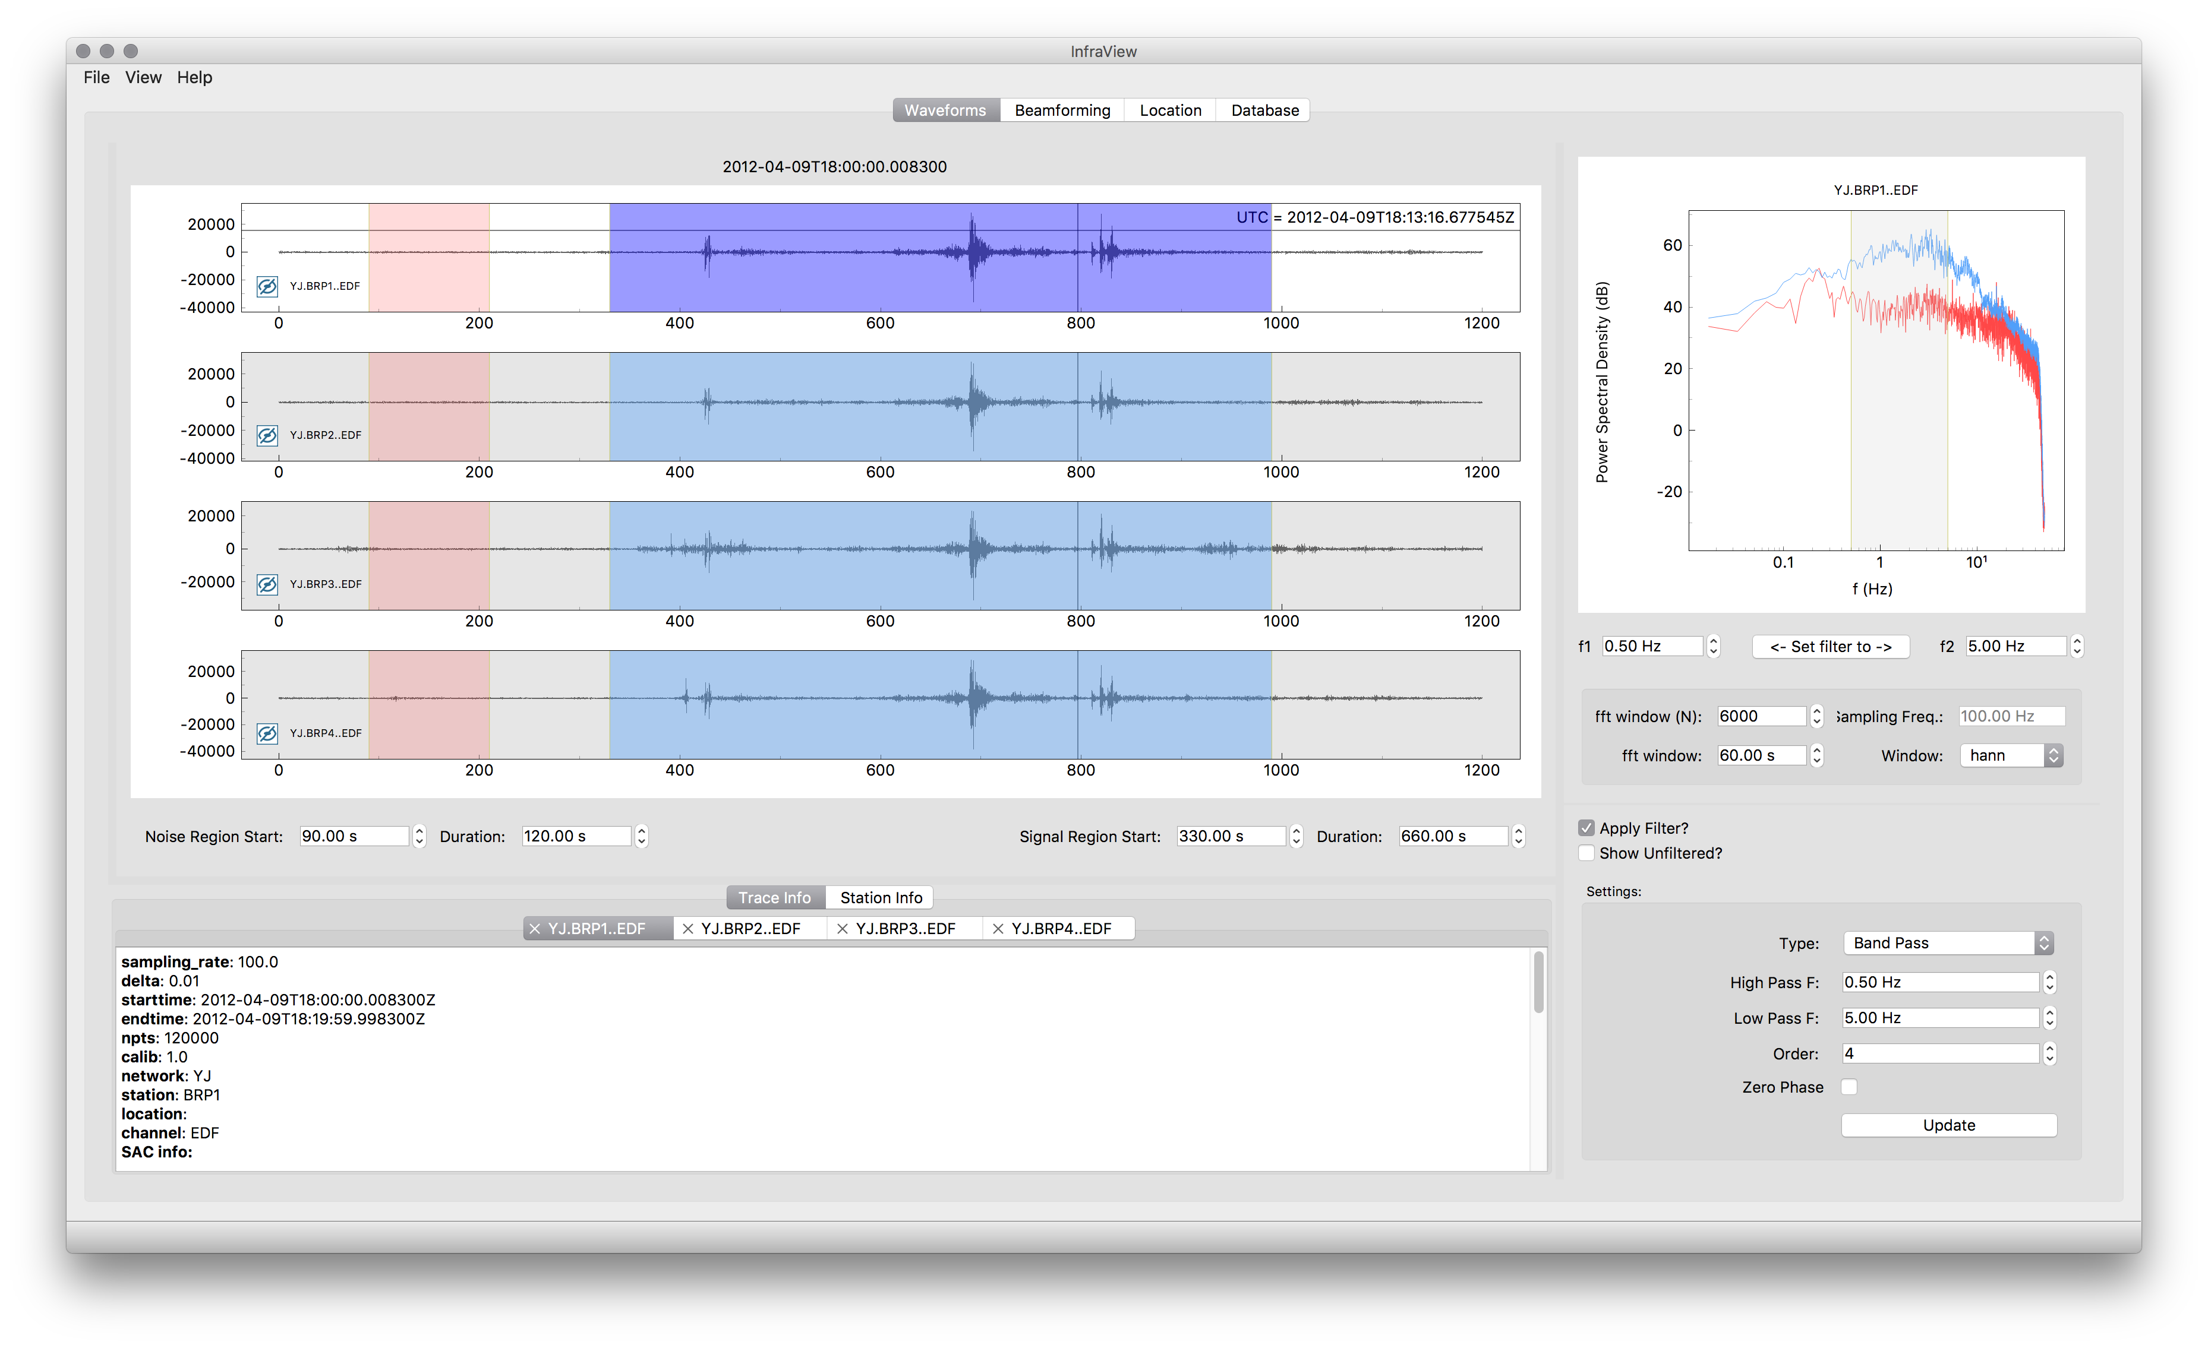
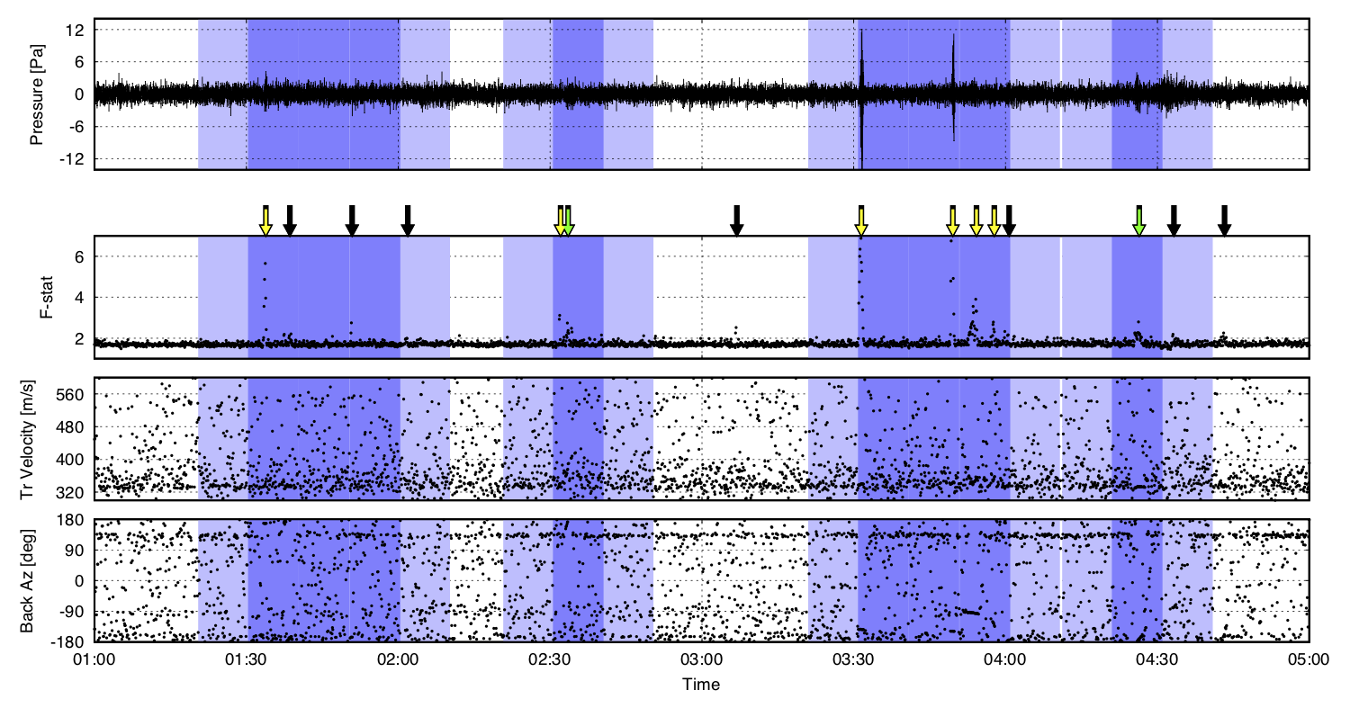
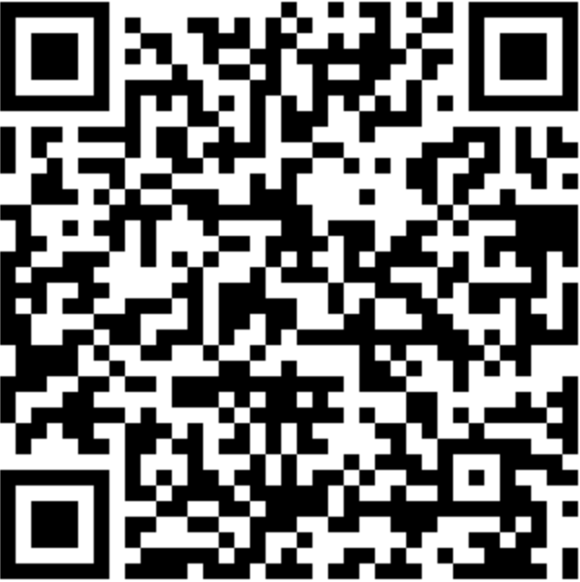
Recent Advances in Automated and Event-of-Interest
Analysis of Infrasonic Events
Philip Blom, Jeremy Webster, and Jordan Bishop
Los Alamos National Laboratory
P3.5-167
Highlights of recent capability development in the InfraPy signal analysis Python software suite
Generalized data ingestion methods (local files, FDSN, database)
Graphical User Interface (InfraView), command line interface, and import for script/notebook
Example analysis of the Tonga Hunga eruption
Summary of recent investigations of machine learning for infrasound detection
Categorization using array processing results (coherence and direction of arrival)
Comparison with Adaptive Fisher Detector
Download InfraPy

