Slide 1
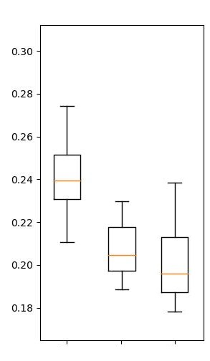
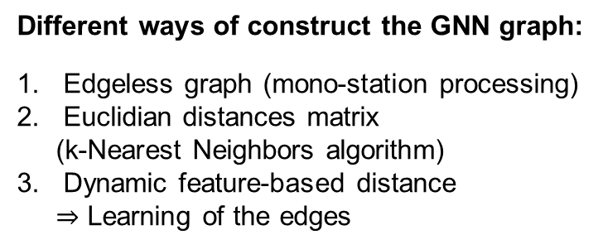
Graph Neural Networks for Seismic Yield Estimation
X. Cassagnou^{1,2}, C. Millet^{1,2}, M. Mougeot^{1,3}
¹ ENS Paris-Saclay, France, ² CEA, DAM, DIF, Arpajon, France, ³ ENSIIE, Evry Courcouronnes, France
P3.5-812
Objectives:
Machine learning for automated seismic source characterization.
Use Graph Theory for multi-station analysis.
Dataset:
Southern California Seismic Network
207 stations, 3740 events (1st Jan. 2000 – 30th June 2019).
Multi-stations waveforms
Aggregation + MLP
CNN
$$X_{l_{1}}∈ℝ^{64}$$
GNN
$$Y_{l_{1}}∈ℝ^{128}$$
$$X_{l_{2}}∈ℝ^{64}$$
$$Y_{l_{2}}∈ℝ^{128}$$
Prediction of source characteristics : latitude, longitude, depth, magnitude
$$Ψ∈ℝ^{4}$$
$$X_{l_{3}}∈ℝ^{64}$$
$$Y_{l_{3}}∈ℝ^{128}$$
$$Y_{l_{4}}∈ℝ^{128}$$
$$X_{l_{4}}∈ℝ^{64}$$
Different ways of construct the GNN graph:
Edgeless graph (mono-station processing)
Euclidian distances matrix
(k-Nearest Neighbors algorithm)
Dynamic feature-based distance
$⇒$ Learning of the edges
Results:
Magnitude estimation is improved using the dynamic distance
We also observe a robustness against different signal processing (filtering, envelope extraction)
Magnitude error

