Slide 1


Graph Neural Networks for Seismic Yield Estimation
X. Cassagnou^{1,2}, C. Millet^{1,2}, M. Mougeot^{1,3}
¹ ENS Paris-Saclay, France, ² CEA, DAM, DIF, Arpajon, France, ³ ENSIIE, Evry Courcouronnes, France
Automated seismological signal analysis is crucial for earthquake catalog generation.
Machine learning and graph theory are investigated to enhance source characterization of seismic signals.
Different architectures of Graph Neural Networks are compared and evaluated on Southern California Seismic Network dataset.
Dynamic included in the graph improve the magnitude estimation and the method is robust to the preprocessing method.
Incorporating the geometry of a seismic network in the graph leads to good results even with partial information in the signals.
Please do not use this space, a QR code will be automatically overlayed
P3.5-812
Notes:
Dire à l’oral
Il y a des outils de machine learning
Et des outils de théorie de graphes
Pas évident de comprendre tous les outils
Contribution : bien comprendre ce que peuvent apporter ces outils

Slide 2
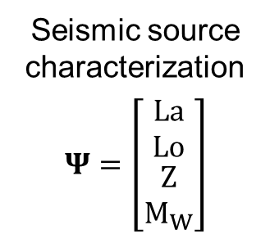
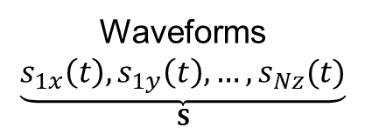
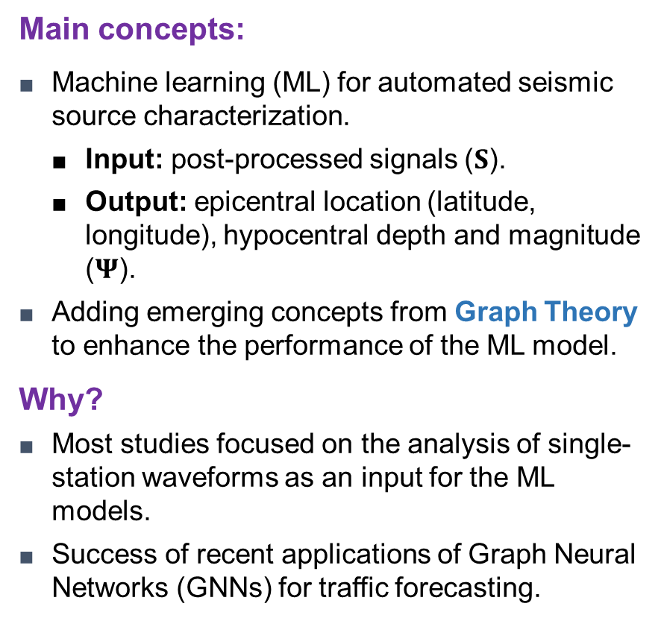
Context and objectives
  Main concepts:
  Machine learning (ML) for automated seismic source characterization.
    Input: post-processed signals ($S$).
    Output: epicentral location (latitude, longitude), hypocentral depth and magnitude ($Ψ$).
  Adding emerging concepts from Graph Theory to enhance the performance of the ML model.
  Why?
  Most studies focused on the analysis of single-station waveforms as an input for the ML models.
  Success of recent applications of Graph Neural Networks (GNNs) for traffic forecasting.
Input
Waveforms
$$\underset{S}{\underbrace{s_{1x}\left(t\right), s_{1y}\left(t\right),…,s_{Nz}(t)}}$$
CNN
Feature extraction
Graph “embedding”
ML model
GNN
Graph attribute
prediction
Graph
MLP
Seismic source characterization
$$Ψ=\left[\begin{matrix}\begin{matrix}La \\ Lo\end{matrix} \\ \begin{matrix}Z \\ M_{W}\end{matrix}\end{matrix}\right]$$
Please do not use this space, a QR code will be automatically overlayed
Output
P3.5-812

Slide 3
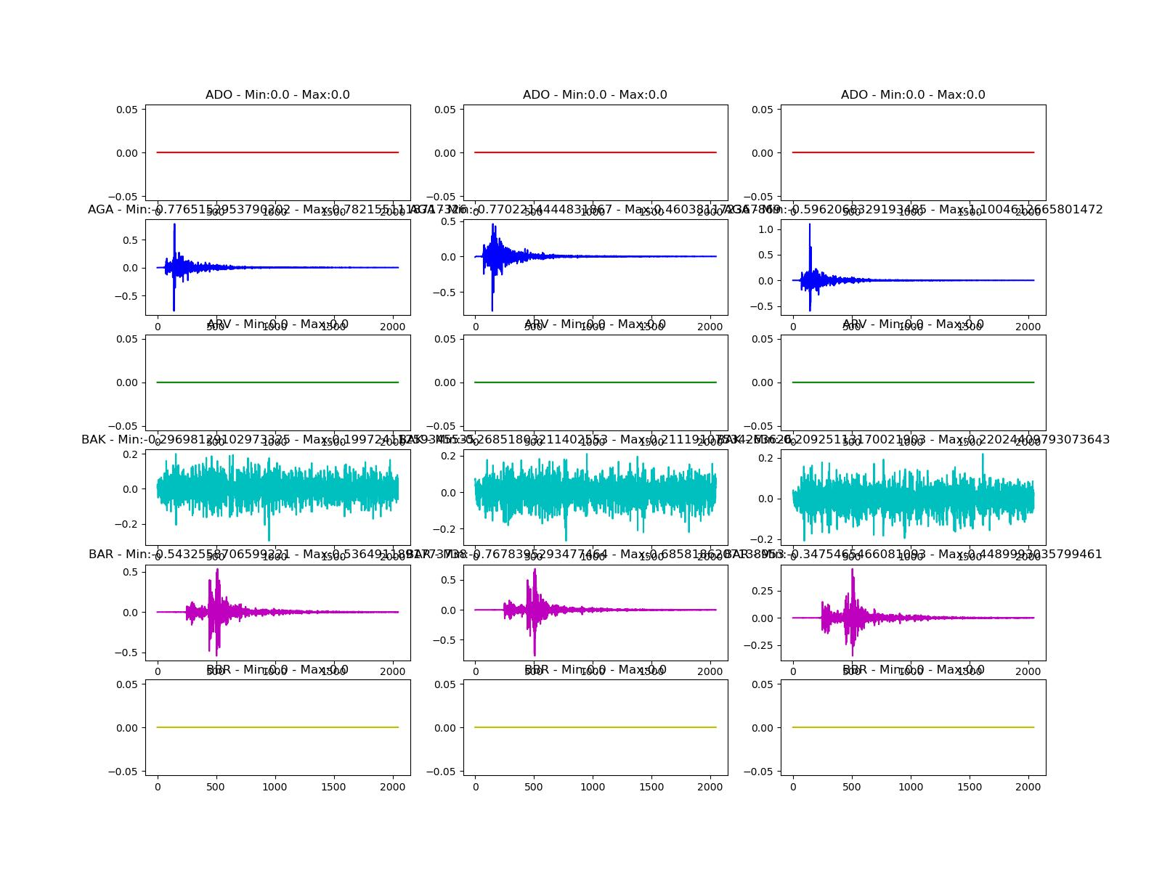



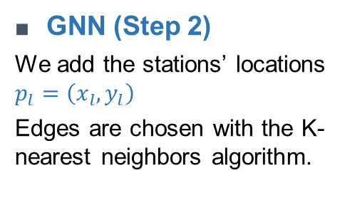











Model architecture
station $l_{1}$
station $l_{max}$
  CNN (Step 1)
  Extracts features from seismic signals for each station
…
is a combination of CNNs and pooling layers
…
$$X_{l_{1}}∈ℝ^{64}$$
$$X_{l_{max}}∈ℝ^{64}$$
  GNN (Step 2)
  We add the stations’ locations $p_{l}=\left(x_{l}, y_{l}\right)$
  Edges are chosen with the K-nearest neighbors algorithm.
$$X_{n_{3}},p_{n_{3}}$$
$$X_{n_{2}},p_{n_{2}}$$
Graph Convolution
$$X_{n_{1}},p_{n_{1}}$$
$$X_{l}∈ℝ^{64}$$
$p_{l}∈$ $ℝ^{2}$
$$Y_{l}∈ℝ^{128}$$
  Aggregation and prediction (Step 3)
$$Y_{l_{1}}∈ℝ^{128}$$
Aggregation
MLP
Prediction of source characteristics : latitude, longitude, depth, magnitude
Please do not use this space, a QR code will be automatically overlayed
…
$$Z∈ℝ^{128}$$
$$Ψ∈ℝ^{4}$$
$$Y_{l_{max}}∈ℝ^{128}$$
$$Z_{i}=\max_{l}{{\left(Y_{l}\right)}_{i}}$$
P3.5-812

Slide 4


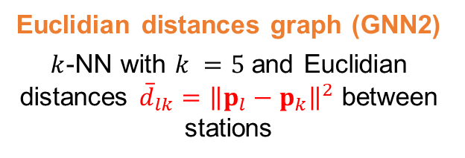
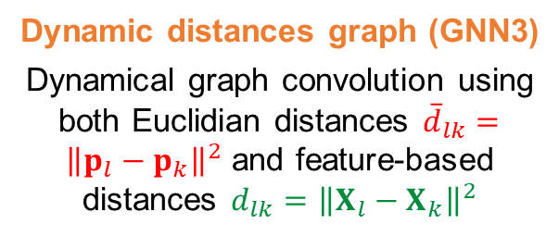
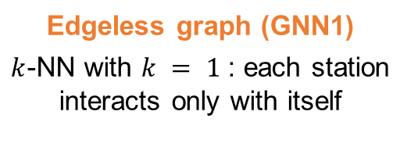







From Edgeless GNN to Dynamic GNN
  Focus on step 2 (Graph Neural Network)
  3 approaches to construct the graph
  Edgeless graph (GNN1)
  $k$-NN with $k = 1$ : each station interacts only with itself
  Euclidian distances graph (GNN2)
  $k$-NN with $k =5$ and Euclidian distances ${\overline{d}}_{lk}={\left\|p_{l}−p_{k}\right\|}^{2}$ between stations
  Dynamic distances graph (GNN3)
  Dynamical graph convolution using both Euclidian distances ${\overline{d}}_{lk}={\left\|p_{l}−p_{k}\right\|}^{2}$ and feature-based distances ${d_{lk}=\left\|X_{l}−X_{k}\right\|}^{2}$
$$X_{l_{1}}∈ℝ^{64}$$
$p_{l_{1}}∈$ $ℝ^{2}$
…
$$X_{l_{max}}∈ℝ^{64}$$
$p_{l_{max}}∈$ $ℝ^{2}$
$$X_{n_{3}},p_{n_{3}}$$
$$X_{n_{3}},p_{n_{3}}$$
$$X_{n_{2}},p_{n_{2}}$$
$$X_{n_{2}},p_{n_{2}}$$
$$X_{n_{1}},p_{n_{1}}$$
$$X_{l}∈ℝ^{64}$$
$p_{l}∈$ $ℝ^{2}$
$$X_{n_{1}},p_{n_{1}}$$
$$X_{l}∈ℝ^{64}$$
$p_{l}∈$ $ℝ^{2}$
$$Y_{l_{1}}∈ℝ^{128}$$
…
$$Y_{l_{max}}∈ℝ^{128}$$
Learning of edges
Please do not use this space, a QR code will be automatically overlayed
[1] Ende & Ampuero (2020). Geophys. Res. Letters, 47(17).
[2] Yu, Yin & Zhu (2018). Proc. of the 27th Int. Joint Conf. on AI.
[3] Zhang, Reichard-Flynn, Zhang, Hirn, & Lin (2022). Journal of Geophysical Research: Solid Earth, 127
P3.5-812

Slide 5
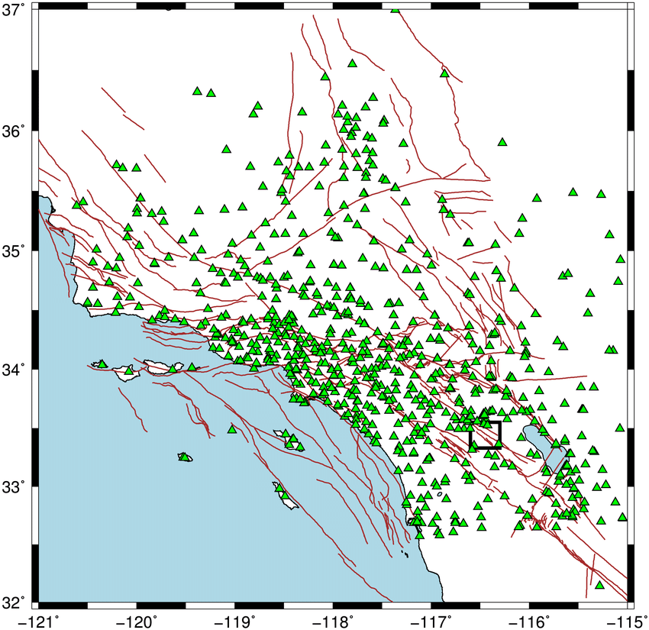
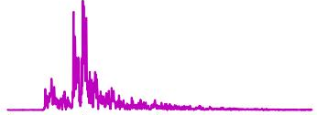
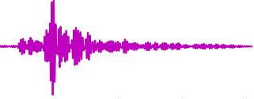
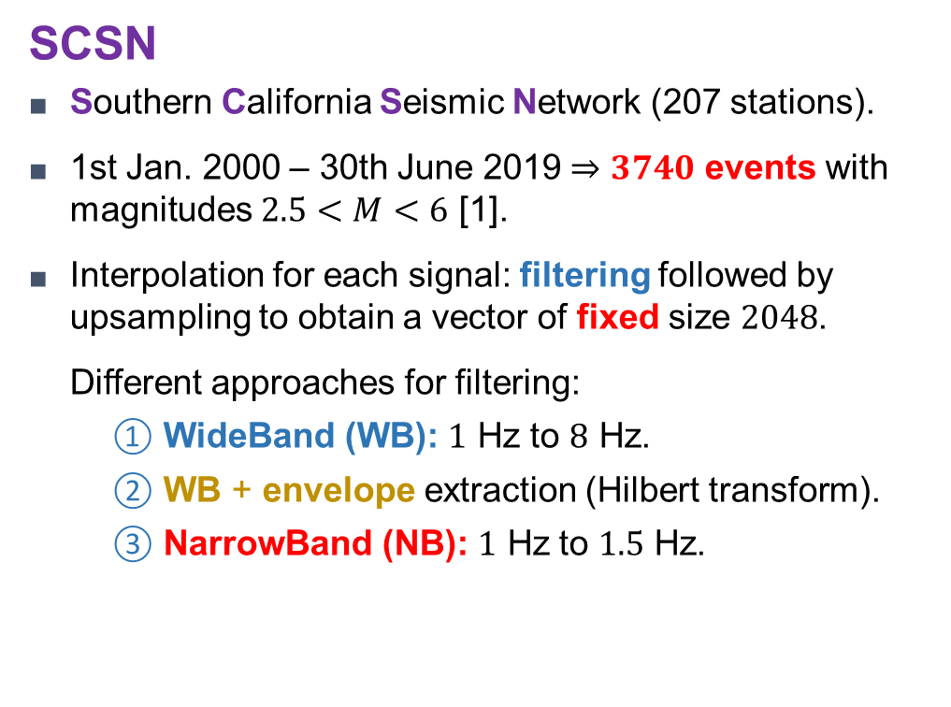
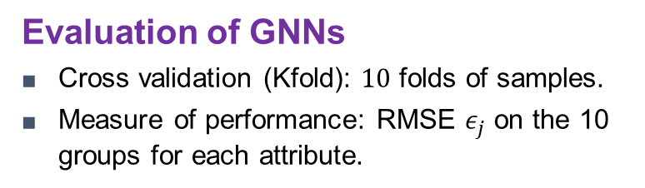
Seismic application dataset
  SCSN
  Southern California Seismic Network (207 stations).
  1st Jan. 2000 – 30th June 2019 $⇒3740$ events with magnitudes $2.5<M<6$ [1].
  Interpolation for each signal: filtering followed by upsampling to obtain a vector of fixed size $2048$.
  Different approaches for filtering:
      WideBand (WB): $1$ Hz to $8$ Hz.
      WB + envelope extraction (Hilbert transform).
      NarrowBand (NB): $1$ Hz to $1.5$ Hz.
WB
WB + env.
NB
  Evaluation of GNNs
  Cross validation (Kfold): $10$ folds of samples.
  Measure of performance: RMSE $ε_{j}$ on the 10 groups for each attribute.
Please do not use this space, a QR code will be automatically overlayed
[4] Hutton, Woessner, & Hauksson (2010). Bulletin of the Seismological Society of America, 100(2).
P3.5-812

Slide 6
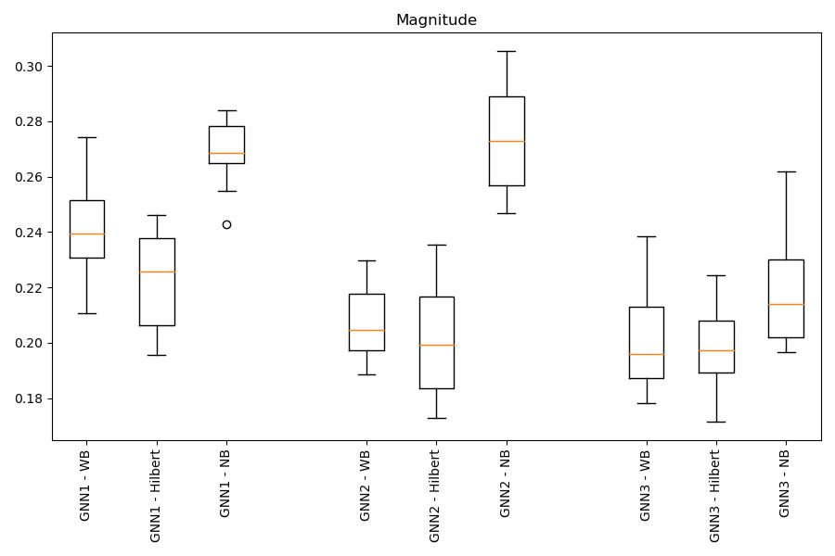
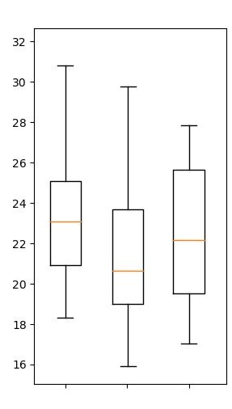
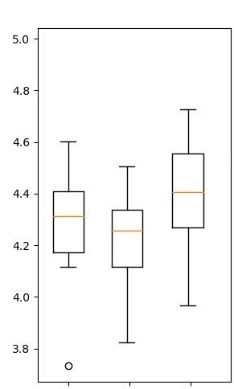
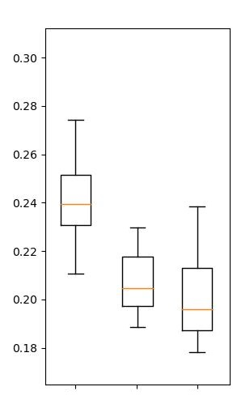
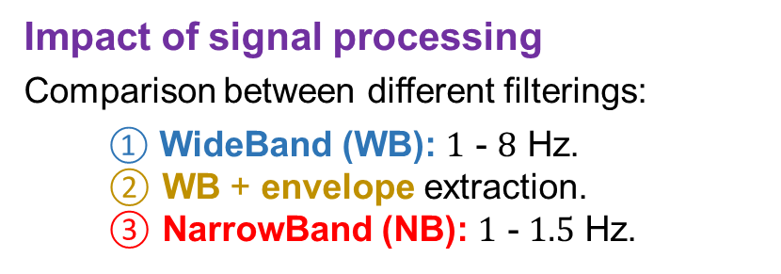
Numerical results on seismic dataset
  Impact of signal similarities
  Comparison between
  Edgeless graph (GNN1)
  Euclidian distances graph (GNN2)
  Dynamic features-based distances graph (GNN3)
  Impact of signal processing
  Comparison between different filterings:
      WideBand (WB): $1$ - $8$ Hz.
      ② WB + envelope extraction.
      ③ NarrowBand (NB): $1$ - $1.5$ Hz.
Magnitude error
GNN1
GNN2
GNN3
Location error (km)
Depth error (km)
Magnitude error
① ② ③
① ② ③
① ② ③
Please do not use this space, a QR code will be automatically overlayed
GNN1
GNN2
GNN3
GNN1
GNN2
GNN3
GNN1
GNN2
GNN3
  High frequency content (reminiscent of attenuation and scattering) does not play a major role for good predictions.
  Magnitude estimation is improved using location/signal similarities.
P3.5-812

Slide 7
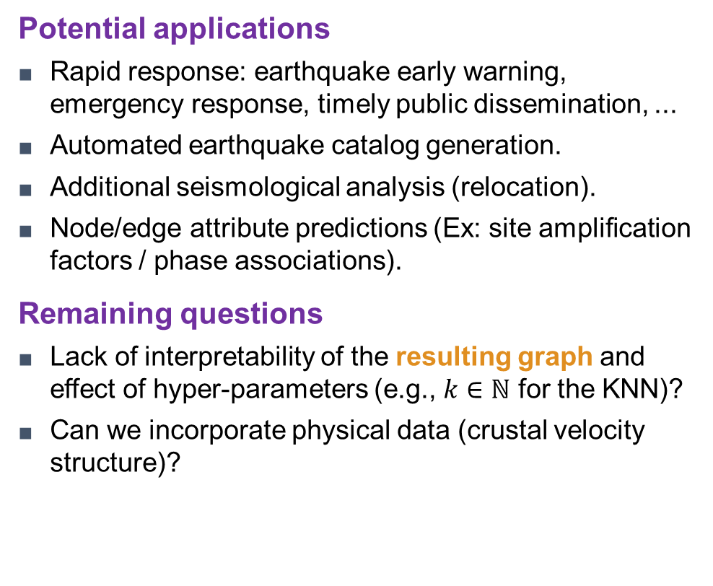



Take-home messages
  Main results
  The geometry of a seismic network is incorporated into ML architectures using a GNN approach.
  By updating the graph during the training from similarities between signal features, GNN leads to better magnitude estimations.
  Good results despite the fact that the information regarding the seismic moment is only partially retained (lower limit of the frequency band is above the corner frequency of $0.2$ Hz).
  The spectrum at higher frequencies does not seem to play a major role in the performance of characterization.
  Potential applications
  Rapid response: earthquake early warning, emergency response, timely public dissemination, ...
  Automated earthquake catalog generation.
  Additional seismological analysis (relocation).
  Node/edge attribute predictions (Ex: site amplification factors / phase associations).
  Remaining questions
  Lack of interpretability of the resulting graph and effect of hyper-parameters (e.g., $k∈ℕ$ for the KNN)?
  Can we incorporate physical data (crustal velocity structure)?
$$𝓥$$
$$+$$
P3.5-812

