Slide 1
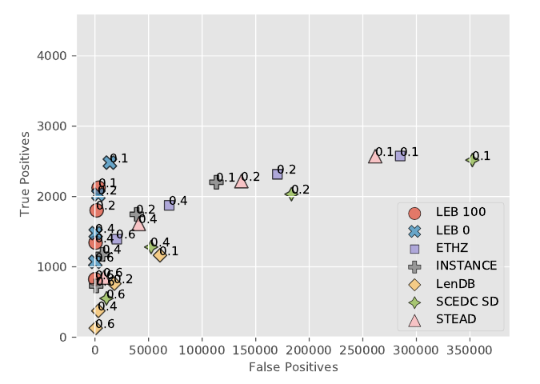
International Monitoring System 3-component seismic signal detection using the PhaseNet deep learning model
Stephen Heck, Jorge Garcia, Rigobert Tibi
Sandia National Laboratories
SAND2023-05012C
P3.5-365
False Positives versus True Positives
Using 14 years of associated signals from the Late Event Bulletin (LEB), we auto-curated a training data set consisting of signal windows containing associated arrivals, and noise windows that contain no LEB associated signals.
We construct five training data sets by varying the ratio of noise windows to signal windows. At the lowest detection thresholds, increasing the number of noise windows increases the precision from .15 to .4 while reducing the recall from .6 to .5.
LEB PhaseNet Models
Detection Thresholds
SeisBench Models
We found the primary advantage of training with IMS data over using the SeisBench models, was the suppression of the false detections on noise windows.
Unanticipated Result: Relative to the IMS-trained models, ETHZ and STEAD SeisBench models did well on teleseismic signals.

