Slide 1
International Monitoring System 3-component seismic signal detection using the PhaseNet deep learning model
Stephen Heck, Jorge Garcia, Rigobert Tibi
Sandia National Laboratories
Producing a complete and accurate set of signal detections is essential for automatically building and characterizing seismic events of interest for nuclear explosion monitoring. We explore training PhaseNet, a deep learning model using three-component sensor data from the IMS.
We constructed five IMS training data sets by varying the ratio of noise windows to signal windows and compared the IMS-trained models to models trained from 8 non-IMS datasets available for download with SeisBench.
The IMS-trained models and SeisBench models were comparable on recall, but the IMS-trained models had 10x fewer false positives. Two of SeisBench models trained on regional signals performed well on teleseismic signals.
We found the primary advantage of training with IMS data over using the SeisBench models, was the suppression of the false detections on noise windows.
This Ground-based Nuclear Detonation Detection (GNDD) research was funded by the National Nuclear Security Administration, Defense Nuclear Nonproliferation Research and Development (NNSA DNN R&D).
Please do not use this space, a QR code will be automatically overlayed
Sandia National Laboratories is a multimission laboratory managed and operated by National Technology &Engineering Solutions of Sandia, LLC, a wholly owned subsidiary of Honeywell International Inc., for the U.S. Department of Energy’s National Nuclear Security Administration under contract DE-NA0003525.
P3.5-365
SAND2023-05012C

Slide 2
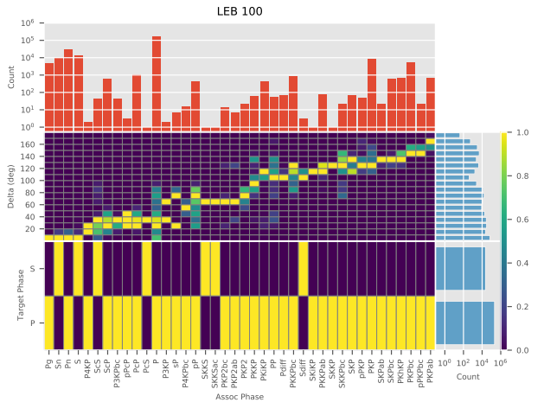
Introduction
IMS LEB Associated Phases Training Dataset
We trained the deep learning model, PhaseNet, for seismic detection on 3-component stations from the International Monitoring System (IMS), and evaluated the results using the Unconstrained Global Event Bulletin (UGEB) [5]. Using 14 years of associated signals from the Late Event Bulletin (LEB), we auto-curated a training data set consisting of signal windows containing associated arrivals, and noise windows that contain no LEB associated signals. We constructed five training data sets by varying the ratio of noise windows to signal windows and found that increasing the number of noise windows increases the precision from .15 to .4 while reducing the recall from .6 to .5. Using the SeisBench Toolbox [2], we compared eight PhaseNet models trained on non-IMS data on the UGEB. The best SeisBench model achieved a .24 F1 score versus a .49 F1 score for our best IMS-models. However, we found that the primary benefit of training with LEB data is not in detecting more signals, but rather the suppression of noise detections.
Count
Delta (Deg)
PhaseNet Phase
Y-Axis Count
Assoc Phase
Please do not use this space, a QR code will be automatically overlayed

Slide 3
Objectives
Are PhaseNet models trained on non-IMS data transportable to IMS?
Methods for building effective IMS training datasets:
How many samples are needed?
How does the ratio of noise windows to associated signal windows affect precision and recall?
What SNR threshold should be used for P and S phases?
Characterize the relationship between signal SNR and PhaseNet’s response.
Identify technical gaps between seismic deep learning research and operational monitoring systems
Please do not use this space, a QR code will be automatically overlayed

Slide 4
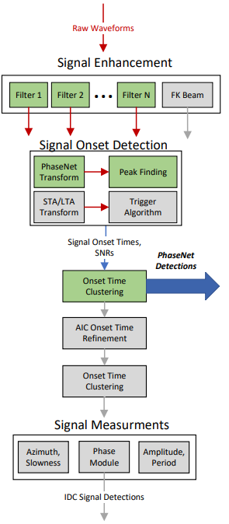
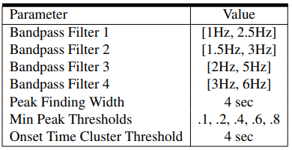
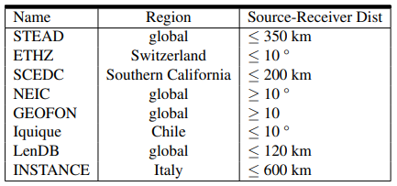
Methods: Datasets and Experimental Setup
IMS Dataset is auto-curated by thresholding waveforms by their estimated SNR using STA/LTA.
Late Event Bulletin (LEB) was used to identify associated waveforms
Multiple bandpass filters were applied to associated and non-associated waveform windows to identify good waveforms.
We removed associated windows below a minimum SNR of 4
We removed unassociated waveforms above a maximum SNR of 3
Training Dataset Naming Convention:
LEB K (ratio of unassociated waveforms to associated waveforms in %)
Evaluation Framework
We used PhaseNet as a replacement for the STA/LTA transform in a processing pipeline similar to the IDC’s signal detection software. Green boxes highlight our processing steps. Gray boxes indicate additional processing steps in the traditional signal detection pipeline. Parameters used in this study:
IMS Training and Evaluation Datasets
Evaluation Dataset (see next slide)
“SeisBench” PhaseNet Baseline models [2]
We tested the “SeisBench” and LEB PhaseNet models on IMS associated signals from the UGEB
using the our Evaluation Framework
Please do not use this space, a QR code will be automatically overlayed

Slide 5
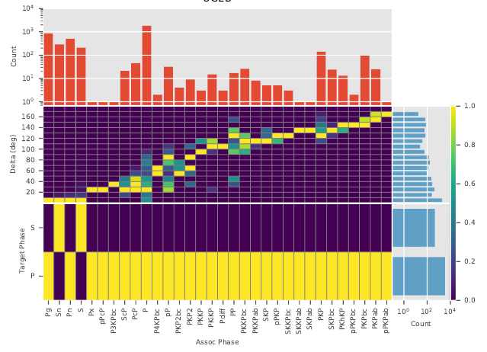
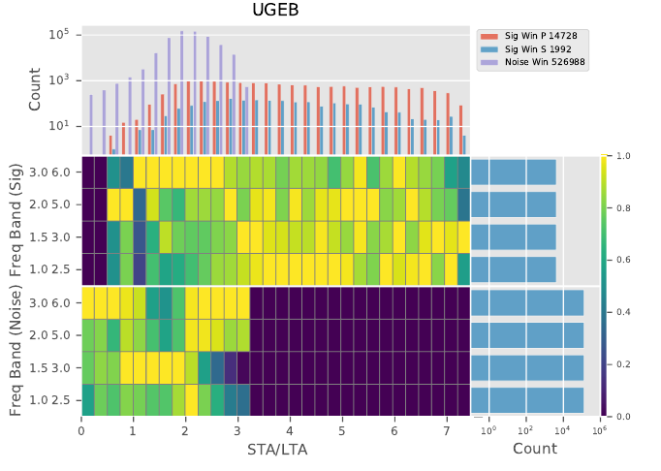
Methods: Evaluation Dataset
Unconstrained Global Event Bulletin (UGEB) [3]
The UGEB spans May 15th 2010 – May 29th 2010 and consists of approximately 11,000 human-analyst-built events. The UGEB was constructed by first starting with LEB’s 1650 events from the same time-period. Note that our LEB training datasets excluded waveforms from this two-week time period.
Phase Statistics
Input Window Statistics
Count
Count
Freq Band
(Signal)
Delta (deg)
Freq Band
(Noise)
PhaseNet Phase
SNR (STA/LTA)
Freq Band Count
Please do not use this space, a QR code will be automatically overlayed
Associated Phase
Each heat-map bin is normalized by the max element

Slide 6
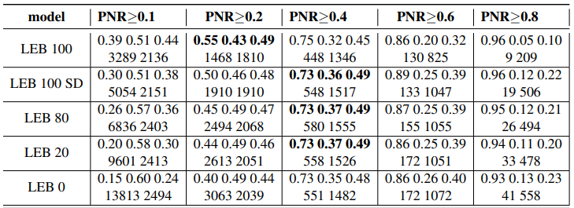
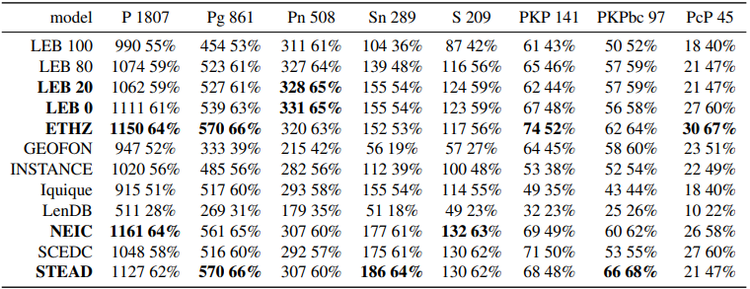
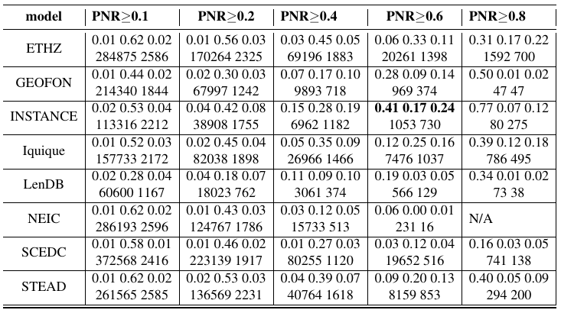
Results: Precision and Recall
Precision and Recall versus Detection Threshold
Cell format
Precision, Recall, F1
False Count, True Count
True Positives by Phase
Cell format
True Count, Recall
IMS Models
Unanticipated Result:
ETHZ and STEAD SeisBench models did well on teleseismic signals with respect to the LEB Models.
SeisBench Models
Please do not use this space, a QR code will be automatically overlayed
Notice the number of true positives remains high relative to other SeisBench models. See the next slide for a visualization.

Slide 7
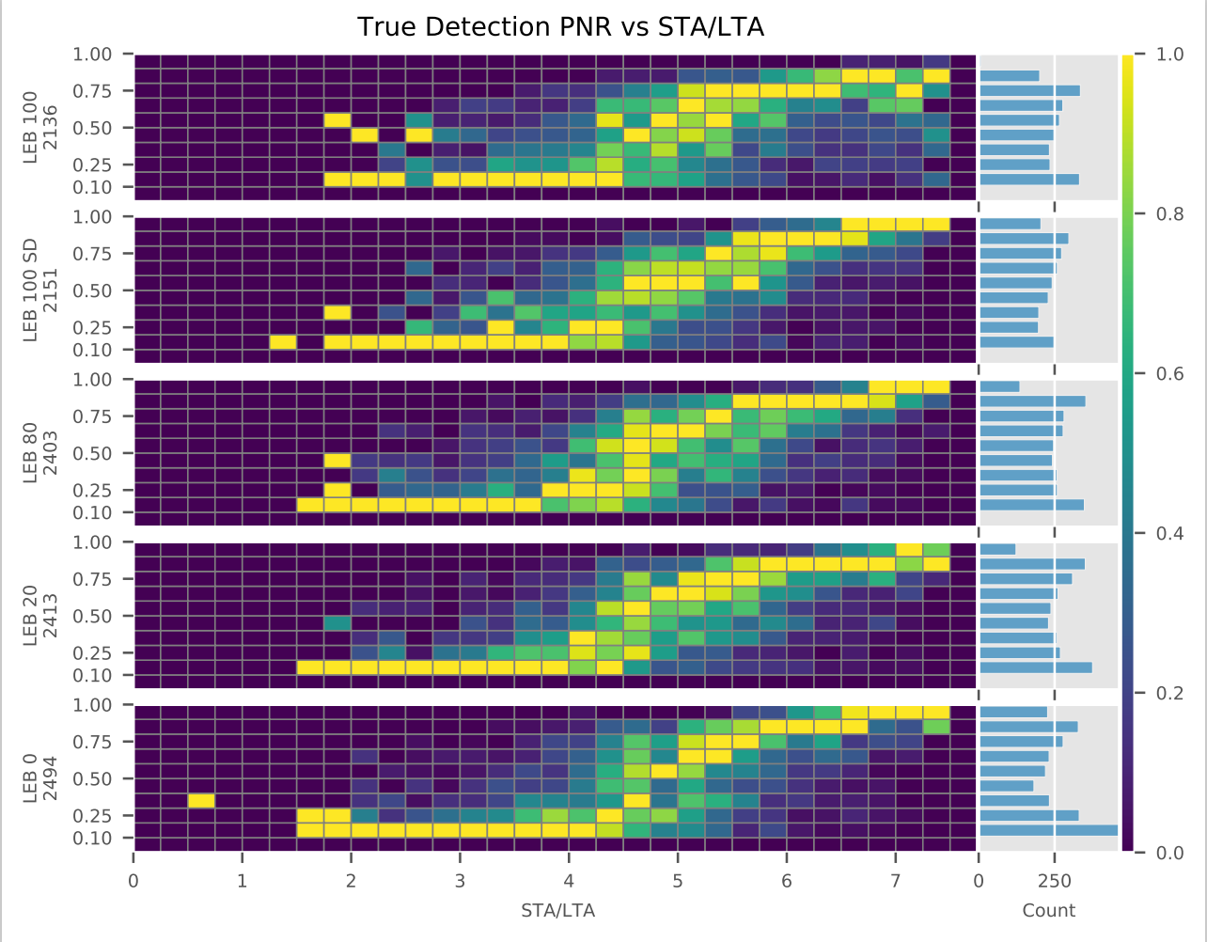
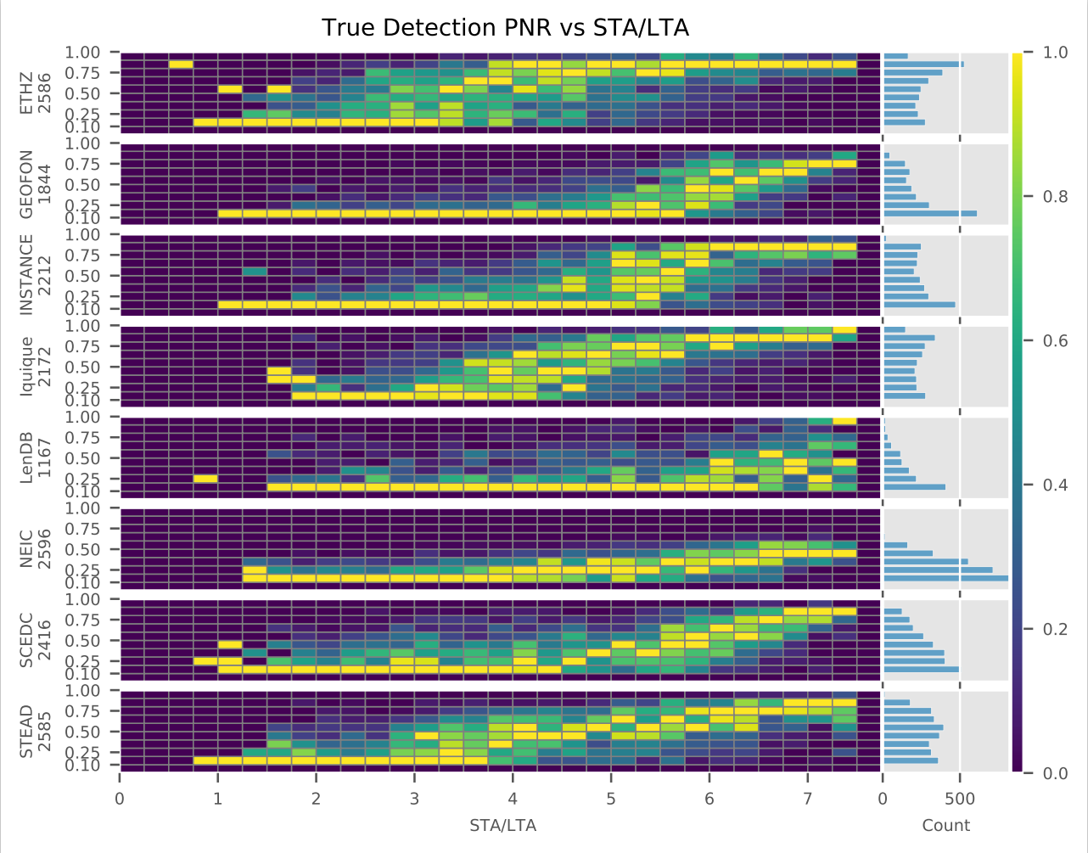
Results: PhaseNet Response versus Signal SNR for True Positives
PhaseNet Response to signal SNR for True Positives Detections
Each heat-map bin is normalized by the max element
SeisBench Models
LEB PhaseNet Models
PhaseNet Response
PhaseNet Response
PhaseNet Response trends higher and the response spread decreases as the STA/LTA response increases. Stated in another way, as the signals become easier to detect, the PhaseNet response tends to have less spread, indicating the model is more consistent with respect to higher SNR signals. Notice the lower PhaseNet response for STA/LTA<=4. Our training dataset signal STA/LTA threshold was 4.
Seisbench models ETHZ, GEOFON, Iquique, SCEDC, and STEAD had response curves similar to that of the LEB models, however there are notable differences. We note that these SeisBench models have higher PNR values for lower STA/LTA response signals (compare the STA/LTA bins 2 to 3 for ETHZ with any of the LEB models). We qualitatively rank the ETHZ model as having the best PhaseNet response due to its higher PNR mass and less spread for STA/LTA bins >= 4, and its higher PNR mass for STA/LTA <= 4 relative to the other models.
Please do not use this space, a QR code will be automatically overlayed

Slide 8
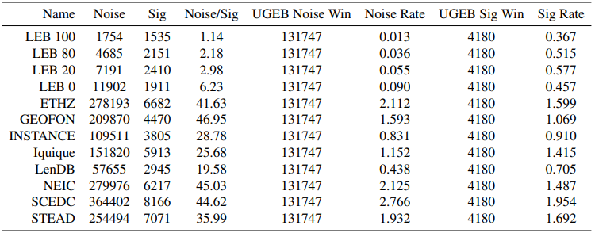
Results: False Positives
False Positive Rates per input window
We separated the false positive detections into two types: false positives created from signal windows, and false positive detections created from noise windows. The table to the right lists the false detections produced from noise windows, signal windows, and their detection rates.
Given the previous slides on recall performance and the PhaseNet response to true detections, this table shows the LEB models' primary advantage over the SeisBench models: generating fewer false detections from noise windows.
Column Descriptions
Noise: false detections within windows without signals
Sig: false detections within windows with signals
Noise/Sig: Ratio between noise window false detections and signal window false detections
UGEB Noise Win: number of unique noise windows in UGEB
Noise Rate: ratio between Noise to UGEB Noise Win columns The final two columns show analogous definitions for signal window false detections.
Please do not use this space, a QR code will be automatically overlayed

Slide 9
Conclusion
Concluding Remarks
We found the primary advantage of training with IMS data over using the SeisBench models, was the suppression of the false detections on noise windows.
Unanticipated Result: Relative to the IMS-trained models, ETHZ and STEAD SeisBench models did well on teleseismic signals.
Lowering the SNR threshold for the LEB dataset signals will likely lead to better performance on lower SNR UGEB evaluation. But, this will also likely lead to more false positives.
Thoughts towards building LEB training datasets for the operational monitoring mission:
Model-centric deep learning research has proven the viability of data-driven methods for seismic monitoring. With the assumption that monitoring organizations will need to retrain models frequently, the challenge is in developing the data interrogation tools/“rules-of-thumb” to build effective training datasets. To address the dataset challenge, we will be focusing on applying Data-centric AI approaches [4, 5].
Please do not use this space, a QR code will be automatically overlayed

Slide 10
References
For additional information on the results presented in this poster:
Heck, et. al 2022 International Monitoring System 3-Component Seismic Signal Detection Using the PhaseNet Deep Learning Model, Sandia Technical Report, SAND2023-10785
References
[1] Zhu Weiqiang and Gregory Beroza. PhaseNet: A Deep-Neural-Network-Based Seismic Arrival Time Picking Method. Geophysical Journal International
[2] Münchmeyer, et. al Which picker fits my data? a quantitative evaluation of deep learning based seismic pickers. Journal of Geophysical Research: Solid Earth
[3] Linville, et. al Global- and Local-Scale High-Resolution Event Catalogs for Algorithm Testing. Seismological Research Letters, 90(5):1987–1993, 07 2019.
[4] Introduction to Data-Centric AI, https://dcai.csail.mit.edu/
[5] Curtis G. Northcutt, Anish Athalye and Jonas Mueller. 2021 Pervasive Label Errors in Test Sets Destabilize Machine Learning Benchmarks. arXiv:2103.14749
Please do not use this space, a QR code will be automatically overlayed

