Slide 1

Analysis and Simulation of Improved Seismic Data using Adaptive Processing by National Data Centre Iraq
Yasameen Hameed Shamkhi
Iraqi National Monitoring Authority (INMA)
This study aims to compare the performance of four popular machine learning algorithms in earthquake detection. The methodology employed in this study involves collecting seismic data from various sources and preprocessing the data.
Perform a comparative analysis of the effectiveness of LSTM, CNN, MLP, and SVM algorithms in earthquake detection.
The obtained results indicate the ability of four renowned machine learning algorithm. This results demonstrate the great performance of CNN network outperforming all other algorithms in all datasets.
The main goal is to perform a comparative analysis of the effectiveness of LSTM, CNN, MLP, and SVM artificial intelligence algorithms in earthquake detection .
Please do not use this space, a QR code will be automatically overlayed
P3.5-529

Slide 2
Introduction
Recent advancements in machine learning (ML) have shown promise in earthquake detection. Several ML algorithms have been applied to this problem, including Long Short-Term Memory (LSTM), Convolutional Neural Networks (CNN), Multilayer Perceptron (MLP), and Support Vector Machines (SVM). However, there is still no clear understanding of which algorithm produces the most accurate earthquake detection.
Therefore, the main goal is to perform a comparative analysis of the effectiveness of LSTM, CNN, MLP, and SVM algorithms in earthquake detection.The study will use various earthquake datasets from Arabian Sea earthquake seismic event on 26 October 2022 at 23:00:07 and seismic event which was also studied and evaluated in Turkey on 23 November at 01:08:15 and investigate the performance of each algorithm on these datasets. The study will also examine the impact of the different parameters of each algorithm on its performance.
Please do not use this space, a QR code will be automatically overlayed
P3.5-529

Slide 3
Objectives
To collect earthquake datasets from different regions and prepare them for analysis.
To develop and implement LSTM, CNN, MLP, and SVM algorithms for earthquake detection.
To evaluate the performance of each algorithm in terms of accuracy, precision, recall, F1-score, and other relevant metrics.
To investigate the impact of different parameters of each algorithm on its performance.
To compare the performance of each algorithm and identify the most effective algorithm for earthquake detection.
Please do not use this space, a QR code will be automatically overlayed
P3.5-529

Slide 4
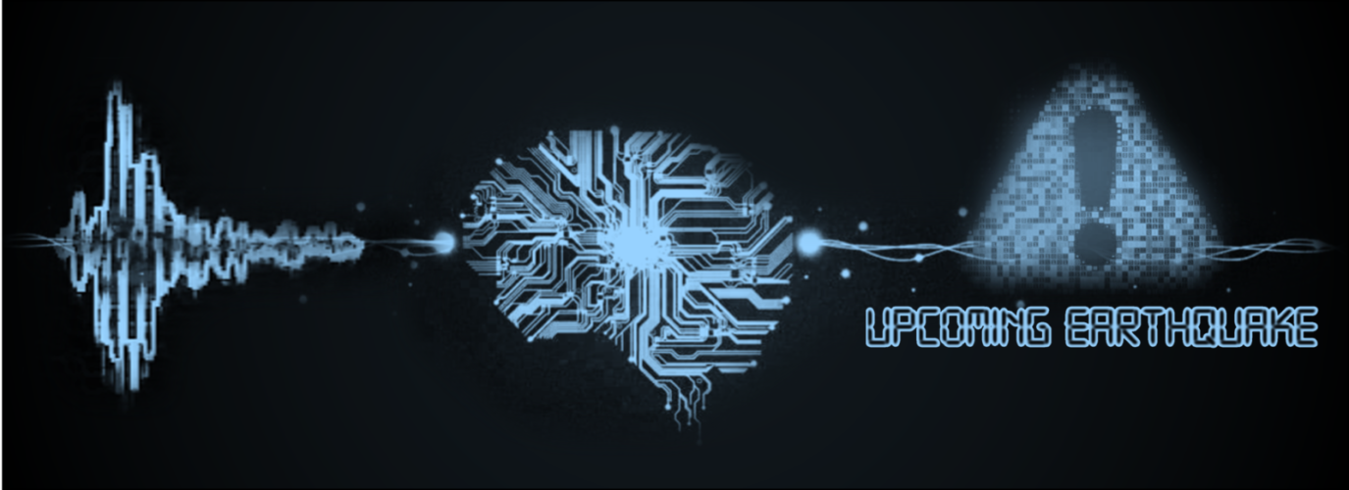
Methodology
This study aims to compare the performance of four popular machine learning algorithms in earthquake detection. The methodology employed in this study involves collecting seismic data from various sources and preprocessing the data.
In the following, we will give a brief explanation of each of SVM, CNN, LSTM and, MLP methods.
SVM
Support Vector Machine (SVM) is a supervised machine learning algorithm used for classification and regression analysis. SVM method has been applied in earthquake detection by using seismic data to classify the occurrence of earthquakes.
CNN
The Convolutional Neural Network (CNN) is a deep learning method commonly used for image classification and recognition tasks. CNNs consist of multiple convolutional layers that apply filters to input images, extracting features such as edges and shapes. . CNNs have also been used in earthquake detection, particularly for detecting seismic signals that can indicate an earthquake.
LSTM
Long Short-Term Memory (LSTM) is a type of Recurrent Neural Network (RNN) that is widely used in natural language processing, speech recognition, and time-series detection. LSTMs have also been used in earthquake detection , particularly for time-series analysis of seismic data. Earthquake signals are typically complex and exhibit nonlinear pattern.
Please do not use this space, a QR code will be automatically overlayed
P3.5-529

Slide 5
Methodology/Data
MLP
Multilayer Perceptron (MLP) is a type of feedforward artificial neural network that is widely used in machine learning applications for classification and regression tasks.
MLP has also been used in earthquake detection, particularly for feature extraction and classification tasks. By training an MLP on seismic data, it is possible to extract features that can indicate the occurrence of an earthquake and classify the input data into earthquake or non-earthquake events.
Dataset
Turkey event on 23 November 2022:
IMS- IDC
Data requested from IDC (International Data Center) products from four IMS (International Monitoring System) seismic stations ( ASF, KBZ, BR131 and DABOX).
Arabian sea event on 26 October 2022:
IMS - IDC
Data from IDC products from hydroacoustic station in the International Monitoring System (IMS) (HA1) .
Data from IDC products from four IMS seismic stations (CM31, KBZ, BR131 and KMBO) .
IRIS dataset:
Data from IRIS stations RAYN (Saudi Arabia station),UOSS (station of United Arab Emirates ) and DHK1 (Iraq local station).
IRIS dataset:
Data from IRIS (Incorporated Research Institutions for Seismology) stations (Iraq local stations BSR and DHK1),UOSS (station of United Arab Emirates) and ANTO station in Turkey.
Please do not use this space, a QR code will be automatically overlayed
P3.5-529

Slide 6
Results
Turkey Event- IMS stations
Input Signals
Obtained accuracies for 10 replications:
Confusion matrix of SVM and MLP
Confusion matrix of CNN and LSTM
Please do not use this space, a QR code will be automatically overlayed
P3.5-529

Slide 7
Results
ROC curve of SVM and MLP
ROC curve of CNN and LSTM
However, the CNN and LSTM show better AUC, and as a result, better performance.
The final evaluation plot is ROC which gives information about true positive rate and false positive rate. The ROC curve shows greater performance when the curve cross near the top-left corner of the axis. Thus, the more area under curve (AUC) can show better performance. As can be seen in the following figures, AUC of both MLP and SVM are not good enough.
Please do not use this space, a QR code will be automatically overlayed
P3.5-529

Slide 8
Results
Turkey Event- IRIS stations
Input Signals
Obtained accuracies for 10 replications:
Confusion matrix of SVM and MLP
Confusion matrix of CNN and LSTM
Confusion Matrix of CNN
1
0
0
NaN%
0.0%
0.0%
NaN%
s
Please do not use this space, a QR code will be automatically overlayed
s
l
a
5
6
54.5%
t
C
2
45.5%
54.5%
45.5%
u
p
t
u
O
0.0%
100%
54.5%
100%
0.0%
45.5%
P3.5-529
1
2
Target Class

Slide 9
Results
ROC curve of SVM and MLP
ROC curve of CNN and LSTM
The final evaluation plot is ROC which gives information about true positive rate and false positive rate. The ROC curve shows greater performance when the curve cross near the top-left corner of the axis. Thus, the more area under curve (AUC) can show better performance. As can be seen in the following figures, AUC of both MLP and SVM are not good enough.
The AUC of LSTM is also the same as MLP and SVM. However, the CNN shows a great AUC and pass through the top-left corner.
Please do not use this space, a QR code will be automatically overlayed
P3.5-529

Slide 10
Results
Arabian sea Event- IMS station(HA1)
Input Signals
Obtained accuracies for 10 replications:
Confusion matrix of SVM and MLP
Confusion matrix of CNN and LSTM
Please do not use this space, a QR code will be automatically overlayed
P3.5-529

Slide 11
Results
ROC curve of SVM and MLP
ROC curve of CNN and LSTM
The final evaluation plot is ROC which gives information about true positive rate and false positive rate. The ROC curve shows greater performance when the curve cross near the top-left corner of the axis. Thus, the more area under curve (AUC) can show better performance. As can be seen in the following figures, AUC of both MLP and SVM are not good enough.
However, the CNN and LSTM show better AUC, and as a result, better performance.
Please do not use this space, a QR code will be automatically overlayed
P3.5-529

Slide 12
Results
Arabian sea event-IMS seismic stations
Input Signals
Obtained accuracies for 10 replications:
Confusion matrix of SVM and MLP
Confusion matrix of CNN and LSTM
Please do not use this space, a QR code will be automatically overlayed
P3.5-529

Slide 13
Results
ROC curve of SVM and MLP
ROC curve of CNN and LSTM
The final evaluation plot is ROC which gives information about true positive rate and false positive rate. The ROC curve shows greater performance when the curve cross near the top-left corner of the axis. Thus, the more area under curve (AUC) can show better performance. As can be seen in the following figures, AUC of both MLP and SVM are not good enough.
The AUC of LSTM is also the same as MLP and SVM. However, the CNN shows better AUC, and as a result, better performance.
Please do not use this space, a QR code will be automatically overlayed
P3.5-529

Slide 14
Results
Arabian sea Event- IRIS stations
Input Signals
Obtained accuracies for 10 replications:
Confusion matrix of SVM and MLP
Confusion matrix of CNN and LSTM
Please do not use this space, a QR code will be automatically overlayed
P3.5-529

Slide 15
Results
ROC curve of SVM and MLP
ROC curve of CNN and LSTM
The final evaluation plot is ROC which gives information about true positive rate and false positive rate. The ROC curve shows greater performance when the curve cross near the top-left corner of the axis. Thus, the more area under curve (AUC) can show better performance. As can be seen in the following figures, AUC of both MLP and SVM are not good enough.
However, the CNN and LSTM show better AUC, and as a result, better performance.
Please do not use this space, a QR code will be automatically overlayed
P3.5-529

Slide 16
Conclusion
The obtained results indicate the ability of four renowned machine learning algorithm.
This results demonstrate the great performance of CNN network outperforming all other algorithms in all datasets.
Three algorithms demonstrate weaknesses, especially MLP and LSTM, performance of which was like a random guess.
The LSTM, however, could achieve some good performances in some datasets, but its overall performance was not good enough.
Please do not use this space, a QR code will be automatically overlayed
P3.5-529

