Slide 1
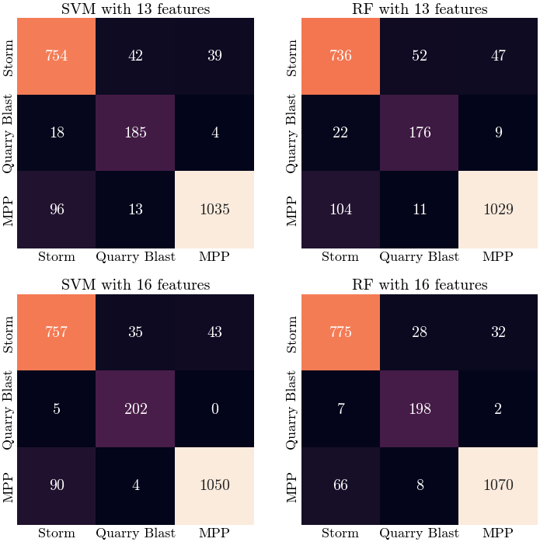
Automatic Event Discrimination with Machine Learning Techniques at the Piszkés-tető Infrasound Array, Hungary
Marcell Pásztor^{1,2,3}, István Bondár²
1 Eötvös Loránd University 2 Inst. for Geological and Geochemical Res 3 Inst. of Earth Physics and Space Science
P3.5-327
14,000 labelled infrasound (PMCC) detections from quarry blasts, storms and a power plant
Time-domain, frequency-domain and PMCC related features were extracted
Training Random Forest and Support Vector Machines to separate the three sources
Good separation between the three classes was found

