Slide 1
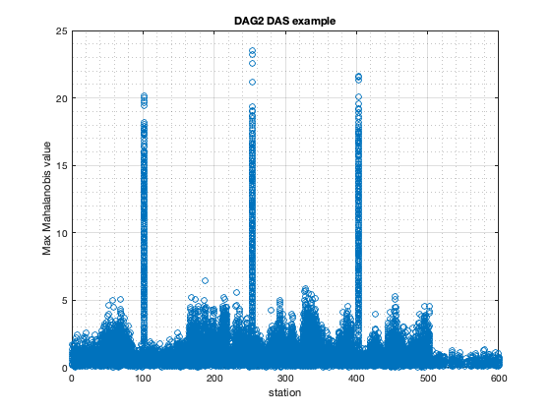
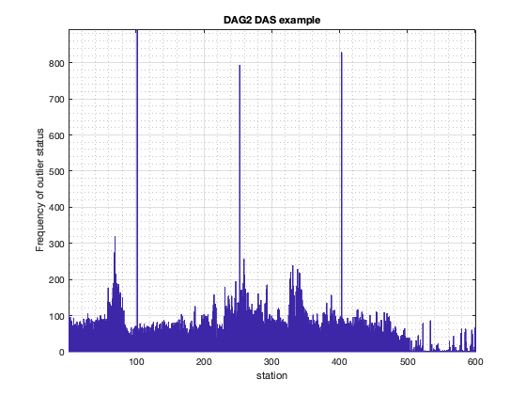
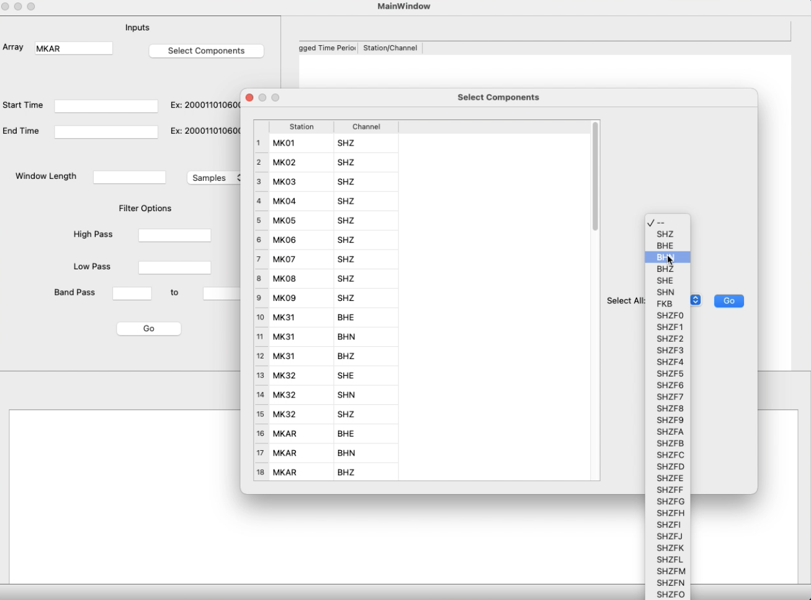
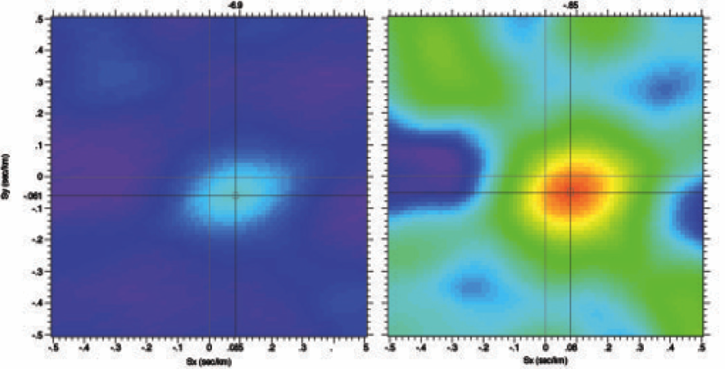
A Python Tool for Evaluating Transient Noise on Seismic Array Components
Charlotte Rowe and Clara Stanbury
Earth and Environmental Sciences, Los Alamos National Laboratory
P3.5-168
A time-varying singular value decomposition of array components, using a jackknifing approach, identifies dynamically changing outliers
The tool is now driven in a Python GUI with time, channel, component and filtering options. Updates to the GUI will include the recently developed randomization approach for large N arrays.
69
Preliminary tests demonstrate successful reporting of anomalies and identification of the problematic channel, both via dynamic K-means clustering and iterative randomized jackknifing applied to large N arrays.
We are building a tool to to identify intermittent noise on seismic array channels to improve the integrity of automated analysis methods.
Group 0
Group 1

