Slide 1
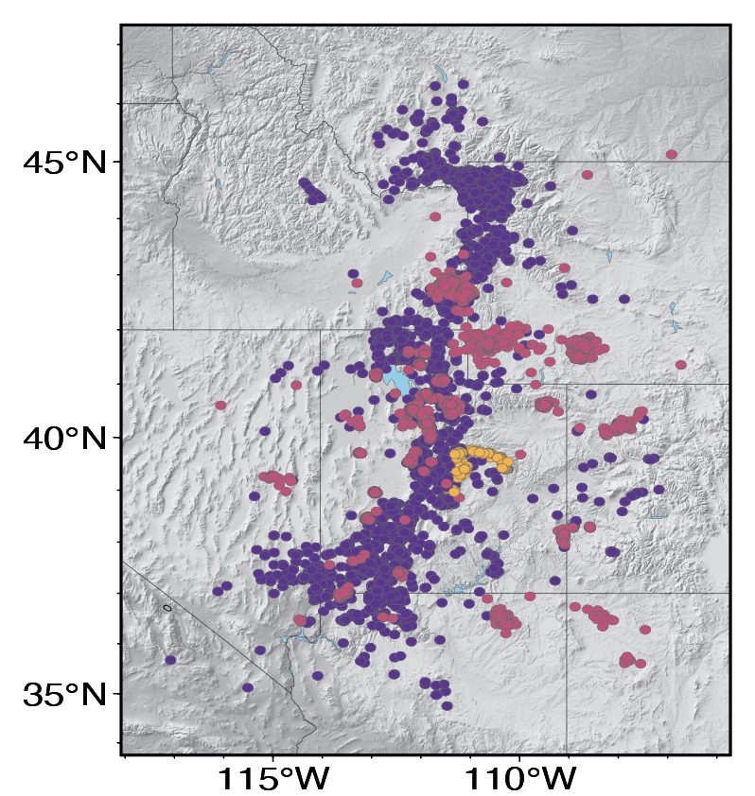
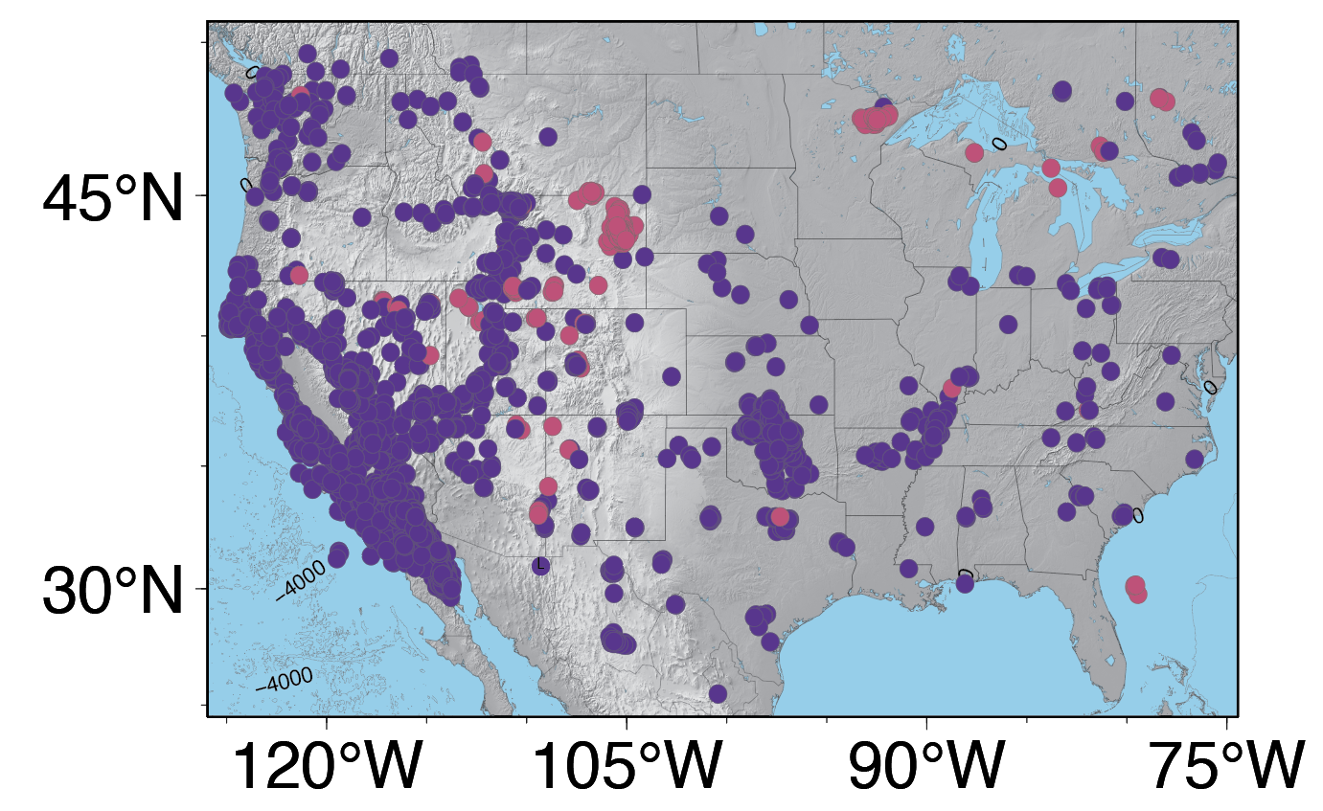
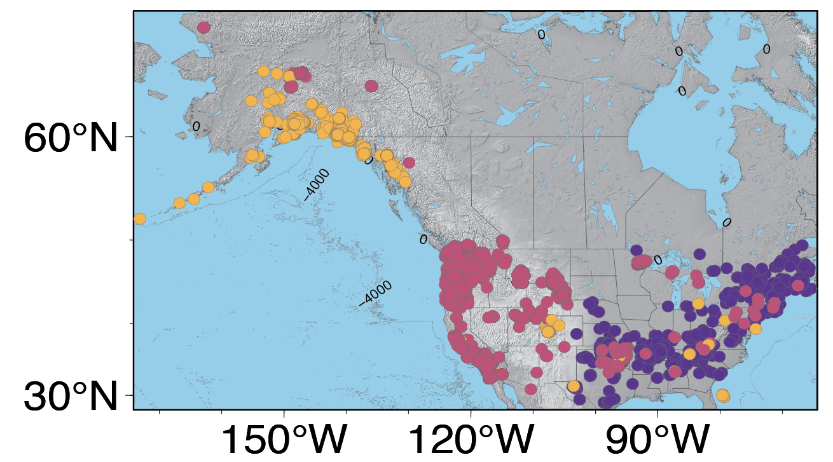
Extending Utah models for event discrimination to the broader US with semi-supervised learning
Lisa Linville¹,Jorge Garcia¹, Rhiannon Vieceli¹
Sandia National Laboratories, Albuquerque, New Mexico USA
P3.5-319
Earthquakes | Explosions | Exotics
Catalog 3
Catalog 1
Catalog 2
With so many different seismic catalogs that have different characteristics and geographic coverage, what is the best way to use each of them in event discrimination over broad scales?
We want prediction models that are generally competent across the continental U.S.
We want models to have credible and useful knowledge of their predictive confidence and to be able to abstaining from decisions when appropriate.
This work suggests that combining all the data together and training a large model may not be as useful as decision fusion from individual models.

