Slide 1
Extending Utah models for event discrimination to the broader US with semi-supervised learning
Lisa Linville¹,Jorge Garcia¹, Rhiannon Vieceli¹
Sandia National Laboratories, Albuquerque, New Mexico USA
This work represents innovations in training data-hungry discrimination models that would otherwise be limited by lack of ground-truth. We also advance the security and safety of their use by integrating uncertainty, outlier detection, and decision abstention.
We train CNN¹ discrimination models using two U.S. scale primary datasets, and evaluate on regional scale datasets. Our objective is to identify the most impactful way to leverage decisions across models to maximize performance and reliable confidence estimates.
Each dataset imparts a specific bias in the predictions (earthquakes or explosions) and therefore simple ensembles of predictions offer more robust uncertainty than joint training. Exotic signals like landslides and bolides are typically assigned low predictive confidence.
Models built with training data from existing catalogs will often fail to generalize. Rather than training models across many different catalogs, or transfer learning between them, simple ensemble approaches can be more valuable for performance and uncertainty estimation.
Please do not use this space, a QR code will be automatically overlayed
P3.5-319

Slide 2
Introduction
How should we use multiple discrete seismic catalogs for event discrimination over large scales (the continental U.S. for example)?
Not all catalogs have complete label sets (which events are of which type, for example). We use an event-based training approach that expects all the stations to make similar (low variance) predictions for all events, even unlabeled ones.
Individual datasets often encode a lot of bias, for example what earthquakes in a specific area observed over set distances look like. Jointly modelling them together may but is not guaranteed to reduce bias.
Here we are assessing bias in large scale catalogs and working towards designing ways to exploit data across catalogs for decision making with uncertainty.
Please do not use this space, a QR code will be automatically overlayed
P3.5-319

Slide 3
Primary Research Objectives
Does more training data lead to better generalization, or can it hurt performance on specific sub-catalogs? Adding TA to NEIC (see data section) probably helps west coast prediction because there is no earthquake coverage in our NEIC catalog in that part of the country, but does it decrease performance on TA test events compared to TA models alone?
Does Event-Based Training (EBT) increase performance in supervised settings (are models trained with EBT weight values > 0 providing the best validation metrics)? If so, is it because EBT is helping us generalize better (they perform better on out-of-distribution or OOD tests) or because we continue to fit a discrete set of repeatable observations?
We know that we can obtain high fidelity separation that alerts us when new catalogs are poorly aligned with the training data, but that this desired behavior breaks down outside our training catalog characteristics. Can ensemble uncertainty approaches consistently and accurately provide us with a way to prioritize analyst attention and filter novel signals?
Please do not use this space, a QR code will be automatically overlayed
P3.5-319

Slide 4
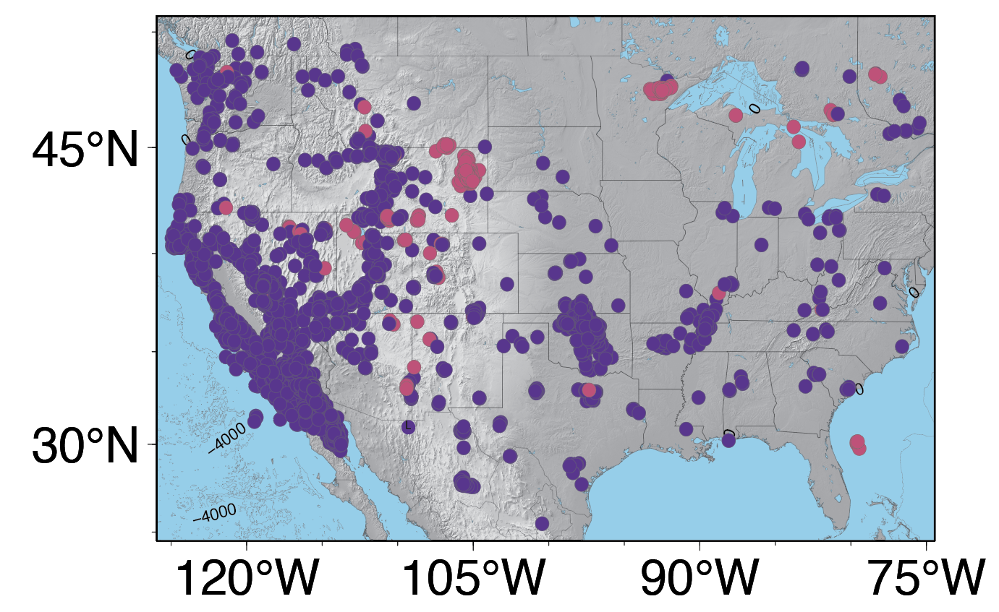
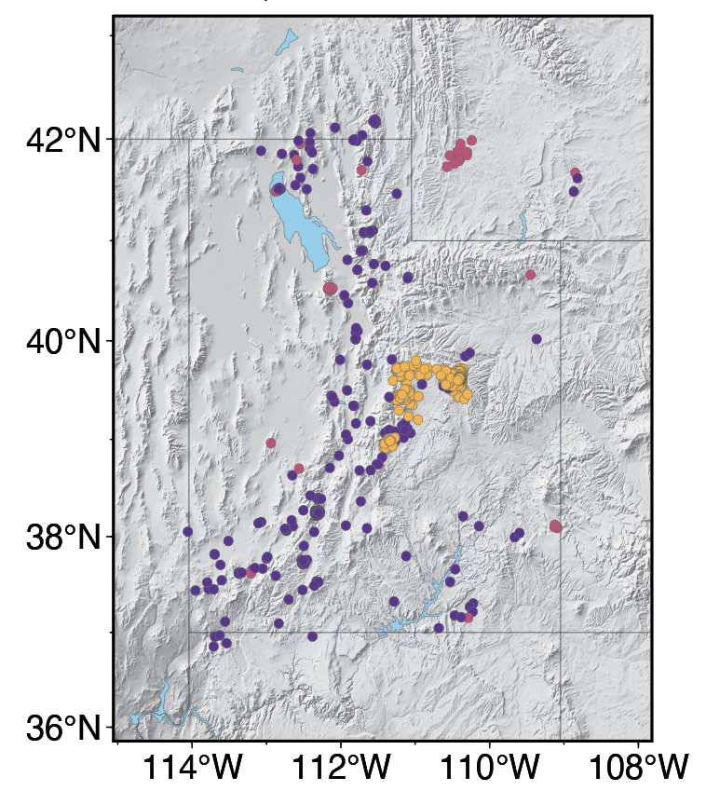
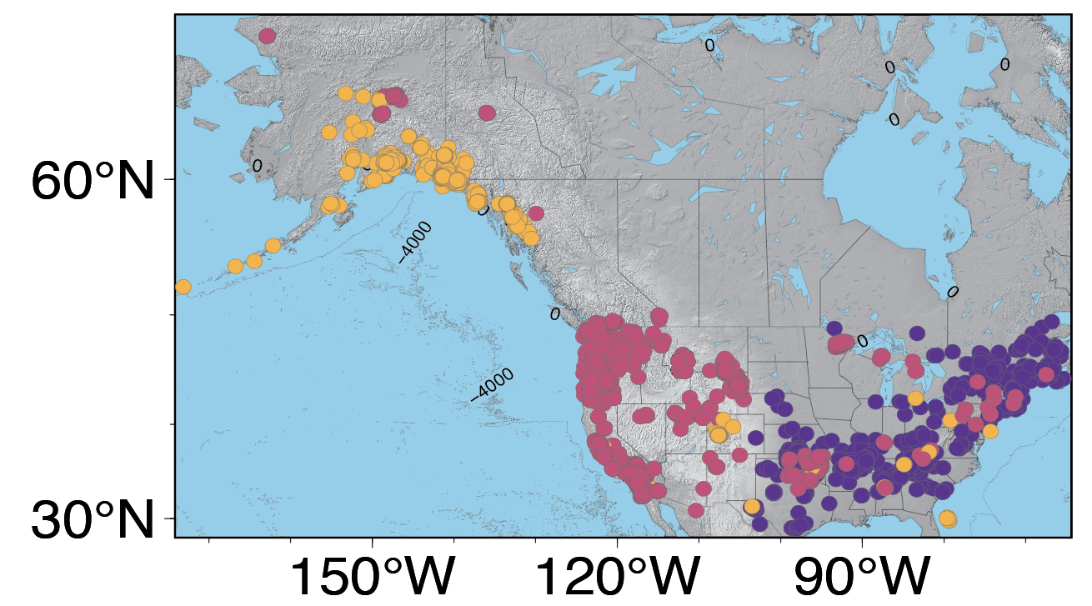
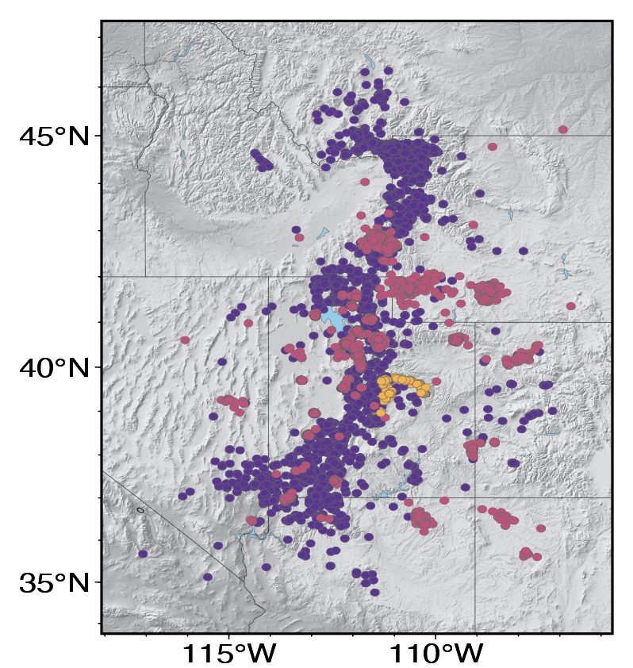
Methods and Datasets
Primary Datasets
Testing Datasets
Supervised Learning + Event-Based Training
Transportable Array- TA
University of Utah Seismograph Stations- UUSS
station
event
CNN models ingest examples from a single station and make station predictions for event type
Supervised Learning
Uses the event labels from an event and tries to match the label given to each station
National Earthquake Information Center- NEIC
Unconstrained Utah Event Bulletin- UUEB
EBT
Minimizes the variance between all the stations that observe a unique event, regardless of label
Please do not use this space, a QR code will be automatically overlayed
P3.5-319
Earthquakes | Explosions | Exotics

Slide 5
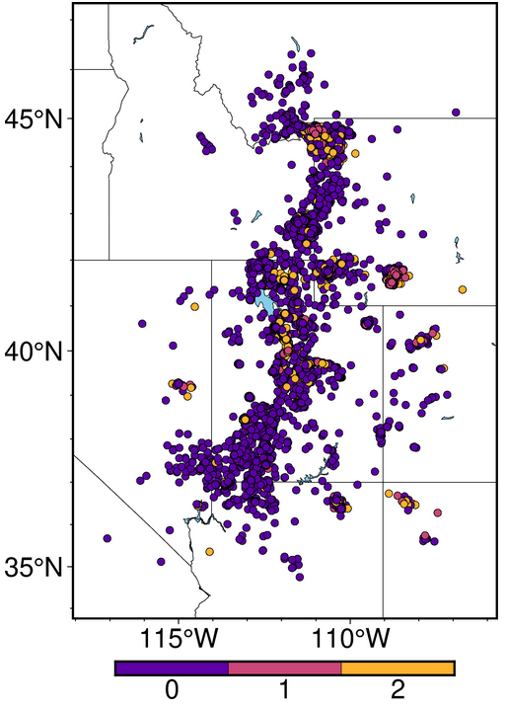
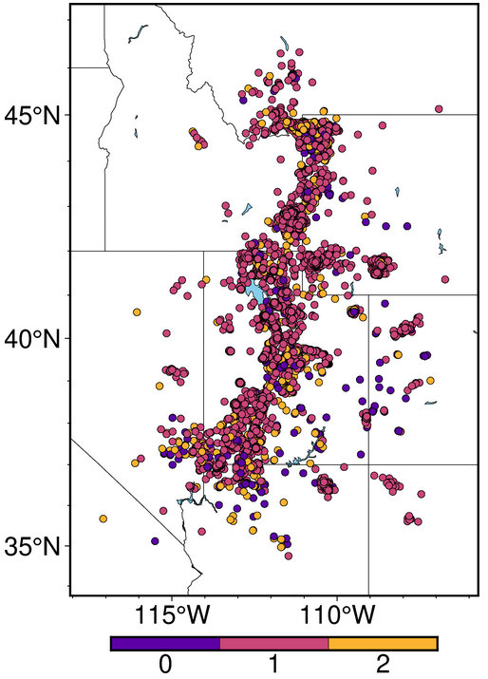
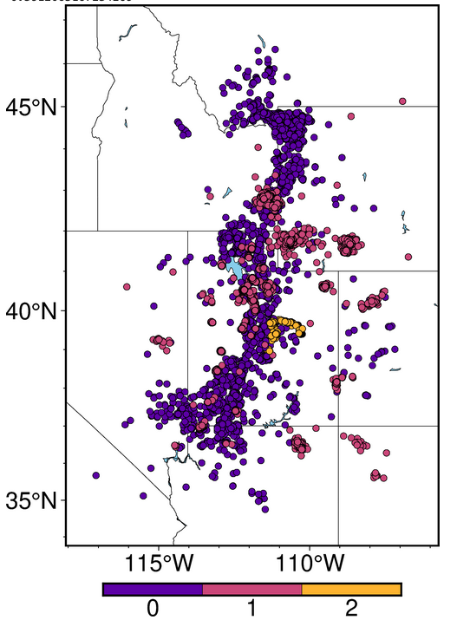
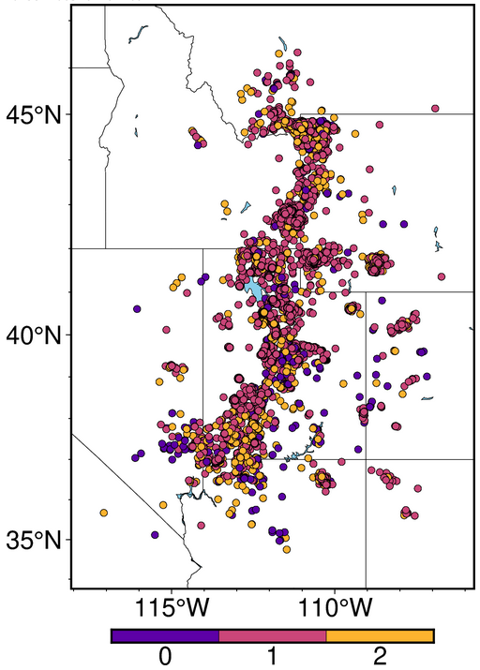
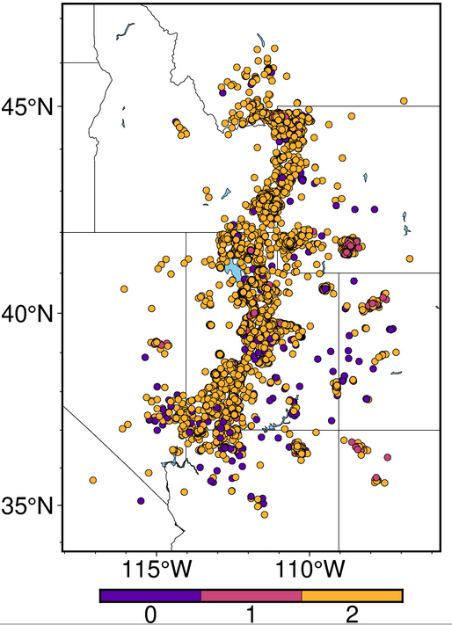
Results: model bias averages out through ensembles
TA labels
NEIC labels
NEIC knows what explosions look like in the west, and what earthquakes look like in the east
TA knows what earthquakes look like in the west, but little about explosions in the west
NEIC + TA is behaviors mimic NEIC, which is 10x more abundant in training
Ensembles with TA and NEIC are good at saying ‘I don’t know’ (yellow labels), but have poor coverage (they abstain from most decisions)
True Labels
prediction probability
NEIC + TA
Ensemble labels
Please do not use this space, a QR code will be automatically overlayed
Exotic events are typically assigned to class 2 (the model is unsure) with a bias toward earthquake prediction (class 0)
P3.5-319

Slide 6
Conclusions
Deep Learning is good at discrimination on specific catalogs (96-98% accuracy)
Trained models do not typically generalize well beyond a specific catalog, even in the same geographic area if the station distributions are significantly different (96% accuracy drops to 82% in Utah)
In exploring U.S. scale discrimination we found that certain catalogs lead to certain bias likely related to propagation paths and training dynamics.
When models have opposing bias, it is more powerful to ensemble than to merge datasets and train jointly. And we find that ensembles provide the same value that Bayesian Neural Networks can under practical implementations.
However, more work is necessary to retain performance, coverage, and acceptable prediction confidence.
We are assessing the use of post-hoc decision modelling across catalogs to assess which catalog decisions will be the most trustworthy.
Please do not use this space, a QR code will be automatically overlayed
P3.5-319

Slide 7
Acknowledgements
Sandia National Laboratories is a multimission laboratory operated by National Technology and Engineering Solutions of Sandia LLC, a wholly owned subsidiary of Honeywell International Inc., for the U.S. Department of Energy’s National Nuclear Security Administration. Sandia Labs has major research and development responsibilities in nuclear deterrence, global security, defense, energy technologies and economic competitiveness, with main facilities in Albuquerque, New Mexico, and Livermore, California.
This research was funded by the National Nuclear Security Administration, Defense Nuclear Nonproliferation Research and Development (NNSA DNN R&D). The authors acknowledge important interdisciplinary collaboration with scientists and engineers from LANL, LLNL, MSTS, PNNL, and SNL
1. CNN
Huh, M., Agrawal, P., & Efros, A. A. (2016). What makes ImageNet good for transfer learning? arXiv preprint arXiv:1608.08614.
P3.5-319

