Slide 1
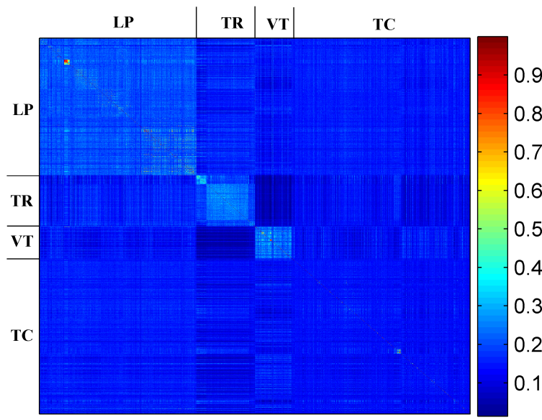
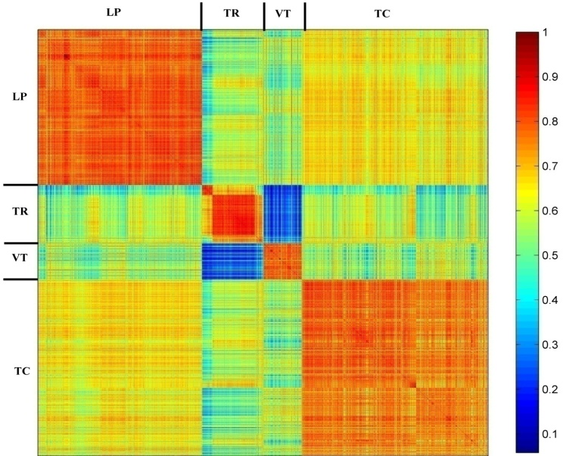


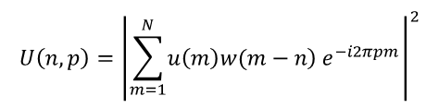
Classification of seismic events using a cross-correlation based approach
A. Atmani¹, E.H. Ait Laasri², D. Agliz³, E. Akhouayri⁴
^{1,2,3}GEMS Laboratory, National School of Applied Sciences, Ibn Zohr University, Agadir, Morocco
⁴LETSMP Laboratory, Faculty of Sciences, Ibn Zohr University, Agadir, Morocco
P3.5-758
Time Domain
Time-Frequency domain
Short Term Fourier Transform STFT
spectrogram U(n,p)
sampled signals u(m)
$$U\left(n,p\right)={\left|\sum_{m=1}^{N}{\left.u\left(m\right)w(m−n\right)}e^{−i2πpm}\right|}^{2}$$
1D cross-correlation
2D cross-correlation
$${MNCC}_{uv}=\frac{\max\left(\left|R_{uv}\left(k\right)\right|\right)}{\sqrt{R_{uu}\left(0\right)R_{vv}\left(0\right)}}$$
$${MNCC}_{UV}=\frac{\max\left(\left|R_{UV}\left(k\right)\right|\right)}{\sqrt{R_{UU}\left(0\right)R_{VV}\left(0\right)}}$$
Classification
Global accuracy of 59,7%
Global accuracy of 92,48%

