Slide 1

Classification of seismic events using a cross-correlation based approach
A. Atmani¹, E.H. Ait Laasri², D. Agliz³, E. Akhouayri⁴
^{1,2,3}GEMS Laboratory, National School of Applied Sciences, Ibn Zohr University, Agadir, Morocco
⁴LETSMP Laboratory, Faculty of Sciences, Ibn Zohr University, Agadir, Morocco
Continuous seismic activity monitoring is one the methods used to detect nuclear explosions. Due to the large amount of recorded data, an automatic classification task is mandatory. In this study we have proposed a straightforward approach. The later is evaluated using four event classes.
The proposed approach is based on the so-called cross-correlation function. Two variants of this method are presented. The former is used in the time domain and the later requires time-frequency domain.
The performance of this approach is examined using volcano data composed of four classes.
The method achieves a global accuracy of 59,7% in time domain and 92,48% in time-frequency domain using the four classes of the database.
  When excluding the TC class, we obtain a global accuracy of 86,3% in time domain and 96.53% in the time-frequency domain.
  The obtained results showed that the proposed approach can achieve high performance, particularly in time-frequency domain. In this study, the method was tested on a volcano data. Nevertheless, we are confident that the method can reach high performance in any other types of classes.
Please do not use this space, a QR code will be automatically overlayed
P3.5-758

Slide 2
Introduction
Among the most efficient methods used to survey continuously active volcanoes is monitoring its seismic activity.
The main goals of this monitoring are:
Studying the behavior of the active volcano in order to understand different physical processes occurring inside it (explosions, rock fracturing, degasification, magmatic intrusion, eruptions, pressurization, and depressurization).
Launching an early alarm when an eruption is about to take place
To achieve this goal, numerous seismic stations are deployed around the volcano, forming a seismic network. Every station transmits its recorded signal to a central observatory where they are retrieved, classified and stored for subsequent analysis and processing.
The classification task of volcano seismic events can be achieved using different methods. Some of them use more sophisticated techniques.
Please do not use this space, a QR code will be automatically overlayed
In this work, we propose an easy and straightforward method to classify volcano seismic events using the cross-correlation function in time and time-frequency domains.
P3.5-758

Slide 3
Objectives
The main objective of this work is developing a classification approach for seismic signal classification using the cross-correlation function in time and time-frequency domains. Indeed, an automatic classification task becomes nowadays necessary due to the large amount of data recorded on a daily basis. This task can significantly help scientists and especially data seismic analysts to classify their databases to a predetermined number of classes depending on the diversity of the physical sources generating them.
The goal is to develop an easy and straightforward method, avoiding the complex processing steps generally needed in many other proposed methods in the literature.
Please do not use this space, a QR code will be automatically overlayed
P3.5-758

Slide 4


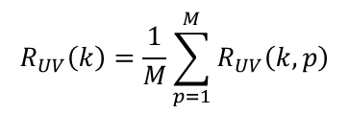
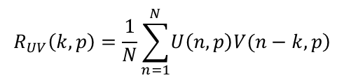
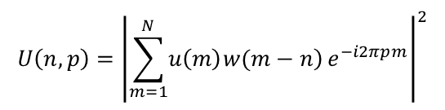
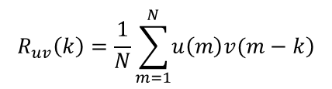
Methods
Time Domain
Time-Frequency domain
To estimate the degree of similarity between two signals u(t) and v(t), we use the Maximum Normalized Cross-Correlation (MNCC) function defined below :
In this domain, we perform a 2D cross-correlation using the spectrogram U(n,p) of the signal u(m) :
$$U\left(n,p\right)={\left|\sum_{m=1}^{N}{\left.u\left(m\right)w(m−n\right)}e^{−i2πpm}\right|}^{2}$$
$${MNCC}_{uv}=\frac{\max\left(\left|R_{uv}\left(k\right)\right|\right)}{\sqrt{R_{uu}\left(0\right)R_{vv}\left(0\right)}}$$
W(m-n) is a time-sliding Hamming window with a length of N/4, centered on discrete time n and normalized to unit energy.
$$R_{UV}\left(k,p\right)=\frac{1}{N}\sum_{n=1}^{N}{\left.U\left(n,p\right)V(n−k,p\right)}$$
R_{uv}(k) is the cross-correlation function of the sampled signals u(m) and v(m) deduced from the continuous signals u(t) and v(t), respectively. It is defined as :
We then calculate the average in each row of the obtained cross-correlation matrix corresponding to frequency bins M :
$$R_{uv}\left(k\right)=\frac{1}{N}\sum_{m=1}^{N}{\left.u\left(m\right)v(m−k\right)}$$
$$R_{UV}\left(k\right)=\frac{1}{M}\sum_{p=1}^{M}{R_{UV}\left(k,p\right)}$$
Please do not use this space, a QR code will be automatically overlayed
We finally calculate the MNCC for the two spectrograms U and V :
N is the number of samples in the signal.
R_{uu}(0) is the autocorrelation of the signal u(m).
$${MNCC}_{UV}=\frac{\max\left(\left|R_{UV}\left(k\right)\right|\right)}{\sqrt{R_{UU}\left(0\right)R_{VV}\left(0\right)}}$$
P3.5-758

Slide 5
Data
To evaluate the performance of the proposed approach, we have used a dataset of the Llaima volcano located in Chile. These data are composed of vertical component of the LAV station (marked by a red triangle in the image on the right) of the OVDAS (Observatorio Vulcanológico de los Andes Sur) seismic monitoring network.
Recording period : between 2010 and 2016.
Sampling frequency : 100 Hz.
Frequency range : 1 and 10 Hz (Filtered with a numerical l0th order Butterworth bandpass).
Normalization : maximum value.
Data classes : Long Period (LP), Tremor (TR), Volcano-Tectonic (VT), and Tectonic (TC).
Class | LP | TR | VT | TC
Number of events | 1310 | 490 | 304 | 1488
Please do not use this space, a QR code will be automatically overlayed
Total of 3592 events in the database
P3.5-758

Slide 6
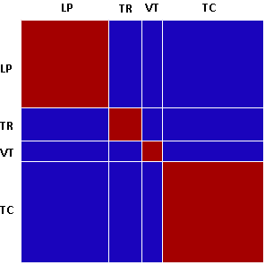

Results
To clearly present the results, the obtained MNCC_{ij} values are presented in a squared and symmetrical matrix (Figure on the right), where the index i and j correspond to the MNCC value between events i and j.
As shown by the colorbar, events that are perfectly correlated (MNCC = 1) are indicated by brown color. These events should be in the same class. whereas uncorrelated events (MNCC = 0) are presented in a blue color. These events should be in different classes.
Please do not use this space, a QR code will be automatically overlayed
P3.5-758

Slide 7
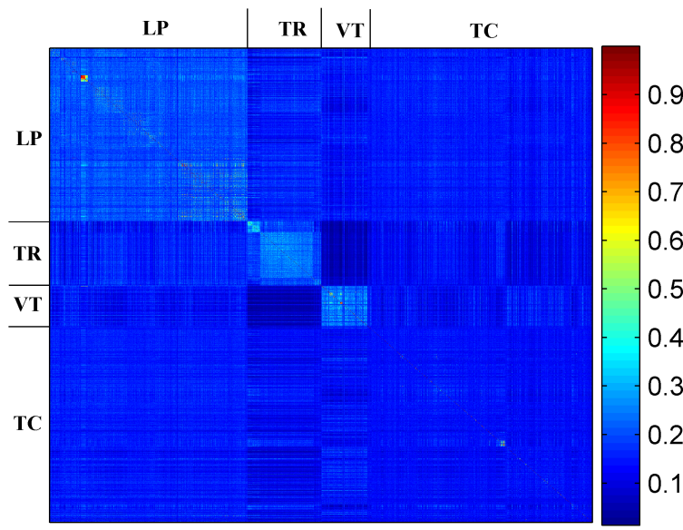
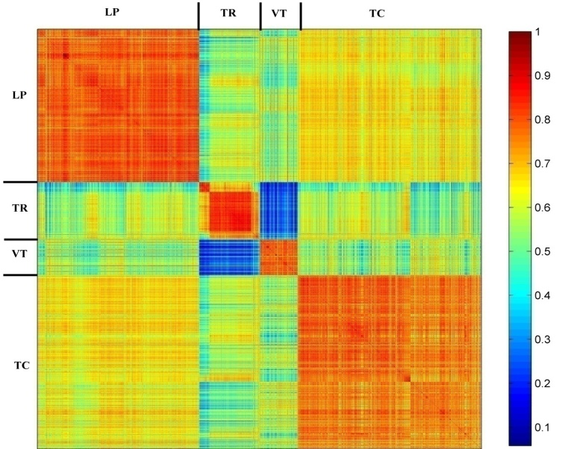
Results
Time Domain
Time-Frequency domain
MNCC heat map
MNCC mean
MNCC mean
 | LP | TR | VT | TC
LP | 0,21 | 0,15 | 0,14 | 0,15
TR | 0,15 | 0,22 | 0,07 | 0,13
VT | 0,14 | 0,07 | 0,23 | 0,13
TC | 0,15 | 0,13 | 0,13 | 0,13
 | LP | TR | VT | TC
LP | 0,74 | 0,51 | 0,53 | 0,61
TR | 0,51 | 0,72 | 0,25 | 0,51
VT | 0,53 | 0,25 | 0,74 | 0,52
TC | 0,61 | 0,51 | 0,52 | 0,71
MNCC Global mean values
Please do not use this space, a QR code will be automatically overlayed
P3.5-758

Slide 8
Results
MNCC_{Base} (i,j) global matrix
New event
MNCC_{Cl} (i,j) Class matrix
Cross-correlation with each class model
Which MNCC is maximal?
Please do not use this space, a QR code will be automatically overlayed
Model (Cl) = I
LP Class
TR Class
TC Class
VT Class
In each class, we extract the most correlated event with all the others to represent the class
The obtained models are then used to classify any new event
P3.5-758

Slide 9
Results
Time Domain
Time-Frequency domain
 |  | Target classes
 |  | LP | TR | VT | TC
Predicted classes | LP | 969 | 46 | 16 | 408
 | TC | 153 | 441 | 0 | 329
 | VT | 20 | 1 | 203 | 220
 | TR | 168 | 2 | 85 | 531
 |  | Target classes
 |  | LP | TR | VT | TC
Predicted Classes | LP | 1264 | 5 | 25 | 20
 | TR | 5 | 475 | 0 | 105
 | VT | 25 | 0 | 274 | 54
 | TC | 16 | 10 | 5 | 1309
The confusion matrix
 | Sensitivity (%) | Specificity (%) | Precision (%) | Accuracy (%) | Error (%)
LP | 74 | 79,40 | 67,34 | 77,42 | 22,58
TR | 90 | 84,46 | 47,78 | 85,22 | 14,78
VT | 66,8 | 92,67 | 45,72 | 90,48 | 9,52
TC | 35,7 | 87,88 | 67,56 | 66,26 | 33,74
 | Sensitivity (%) | Specificity (%) | Precision (%) | Eccuracy (%) | Error (%)
LP | 96,49 | 97,81 | 96,19 | 97,33 | 2,67
TR | 96,94 | 96,45 | 81,20 | 96,52 | 3,48
VT | 90,13 | 97,60 | 77,62 | 96,97 | 3,03
TC | 87,97 | 98,53 | 97,69 | 94,15 | 5,85
Performance evaluation of the classifier
Please do not use this space, a QR code will be automatically overlayed
Global accuracy of 59,7%
Global accuracy of 92,48%
P3.5-758

Slide 10
Conclusion
The classification of seismic events is the first processing step before any further analysis. The use of cross correlation function is one of the simplest but also quite efficient approach especially in time-frequency domain. The principal results of this study are summarized below :
In time domain :
  The tectonic events (TC) are not well identified by this method. A global accuracy of about 60% was reached using the four classes.
  Excluding the TC events improves the global accuracy to 86,3%.
In time-frequency domain :
  The classification task is significantly improved compared to time domain. The method allows the classification of all types of events in the seismic database including the TC class.
  We have obtained a global accuracy reaching 92,48% using all classes of the database, and 96.53% if the TC class is excluded.
Please do not use this space, a QR code will be automatically overlayed
P3.5-758

Slide 11
References
A. Atmani, E. H. Ait Laasri, D. Agliz, E. Akhouayri, “Llaima’s Volcano Seismis Event Classification Using The Cross Correlation Function”, International Journal of Computer Sciences and Engineering, Vol. 10, Issue. 3, pp. 1–7, 2022.
Theodorus Permana, Takeshi Nishimura, Hisashi Nakahara and Nikolai Shapiro. “ Classification of volcanic tremors and earthquakes based on seismic correlation: application at Sakurajima volcano, Japan”. Geophysical Journal International. 229, 1077–1097, 2022.
E.H. Ait Laasri, A. Atmani, D. Agliz, E. Akhouayri, “Application of Cross-Correlation to Seismic Signal Database of Agadir”. International Journal of Computer Sciences and Engineering. Vol. 9, Issue.6. 2021.
J. P. Canario, R. Mello, M. Curilem, F. Huenupan , and R. Rios, “Llaima Volcano Dataset: In-Depth Comparison of Deep Artificial Neural Network Architectures on Seismic Events Classification”, Data in Brief, 30, 105627, 2020.
M. Curilem, R.F. de Mello, F. Huenupan, C. San Martin, L. Franco, E. Hernández, R.A. Rios. “Discriminating seismic events of the Llaima volcano (Chile) based on spectrogram cross-correlations”, Journal of Volcanology and Geothermal Research 367, pp.63–78, 2018.
Soto, R., Huenupan, F., Meza, P., Curilem, M., & Franco, L. Spectro-temporal features applied to the automatic classification of volcanic seismic events. Journal of Volcanology and Geothermal Research, 358, 194–206. doi:10.1016/j.jvolgeores.2018.04.025, 2018,
David P. Schaff, Won-Young Kim, Paul G. Richards, Eunyoung Jo, and Yonggyu Ryoo. Using Waveform Cross Correlation for Detection, Location, and Identification of Aftershocks of the 2017 Nuclear Explosion at the North Korea Test Site. Seismological Research Letters, Volume 89, Number 6 pp. 2113-2119. 2018.
B.R. Julian, “Volcanic tremor: nonlinear excitation by fluid flow”. Int. J. Comput. Sci. Secur. 99, 11859–11877. 1994.
B. Chouet, “A seismic model for the source of long-period events and harmonic tremor”. Volcanic Seismology. Berlin, Heidelberg. pp. 133–156. 1992.
S.R. McNutt, “Volcanic tremor”. Encyclopedia of Earth System Science. 4. pp. 417–425. 1992.
Please do not use this space, a QR code will be automatically overlayed
P3.5-758

