Slide 1
The Effects of Uniform Prior and Event Definition Criteria on the NET-VISA Bulletin
Nimar Arora
Bayesian Logic, Inc.
A common criticism for NET-VISA in past years has been that it uses an event location prior which somehow induces a bias in event formation. Also, the fact that NET-VISA doesn’t use the Event Definition Criteria (EDC) gives it an advantage over GA and hence the comparisons with GA are unfair. In this work we dispel both of these myths.
We analyzed IDC data from Jan 1, 2017 to July 1 2017 using various versions of NET-VISA as well as GA (Global Assoc). The versions of NET-VISA were
plain NET-VISA (NV)
NV with a Uniform Location (UL) prior
NV with the EDC
NV with UL + EDC
The introduction of EDC causes the bulletin to produce far fewer events, even less than the current GA (or SEL3) bulletin, while having higher overlap with LEB and REB. However, the overlap is less than the current NET-VISA model. Introducing uniform location causes the NET-VISA bulletin to produce many more events and a higher overlap with LEB and REB, but at the cost of very many spurious events. Introducing both EDC and uniform location produces results that are similar but worse than the current NET-VISA model.
The NET-VISA model naturally produces an event bulletin with high overlap with LEB and REB while producing few spurious events. On the one hand there is nothing to be gained by adding UL or EDC and on the other hand even with the EDC the performance of NET-VISA is far superior to that of GA.
Please do not use this space, a QR code will be automatically overlayed
P3.5-892

Slide 2
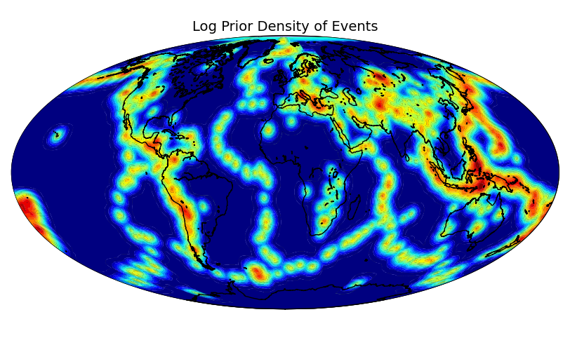
Key Questions
Authors: Nimar Arora (Bayesian Logic, Inc.), Geeta Arora (Bayesian Logic Inc.), Noriyuki Kushida (CTBTO Preparatory Commission), Ronan Le Bras (Former CTBTO Preparatory Commission)
We attempt to answer two questions in this work.
What is the effect of the NET-VISA event location prior on the resultant NET-VISA bulletin?
What if we filter out NET-VISA events that don’t satisfy the EDC (Event Definition Criteria)?
Please do not use this space, a QR code will be automatically overlayed
P3.5-892

Slide 3
Why these specific questions?
Regarding the Event Location Prior, A frequent concern is that this can somehow bias NET-VISA towards producing more events in certain parts of the world where there is a historic record of natural seismicity.
Regarding the Event Definition Criteria, Since this is used by the existing GA (Global Association) algorithm there is a concern that we are making an unfair comparison with GA which has to abide by the EDC.
Please do not use this space, a QR code will be automatically overlayed
P3.5-892

Slide 4
The Experiment
We ran NET-VISA on the IDC data for 2017 in 3 configurations.
Plain NET-VISA (NV)
NV with a uniform event location prior (UL). The value of the prior was set to the maximum value on earth that is used in the plain NET-VISA model.
NV bulletin filtered with the Event Definition Criteria (EDC)
NV with both UL and EDC
These bulletins were compared with Global Association (current SEL3 bulletin).
We used LEB or REB as the reference and computed overlap and inconsistency with the reference bulletin.
Please do not use this space, a QR code will be automatically overlayed
P3.5-892

Slide 5
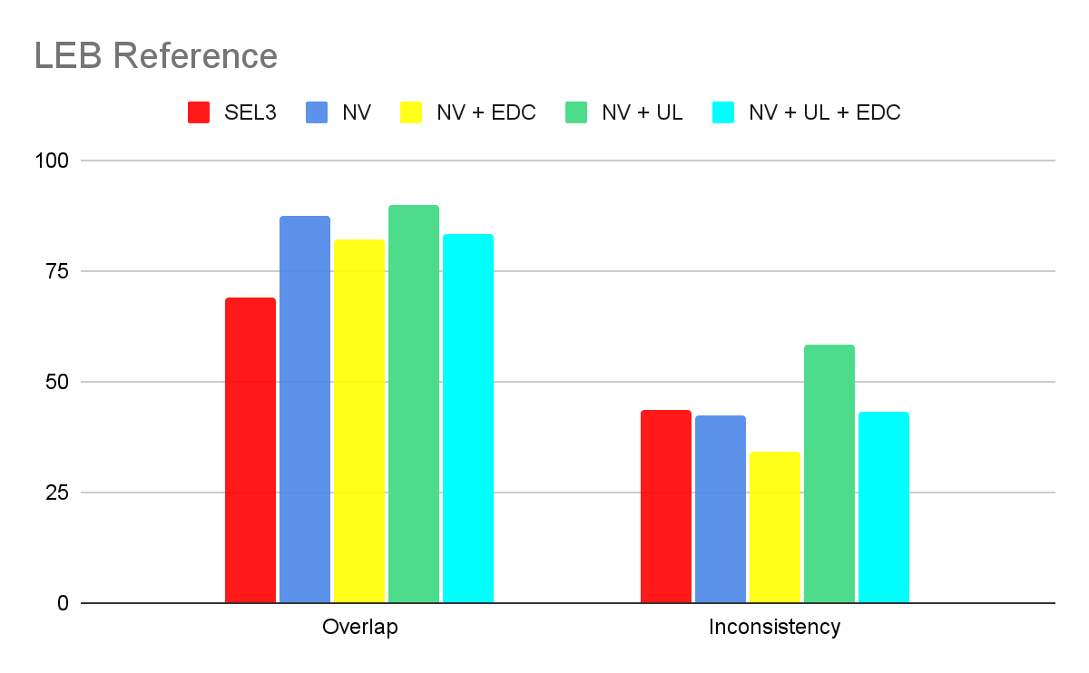
Results
Please do not use this space, a QR code will be automatically overlayed
P3.5-892

Slide 6
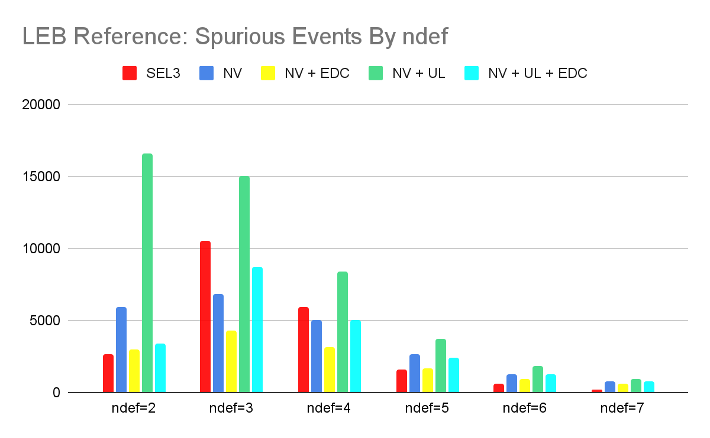
Results
Please do not use this space, a QR code will be automatically overlayed
P3.5-892

Slide 7
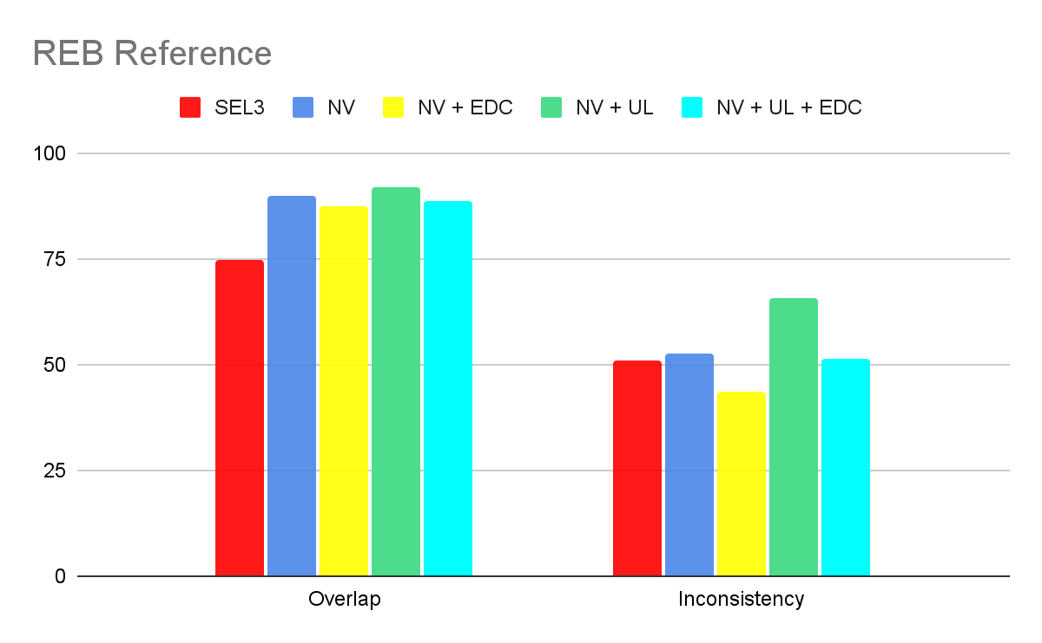
Results
Please do not use this space, a QR code will be automatically overlayed
P3.5-892

Slide 8
Conclusion Slide Title goes here [Font: Arial Regular Size 20]
The Event Location Prior doesn’t really create a bias. It helps avoid building spurious events in areas of low seismicity with weak evidence of an event (for example a small number of defining phases).
Adding the Event Definition Criteria (EDC) results in a bulletin with worse overlap than the regular NET-VISA bulletin.
Even with the EDC the overlap of NET-VISA (with either LEB or REB) is still far better than Global Association and it produces a fewer total number of events. Note: that more recent work on coda improvements in NET-VISA have now resulted in NET-VISA producing fewer events than Global Association without any significant drop in overlap.
Please do not use this space, a QR code will be automatically overlayed
P3.5-892

