Slide 1
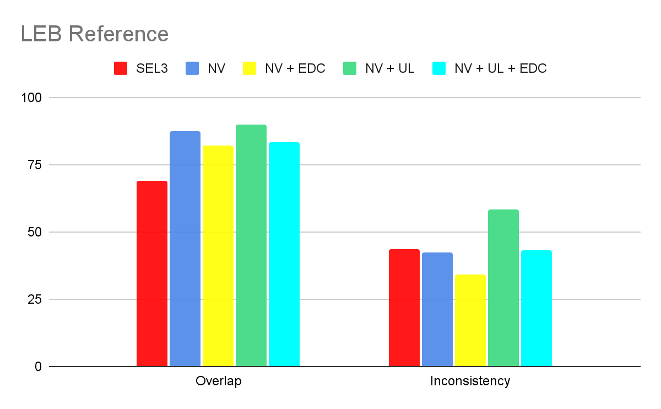
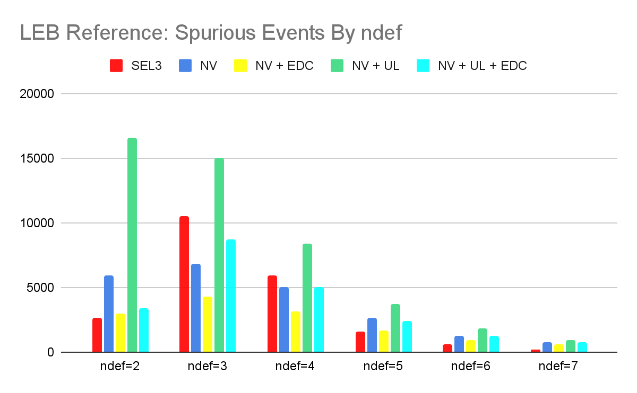
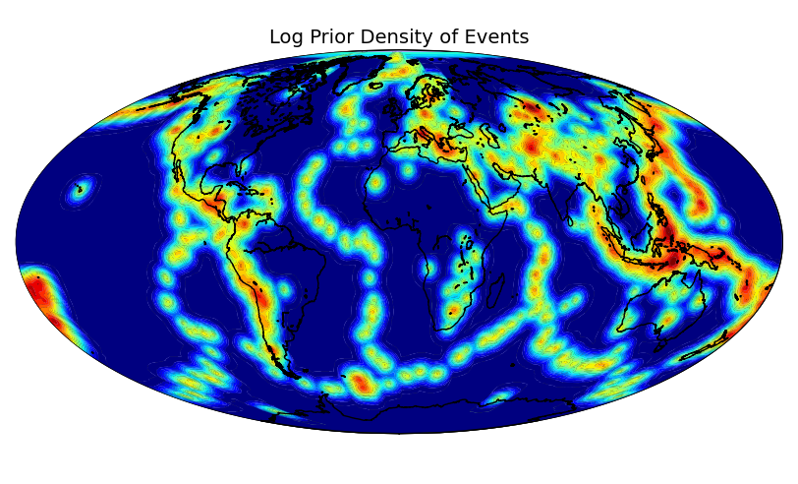
The Effects of Uniform Prior and Event Definition Criteria on the NET-VISA Bulletin
Nimar Arora
Bayesian Logic, Inc.
P3.5-892
Notes:
With a uniform prior of event locations we tend to create a lot more small spurious events. Adding the EDC by itself doesn’t get the best overlap. EDC+UL is also worse than NET-VISA.

