Slide 1
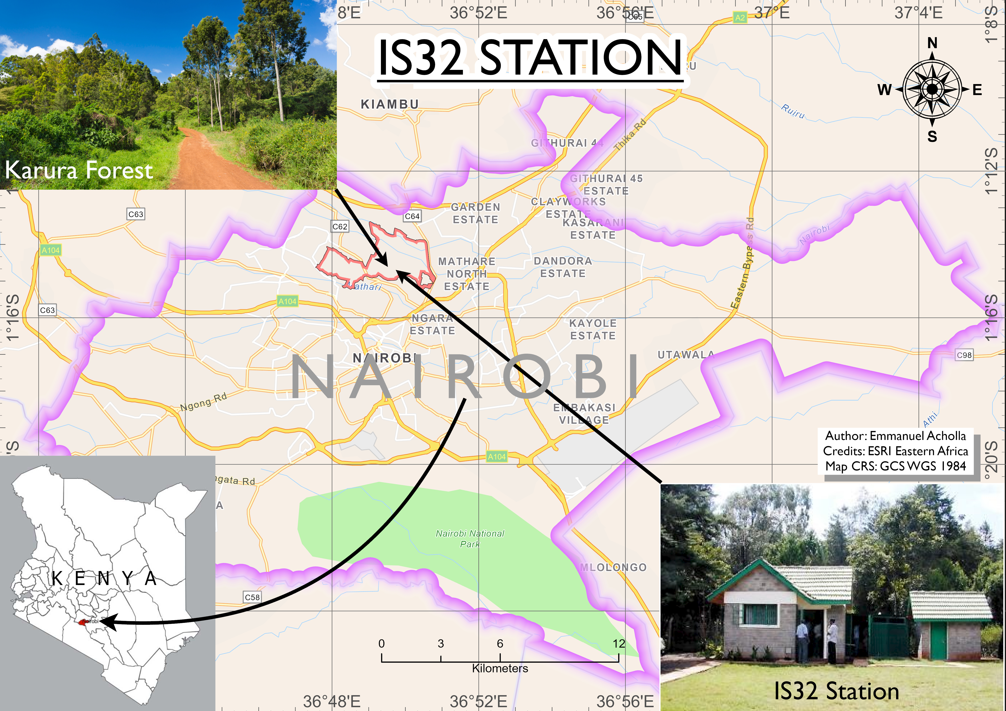
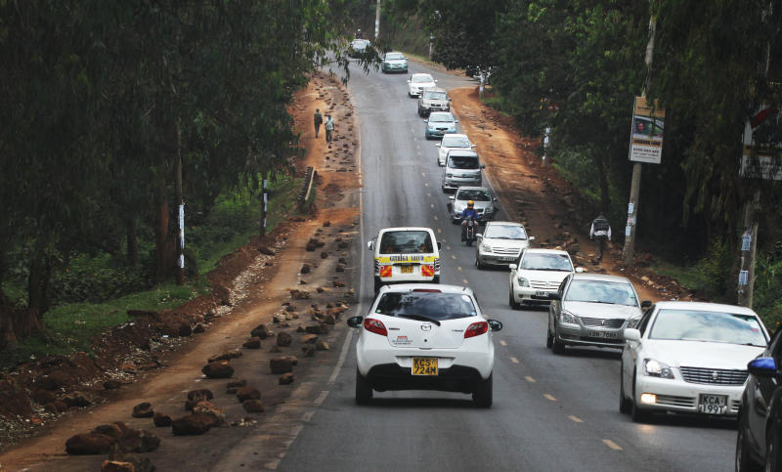
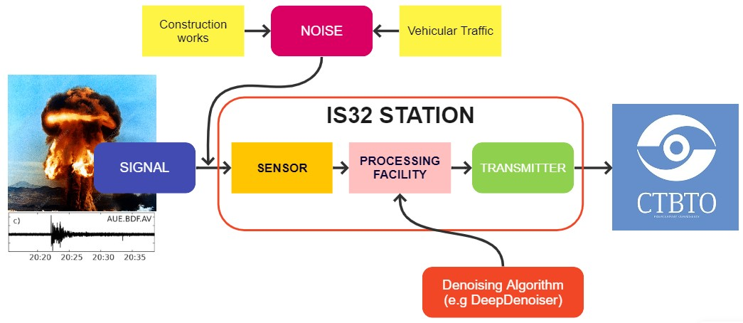
Integration of Artificial Intelligence Techniques to the mitigation of Anthropogenic Noise in Seismic Data from International Monitoring Stations in Rapidly urbanizing Areas like Nairobi, Kenya.
Emmanuel Mulehane Acholla
University of Nairobi
P3.5-119
INTRODUCTION
The CTBTO operates an infrasound station (IS32) at Karura Forest in Nairobi City. With 5.32 million residents increasing at a rate of 2.8%, an upsurge in civil works (road expansions) and the associated vehicular traffic means increased noise in the vicinity of IS32 station.
DATA/RESULTS
There are A.I & M.L tools capable of separating noise from seismic, and by extension, infrasound signals.
DeepDenoiser (Zhu et al. 2019) when trained on noisy seismic data from the North California Seismic Network, recovered clean waveforms and improved SNR by 15dB.
CONCLUSION
Intelligent algorithms can be a viable strategy to reduce anthropogenic noise at IMS infra-seismic stations. R&D/implementation costs can be reduced through collaboration with institutions, researchers or States.
Credits: Zhu,W., Mousavi, S.M., Beroza, G.C. (2019) Seismic Signal Denoising & Decomposition Using Deep Neural Networks. IEEE Transactions in Geoscience & Remote Sensing. DOI: 10.1109

