Slide 1
Integration of Artificial Intelligence Techniques to the Mitigation of Anthropogenic Noise in Seismic Data from International Monitoring Stations in Rapidly urbanizing Areas like Nairobi, Kenya.
Emmanuel M. Acholla
University of Nairobi, Department of Earth & Climate Sciences
Place your institution logo here
(remove this text box)
The CTBTO operates an infrasound station (IS32) at Karura Forest in Nairobi City. With 5.32 million residents increasing at a rate of 2.8%, an upsurge in civil works (road expansions) and the associated vehicular traffic means increased noise in the vicinity of IS32 station.
A review of applicable A.I &
M.L tools capable of
reducing noise at infra-seismic stations.
Algorithms do exist which can:
separate noise from signals.
A good example is DeepDenoiser (Zhu et al, 2019).
DeepDenoiser (Zhu et al. 2019) is based on a deep neural network. When trained on noisy seismic data from the North California Seismic Network, it recovered clean waveforms and improved SNR by 15dB.
Intelligent algorithms can be a viable strategy to
reduce anthropogenic noise at IMS infra-seismic stations.
The costs and technical challenges of implementation
could be mitigated through:
Partnerships/collaboration with relevant institutions, researchers and Member State governments.
Please do not use this space, a QR code will be automatically overlayed
P3.5-119

Slide 2
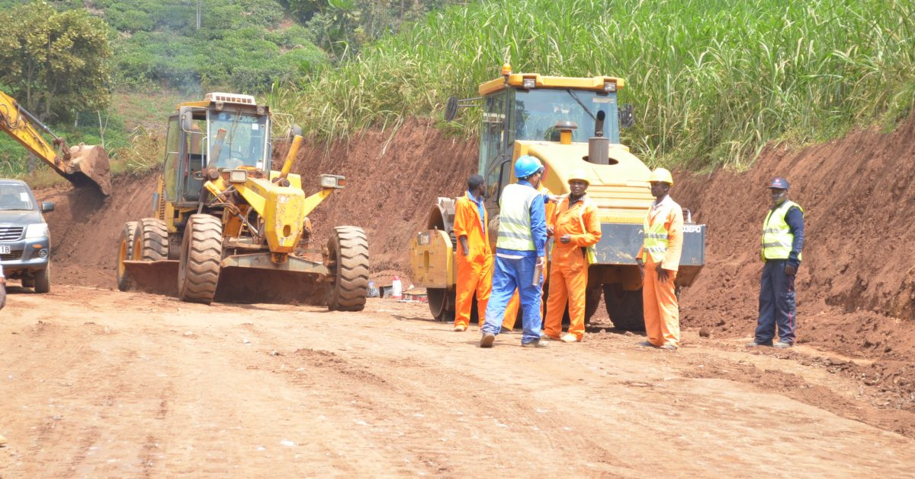
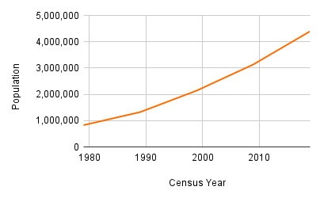
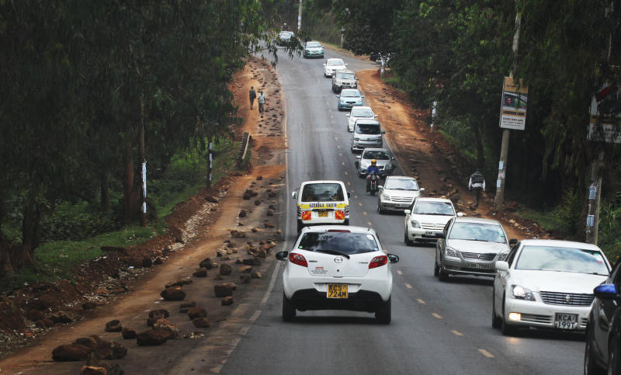
INTRODUCTION
Kenya signed the CTBT in 1996, ratified it in 2000 and hosts an IMS infrasound station (IS32) located at Karura Forest in the northern part of her capital city, Nairobi.
Nairobi has a population of 5.32 million residents (2023) increasing at a rate of 2.8%, and coupled with an upsurge in civil projects (roads) and the associated vehicular traffic means increased noise in the vicinity of the IS32 station.
Roadworks at Kiambu Road.
Please do not use this space, a QR code will be automatically overlayed
P3.5-119
Kiambu Road, next to Karura Forest

Slide 3
OBJECTIVES
The overall objective of this study is to outline Artificial Intelligence techniques suitable for the reduction of anthropogenic noise at the IS32 IMS station in Karura Forest, Nairobi, Kenya.
The specific objectives are:
To identify sources of anthropogenic noise in the vicinity of the IS32 station
To review and identify suitable Artificial Intelligence noise-reduction tools applicable to IS32
To propose solutions to the technical and financial challenges of implementation of the A.I tools
Please do not use this space, a QR code will be automatically overlayed
P3.5-119

Slide 4
METHODS
This study involved:
a review of the sources of anthropogenic noise affecting the IMS IS32 station in Nairobi
state of the art literature on applicable artificial intelligence & machine-learning tools capable of reducing anthropogenic noise in infrasound data.
References included statistical, geospatial data and published scientific papers. Finally, conclusions were drawn based on this data and recommendations outlined.
Please do not use this space, a QR code will be automatically overlayed
P3.5-119

Slide 5
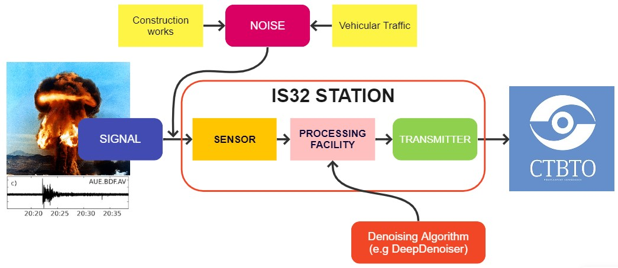
RESULTS
There are A.I & M.L tools capable of separating noise from seismic, and by extension, infrasound signals. DeepDenoiser (Zhu et al. 2019, Stanford University) is based on a deep neural network. When trained on noisy seismic data from the North California Seismic Network, it recovered clean waveforms and improved the SNR by 15dB.
Please do not use this space, a QR code will be automatically overlayed
P3.5-119

Slide 6
CONCLUSION
Intelligent algorithms can be a viable strategy to reduce anthropogenic noise in infra-seismic data.
The costs and technical challenges of implementing these algorithms could be mitigated through:
suitable funded partnerships between the CTBTO and the relevant research institutions (e.g. Stanford University), researchers and Member State governments.
Please do not use this space, a QR code will be automatically overlayed
P3.5-119

Slide 7
REFERENCES
Central Intelligence Agency (2023) The World Fact Book. URL: https://www.cia.gov/the-world-factbook/countries/kenya/#people-and-society Last Accessed: 09-05-2023.
Kenya National Bureau of Statistics (2019) 2019 Kenya population and Housing Census. Volume I. Nairobi, Kenya.
Zhu,W., Mousavi, S.M., Beroza, G.C. (2019) Seismic Signal Denoising & Decomposition Using Deep Neural Networks. IEEE Transactions in Geoscience & Remote Sensing. IEEE. PP. 1-13. 10.1109/TGRS.2019.2926772.
Please do not use this space, a QR code will be automatically overlayed
P3.5-119

