Slide 1
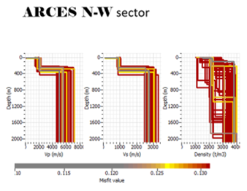
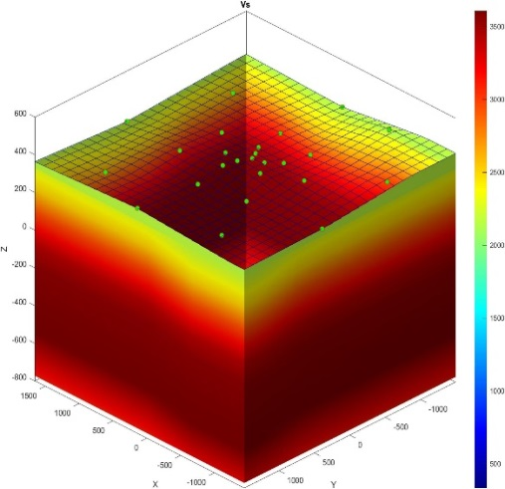
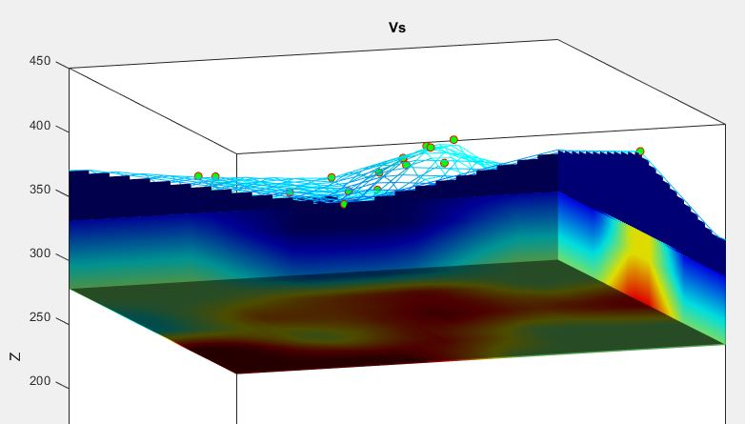
Perspective of the International Monitoring System Seismic Event Location Capability Improvement with Ambient Noise Tomography
Ivan Kitov¹⁾, Mikhail Rozhkov²⁾, Yuri Starovoit³⁾
CTBTO, ISTI, AddProject
P3.5-408
Event location accuracy improvement is hinged on the knowledge of the velocity model underlying seismic array or local network
In our case study we demonstrate feasibility of ambient seismic noise spatial auto-correlation (SPAC) , horizontal-to-vertical spectral ratio (HVSR) methods for velocity model restoration underlaying seismic arrays.
HVSR branch of velocity modeling should be jointly applied with SPAC results for refining of the uppermost model underlaying the IMS array
Both methods must be used together to compensate the
non-uniqueness of the inversion.
These methods are seen promising for enhancement of IDC
regional seismic locations as well as for OSI Seismic
Aftershocks Monitoring System (SAMS)

