Slide 1
Perspective of the International Monitoring System Seismic Event Location Capability Improvement with Ambient Noise Tomography
Ivan Kitov¹⁾, Mikhail Rozhkov²⁾, Yuri Starovoit³⁾
CTBTO, ISTI, AddProject
Event location accuracy improvement is hinged on the knowledge of the velocity model underlying array or local network deployment. Retrieved model using ambient noise tomography (ANT) lead to reduction of the seismic residuals thus contributing to such improvement.
Ambient noise spatial auto-correlation, horizontal-to-vertical channel spectral ratio and their modifications are pivotal methods applied for velocity model restoration in this case study.
Highly availably seismic background data in CTBTO databases makes promising such application for IMS arrays.
Inversion of surface waves dispersion curves obtained by MSPAC in four quadrants of ARCES array reveals distinct velocity models consistent with OpenHVSR inversion.
Both methods must supplement each other to reduce uncertainties in velocity model restoration.
ANT is a powerful approach for detailing velocity structure underlying IMS arrays as well as possibly for OSI SAMS installations
Both MSPAC and HVSR approaches must be used together to rectify velocity model and compensate the non-uniqueness of the inversion.
Place your QR Code here after removing this text box!
P3.5-408

Slide 2
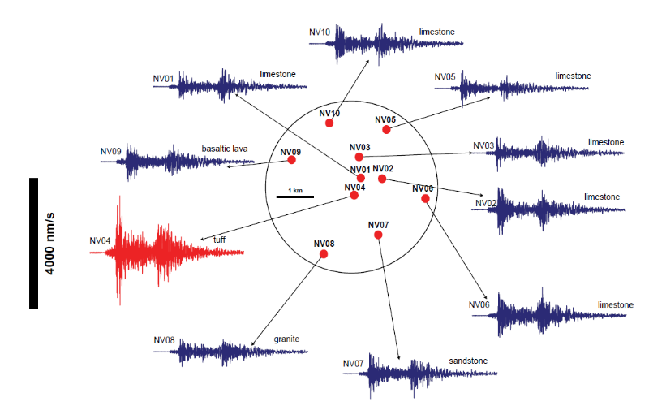
Introduction
One of the beam forming problems is the absence of the empirical arrival times at the array’s sensors. Theoretical time delays between channels, as based on theoretical slowness, in many cases are not accurate because of complex velocity structure beneath the array. Low or high velocity inclusions may introduce disturbances in the relative arrival times and amplitudes. Variations in amplitude and arrival time delays are related to underlaying geology and lead to potentially significant beam loss as driven by the absence of signal synchronization in time and amplitude.
Left: Different shapes of the wave trains at the Nevada Seismic Array station due to local heterogeneities (from Petru T. Negraru “Application of Seismo-Acoustic Signals to the Study of Local Site Effects”, Acta Geophysica, 2010)
Place your QR Code here after removing this text box!
P3.5-408

Slide 3
Objectives
The IDC needs empirical arrival time delays for the whole set of detection beams, i.e. a set of azimuth/scalar slowness pairs.
Results of velocity model recovery by the ambient noise-based passive methods might be useful for enhancements in IDC processing.
Major objectives
Learn if currently available data processing methods are able to deliver results appropriate for refining the crustal model beneath primary and auxiliary IMS seismic arrays
Provide a number of use cases proving a preliminary validity of the passive methods approach for building and/or refinement of the crustal velocity models beneath the IMS stations
Provide a tentative framework for the toolbox capable to building a set of shallow crust velocity models beneath the IMS seismic stations
Place your QR Code here after removing this text box!
P3.5-408

Slide 4
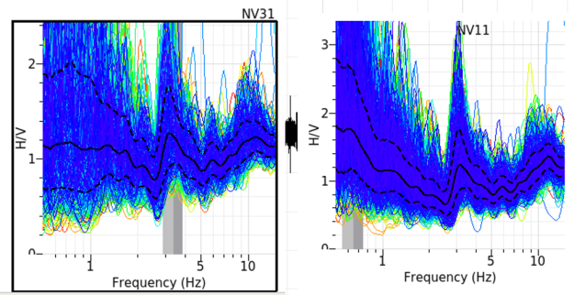
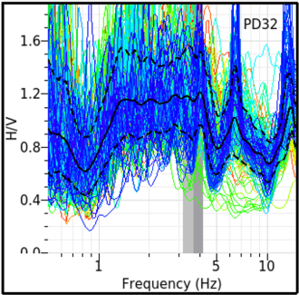
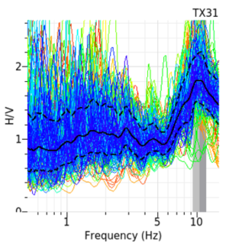
Ambient Noise Analysis methods as an approach to building local seismic velocity structure
Place your institution logo here after removing this text box!
Passive seismic techniques MSPAC* , HVSR*, and other ambient noise tomography methods may comprise an efficient toolbox for refinement of velocity models underneath seismic array elements.
Such a toolbox can be useful for enhancement of ParMT (joint seismic moment tensor, depth and magnitude determination), for improvement of IDC regional locations and the OSI Seismic Aftershocks Monitoring System (SAMS).
Velocity models’ restoration is based on inversion of surface waves dispersion, and a number of numerical modelling used for fitting the HVSR/ellipticity curves to theoretical models, or just by the inversion of the HVSR main picks to the depths of layers with the highest impedances. This technique could be widely utilized for IMS seismic arrays using vast amount of noise data
* - MSPAC – Modified Spatial Autocorrelation Analysis; HVSR – Horizontal to Vertical Spectral Ratio Analysis;
Left: Simple bedrock characterization by H/V curves (GEOPSY ) for IMS arrays NVAR, PDAR, TXAR.
Place your QR Code here after removing this text box!
P3.5-408

Slide 5
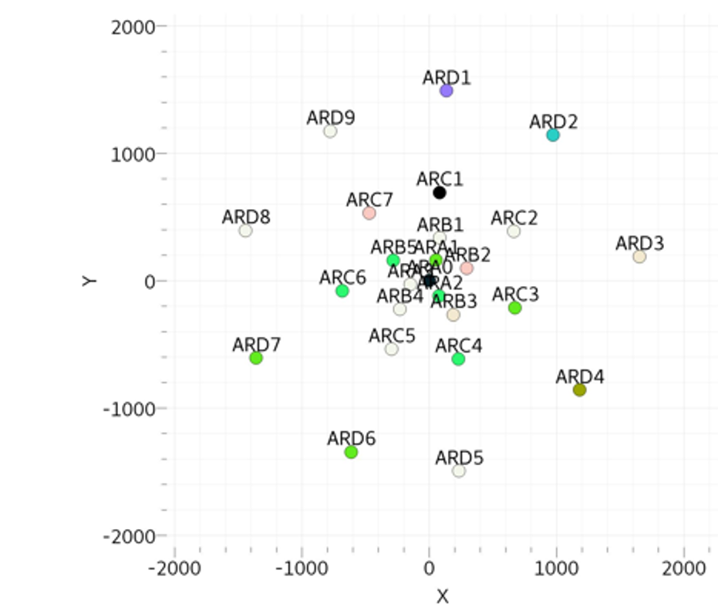
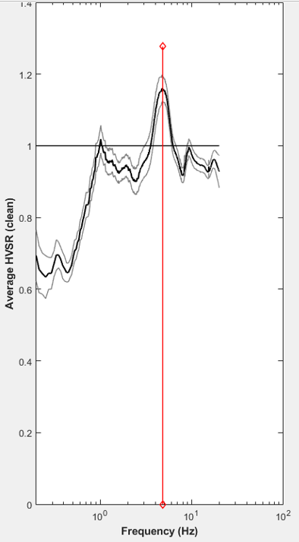
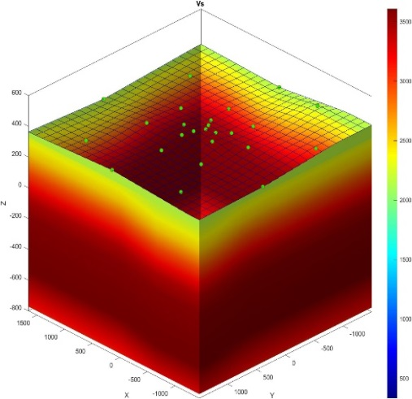
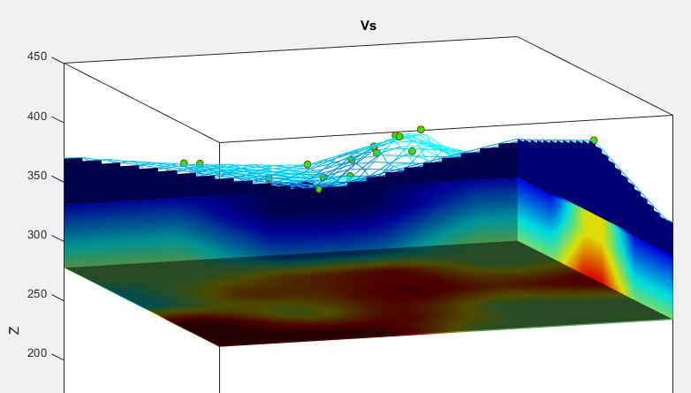
Results for ARCES case. OpenHVSR
Place your institution logo here after removing this text box!
Joint analysis with GEOPSY and OpenHVSR packages for different ARCES (25 elements - all BB 3C). White color code characterize shallow reflectors, black – deep.
ARA0 ARA2 ARD9
Depth, m
velocity
Place your QR Code here after removing this text box!
Left: - basic inversion model. f_{r} is a resonant frequency, H is the thickness of the sedimentary package, given an average shear-wave velocity (Vs)
$$f_{r}=\frac{V_{s}}{4∙H}$$
Results for deep (left) and shallow (top) ARCES’ HVSR inversion
P3.5-408

Slide 6
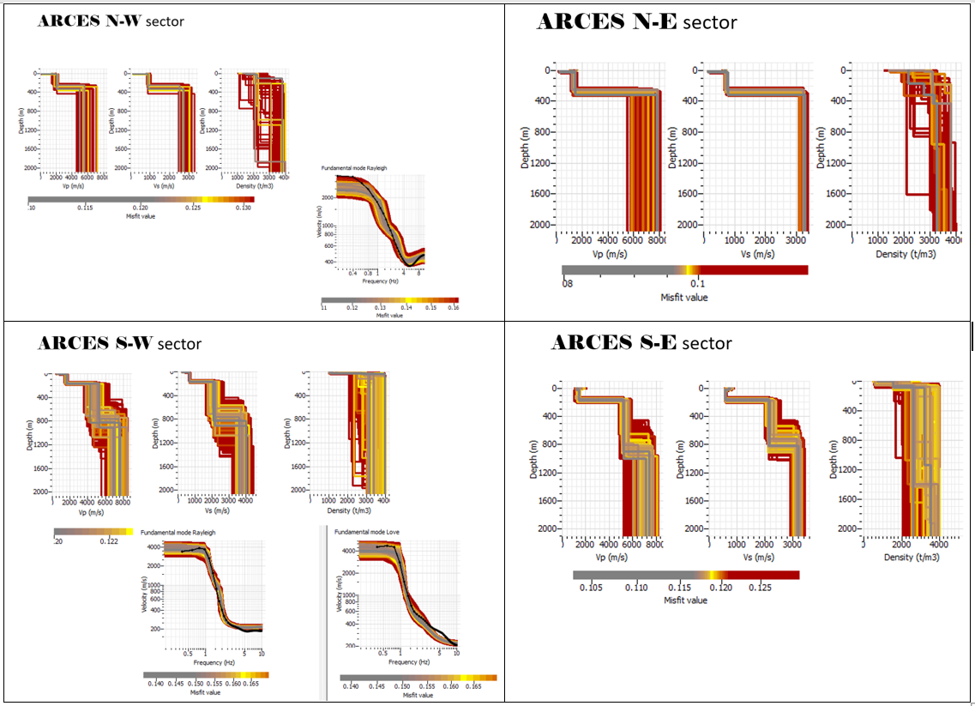
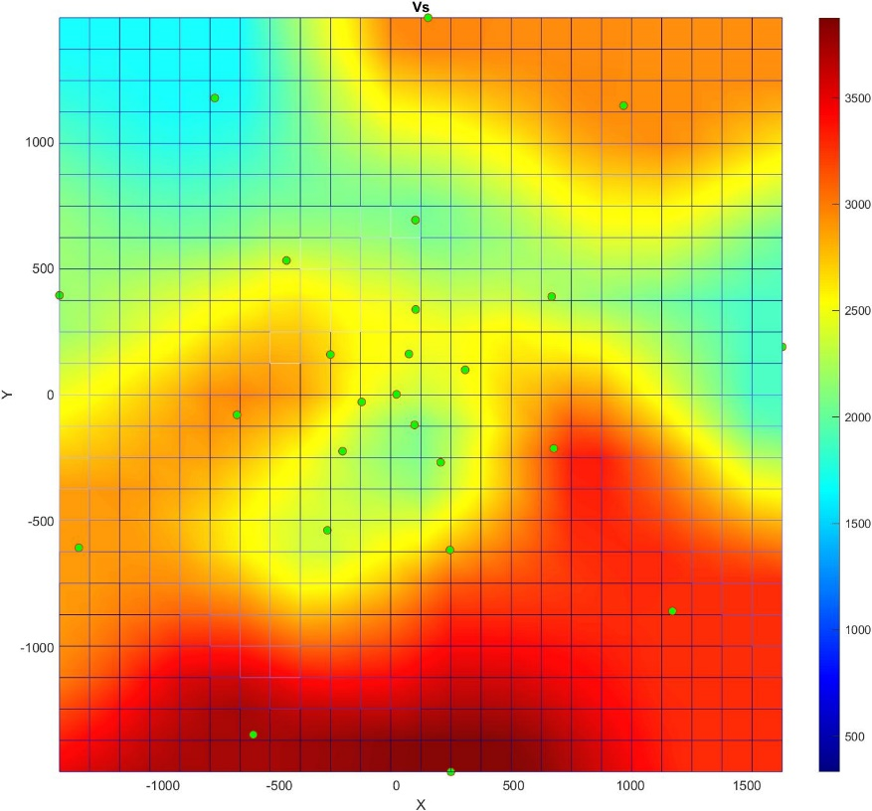
Results for ARCES case. MSPAC
Left: average Vs sectoral velocity models (retrieved by MSPAC method in GEOPSY) are higher for the NE quadrant then for the NW quadrant for the ~900 m depth, and the highest velocities are for the SE quadrant, with the SW velocities higher than for both northern sectors. Inversion of HVSR results gives similar results (OpenHVSR) below).
Place your QR Code here after removing this text box!
P3.5-408

Slide 7
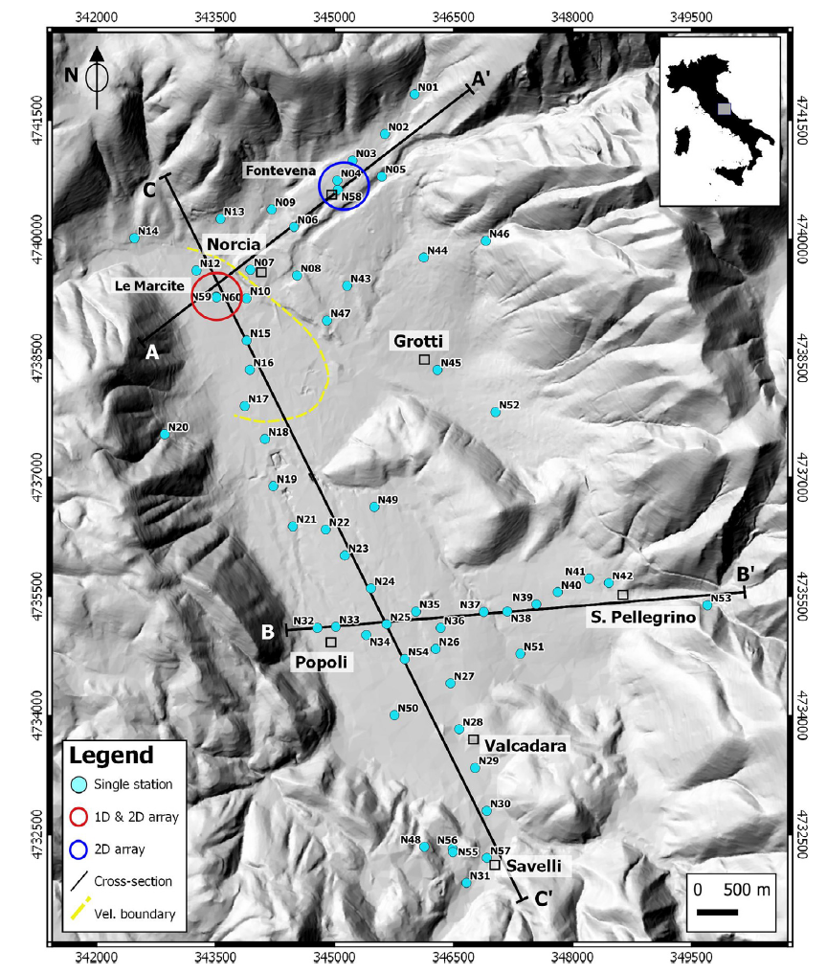
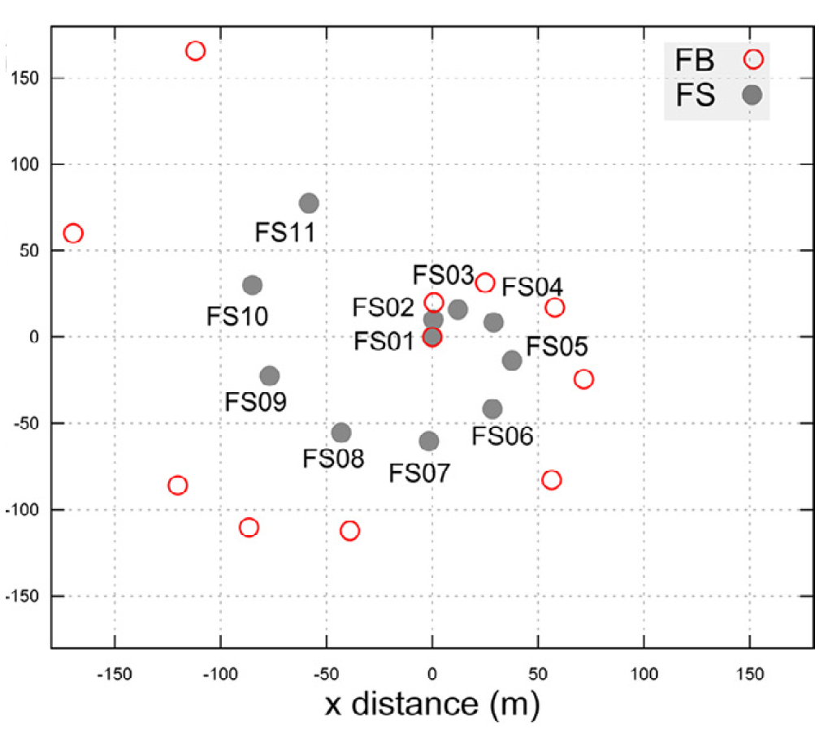
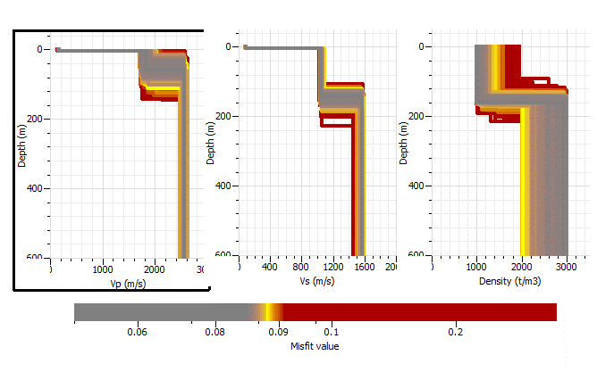
Results for “spiral” array, Central Italy, Norcia Basin
Example with the spiral geometry but smaller aperture seismic array in Norcia intermountain basin, Northern Italy. The model estimation based on MSPAC conducted with the medium range sensors provides the results consistent with the well and gravity study conducted in Italy (F. Ferri, et al., 2019) and HVSR processing conducted earlier.
Ercoli, M., et al 2020
Place your QR Code here after removing this text box!
P3.5-408

Slide 8
Conclusion
Ambient noise analysis is a powerful approach for building detailed velocity structure for IMS sites as well as possibly for OSI SAMS installations
Using spatial correlation methods (MSPAC, Extended MSPAC) is a most common way for building velocity models for both 3-component data and vertical-only using IDC data. These methods must be considered for already available IMS seismic arrays data.
HVSR branch of velocity modeling (including Random Decrement and the Diffusive Field Assumption Techniques) is based on 3-component data processing and cannot be applied directly with most IMS arrays for joint inversion, but still can be jointly assessed with MSPAC results for refining of the uppermost model underlaying the IMS array.
Ideally both approaches must be used together to compensate the non-uniqueness of the inversion.
Place your QR Code here after removing this text box!
P3.5-408

Slide 9
References
Bignardi, S., Mantovani, A., and Abu Zeid, N. (2016). OpenHVSR: imaging the subsurface 2D/3D elastic properties through multiple HVSR modeling and inversion, Computers & Geosciences 93, 103-113.
Ibs-von Seht, M., Wohlenberg, J. (1999). Microtremor measurements used to map thickness of soft sediments. Bulletin of the Seismological Society of America 89 (1) 250-259.
Picozzi, M., Parolai, S., and Richwalski, S.M. (2005). Joint inversion of H/V ratios and dispersion curves from seismic noise: Estimating the S-wave velocity of bedrock. Geophysical Research Letters 32 (11), 308.
Pina-Flores, J., Perton, M., García-Jerez, A., Carmona, E., Luzon, F., Molina-Villegas, J.C., Sánchez-Sesma, F.J. (2016). The inversion of spectral ratio H/V in a layered system using the diffuse field assumption (DFA). Geophysical Journal International 208 (1) 577-588.
Sánchez-Sesma, F.J., et al. (2011). A theory for microtremor H/V spectral ratio: application for a layered medium. Geophysical Journal International 186 (1), 221-225.
Shabani, E., Bard, P.-Y., Mirzaei, N., Eskandari-Ghadi, M., Cornou, C. and Haghshenas, E. (2010). An extended MSPAC method in circular arrays. Geophysical Journal International, 182, 1431-1437.
Wathelet, M., J‐L. Chatelain, C. Cornou, G. Di Giulio, B. Guillier, M. Ohrnberger, A. and Savvaidis, A. (2020). Geopsy: A User‐Friendly Open‐Source Tool Set for Ambient Vibration Processing. Seismological Research Letters, 91 (3), 1878–1889.
Place your QR Code here after removing this text box!
P3.5-408

