Slide 1
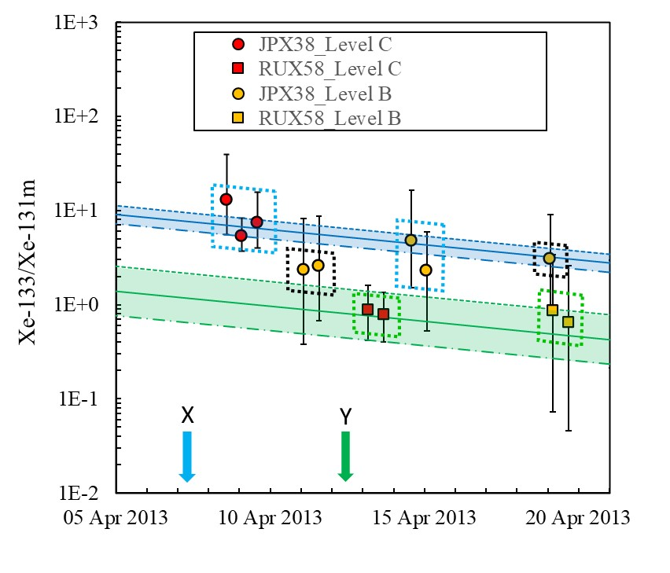
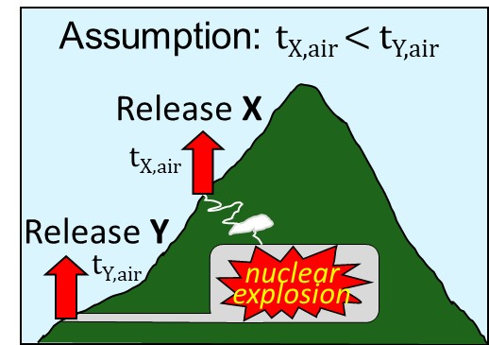
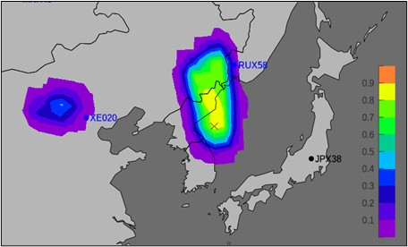
Investigation on sample association using decay consistency analysis for consecutive Level C samples and prior/post Level B samples
Yuichi Kijima, Robin Schoemaker, Boxue Liu, Joshua Kunkle,
Anne Tipka, Jolanta Kuśmierczyk-Michulec, Martin Kalinowski
CTBTO/IDC
P3.6-414
The Standard Screened Radionuclide Event Bulletin (SSREB) which is one of the International Data Centre
(IDC) products needs to be enhanced by associating the detections of CTBT-relevant nuclides with other
samples that detect the same release. This is useful for the application of methods to characterize the source
for the purpose of nuclear explosion monitoring.
In case of detection of multiple isotopes, the consistency of the isotopic ratios in subsequent samples with radioactive decay gives another plausible hint that the isotopes contained in different samples come from the same source.
Atmospheric transport modelling (ATM) can provide further evidence for a more confident sample association
by identifying the air masses that link an assumed release to multiple samples.
Example of radioxenon
release scenario
Decay consistency analysis
Example of possible
source region analysis
It might be possible that there were
two distinct releases at DPRK’s
nuclear test site in April 2013.

