Slide 1
Investigation on sample association using decay consistency analysis for consecutive Level C samples and prior/post Level B samples
Yuichi Kijima, Robin Schoemaker, Boxue Liu, Joshua Kunkle,
Anne Tipka, Jolanta Kuśmierczyk-Michulec, Martin Kalinowski
CTBTO/IDC
The Standard Screened Radionuclide Event Bulletin (SSREB) which is one of the International Data Centre (IDC) products needs to be enhanced by associating the detections of CTBT-relevant nuclides with other samples that detect the same release.
This is useful for the application of methods to characterize the source for the purpose of nuclear explosion monitoring.
Bayesian statistical methods are useful for estimation of isotopic ratio and its coverage interval, especially when the uncertainty of the isotopic ratio is large.
Decay consistencies are checked using isotopic ratios and their coverage intervals, as estimated by the Bayesian statistical methods.
Regarding the 2013 DPRK’s declared nuclear test, it might be possible that there were two distinct releases at DPRK.
Sample association for the same release event using Level C episodes, often applied to events of special interest, can be generalized and applied systematically to all stations and all episodes to enhance the IDC product SSREB and expert technical analysis (ETA).
Please do not use this space, a QR code will be automatically overlayed
P3.6-414

Slide 2
Introduction
The Standard Screened Radionuclide Event Bulletin (SSREB) which is one of the
International Data Centre (IDC) products needs to be enhanced by associating the
detections of CTBT-relevant nuclides with other samples that detect the same release.
This is useful for the application of methods to characterize the source for the purpose
of nuclear explosion monitoring.
In case of detection of multiple isotopes, the consistency of the isotopic ratios in
subsequent samples with radioactive decay gives another plausible hint that the
isotopes contained in different samples are from the same source.
Atmospheric transport modelling (ATM) can provide further evidence for a more
confident sample association by identifying the air masses that link an assumed release
to multiple samples.
P3.6-414
Please do not use this space, a QR code will be automatically overlayed

Slide 3
Objectives
Development of sample association methods using the consistency of isotopic ratio
decay over time and ATM.
This approach forms the stepping stone to defining analysis procedures and criteria
for automatic sample association for the SSREB, which is relevant for Expert Technical
Analysis (ETA).
P3.6-414
Please do not use this space, a QR code will be automatically overlayed

Slide 4
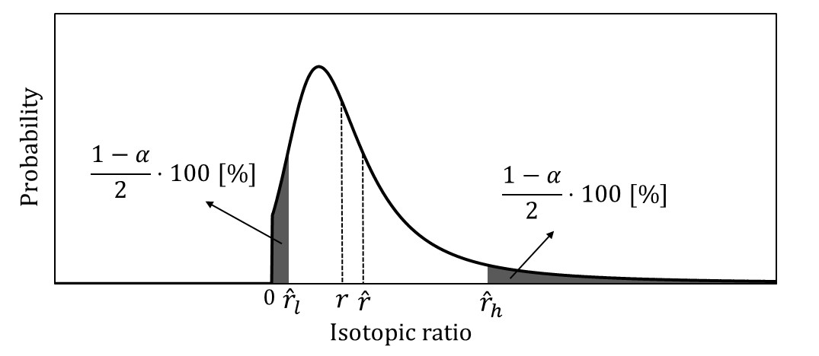
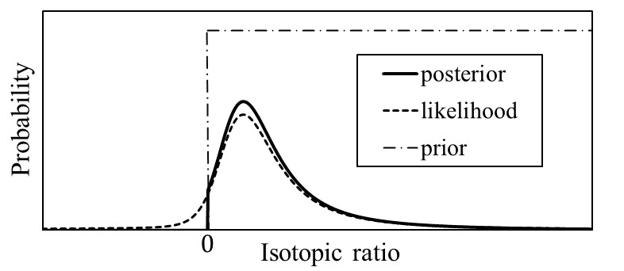
Methods/Data
Example of isotopic ratio and
its coverage interval
Example of posteriori probability
density function
Bayesian statistical methods are useful for estimation of isotopic ratio and its coverage interval, especially when the uncertainty of the isotopic ratio is large.
For example, the second-order terms of the Taylor series expansion and the joint probability density function based on the Bayesian statistical methods are used for estimating the isotopic ratio and its coverage interval.
P3.6-414
Please do not use this space, a QR code will be automatically overlayed
Decay consistencies are checked using isotopic ratios and their coverage intervals, as estimated by the Bayesian statistical methods.

Slide 5
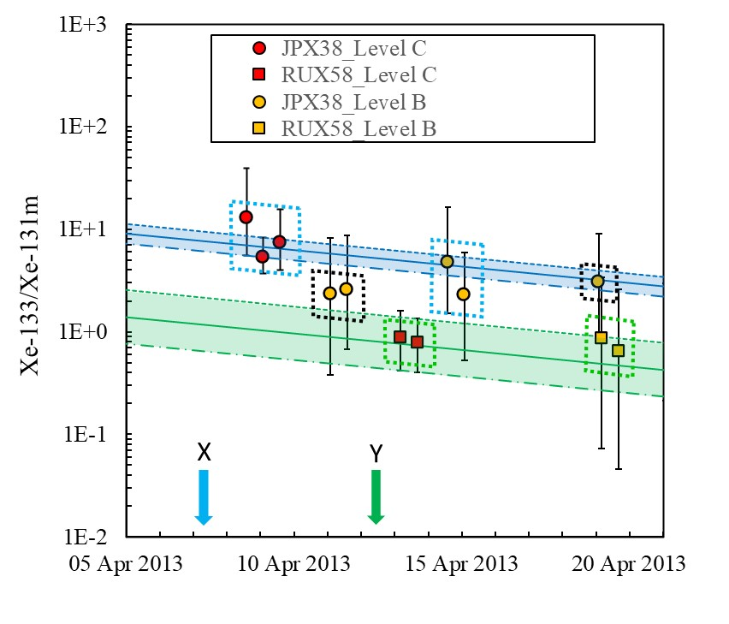
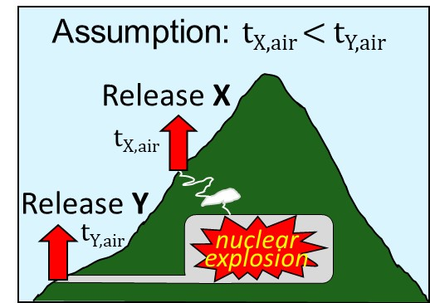
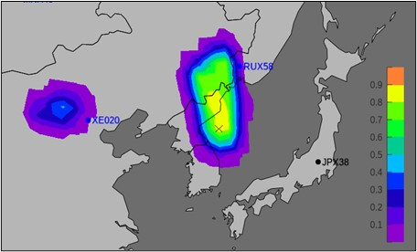
Results
This case study investigates an episode of Level C samples at JPX38 (Takasaki, Japan) and RUX58
(Ussuriysk, Russia) considered to have originated from the 2013 DPRK’s declared nuclear test.
Fig.2. Decay consistency analysis
Fig.1. Example of radioxenon
release scenario
It might be possible that the samples within the
bandwidth are associated, that is, originated
from a same release.
It can be said that the three Level C samples at JPX38 are associated and that the two Level C samples at RUX58 are associated.
It might be possible that there were two distinct releases at DPRK, since the blue and green bandwidth (shown in Fig.2) are not overlapped.
Fig.3. Example of possible
source region analysis
P3.6-414
The results of possible source region (PSR) analysis using atmospheric transport modelling (ATM) indicate that the two Level B samples at JPX38 are associated with the three Level C samples at JPX38 (shown in the two blue dashed boxes in the Fig.2).
Please do not use this space, a QR code will be automatically overlayed

Slide 6
Conclusion
Sample association for the same release event using Level C episodes, often applied
to events of special interest, can be generalized and applied systematically to all stations
and all episodes to enhance the IDC product Standard Screened Radionuclide Event
Bulletin (SSREB) and expert technical analysis (ETA).
Sample association using the consistency of isotopic ratio decay over time and ATM
can incorporate Level B as well.
P3.6-414
Please do not use this space, a QR code will be automatically overlayed

