Slide 1
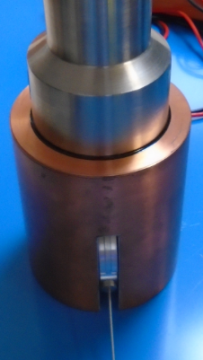
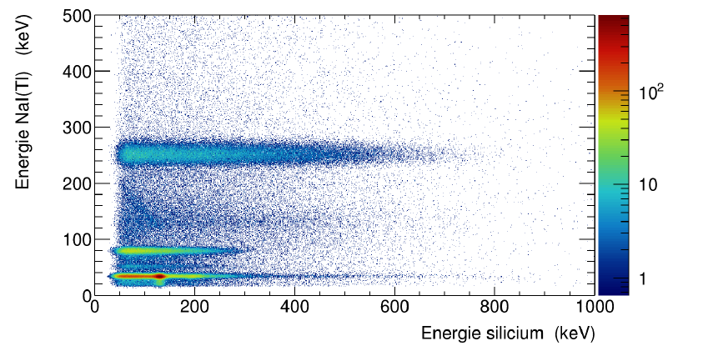
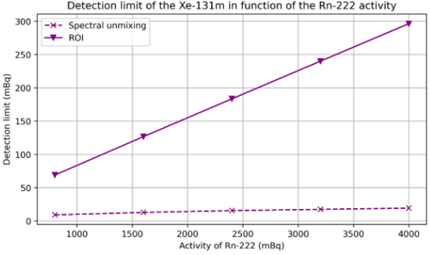
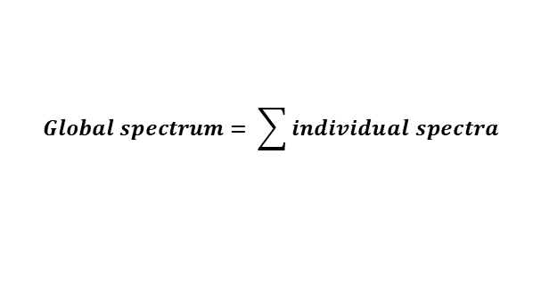
Automatic Analysis of Two-Dimension Coincidence Spectra
Hugues Paradis, Charles-Philippe Mano, Philippe Gross, Anthony Der Mesrobian Kabakian
CEA/DAM
P3.6-886
The laboratory is developing a compact detector (NaI(Tl)-Si) which gives data in the form of 2D spectra. To improve the analysis, a new algorithm based on the global spectrum has been developed.
This new algorithm is based on the Bayes formula and works as an iterative process to determine the proportion of each radionuclide defined in the spectral library.
Very good activities estimated, better uncertainties and improvement of characteristics limits.
2D spectrum
$$Global spectrum= \sum{individual spectra}$$
$$P\left(A_{k} | i\right)=\frac{P\left(A_{k}\right)·P\left(i | A_{k}\right)}{\sum{P(A_{k})·P\left(i | A_{k}\right)}}$$
PMT
Energy NaI(Tl) (keV)
NaI(Tl)
PIPSBox
Energy Si (keV)
Measurement system

