Slide 1
Automatic Analysis of Two-Dimension Coincidence Spectra
Hugues Paradis, Charles-Philippe Mano, Philippe Gross, Anthony Der Mesrobian Kabakian
CEA/DAM
CEA/DAM is developing new β/γ measurement systems ; in order to improve the analysis methods at low count rates, a new multiplicative spectral unmixing algorithm for full-spectrum analysis was tested on a particular setup for different types of mixtures.
Spectral unmixing is the process of decomposing a mixed spectrum into several contributing species based on their respective spectral signatures, to which abundances are attributed. Using an iterative process, the abundance of each radionuclide is calculated.
The spectral unmixing algorithm finds reconstructed activities of complex mixtures with good accuracy. Notably, the uncertainties are smaller than for the classical method. Characteristic limits (detection threshold and limit) are improved in many cases.
The first results with this new algorithm show that this method is more accurate with the use of all the information in the spectrum. Characteristic limits are improved in many cases. The next step is the test the algorithm with measured data from stations of the IMS.
Please do not use this space, a QR code will be automatically overlayed
P3.6-886

Slide 2
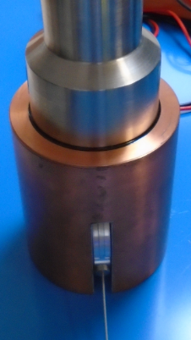
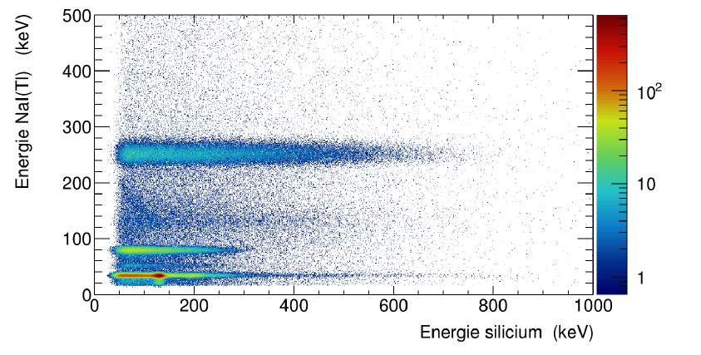
Introduction : 2D β/γ spectrum
The Comprehensive nuclear-Test Ban Treaty (CTBT) is an international treaty open to signature in 1996 to prevent any nuclear test. In this context, the CTBT organization deployed the International Monitoring System (IMS) to measure seismic, hydro-acoustic, infrasound and radionuclide signals to detect potential nuclear events. Out of the 336 stations of the IMS, around 40 are dedicated to the measurement of radioxenon (^{131m}Xe, ^{133m}Xe, ¹³³Xe and ¹³⁵Xe) in the air.
A detector under developement in the laboratory is composed of a well NaI(Tl) detector for X and γ measurement and a silicon detector (PIPSBox) for β measurement. Both these measurements are done in coincidence, and data are analyzed as 2D spectra.
Example of a low β-γ resolution spectrum
PMT
ROI ¹³⁵Xe
Energy NaI(Tl) (keV)
NaI(Tl)
ROI ¹³³Xe
Please do not use this space, a QR code will be automatically overlayed
ROI ^{133m}Xe
PIPSBox
Measurement system
ROI ^{131m}Xe
Energy Si (keV)
P3.6-886

Slide 3
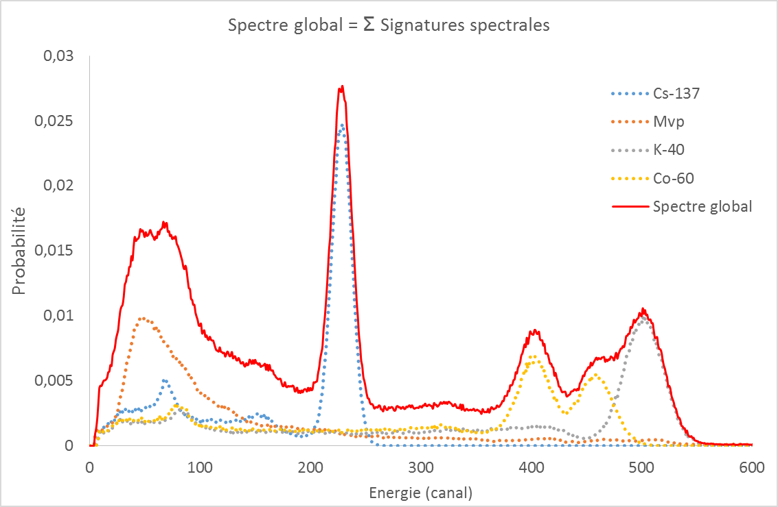
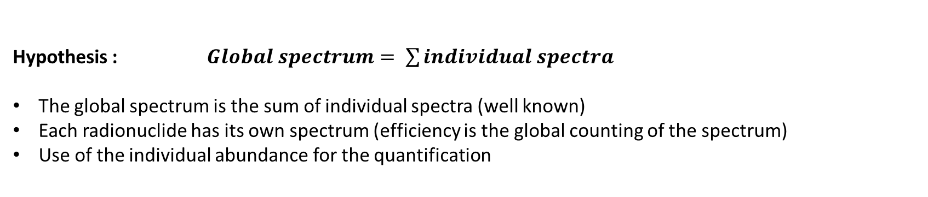
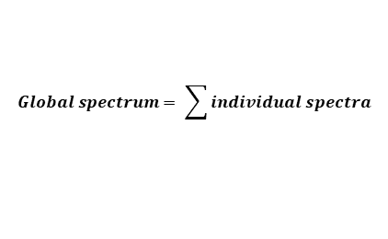
Hypotheses and objectives
Hypothesis : $Global spectrum= \sum{individual spectra}$
The global spectrum is the sum of individual spectra (well known)
Each radionuclide has its own spectrum (efficiency is the global counting of the spectrum)
Use of the individual abundance for the quantification
$$Global spectrum= \sum{individual spectra}$$
abundance
Energy (channel)
Example for a 1D spectrum
Please do not use this space, a QR code will be automatically overlayed
Objectives :
Use of all the information (uncertainties and characteritics limits improved)
Automatic analysis (without expert)
P3.6-886

Slide 4
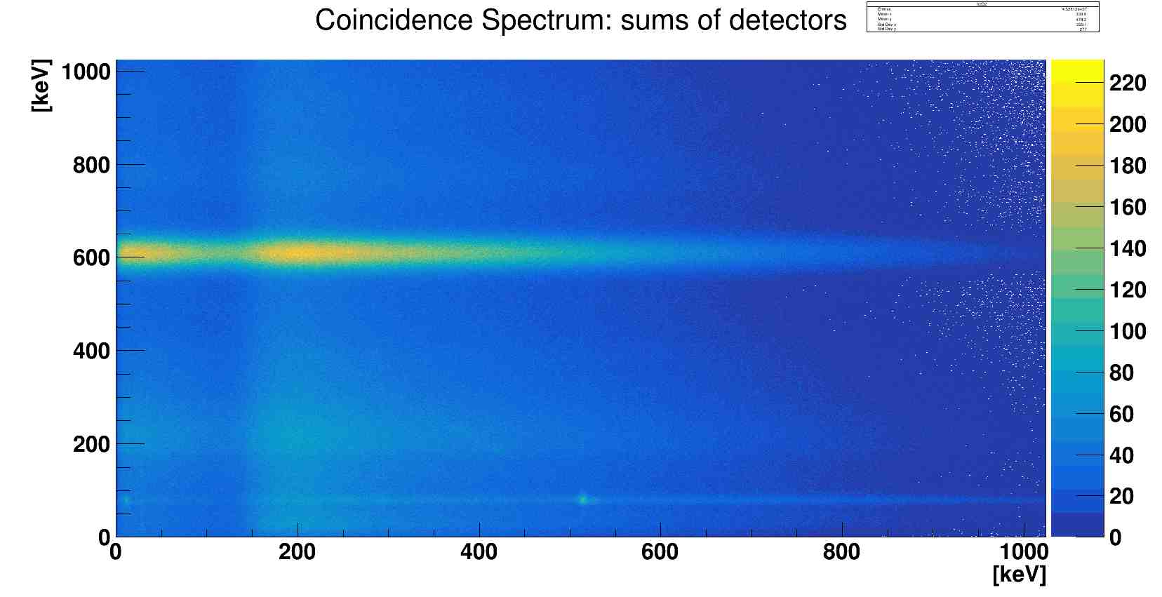
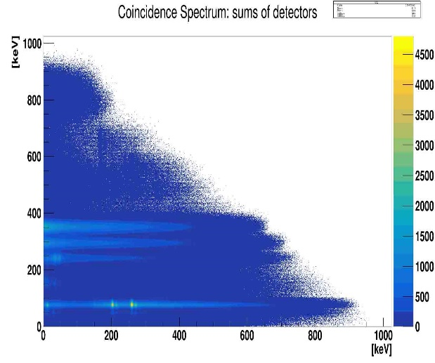
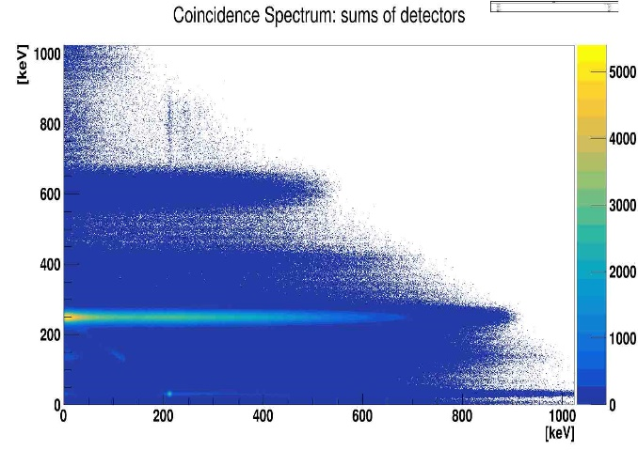
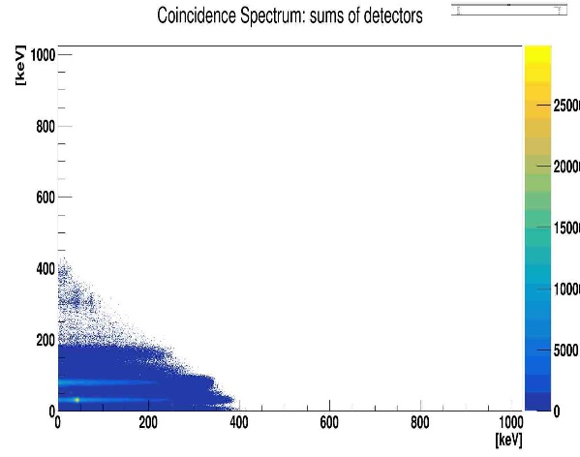
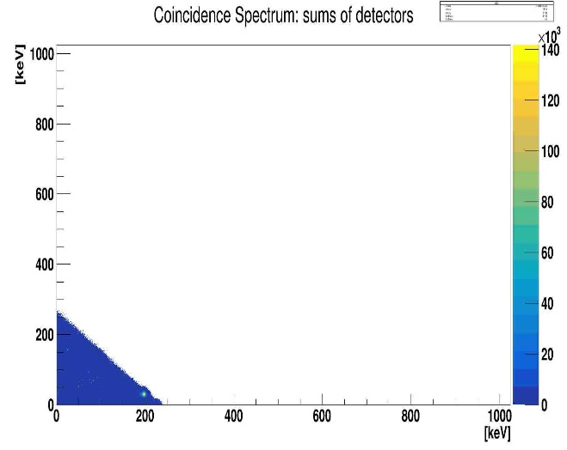
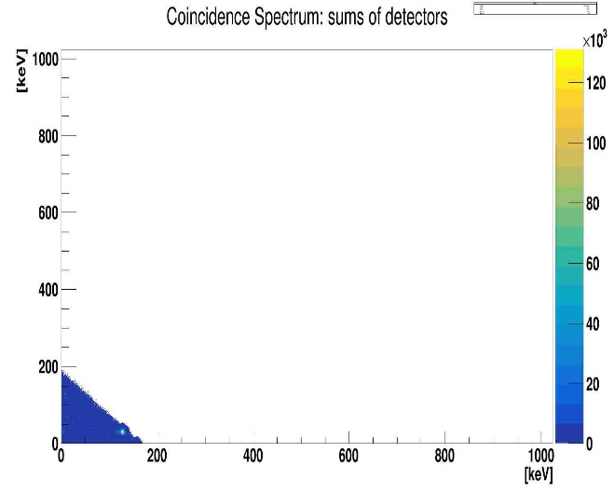
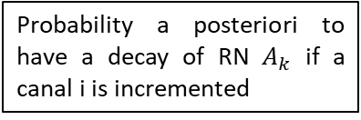
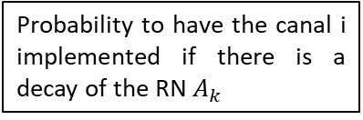

Method : spectral unmixing
²¹⁴Bi
²¹⁴Pb
Probability a posteriori to have a decay of RN $A_{k}$ if a canal i is incremented
Probability to have the canal i implemented if there is a decay of the RN $A_{k}$
$$P\left(A_{k} | i\right)=\frac{P\left(A_{k}\right)·P\left(i | A_{k}\right)}{\sum{P(A_{k})·P\left(i | A_{k}\right)}}$$
¹³⁵Xe
¹³³Xe
Probability a priori to have a decay of the RN $A_{k}$
Advantages :
Maximized counting efficiency
Validated method on 1D spectra (H Paradis et al., Appl. Radiat. Isot. 158 (2020) 109068 ; R André et al., Metrologia 58 (2021) 015011)
All the information of the spectrum is used
Limitations :
High computational resources needed for SD/LD (parallelization on a GPU computing server)
^{133m}Xe
^{131m}Xe
Please do not use this space, a QR code will be automatically overlayed
Spectra for each radionuclide of interest individually
P3.6-886

Slide 5
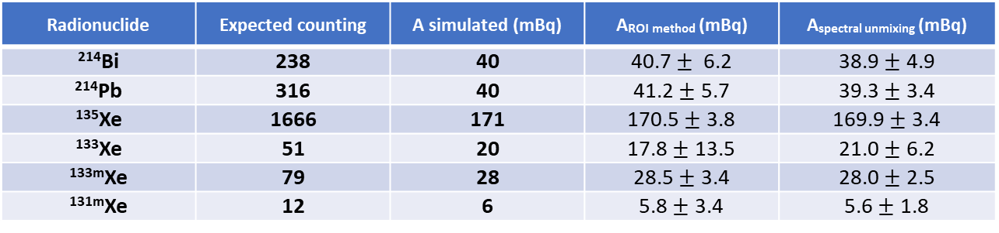
Results : accuracy and characteristic limits
The algorithm is compared with the classical ROI method. Trueness, accuracy and characteristic limits are compared.
Spectral unmixing reconstructs activities fairly accurately, with uncertainties smaller than with the ROI method.
The DT and DL are lower for the spectral unmixing algorithm, except for ¹³⁵Xe.
Radionuclide | Expected counting | A simulated (mBq) | A_{ROI} _{method} (mBq) | A_{spectral unmixing} (mBq)
²¹⁴Bi | 238 | 40 | 40.7 $±$ 6.2 | 38.9 $±$ 4.9
²¹⁴Pb | 316 | 40 | 41.2 $±$ 5.7 | 39.3 $±$ 3.4
¹³⁵Xe | 1666 | 171 | 170.5 $±$ 3.8 | 169.9 $±$ 3.4
¹³³Xe | 51 | 20 | 17.8 $±$ 13.5 | 21.0 $±$ 6.2
^{133m}Xe | 79 | 28 | 28.5 $±$ 3.4 | 28.0 $±$ 2.5
^{131m}Xe | 12 | 6 | 5.8 $±$ 3.4 | 5.6 $±$ 1.8
Example of an analysis of a mix with 6 radionuclides (and background). Activities and uncertainties obtained with 1000 different spectra analysed
 | Detection threshold (DT) |  |  |  | Detection limits (DL)
Radionuclide | DT_{ROI} (count) | DT_{unmix} (count) | DT_{ROI} (mBq) | DT_{unmix} (mBq) | DL_{ROI} (count) | DL_{unmix} (count) | DL_{ROI} (mBq) | DL_{unmix} (mBq)
¹³⁵Xe | 8.7 | 12.8 | 1.2 | 1.3 | 20.1 | 31.3 | 2.7 | 3.22
¹³³Xe | 13.2 | 3.4 | 10.4 | 1.3 | 29.2 | 10.7 | 23.0 | 4.12
^{133m}Xe | 3.3 | 1.0 | 1.6 | 0.3 | 9.3 | 4.0 | 4.6 | 1.43
^{131m}Xe | 3.3 | 1.2 | 1.6 | 0.6 | 9.3 | 4.0 | 4.6 | 1.85
Please do not use this space, a QR code will be automatically overlayed
Detection thresholds and detection limits with 300 hits of background in the spectrum (1000 different spectra analysed)
P3.6-886

Slide 6
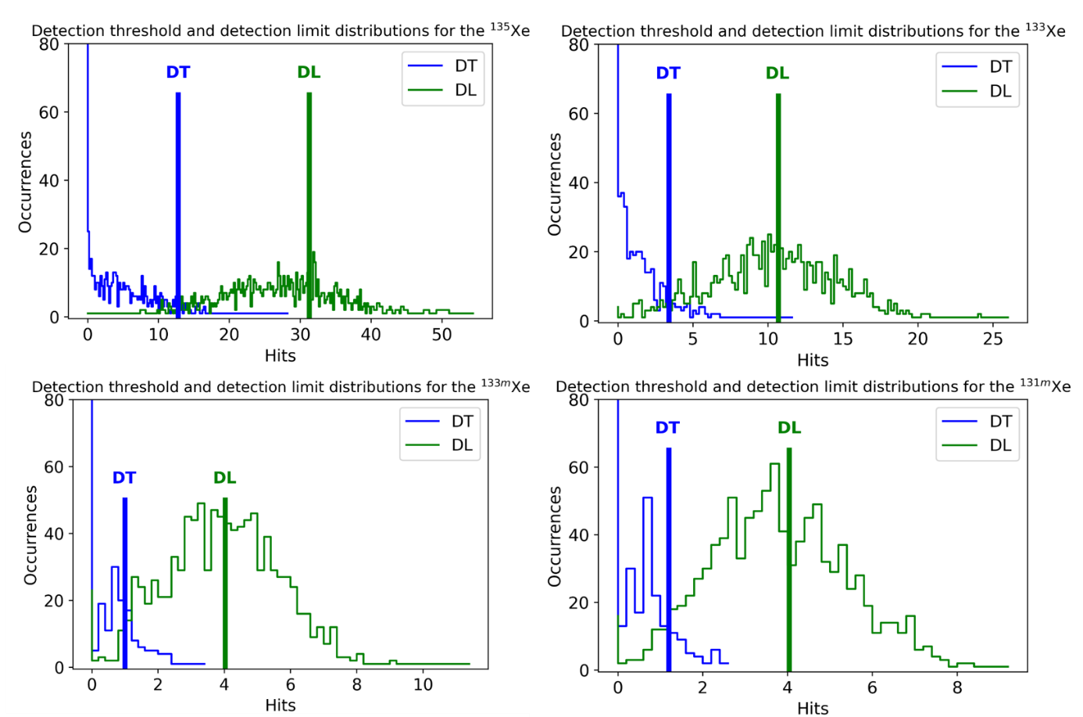
Results : characteristics limits
The spectral unmixing algorithm gives non Gaussian distributions for the DT and DL :
    Depending of the radionuclide
    Calculated by Monte-Carlo simulations
It is necessary to determine them before the start of any measurement
Please do not use this space, a QR code will be automatically overlayed
P3.6-886

Slide 7
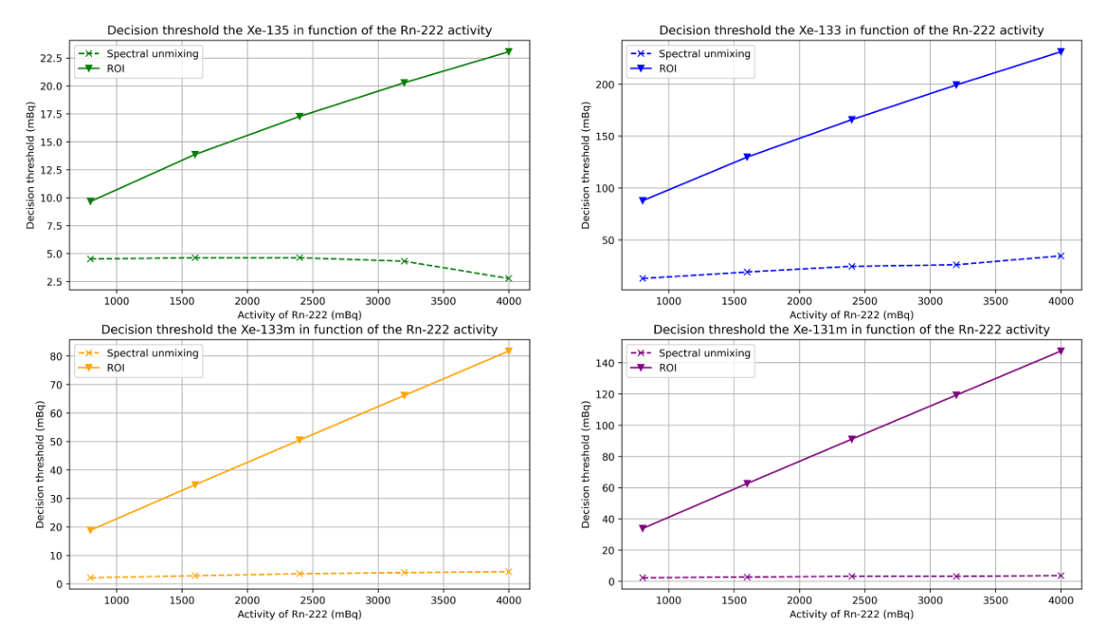
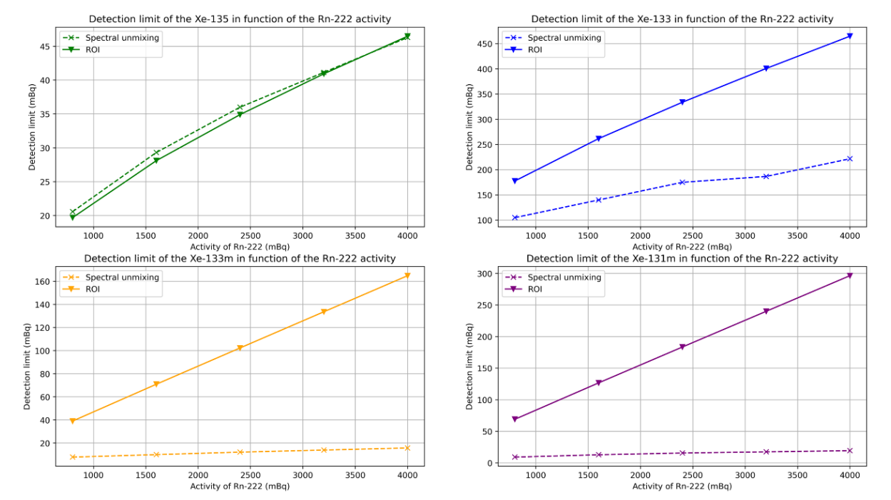
Results : characteristics limits
In many cases, a small amount of Rn can be present in the measurement cell
→ Daughters (²¹⁴Pb and ²¹⁴Bi) are detected in β/γ measurement
→ signal overlay
→ Increase of DT and DL
The DT is lower for the spectral unmixing algorithm in all cases
The DL is lower for the spectral unmixing algorithm in all cases, except for ¹³⁵Xe
Evolution of DT with the activity of ²²²Rn
Evolution of DL with the activity of ²²²Rn
Please do not use this space, a QR code will be automatically overlayed
P3.6-886

Slide 8
Conclusion
Development of a spectral unmixing algorithm based on the global analysis of the spectrum
Activities reconstructed with a good accuracy
Uncertainties lower than with the classical method (ROI)
Detection threshold and detection limits globally better than with ROI method on background spectra
➔ Improvement for ¹³⁵Xe :
    Reduction of energy cut in β channel (100 keV → 30 keV)
    Optimization on spectral signatures (cut of the high energies to limit mix with ²¹⁴Bi)
➔ Analysis of spectra from the IMS
What’s next?
Please do not use this space, a QR code will be automatically overlayed
P3.6-886

