Slide 1
Neural-network Based Isotope Estimation with Simultaneous Curve Fitting
J.R. Powers-Luhn, Michael F. Mayer, Matthew W. Cooper
Pacific Northwest National Lab
Accurately estimating activity due to Xenon isotopes in noble gas detectors requires attributing observed counts to each isotope. Physics informed machine learning could produce interpretable 2D Gaussian regions of interest that out-perform current rectangular ROIs.
Geant4 simulated beta/gamma histograms were used to train a neural network with a novel 2D Gaussian response function.
The neural network reduced root mean squared error by 75% or more for each isotope. The resulting 2D Gaussians were less closely linked to known emission peaks of the isotopes in question.
This method produced viable and interpretable results but should be extended with more complex simulations and tested on real-world calibration samples.
This Ground-based Nuclear Detonation Detection (GNDD) research was funded by the National Nuclear Security Administration, Defense Nuclear Nonproliferation Research and Development (NNSA DNN R&D).
Please do not use this space, a QR code will be automatically overlayed
PNNL-SA-186270
P3.6-538

Slide 2
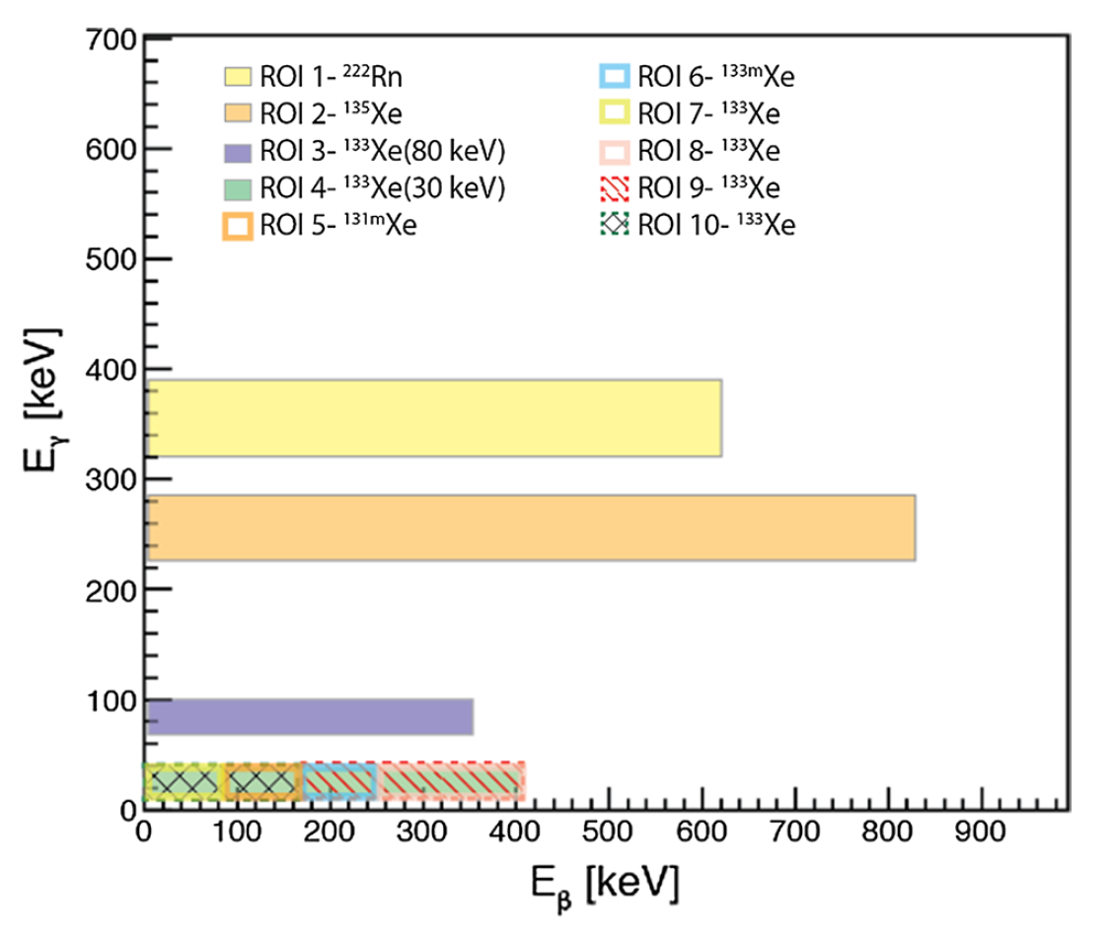
Introduction
Introduction
Noble gas detection systems are used to detect underground nuclear detonations by measuring the activity of four Xenon isotopes: Xe-135, Xe-133, Xe-133m, and Xe-131m. These isotopes are useful due to their ability to migrate from a test location to the testing stations but are also produced by civil nuclear processes. To differentiate between these, gas samples are measured with beta/gamma coincidence detectors. Events with beta/gamma energies that fall within one of 7 or 10 regions of interest (ROI) are assumed to come from their respective isotope.
Prior Work
Convolutional neural networks have been shown to be able to accurately classify beta/gamma histograms as anomalous (Azimi, Afarideh et al. 2021) and have produced accurate classification of isotope presence or absence and estimation of isotopic concentration in simulated samples (Armstrong, Carpency et al. 2021).
Please do not use this space, a QR code will be automatically overlayed
Regions of interest for the 10-ROI method (Cooper, Auer et al. 2019)

Slide 3
Objectives
Using a novel neural network architecture, estimate the number of counts produce by each of four Xenon isotopes
To avoid “black box” models, select an architecture that is interpretable and uses physics-based assumptions (e.g. that ROI’s can be approximated with 2D Gaussian functions of energy)
Please do not use this space, a QR code will be automatically overlayed

Slide 4
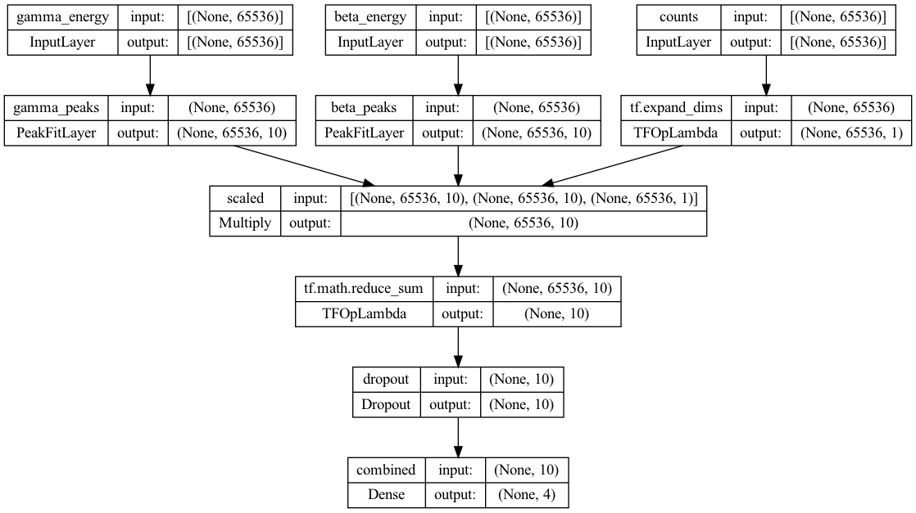
Methods and Data
Data
Network description
The data were generated using a GEANT4 simulation of a detector representative of the beta/gamma cells in the International Monitoring System (IMS noble gas stations. The dataset consisted of 31,000 histograms which were split into training, validation, and test sets (80/10/10). Detector background was included at a constant level.
The final network consists of forty 2D gaussian peaks which are used to weight each count as a function of $(E_{γ}, E_{β})$. These are summed to estimate the amplitude of each peak. A weighted sum of the peak amplitudes is then used to calculate the number of counts from each isotope. $(E_{γ}, σ_{γ}, E_{β}, σ_{β})$ are learned during training.
Network tuning
Dropout: 25% (final layer)
Learning algorithm: ADAM (Kingma and Ba 2014)
Learning rate: (initial) $5×{10}^{−3}$, reduced on training plateau
Loss function: $\log{(\cosh{E})}$
Please do not use this space, a QR code will be automatically overlayed

Slide 5
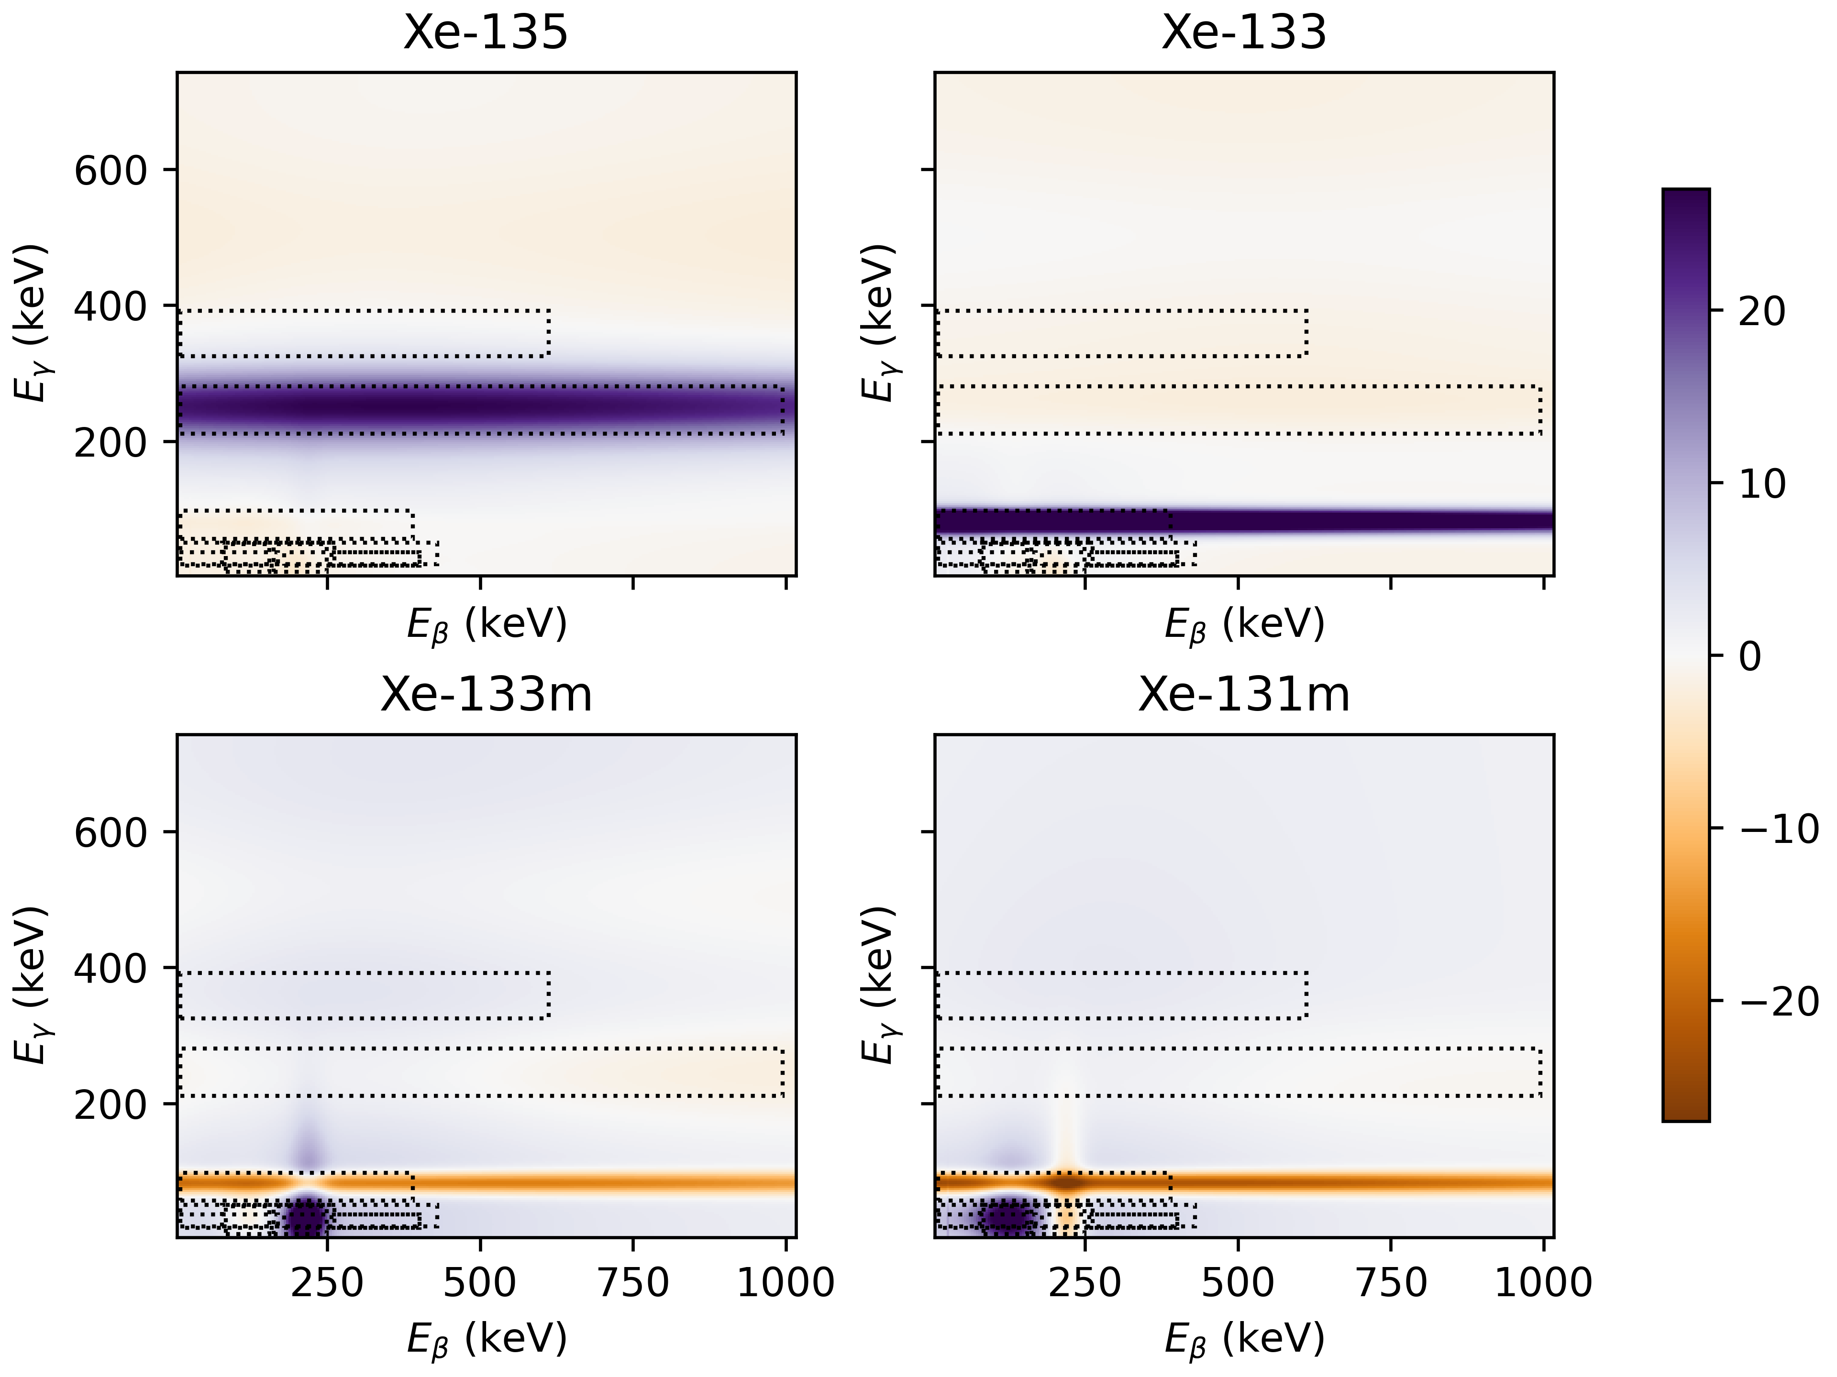
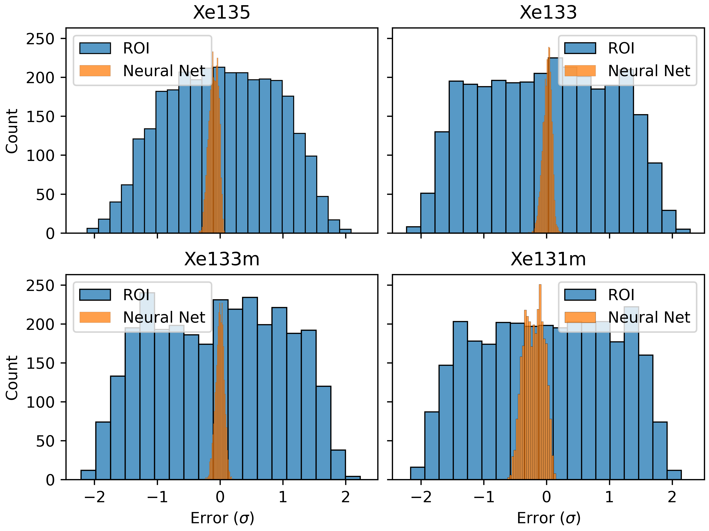
Results
Weighted ROIs for each of the isotopes of interest. Blue regions are added to the count for the isotope and orange regions are subtracted. Both Xe-133m and Xe-131m subtract counts from the primary Xe-133 ROI (at $E_{γ}≈79 keV$). Xe-133m includes a beta peak at $≈200 keV$ (corresponding to a physical decay peaked at $198.7 keV$) while Xe-131m subtracts this peak but includes a wider peak at a slightly lower beta energy (near physical peaks at $129.4$ and $158.5 keV$, accounting for 61.6% and 28.8% of decays, respectively).
Distribution of errors in units of standard distribution of the true values. The neural net results exhibit much lower errors, though with some bias in the Xe-135 and Xe-131m predictions.
Please do not use this space, a QR code will be automatically overlayed

Slide 6
Conclusions and Future Work
Conclusions
This method accurately attributed counts to appropriate isotopes of Xenon in simulation.
Physics informed neural networks can produce interpretable models: in this case, the trained parameters are presented in the same format as current energy-based ROIs. The resulting peaks closely matched the regions of interest from existing literature. This represents both a validation of the current ROI method and of the use of interpretable machine learning methods.
While the results are interpretable, there is a limitation of the architecture; the gradient of the Gaussian peaks falls off quickly ($\sim e^{−x^{2}}$), which could result in parameters being “trapped” close to their initialization position.
Future Work
No Radon or Lead counts were included in the simulations. The network was therefore not trained to account for these. More realistic simulations should result in improved peak selection.
One potential source of error from beta/gamma coincidence detectors is undetected drift in the energy-to-channel calibration. By introducing these errors as augmentations to the training data, it may be possible to generate ROIs that are robust to this calibration drift.
Please do not use this space, a QR code will be automatically overlayed

Slide 7
References and Acknowledgement
Cooper, M. W., et al. (2019). "Radioxenon net count calculations revisited." Journal of Radioanalytical and Nuclear Chemistry 321(2): 369-382.
Azimi, S. A., et al. (2021). "Classification of radioxenon spectra with deep learning algorithm." Journal of Environmental Radioactivity 237: 106718.
Armstrong, J., et al. (2021). "Machine learning for the analysis of 2D radioxenon beta gamma spectra." Journal of Radioanalytical and Nuclear Chemistry 327(2): 857-867.
Kingma, D. P. and J. Ba (2014). "Adam: A method for stochastic optimization." arXiv preprint arXiv:1412.6980.
This Ground-based Nuclear Detonation Detection (GNDD) research was funded by the National Nuclear Security Administration, Defense Nuclear Nonproliferation Research and Development (NNSA DNN R&D).
Please do not use this space, a QR code will be automatically overlayed
PNNL-SA-186270

