Slide 1
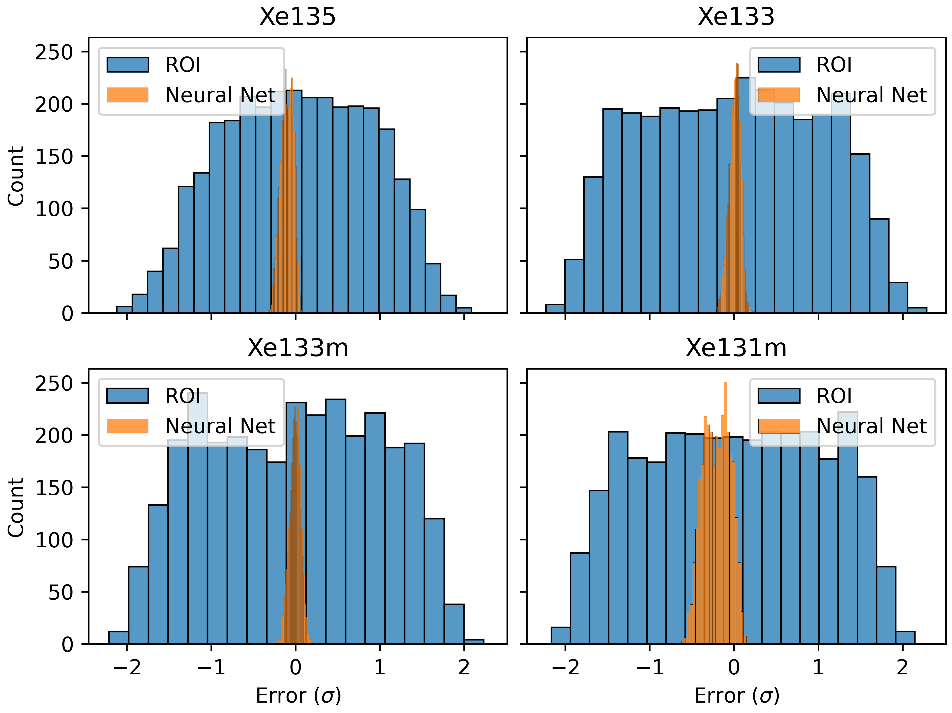
Neural-network Based Isotope Estimation with Simultaneous Curve Fitting
J.R. Powers-Luhn, Michael F. Mayer, Matthew W. Cooper
Pacific Northwest National Lab
P3.6-538
A novel neural net was used to find elliptical regions of interest (ROI) for improved attributions of detected counts to isotopes of interest in a simulated beta/gamma coincidence detector. The regions identified by this system largely fit within the rectangular regions used in current analysis but resulted in more accurate count attribution as compared to a weighted sum of current ROIs. RMSE was reduced by 75% as compared to a least squares fit of the 10-ROI regions, though the resulting network predictions showed some bias.
Count error distribution (in standard deviation of the original test set distribution). In each case the elliptical ROIs generated by the neural net improve RMSE by 75% or more. Xe-135 and Xe-131m show an unexplained bias.
Results
The 2D gaussian ROIs generated by this method converged on known Xe beta/gamma peaks and produced accurate count estimation compared to existing methods.
Response regions for the four Xenon isotopes of interest. Blue regions are added to the count total while orange regions are subtracted. Current regions (from the 10-ROI calculation method) are identified by dotted boxes for comparison.
PNNL-SA-186270

