Slide 1
Isotopic ratio distributions of radioxenon at International Monitoring System radionuclide stations using emissions from nuclear facilities with decay correction based on the atmospheric transport time distributions between these facilities and stations
Yuichi Kijima, Robin Schoemaker, Boxue Liu, Joshua Kunkle,
Anne Tipka, Jolanta Kuśmierczyk-Michulec, Martin Kalinowski
CTBTO/IDC
We investigate the isotopic ratio and concentration distributions at International Monitoring System (IMS) stations using emission distributions at nuclear facilities and source receptor sensitivity (SRS) distributions for the development of the expert technical analysis (ETA) and a Xenon Background Estimation Tool (XeBET).
Emission probability density function (PDF) at Canadian Nuclear Laboratories (CNL) and SRS PDF between CNL and an IMS radionuclide station in Canada (CAX17) are combined to predict concentration PDF at CAX17 using Monte Carlo method (MCM).
Regarding isotopic ratio PDF, threshold using results of prediction is 0.17 for 95% confidence level and 0.25 for 99%.
Regarding concentration PDF, threshold using results of prediction is 24.70 mBq/m3 for 95% confidence level and 54.96 for 99%.
The MCM described here could be one of several prospective approaches to predict concentrations and its isotopic ratios of radioxenons at IMS stations.
The knowledge about the radioxenon isotopic ratio distribution at the source is not sufficient for screening purposes.
Please do not use this space, a QR code will be automatically overlayed
P3.6-421

Slide 2
Introduction
The typical isotopic ratios of radioxenon released from nuclear facilities are well known.
However, due to the short half-life of some of the relevant radioxenons, the isotopic
ratios have changed when reaching the International Monitoring System (IMS)
radionuclide stations.
It is important to develop methods for screening by distinguishing between normal
(based on known sources) and anomalous isotopic ratios.
P3.6-421
Please do not use this space, a QR code will be automatically overlayed

Slide 3
Objectives
Investigation on the isotopic ratio distributions at IMS radionuclide stations using the
emission distributions at nuclear facilities and atmospheric transport modelling (ATM)
for e.g., the development of the expert technical analysis (ETA).
This investigation could be applied to predict radioxenon activity concentration
distribution at IMS radionuclide stations or emission distribution at nuclear facility
for e.g., the development of a Xenon Background Estimation Tool (XeBET).
P3.6-421
Please do not use this space, a QR code will be automatically overlayed

Slide 4
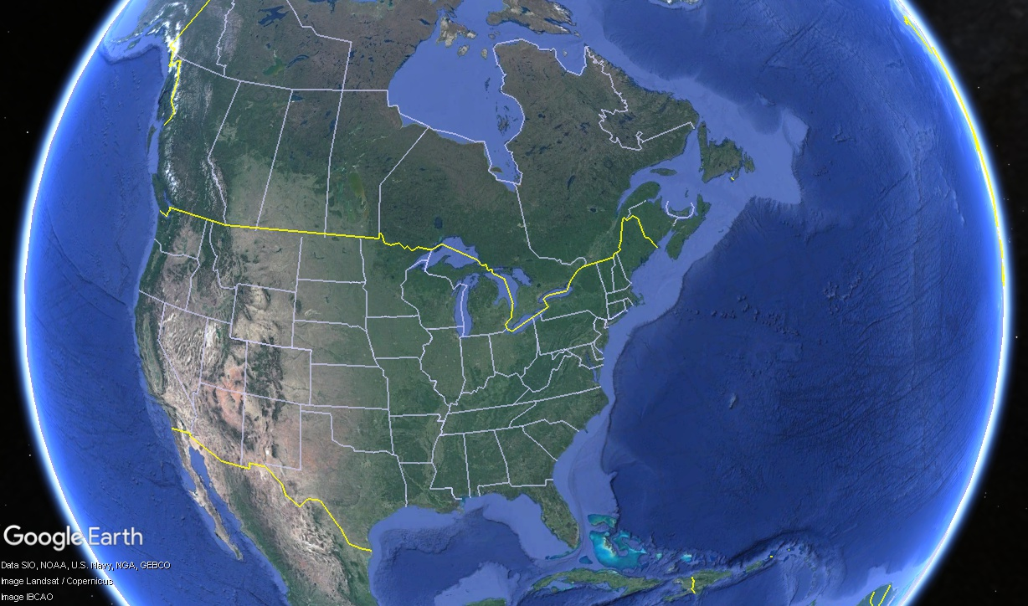
Methods/Data
1. Isotopic ratio PDF
2. Concentration PDF
CAX17
Emission PDF at CNL in 2014
CNL
Emission PDF at CNL in 2014
Atmospheric transport time PDF (first time arrival) between CNL and CAX17 in July – September in 2014
SRS (max value) PDF between CNL and CAX17 in July – September in 2014
P3.6-421
Please do not use this space, a QR code will be automatically overlayed
Emission PDF (probability density function) at CNL (Canadian Nuclear Laboratories) and transport time PDF between CNL and CAX17 (an IMS radionuclide station in Canada) are combined to predict isotopic ratio PDF at CAX17 using Monte Carlo Method (MCM).
Emission PDF at CNL and SRS (source receptor sensitivity) PDF between CNL and CAX17 are combined to predict concentration PDF at CAX17 using MCM.

Slide 5
Results
1. Isotopic ratio PDF
2. Concentration PDF
Predicted isotopic ratio PDF at CAX17 in 2014
Predicted concentration PDF at CAX17 in 2014
(log)
(log)
Measured isotopic ratio PDF at CAX17 in 2014
Measured concentration PDF at CAX17 in 2014
(log)
(log)
Threshold using results of prediction is 24.70 mBq/m³ for 95% confidence level and 54.96 for 99%.
P3.6-421
Threshold using results of prediction is 0.17 for 95% confidence level and 0.25 for 99%.
Please do not use this space, a QR code will be automatically overlayed
It might be possible that the emission sources of samples of CAX17 with an activity concentration greater than 24.70 (or 54.96 mBq/m³) are nuclear facilities other than CNL.
It might be possible that the emission sources of samples of CAX17 with a ratio greater than 0.17 (or 0.25) are nuclear facilities other than CNL.

Slide 6
Conclusion
The Monte Carlo method described here could be one of several prospective
approaches to predict the activity concentrations and the isotopic ratios of CTBT-relevant
radioxenons at IMS radionuclide stations.
The knowledge about the radioxenon isotopic ratio distribution at the source is not
sufficient for screening purposes.
Acknowledgements
P3.6-421
Atomic Energy of Canada Limited and Health Canada are acknowledged for
providing the high time-resolution stack release data of CNL under open
government licence Canada
https://open.canada.ca/data/en/dataset/eaf01a95-a241-445e-b1a9-ff2256b59f98
Please do not use this space, a QR code will be automatically overlayed

