Slide 1
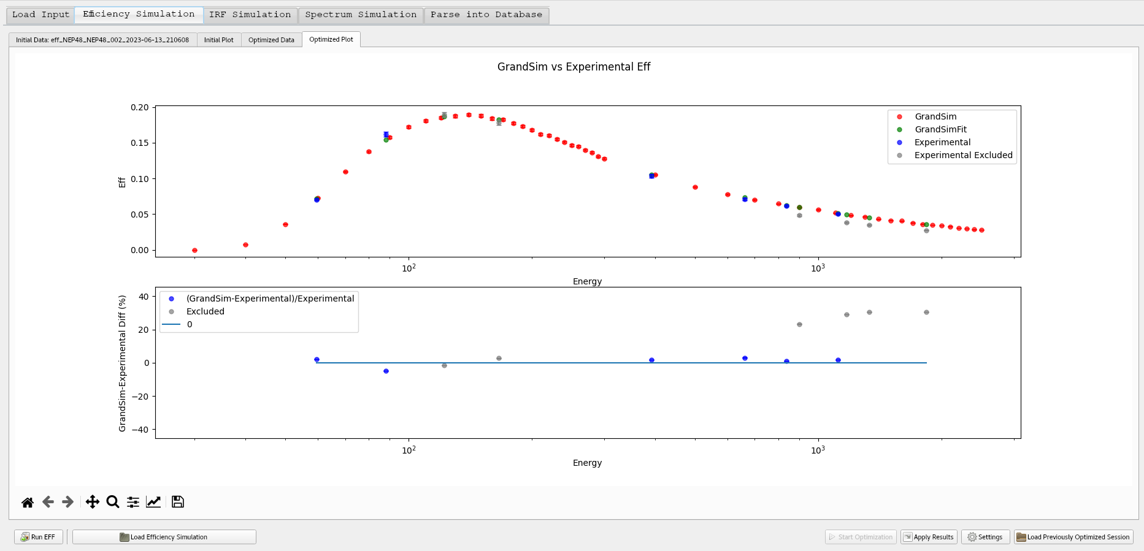
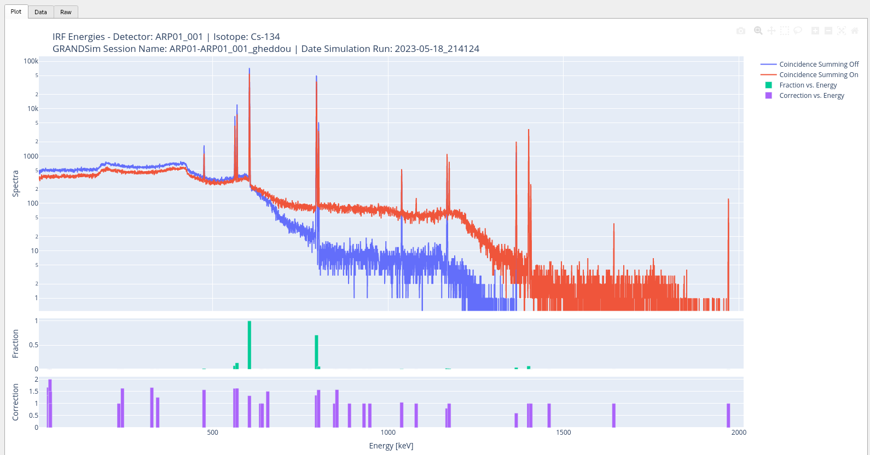
GRANDSim: a Geant4 based simulation software for detectors
in use at CTBTO radionuclide particulate systems
Abdelhakim Gheddou, Martin B. Kalinowski, Jonathan Baré, Arend Harms,
Jana Merešová, Eric Jilbert Nguelem Mekongtso, Carla Pires, Seokryung Yoon
CTBTO
P3.6_560
With the aim of migrating to open source, the CTBTO IDC developed a new software dubbed GRANDSim (Geant4-based RAdioNuclide Detector Simulation).
GRANDSim covers all HPGe detectors in use at CTBTO IMS radionuclide stations.
Input setup parameters are read from DOTS database.
The physical model is optimised automatically.
Simulation output is parsed into GARDS database.
GRANDSim simulation output for supporting spectra analysis:
(a) detector efficiency calibration,
(b) isotope response function for boosting peak identification
(c) Cascade summing correction factors for activity calculation
GRANDSim is available in IDC and delivered to NDCs.

