Slide 1
GRANDSim: a Geant4 based simulation software for detectors in use at CTBTO radionuclide particulate systems
Abdelhakim Gheddou, Martin B. Kalinowski, Jonathan Baré, Arend Harms, Jana Merešová, Eric Jilbert Nguelem Mekongtso, Carla Pires, Seokryung Yoon
CTBTO
GRANDSim supports all HPGe detectors in use at IMS radionuclide stations.
Input setup parameters are read from DOTS.
The physical model is optimised automatically.
Simulation output is parsed into GARDS database.
GRANDSim simulation output allows:
(a) improving the efficiency calibration,
(b) enhancing nuclide identification
(c) ensuring reliable activity concentration
A new Monte Carlo simulation tool was successfully developed and tested.
It covers all technologies/ configurations in use at IMS radionuclide stations
GRANDSim is available in IDC and delivered to NDCs.
Monte Carlo simulation is used extensively in CTBTO IDC software for radionuclide data analysis.
With the aim of migrating to open source, the IDC developed a new software dubbed GRANDSim (Geant4-based RAdioNuclide Detector Simulation).
Please do not use this space, a QR code will be automatically overlayed
P3.6-560

Slide 2
Introduction
Monte Carlo simulation (MC) is extensively used in Radionuclide software in use at the IDC and delivered to NDCs. MC output parameters allow:
Improving the efficiency calibration data quality (by including coincidence summing corrections);
Enhancing nuclide identification results (by including summation peaks) which reduces the Analysts workload in interactive mode;
Ensuring reliable activity concentration results by including required coincidence summing corrections when applicable.
The IDC was operating a Monte Carlo simulation tool limited to HPGe gamma detector systems in use at IMS particulate stations.
The tool called VGSL (Virtual Gamma Spectroscopy Laboratory) uses MCNP license dependent code.
Therefore the IDC could not distribute VGSL as part of the NDC-in-a-Box software package.
P3.6-560

Slide 3
Objectives
In Nov. 2018, the IDC initiated the development of a Monte Carlo simulation tool based on Geant 4 open-source toolkit. The new software is dubbed GRANDSim (Geant4 based RAdioNuclide Detectors Simulation).
Specific objectives:
To complete the migration of RN software tools to open source (license free).
To progressively extend PTS simulation capabilities to beta-gamma coincidence-based detection technologies of IMS noble gas systems. This will include upcoming systems making use of high-resolution beta and/or gamma detectors.
To further enhance the integration level into the RN processing pipeline for by reading the simulation input from DOTS and writing the output into GARDS database.
GRANDSim is intended for internal use at the PTS and distribution to NDCs as part of the (license free) NDC-in-a-Box software package.
P3.6-560

Slide 4
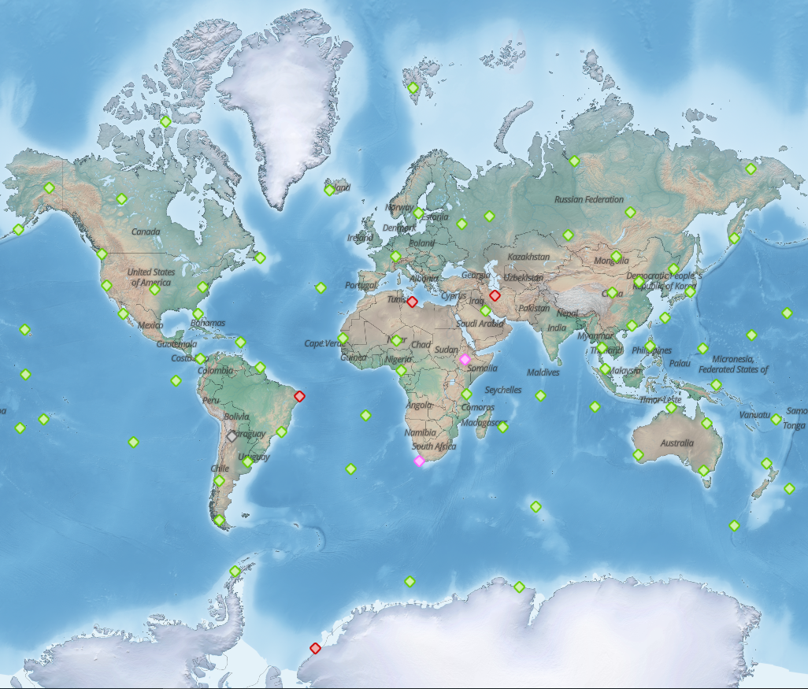
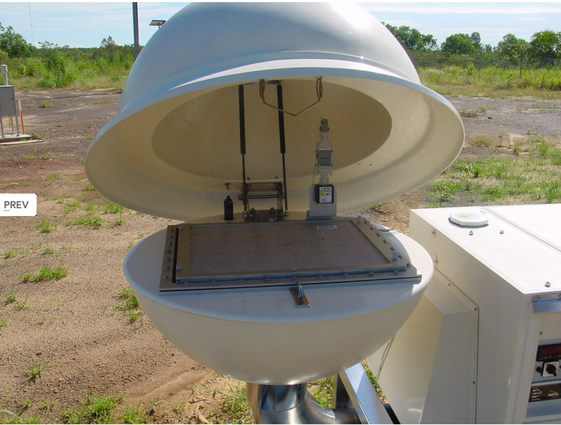
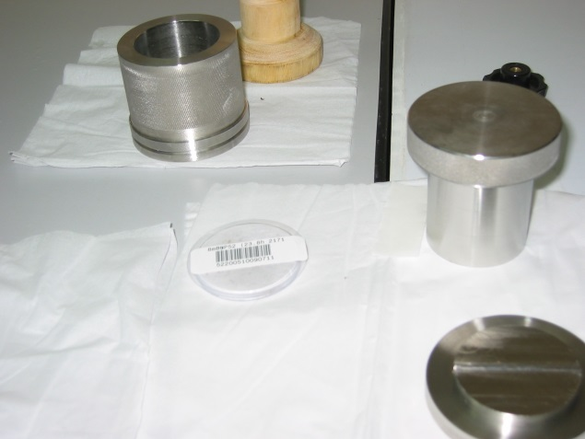
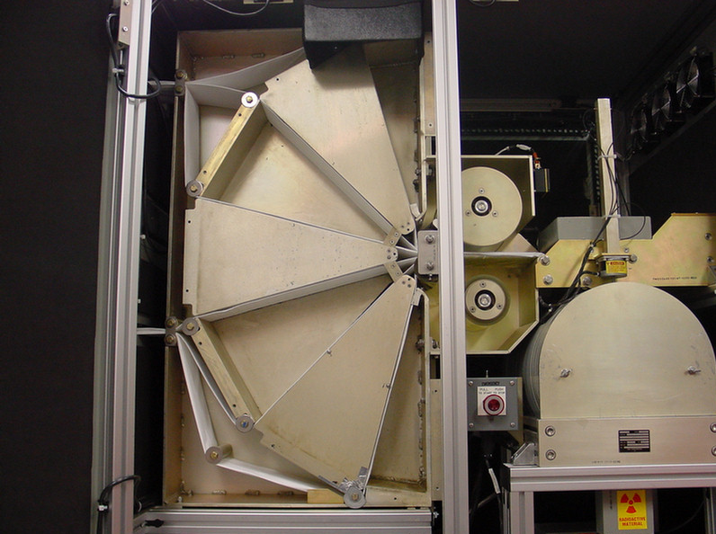
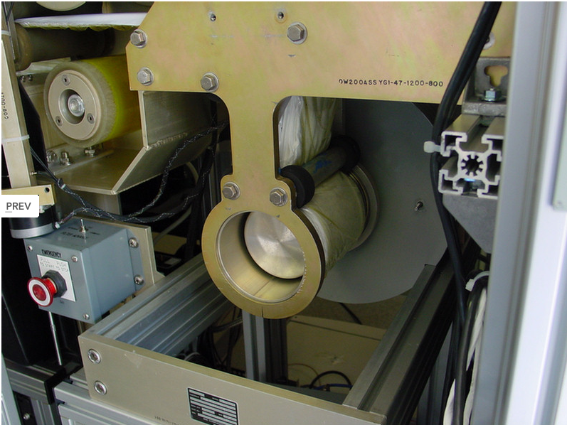
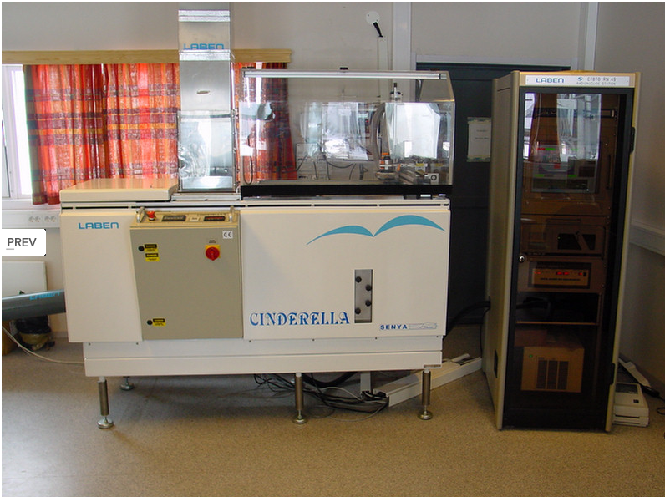
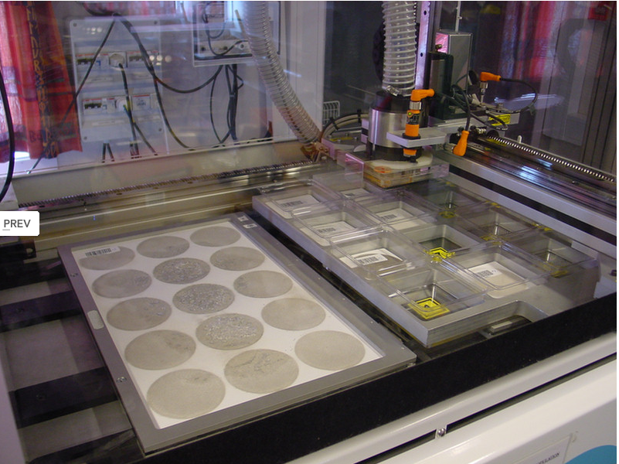
Methods/data: IMS particulate stations
Out of the 80 IMS particulate stations 72 are currently in IDC operations (certified).
Three types of systems:
Manual
RASA
Cinderella (ARAME)
P3.6-560

Slide 5
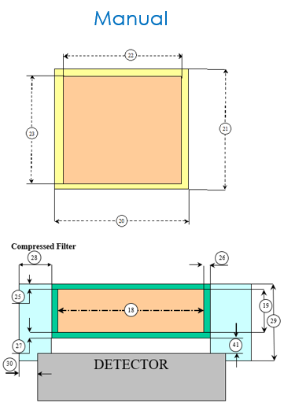
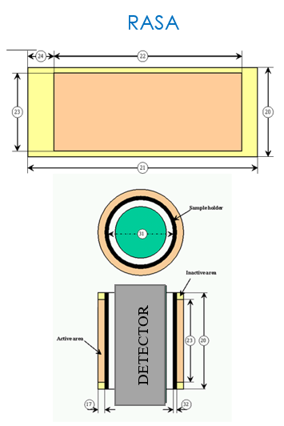
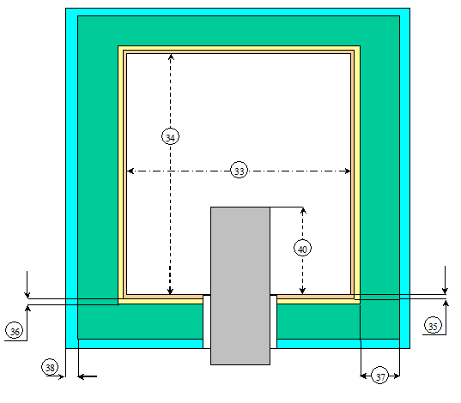
Methods/data: input parameters
Coaxial HPGe detector
Sample geometries
Shielding
Planar (BEGe) detector
P3.6-560

Slide 6

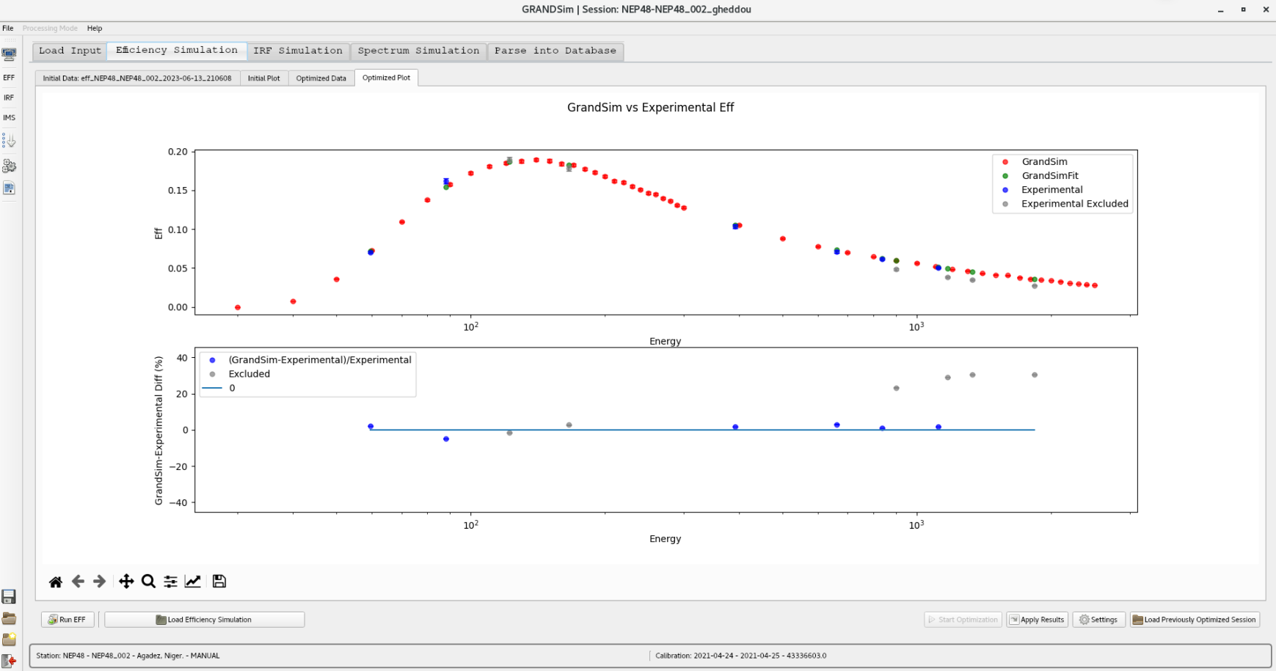
Methods/data: software features
(a) Database mode:
  Input setup parameters (detector, sample, shielding) from DOTS (Database Of the Technical Secretariat) database.
  Experimental calibration from GARDS (Global Atmospheric Radionuclide Detection System) database.
  Simulation output (Efficiency, IRF and CSC) will be parsed into GARDS database.
(b) Standalone mode:
  Input will be read from local configuration.
  Can also be provided from the GUI.
  Output (ascii files) into filesystem.
Model optimization
GRANDSim performs consistency check between simulation and experimental efficiency.
The physical model is automatically optimized by constraining simulation results against experimental calibration for non-summing energies.
P3.6-560

Slide 7
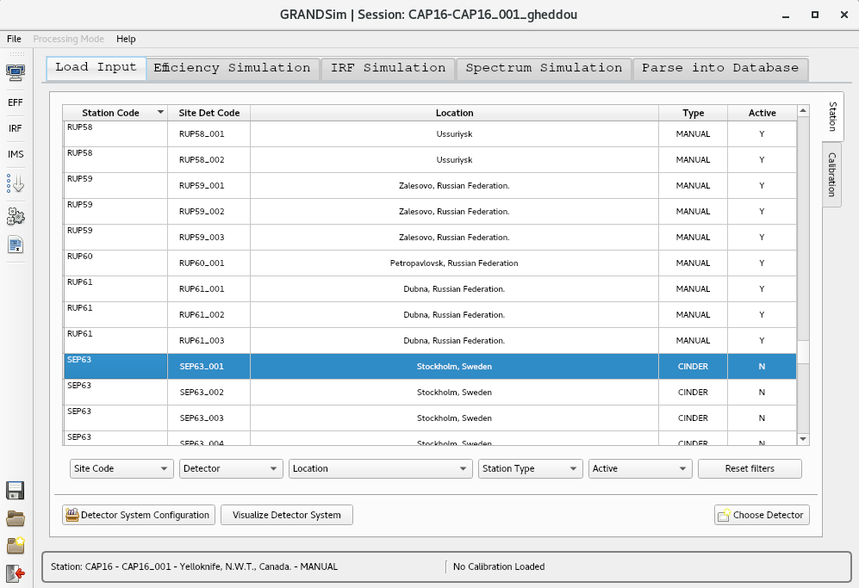
Results: simulated entities
Simulated entities:
Detection efficiency
Isotope Response Function (IRF)
Cascade Summing Correction (CSC) factors
Spectra in IMS2.0 format
P3.6-560

Slide 8
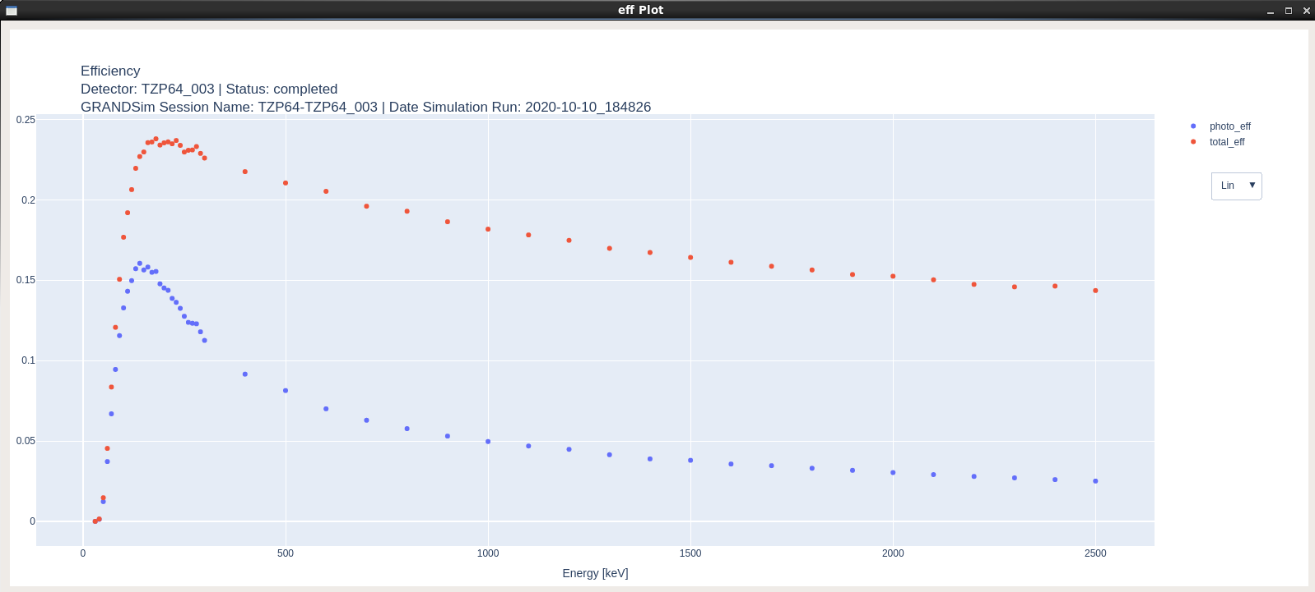
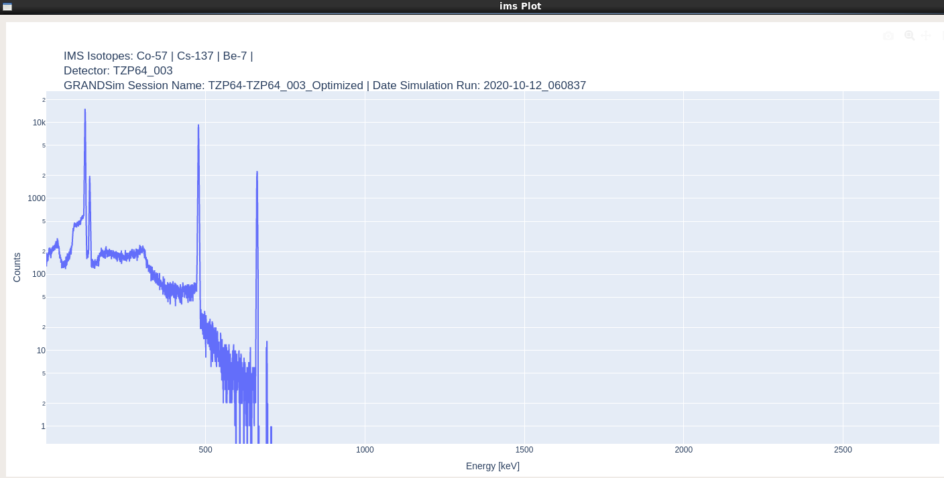
Results: simulated entities
Illustration figures:
Top right: Detection efficiency
Top left: Isotope Response Function (IRF) along with cascade Summing Correction (CSC) factors
Bottom: Spectrum in IMS2.0 format
P3.6-560

Slide 9

Conclusion
The CTBTO International Data Centre (IDC) developed a novel Geant4 based Monte Carlo simulation software for HPGe detectors in use at particulate systems of the International Monitoring System (IMS).
The software, dubbed GRANDSim (an acronym for Geant4-based RAdioNuclide Detector Simulation tool), allows to simulate both coaxial and planar detectors, and includes default definitions of standard measurement geometries and shielding configurations of the three technologies operated at IMS particulate systems.
The software simulates efficiency calibration, isotopic response function and coincidence summing correction factors for any natural and anthropogenic radionuclides of interest.
The physical model is automatically optimized by constraining simulation results against experimental calibration for non-summing energies.
A complete simulation process takes around 2 hours, as per IDC standard procedure for new detector validation. This consists of efficiency calibration, isotope response function and cascade summing correction factors for nine radionuclides of interest: Pb-212 (including decay products Bi-212 and Tl-208), Pb-214, Bi-214, Ac-228, I-132, Cs-134, Cs-136, Ba-140 and La-140.
This is made possible thanks to GRANDSim features:
Direct connection to DOTS database for reading input parameters (detector, sample and shielding);
Multithreading for better usage of hardware resources;
Automatic model optimization for best fit of simulation vs. experimental efficiency calibration;
Batch mode for running a set of radionuclides in hands-off mode
Direct connection to GARDS database for storing output results
P3.6-560

